Slide 1
Computer Vision for self-driving car
Detect free space & obstacles for path planning

Slide 2
Free space detection
Detect multiple lanes based on single CNN with scene identification

Slide 3
What is this for?
Apply deep learning into Self Driving Car (Navigation task)
Traditional algorithms usually estimate only the position of the lanes on the road.
An autonomous control system may also need to know if a lane marking can be crossed or not.
Tradition = CNN(lanes position) + CNN(navigable areas).
This = one single CNN (lighter and more suitable).

Slide 4
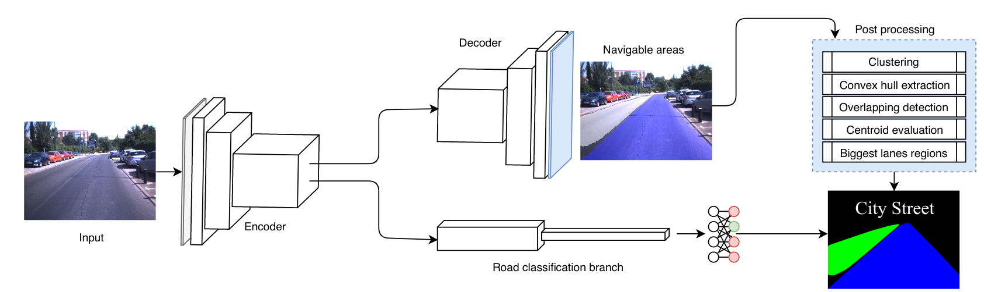
CNN architecture

Slide 5
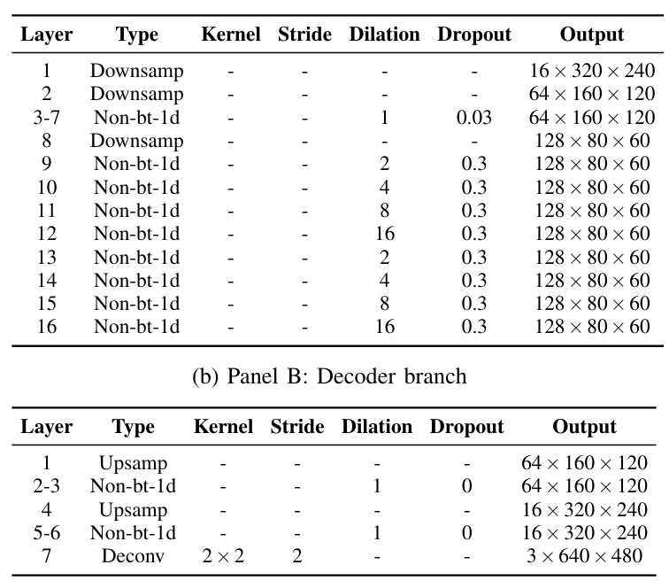
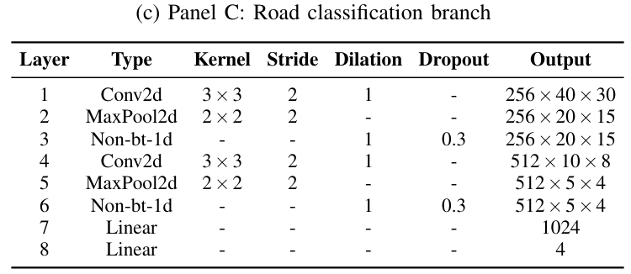

Slide 6
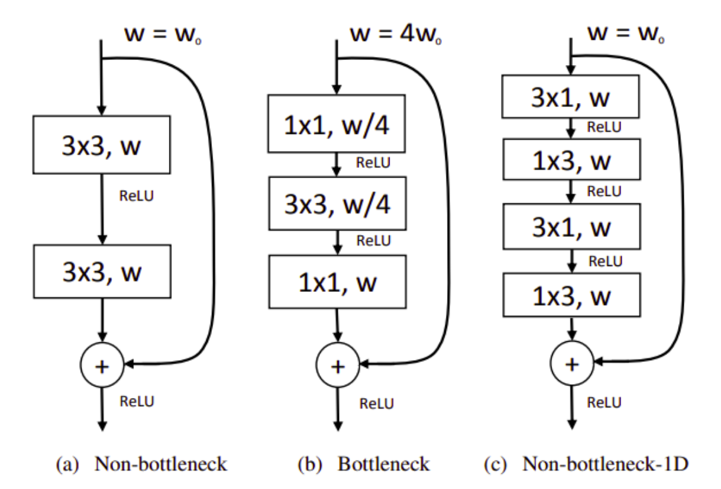
Non-bottleneck-1d

Slide 8
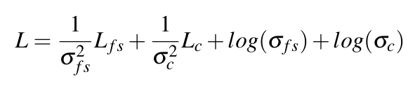
Loss function

Slide 9
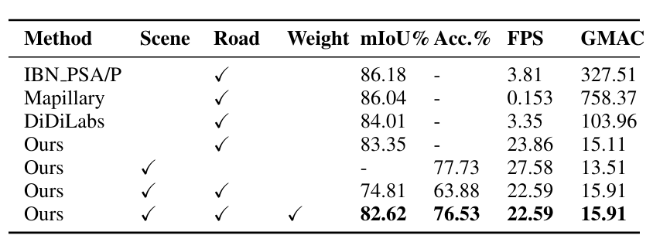
Quantitative evaluation

Slide 10
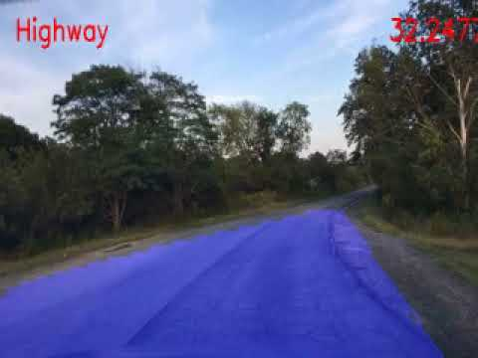
Demo

Slide 11
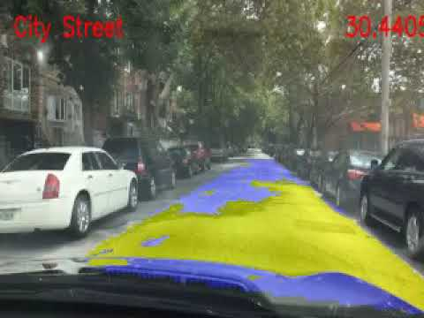

Slide 12
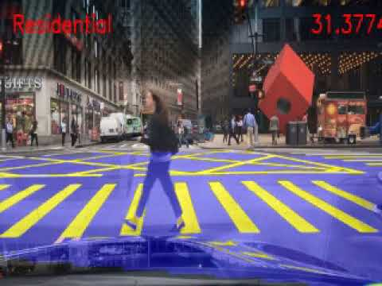

Slide 13
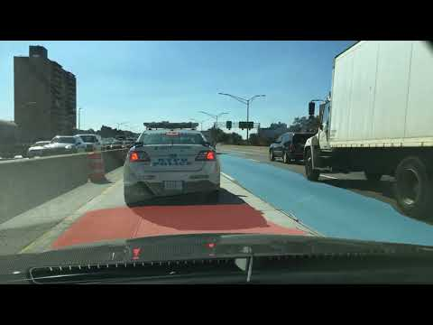

Slide 14
Detect obstacles
Detection by using Yolov4 training on darknet

Slide 15
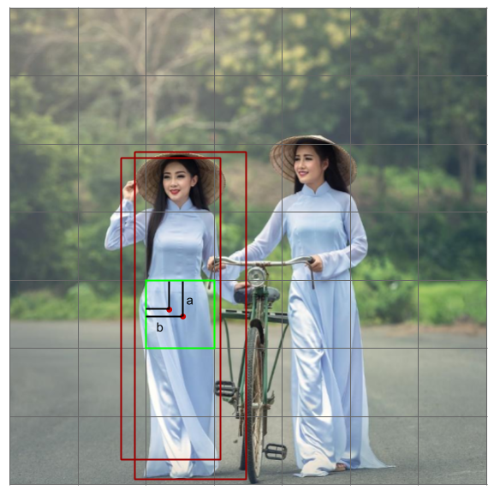
Yolo (You Only Look Once)
-Gird SxS (7x7, 9x9, …)
-Mỗi cell:
Object ?
Bounding Box
Class ?
=> n_bb + 4*n_bb +n_class
images: https://pbcquoc.github.io/yolo/

Slide 16
Yolo (You Only Look Once)
-Hàm mất mát:
Classification loss
Localization loss
Confidence loss

Slide 17
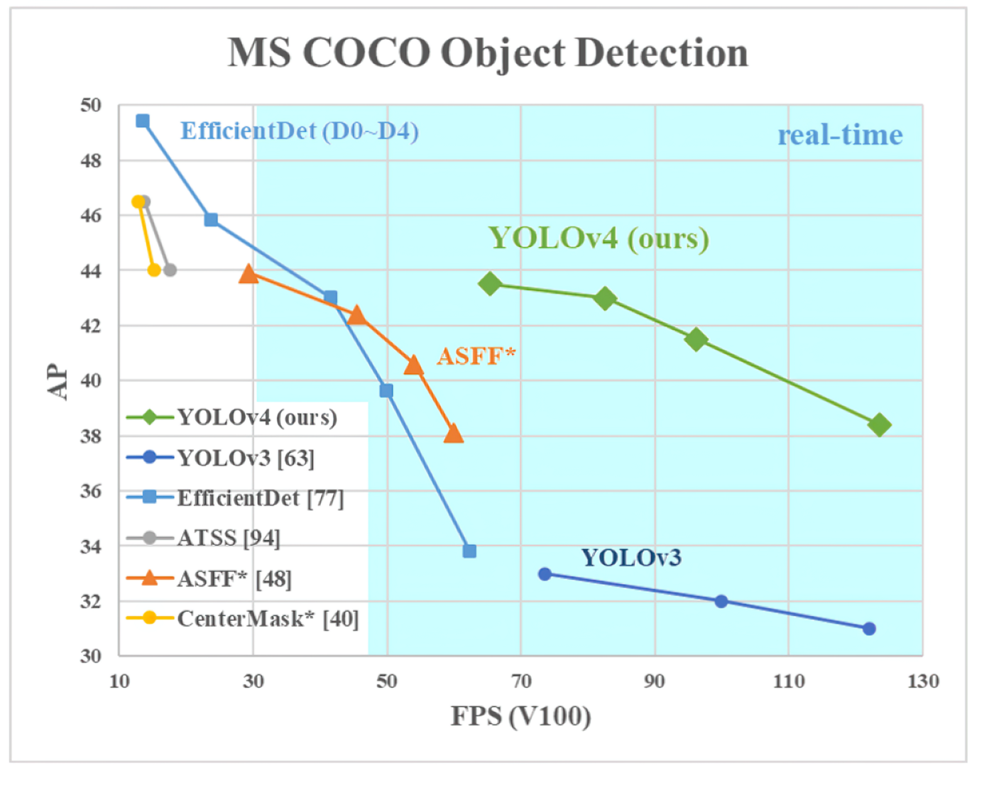
Yolov4

Slide 18
Yolov4
Backbone: CSPDarknet53
Head: yolov3 custom
=> Bag of Specials and Bag of Freebies

Slide 19
Yolov4
Bag of Specials | Bag of Freebies
- Mish activation - Cross-stage partial connections (CSP) - Multiinput weighted residual connections (MiWRC) - DIoU-NMS - PAN - SPP-block, SAM-block | - Cutmix and Mosaic data augmentations - Dropblock regularization - Class label Smoothing - CIoUloss - CmBN - Self-Adversarial Training (SAT) - Eliminate grid sensitivity - Cosine annealing scheduler - Optimal hyper-parameters, Random training shapes
Reference: https://medium.com/@jonathan_hui/yolov4-c9901eaa8e61

Slide 20
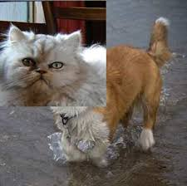
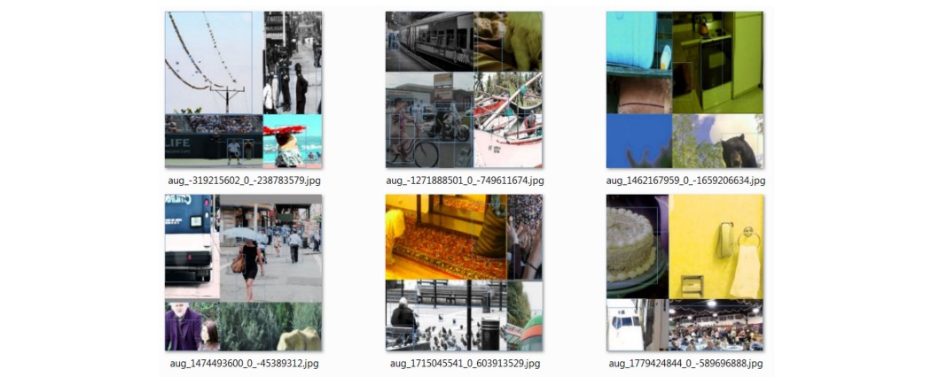
Yolov4
MixCut
Mosaic

Slide 21
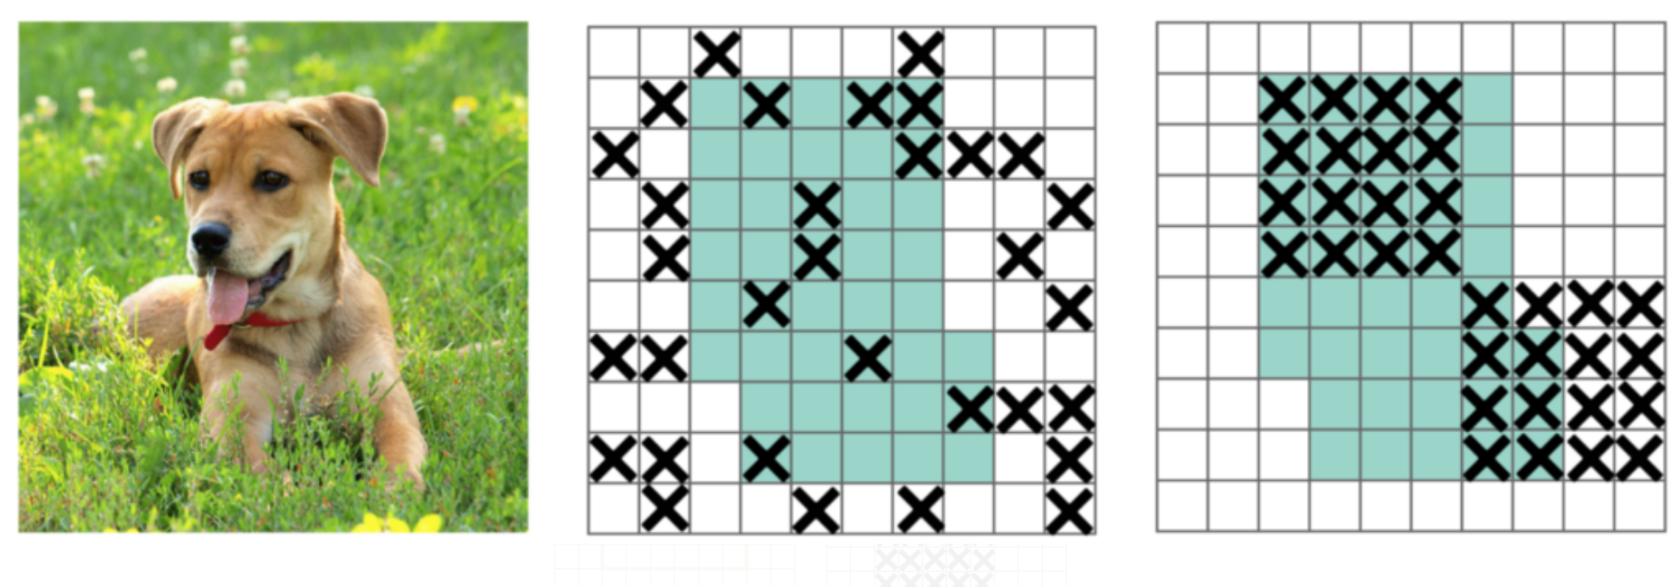
Yolov4
Dropblock

Slide 22
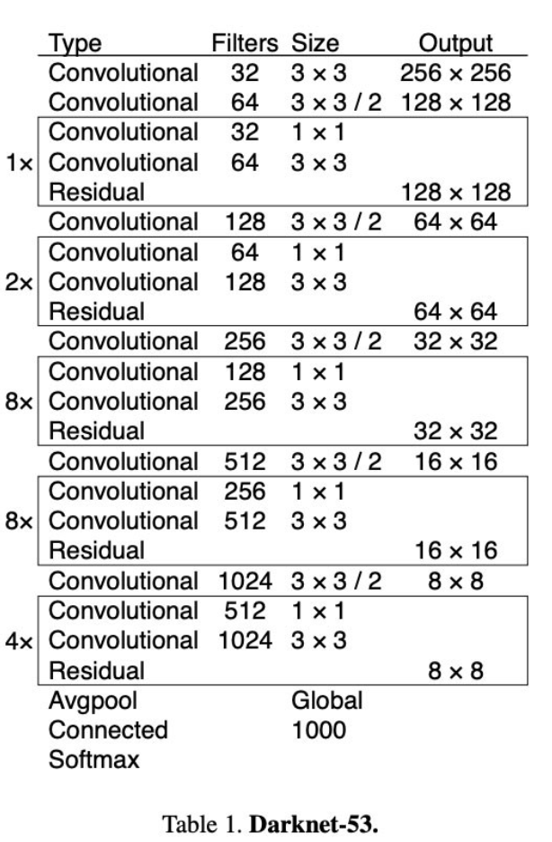
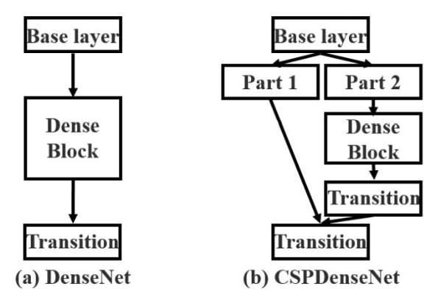
Yolov4
CSP connections

Slide 23
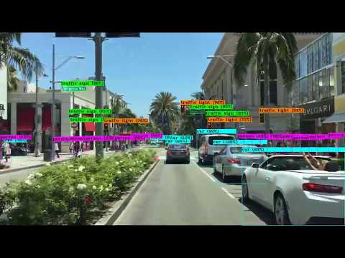

Slide 24
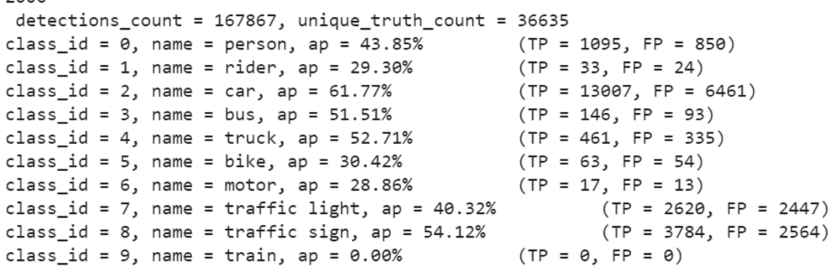
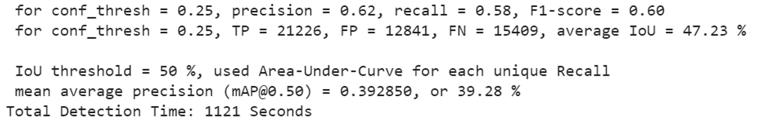
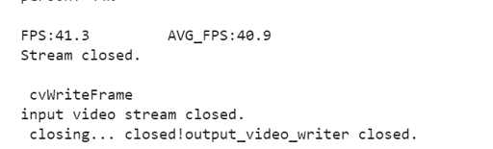
Yolov4: Demo

Slide 25

Question and Answer

