Slide 1
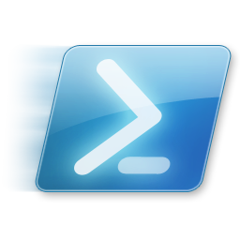
Windows PowerShell
System administration and automation in a Windows environment
-Desired State Configuration -
Jochen Mariën

Slide 2
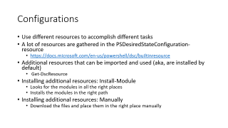
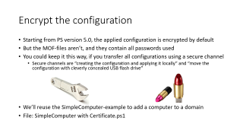
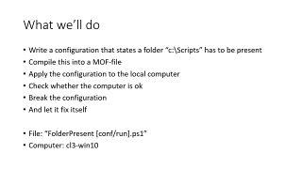
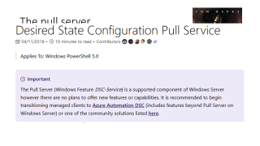
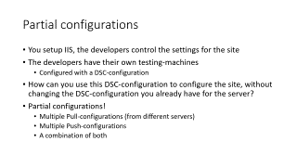
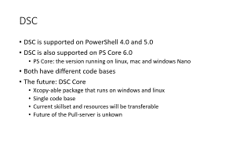
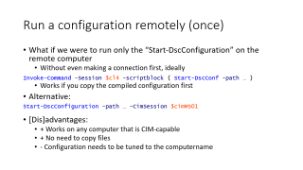
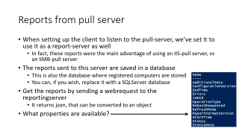

Slide 3
The course material
All course material is distributed by USB
About the examples:
Don’t just run the entire script, but run all commands one at a time
You’ll see what works and what goes wrong
This voids the #require on top of some scripts
About the slides:
Note the notes – they contain the links to the origin of the course material

Slide 4
DSC
DSC is supported on PowerShell 4.0 and 5.0
DSC is also supported on PS Core 6.0
PS Core: the version running on linux, mac and windows Nano
Both have different code bases
The future: DSC Core
Xcopy-able package that runs on windows and linux
Single code base
Current skillset and resources will be transferable
Future of the Pull-server is unkown
Notes:
https://docs.microsoft.com/en-us/powershell/dsc/overview
https://blogs.msdn.microsoft.com/powershell/2018/01/26/dsc-planning-update-january-2018/

Slide 5
"I have PowerShell, why do I need Desired State Configuration?"
Create a share in normal powershell:
Simple script, but what if Bob already has access, or the folder doesn’t exist, or…
So the actual script:
New-SmbShare -Name MyShare -Path C:\Temp -FullAccess Alice -ReadAccess Bob
$shareExists = $false
$smbShare = Get-SmbShare -Name $Name -ErrorAction SilentlyContinue
if($smbShare -ne $null)
{
Write-Verbose -Message "Share with name $Name exists"
$shareExists = $true
}
if ($shareExists -eq $false)
{
Write-Verbose "Creating share $Name to ensure it is Present"
New-SmbShare @psboundparameters
}
else
{
# Need to call either Set-SmbShare or *ShareAccess cmdlets
if ($psboundparameters.ContainsKey("ChangeAccess"))
{
#...etc, etc, etc
}
}
Notes:
https://docs.microsoft.com/en-us/powershell/dsc/dscforengineers

Slide 6
“What you want to do” vs “how to do it?”
You know what you want to do, but have to figure out how to do it
The idea behind DSC is that you define what you want to do, and the resources (official, community or custom) know how to do this
So, a share with the correct access:
Configuration Sample_Share
{
Import-DscResource -Module xSmbShare
Node $NodeName
{
xSmbShare MySMBShare
{
Ensure = "Present"
Name = "MyShare"
Path = "C:\Demo\Temp"
ReadAccess = "Alice"
FullAccess = "Bob"
}}}

Slide 7



Slide 8
Key concepts
Configurations:
Declarative PS-script that defines and configures a configuration
Uses resources and is applied to an LCM
Resources:
Transform a configuration into an actual PS-script
The Local Configuration Manager:
The engine to which configurations are applied
Runs on every target node

Slide 9
DSC vs GPO’s
GPO | DSC
Proven technology that we all know | Very new, still changing
Requires Active Directory | Works anywhere (the DMZ, …)
Works on every Windows since 2000 | Can be installed on 7/2008R2, but also works on linux (mostly with the same commands, even)
Prevents changes | Reverts changes
Administered via GUI | Administered via PowerShell
For workstations | For servers
Sort of extensible, but not really | Really extensible (when you can program and have some time on your hands)
If clients really don’t want GPO’s, they don’t get GPO’s | Can be distributed, but an admin on the server can turn it off
As many GPO’s as you like | Only one DSC configuration can be present at a time (but partial configurations are supported)
Notes:
https://blogs.technet.microsoft.com/ashleymcglone/2017/02/27/compare-group-policy-gpo-and-powershell-desired-state-configuration-dsc/

Slide 10
What we’ll do
Write a configuration that states a folder “c:\Scripts” has to be present
Compile this into a MOF-file
Apply the configuration to the local computer
Check whether the computer is ok
Break the configuration
And let it fix itself
File: “FolderPresent [conf/run].ps1”
Computer: cl3-win10

Slide 11
Write the configuration
A DSC configuration is really a function of the type “configuration”
It needs a name, and this can be any name
But that is the name you will use later on to ‘load’ the configuration
It needs one or more node-blocks
Define the nodes that the configuration will apply to
Named “localhost” or the name of the PC
Every node-block needs resource-blocks
Contain the actual configuration
Also have a name that you can refer to later on when using “DependsOn”
Named after the resource we’ll be configuring
“File”, “xComputer”, “WindowsFeature”, …
Notes:
https://docs.microsoft.com/en-us/powershell/dsc/configurations

Slide 12
Write the configuration
Our configuration:
For localhost, ensure folder “c:\Scripts” is present using the File-resource
https://docs.microsoft.com/en-us/powershell/dsc/fileresource
configuration FolderPresent
{
Node localhost
{
File Directory
{
Ensure = "Present" # You can also set Ensure to "Absent"
Type = "Directory" # Default is "File".
DestinationPath = "C:\Scripts"
}
}
}

Slide 13
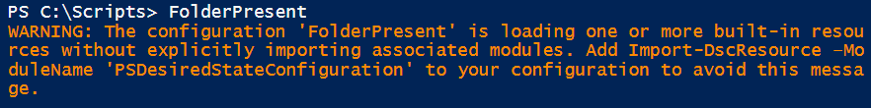

Compile the configuration
Simply run the name of the previously made configuration:
When you get a warning:
Fix it by adding ‘Import-…’ to the configuration-block
Result: a MOF-file with the name of the node-block is generated
In a subfolder with the name of the configuration in the current folder
FolderPresent

Slide 14
Compile the configuration
When compiling (or calling) the configuration will resolve all variables
And store any passwords you’ve used in plain text
This file can be copied to any computer and applied
This would be the simplest way of distributing configurations
In fact, that is what an SMB-pull server does
Notes:
https://docs.microsoft.com/en-us/powershell/dsc/securemof

Slide 15
Apply the configuration
Start-DscConfiguration on the path where the MOF-file is located
Starts a job by default, so to follow the output, use –wait
You could not use -wait, and ‘catch’ the resulting job
… and use “Receive-Job” to see the results
Or get the job using Get-Job
-Verbose is very interesting as well
Note: Start-DscConf needs the winrm-service to be enabled

Slide 16
Check successful execution
Is the folder present?
Get-DscConfiguration
Gives an overview
Test-DscConfiguration
Test with and without the folder
After deleting the folder, recreate using Start-DscConf… -useExisting

Slide 17
The configuration with a parameter
Let’s spice things up: the same configuration, but using a parameter for the folder want to exist
A configuration uses parameters exactly like a function
https://technet.microsoft.com/en-us/library/jj554301.aspx
So add the parameter to the configuration, and recompile it
Also, apply the configuration to the computer again
File: FolderPresent conf with parameter.ps1

Slide 18

And what about Scripts?
We applied a new configuration to the computer
And the LCM can only allow one configuration
So, when we delete c:\Scripts (the old configuration), and recheck…

Slide 19
But I don’t want to check the servers
Remove c:\tmp
How long will we have to wait for it to return?
Indefinitely:
To fix:
Create a new configuration containing only a “LocalConfigurationManager”-resource block in the node “localhost”
Compile and apply using Set-DscLocalConfigurationManager
(The existing DscConfiguration isn’t replaced)
Now wait 15 minutes
(Example: LCM push configuration.ps1)
Get-DscLocalConfigurationManager

Slide 20
Exercise: Basic webserver
Write a configuration that will make sure a server:
Has IIS installed (the windows feature called “Web-Server”)
Also make sure the “IIS 6 management compatibility” is installed
Has a file called “index.htm” with a basic website at c:\inetpub\wwwroot
(You can pre-create this file locally)

Slide 21
Configurations
Use different resources to accomplish different tasks
A lot of resources are gathered in the PSDesiredStateConfiguration-resource
https://docs.microsoft.com/en-us/powershell/dsc/builtinresource
Additional resources that can be imported and used (aka, are installed by default)
Get-DscResource
Installing additional resources: Install-Module
Looks for the modules in all the right places
Installs the modules in the right path
Installing additional resources: Manually
Download the files and place them in the right place manually

Slide 22
On resources
Some resources are made by Microsoft, but most are made by the community
The old naming convention (suffix):
X for experimental
C for community-developed
Dsc for resources of high quality
The new naming convention (suffix):
Always use the Dsc-suffix
A tag is added for high quality resources
A lot of resources still have the x-prefix
The new convention started on December 8, 2017
Notes:
https://blogs.msdn.microsoft.com/powershell/2017/12/08/dsc-resource-naming-and-support-guidelines/

Slide 23
Simple computer
The settings:
Member of a domain
Domain Users is member of local Allow RDP-users
The difficulties:
We need a user account to become member of the domain: Encryption
We need to reboot to become member of the domain
We need additional modules
What we won’t be dealing with:
Connecting to the computer: Simply open a new PSSession to the VMname
File: SimpleComputer.ps1
$admin = Get-Credential Administrator
$ms01 = New-PSSession -VMName "MS01" -Credential $admin

Slide 24
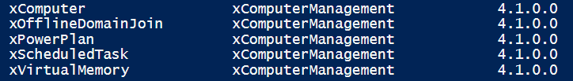
Installing modules
Install the additional modules:
Uses the PowerShell packagemanager to find, download and install the package
After installation, check:
And run the configuration…
Install-Module -Name xComputerManagement
Get-DscResource

Slide 25
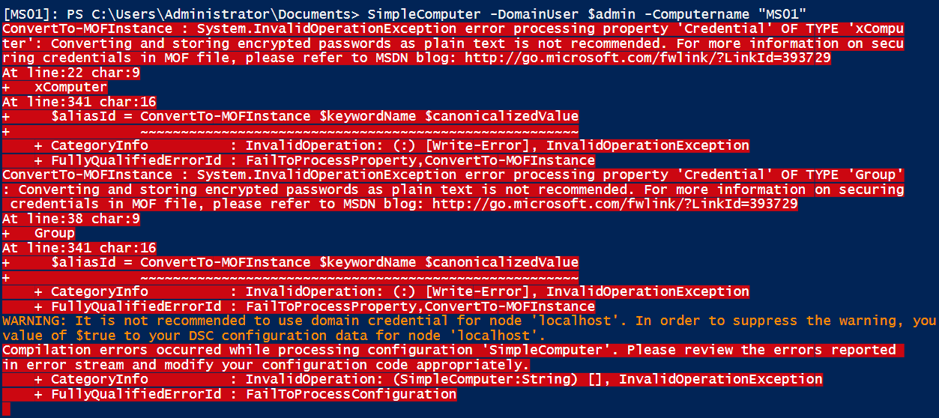
Compile the configuration
Creating the parameter values is easy
Get-credential for a credential, or some more elaborate way that involves less typing
Simply type the computername
But…

Slide 26
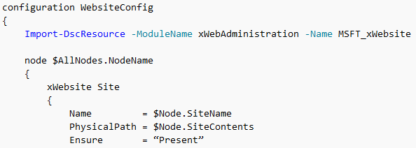
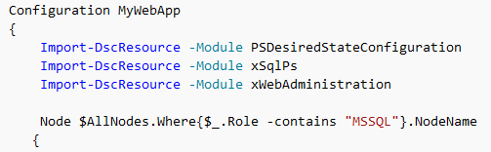
Compiling: Configuration data
Can be used to write a single configuration-block for different types of servers
In the configuration, you can refer to the different configuration-data settings
In the configuration-data, you can define settings
Can also be used to pass parameters to the configuration block, even though they haven’t been defined as parameters
Notes:
https://docs.microsoft.com/en-us/powershell/dsc/configdata

Slide 27
Compiling: Configuration data
But it can also be used to allow plain text password…
Which is a bad idea, but it’s easier than going full-encryption
$cd = @{
AllNodes = @(
@{
NodeName = 'localhost'
PSDscAllowPlainTextPassword = $true
PSDscAllowDomainUser = $true
}
)
}
SimpleComputer -DomainUser $admin -Computername "MS01" -ConfigurationData $cd
Notes:
https://docs.microsoft.com/en-us/powershell/dsc/configdatacredentials
Advanced configuration data:
https://docs.microsoft.com/en-us/powershell/dsc/separatingenvdata

Slide 28
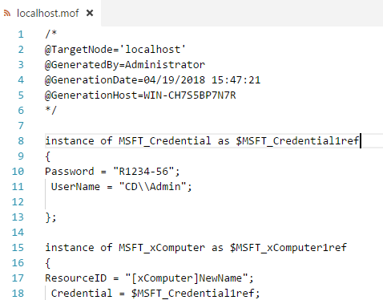
But the password is encrypted
It was in the parameter, but it isn’t in the MOF-file anymore…
The only way to fix this is by encrypting the configuration
We’ll get to that

Slide 29



Can this fix another of our problems?
Adding a computer to a domain requires a restart
It still does. It’s annoying, but it still does.
A second file was generated:
We remember those:
Example: LCM push configuration.ps1
Apply localhost.meta.mof…
We need to do this manually, because we could have created this configuration for another computer
Get-DscLocalConfigurationManager
Set-DscLocalConfigurationManager -Path .\SimpleComputer

Slide 30
Exercise: Domain Controller
Write a DSC-script to check up on a domain controller
Include, but don’t feel limited to
Computername
Install Domain Services, DHCP, DNS (and their RSAT’s)
Set a static IP, DNS-server, default gateway
Install the domain
Install a DHCP scope
Set the DHCP server options (DNS suffix, DNS server, default gateway)
You can save all passwords in plain text

Slide 31
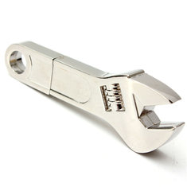
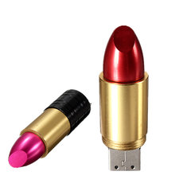
Encrypt the configuration
Starting from PS version 5.0, the applied configuration is encrypted by default
But the MOF-files aren’t, and they contain all passwords used
You could keep it this way, if you transfer all configurations using a secure channel
Secure channels are “creating the configuration and applying it locally” and “move the configuration with cleverly concealed USB flash drive”
We’ll reuse the SimpleComputer-example to add a computer to a domain
File: SimpleComputer with Certificate.ps1
Notes:
https://docs.microsoft.com/en-us/powershell/dsc/securemof
https://blogs.technet.microsoft.com/ashleymcglone/2015/12/18/using-credentials-with-psdscallowplaintextpassword-and-psdscallowdomainuser-in-powershell-dsc-configuration-data/

Slide 32
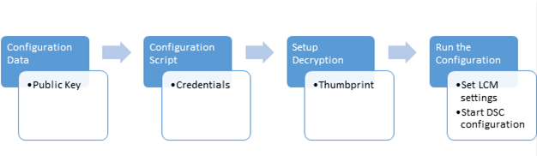
Overall process
Setup the certificates
Target node has the certificate
Configuration computer has the public key and thumbprint
Create a configuration data block that contains the key and thumbprint
Create a configuration script that
Contains the actual configuration
Sets up decryption
Run the configuration

Slide 33
We have two computers
Target computer: the one who will be subjected to the configuration
Cl4-win10
Authoring computer: the one we’ll use to create the configuration
The host
$p1 = Get-Credential "Player 1" # R1234-56
$cl4 = New-PSSession -VMName "cl4-win10" -Credential $p1
Enter-PSSession $cl4

Slide 34
Creating the certificate
Create the self signed certificate:
Export the public key:
Copy the exported file to the other computer
And import the certificate
$cert = New-SelfSignedCertificate -Type DocumentEncryptionCertLegacyCsp ` -DnsName 'DscEncryptionCert' -HashAlgorithm SHA256
$cert | Export-Certificate -FilePath "c:\temp\DscPublicKey.cer" -Force
Import-Certificate -FilePath "$env:temp\DscPublicKey.cer" `
-CertStoreLocation Cert:\LocalMachine\My

Slide 35
The configuration
The configuration doesn’t change
This is the good part: when writing configurations, the way they are distributed doesn’t matter
You could pull them
You could push them
You could encrypt them
You store them in a publicly available share
What changes is the way the configuration is turned into a MOF-file
Aka the compilation

Slide 36
Compiling the configuration
We’ve forgotten to store the thumbprint when importing the certificate
So, look for the certificate, and store the thumbprint
The configuration data
$cert = Get-ChildItem Cert:\LocalMachine\My |
where-object Subject -eq "CN=DscEncryptionCert"
$cert.Thumbprint
$cd = @{AllNodes = @( @{
NodeName = 'localhost’
PSDscAllowDomainUser = $true
Thumbprint = $cert.Thumbprint
CertificateFile = "c:\Scripts\Public Keys\DscPublicKey.cer"
} ) }

Slide 37
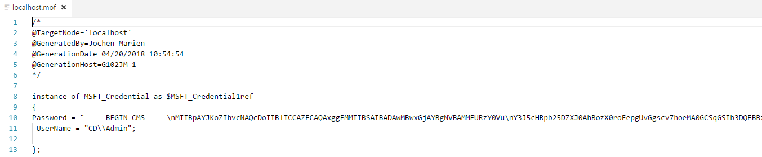


Slide 38
Applying the configuration
Copy all MOF-files to the target computer
Run the local configuration (to enable reboots)
Add the certificate thumbprint in the LCM-configuration
Which is bad news:
We could add it now, risking that we loose the “Reboot if needed”
We could have added the thumbprint in the configuration, making it specific for that computer (/certificate)
Set-DscLocalConfigurationManager -Path .\SimpleComputer
Get-DscLocalConfigurationManager

Slide 39
Adding it now
Also see file: LCM push configuration.ps1
Get the thumbprint:
New configuration (only LocalConfigurationManager-block)
Compile and apply
Note how “RebootIfNeeded” is back to false…
$cert = Get-ChildItem Cert:\LocalMachine\My |
where-object Subject -eq "CN=DscEncryptionCert"
Configuration LCMConfiguration
{ Node "localhost"
{ LocalConfigurationManager
{ CertificateID = $cert.Thumbprint
} } }

Slide 40
Add it in the configuration
A bit more work, but the better option
In the configuration
Add the thumbprint as a parameter (or insert it through the configuration data)
Add the “CertificateID” to the LocalConfigurationManager
Recompile (with the extra parameter), copy, reapply the LCM-config

Slide 41

Compile and run
Nothing new here, simply start the DSC configuration

Slide 42
Encryption
… is quite a lot of work
But you really should, especially since configurations don’t ‘add up’
If you want to add a setting to a configuration, you’ll need the current configuration to alter it
It would be great if you could integrate this with the company CA, and not be dependent on self-signed certificates
Another approach would be to create users with JEP (just enough permissions), so their credentials aren’t that important
Even common users can add up to 5 computers to a domain…

Slide 43
Run a configuration remotely (once)
What if we were to run only the “Start-DscConfiguration” on the remote computer
Without even making a connection first, ideally
Works if you copy the compiled configuration first
Alternative:
[Dis]advantages:
+ Works on any computer that is CIM-capable
+ No need to copy files
- Configuration needs to be tuned to the computername
Invoke-Command -Session $cl4 -scriptblock { Start-DscConf -path … }
Start-DscConfiguration -path … -CimSession $cimMS01

Slide 44
Wait, CIM?
CIM session are a lighter version of PSSessions
CIM is the ‘new’ WMI and, theoretically, any OS can understand CIM
The main difference for running a command over CIM: a connection is made to the CIM database, not to PowerShell
The target doesn’t need PowerShell installed
A CIM session is only openened when needed, not maintained
CIM and PSSession both use WinRM, but CIM can also use DCOM
Notes:
https://blogs.technet.microsoft.com/heyscriptingguy/2014/01/31/comparing-powershell-pssessions-and-cim-sessions/
https://technet.microsoft.com/en-us/library/dn448522(v=wps.630).aspx

Slide 45

Let’s start
File: Cim.ps1
Take any regular configuration, but change…
Where “172.20.1.1” is the name of the target computer
Also change it in the configuration data, if needed
On compilation, you’ll get the following files:
Node Localhost to Node "172.20.1.1”

Slide 46
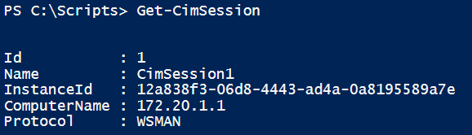
Run it remotely
Create the session
Credentials are the same type of variable as PSSessions
And run the configurations…
$cimMS01 = New-CimSession -Credential $credAdmin -ComputerName "172.20.1.1"
Set-DscLocalConfigurationManager -Path .\SimpleComputerRemote `
-CimSession $cimMS01
Start-DscConfiguration -path .\SimpleComputerRemote -CimSession $cimMS01 `
-Force -Wait -Verbose

Slide 47
But why?
The advantage is that we can make a single configuration for a lot of computers, and run this configuration on all those computers without logging on to these computers locally to copy files or run commands
Exercise: Testlab
You need to prestage 15 computers for a PowerShellcourse with a domain controller and a fileserver
Write a script that will setup both servers
Hint: you can reuse a lot of code we made earlier
Another hint: Using their IP-addresses will make life a lot easier

Slide 48

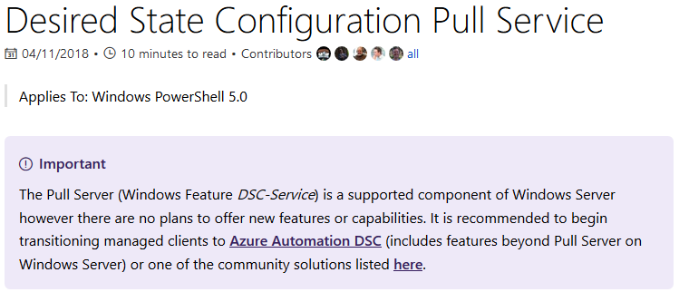
The pull server
Now, there are two codebases for DSC
One for PowerShell
One for PowerShell core
Maintaining two separate codebases for the same project is hard
So Microsoft is working towards one codebase that replaces the two existing ones
And in all the blog-posts regarding this, the pull-server is rarely mentioned
What is mentioned, is this:

Slide 49

Azure
DSC is strongly integrated with Azure, and running some servers in the cloud isn’t that bad an idea
But Azure isn’t free, and unlike for server operating systems (where there’s really only one option), there are a lot of cloud providers
But creating your entire configuration in Azure DSC makes transitioning to the competition difficult
But the blog posts say MS understands not all environments can go full cloud, so some support for pull servers will remain
We’ll go into pull servers as they are now, hoping for the best

Slide 50
Types of pull server
Web service
Has an Odata interface
Can include capabilities for target nodes to report back confirmation of success or failure
Generally advisable when you have a lot of servers to manage
SMB Service
Basically a share on a server
Less work to setup
Doesn’t need the soon to be deprecated DSC-service
Great in smaller environments
Notes:
https://docs.microsoft.com/en-us/powershell/dsc/secureserver

Slide 51
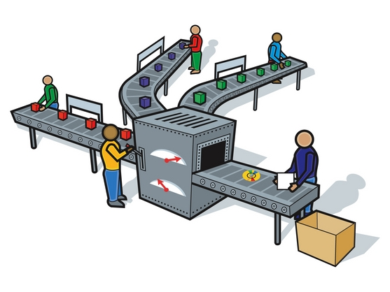



Setting up the pull server
File: Pull server setup.ps1
We’ll promote MS01 to our pull server
And FS01 to our client
Connect to MS01, and install the module xPSDesiredStateConfiguration
Unlike the example, we’ll setup a HTTP pull-server
Which is fine for labs, but not for production

Slide 52
Configure the pull server
To configure the pull server, an example configuration file is available
Look for Sample_xDscWebServiceRegistration.ps1
The script needs:
A node name, localhost is default and fine
A unique guid value, that can be generated using “New-Guid”
What the script does:
Installs the DSC-Service
Configures the server to use port 8080 and some more useful stuff
Exports the registration key (the random guid) to a file

Slide 53
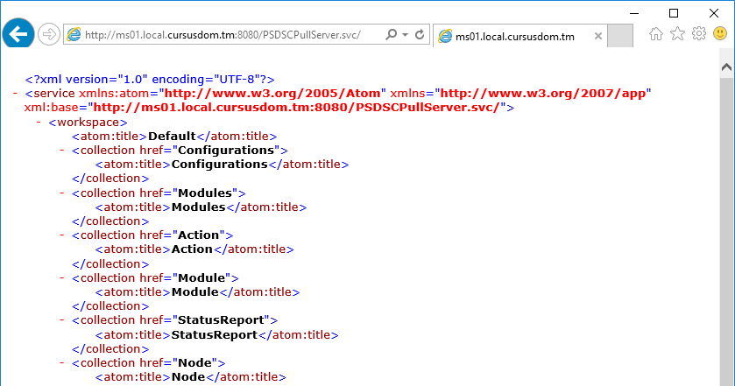
Is my pull server running?
Surf to http://[name of server]:8080/PSDSCPullServer.svc

Slide 54
Setup the client to listen
For the client, another script is available (in the same file as before)
The script needs:
A node name, localhost is default and fine
The exported unique random value from before
The name of the pull-server
The name of the configuration on the pull server that this computer will use
What the script does:
Configures the LCM to use Pull (and reboot, and refresh regularly)
Saves the guid and name for the server containing configurations
Saves the guid and name for the reporting server
Notes:
https://docs.microsoft.com/en-us/powershell/dsc/pullclientconfignames

Slide 55
Adding the configuration
The client is listening, so back to the server to create a configuration
To start of simply, let’s just create a folder…
configuration FS01
{
Import-DscResource –ModuleName 'PSDesiredStateConfiguration'
Node FS01
{
File Directory
{
Ensure = "Present" # You can also set Ensure to "Absent"
Type = "Directory" # Default is "File".
DestinationPath = "C:\SharedFolder"
}
}
}
FS01

Slide 56
Distributing the configuration
Comes down to moving the files with the correct name and a checksum to the right location
Correct name: the ClientConfigName from when installing the pull server
A checksum: New-DscChecksum
The right location: "$env:PROGRAMFILES\WindowsPowerShell\DscService\Configuration"
New-DscChecksum -ConfigurationPath .\FS01 -OutPath .\FS01 -Verbose -Force
Get-ChildItem .\FS01 -Filter FS01* | Copy-Item `
-Destination "$env:PROGRAMFILES\WindowsPowerShell\DscService\Configuration"

Slide 57
But has it worked?
Back to the client!
Get-ChildItem c:\ # c:\SharedFolder?
Get-DscConfiguration # output?
Test-DscConfiguration # true?

Slide 58
Exercise: Adding to the domain
FS01 isn’t a member of the domain yet
I’m going to let that sink in
Let’s add it
You’ll need to use the xComputer module
To compile the configuration
To apply the configuration
Preferably without installing it on the client first
Notes:
https://blogs.technet.microsoft.com/mhendric/2014/11/10/using-a-dsc-pull-server-to-deploy-the-xexchange-module-managing-exchange-2013-with-dsc-part-4/ and scroll down a lot

Slide 59
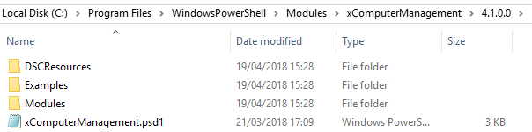
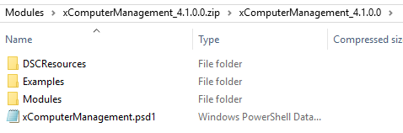
Solution: Distributing a module
Modules are downloaded in $env:PSModulePath
This contains three paths (;-separated), and the middle one is where the modules are installed when using Install-Module
The structure of an installed module:
The structure of the zipped module (ready to distribute):
Version-subfolder isn’t allowed

Slide 60
Solution: Distributing a module
After zipping the module (Compress-Archive)
Move it to the location selected when installing the Pull-server
Generate a checksum
And to have a client download it
Refer to it in a configuration
PS: Where are the modules installed?
$env:PSModulePath
Foreach($path in $env:PSModulePath.Split(";"))
{
Get-ChildItem $path
}

Slide 61
Exercise: add the DC to the pull server
We’ve already created the configuration for our domain controller
It would be easy to add this configuration to our pull-server, no?
Hint: Compile the MOF on the DC, otherwise you’ll have a lot of work installing modules

Slide 62
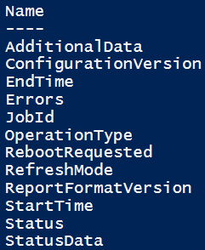
Reports from pull server
When setting up the client to listen to the pull-server, we’ve set it to use it as a report-server as well
In fact, these reports were the main advantage of using an IIS-pull server, vs an SMB-pull server
The reports sent to this server are saved in a database
This is also the database where registered computers are stored
You can, if you wish, replace it with a SQLServer database
Get the reports by sending a webrequest to the reportingserver
It returns json, that can be converted to an object
What properties are available?
Notes:
https://docs.microsoft.com/en-us/powershell/dsc/reportserver
https://docs.microsoft.com/en-us/powershell/dsc/queryservernodes

Slide 63
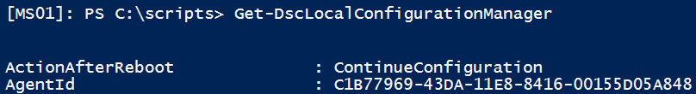
Getting the reports
Problem: to get the reports, you have to pass the agentID of the server the reports will be about
Getting the agentID?
Can’t I get the agentID’s from the server?
Not easily…
File: Reports.ps1

Slide 64
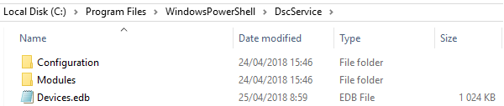
Hacking the database
Remember the database:
You could open it using a GUI-tool
https://www.nirsoft.net/utils/ese_database_view.html
Or using PowerShell
Someone made a module
First copy the database, with IIS stopped
Then investigate
File: Hacking the database.ps1

Slide 65
Partial configurations
You setup IIS, the developers control the settings for the site
The developers have their own testing-machines
Configured with a DSC-configuration
How can you use this DSC-configuration to configure the site, without changing the DSC-configuration you already have for the server?
Partial configurations!
Multiple Pull-configurations (from different servers)
Multiple Push-configurations
A combination of both
Notes:
https://docs.microsoft.com/en-us/powershell/dsc/partialconfigs

Slide 66
The example
FS01 gets the following config from the Pull-server
Folder c:\SharedFolder exists
Is member of domain
We’ll replace it by two different configurations
IIS is installed, with the management interface
A file called “index.htm” exists at c:\inetpub\wwwroot
File: Partial configuration.ps1

Slide 67
Exercise: Mixed partial configuration
Add the previous Pull-configuration for FS01 back into the full configuration

Slide 68


Slide 69
Followup
My email: Jochen.marien@thomasmore.be
Please send
Questions (not to difficult)
Real live examples (as difficult as possible)
Stuff you notice in three weeks I should have told you now

