Slide 1

Windows PowerShell
System administration and automation in a Windows environment
-Desired State Configuration, part 2 -
Jochen Mariën

Slide 2
In this presentation
Writing configurations

Slide 3
Configurations
Use different resources to accomplish different tasks
A lot of resources are gathered in the PSDesiredStateConfiguration-resource
https://docs.microsoft.com/en-us/powershell/scripting/dsc/resources/resources?view=powershell-7
Additional resources that can be imported and used (aka, are installed by default)
Get-DscResource
Installing additional resources: Install-Module
Looks for the modules in all the right places
Installs the modules in the right path
Installing additional resources: Manually
Download the files and place them in the right place manually

Slide 4
On resources
Some resources are made by Microsoft, but most are made by the community
The old naming convention (suffix):
X for experimental
C for community-developed
Dsc for resources of high quality
The new naming convention (suffix):
Always use the Dsc-suffix
A tag is added for high quality resources
A lot of resources still have the x-prefix
The new convention started on December 8, 2017
Notes:
https://blogs.msdn.microsoft.com/powershell/2017/12/08/dsc-resource-naming-and-support-guidelines/

Slide 5
Simple computer
The settings:
Member of a domain
Domain Users is member of local Allow RDP-users
The difficulties:
We need a user account to become member of the domain: Encryption
We need to reboot to become member of the domain
We need additional modules
What we won’t be dealing with:
Connecting to the computer: Simply open a new PSSession to the VMname
File: SimpleComputer.ps1
$admin = Get-Credential Administrator
$ms01 = New-PSSession -VMName "MS01" -Credential $admin

Slide 6
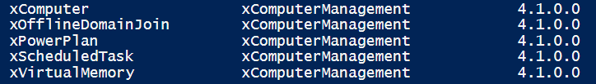
Installing modules
Install the additional modules:
Uses the PowerShell packagemanager to find, download and install the package
After installation, check:
And run the configuration…
Install-Module -Name xComputerManagement
Get-DscResource

Slide 7
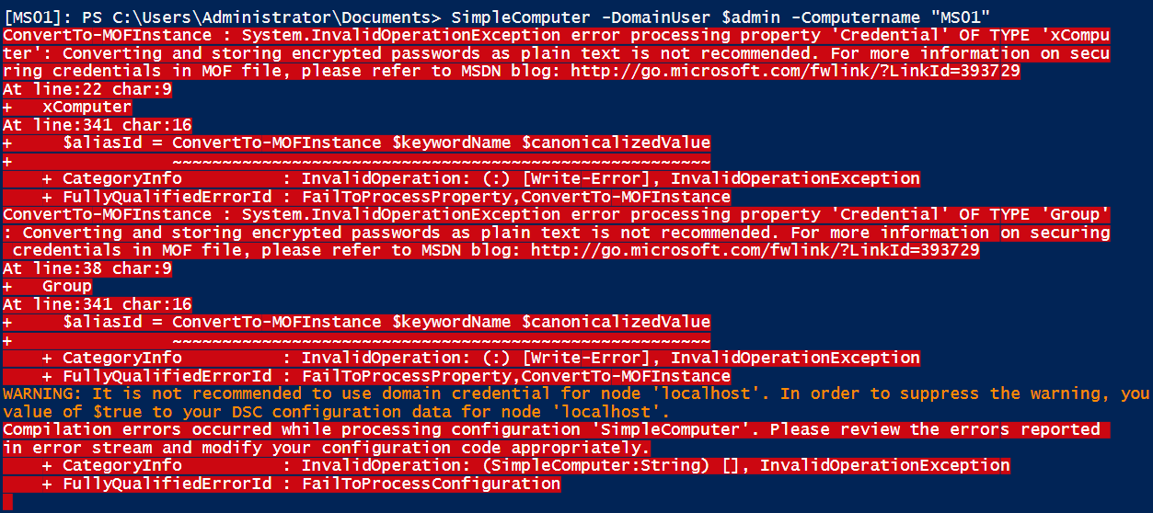
Compile the configuration
Creating the parameter values is easy
Get-credential for a credential, or some more elaborate way that involves less typing
Simply type the computername
But…

Slide 8
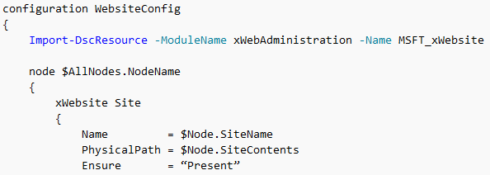
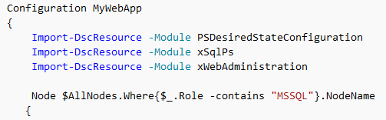
Compiling: Configuration data
Can be used to write a single configuration-block for different types of servers
In the configuration, you can refer to the different configuration-data settings
In the configuration-data, you can define settings
Can also be used to pass parameters to the configuration block, even though they haven’t been defined as parameters
Notes:
https://docs.microsoft.com/en-us/powershell/dsc/configdata

Slide 9
Compiling: Configuration data
But it can also be used to allow plain text password…
Which is a bad idea, but it’s easier than going full-encryption
$cd = @{
AllNodes = @(
@{
NodeName = 'localhost'
PSDscAllowPlainTextPassword = $true
PSDscAllowDomainUser = $true
}
)
}
SimpleComputer -DomainUser $admin -Computername "MS01" -ConfigurationData $cd
Notes:
https://docs.microsoft.com/en-us/powershell/dsc/configdatacredentials
Advanced configuration data:
https://docs.microsoft.com/en-us/powershell/dsc/separatingenvdata

Slide 10
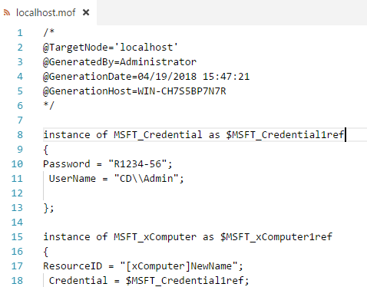
But the password is encrypted
It was in the parameter, but it isn’t in the MOF-file anymore…
The only way to fix this is by encrypting the configuration
We’ll get to that

Slide 11



Can this fix another of our problems?
Adding a computer to a domain requires a restart
It still does. It’s annoying, but it still does.
A second file was generated:
We remember those:
Example: LCM push configuration.ps1
Apply localhost.meta.mof…
We need to do this manually, because we could have created this configuration for another computer
Get-DscLocalConfigurationManager
Set-DscLocalConfigurationManager -Path .\SimpleComputer

Slide 12
Exercise: Domain Controller
Write a DSC-script to check up on a domain controller
Include, but don’t feel limited to
Computername
Install Domain Services, DHCP, DNS (and their RSAT’s)
Set a static IP, DNS-server, default gateway
Install the domain
Install a DHCP scope
Set the DHCP server options (DNS suffix, DNS server, default gateway)
You can save all passwords in plain text

