Slide 1
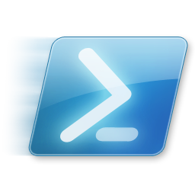
Windows PowerShell
System administration and automation in a Windows environment
-Desired State Configuration, part 3 -
Jochen Mariën

Slide 2
In this presentation
Encrypting configurations
Running configs remotely with CIM

Slide 3
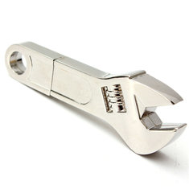
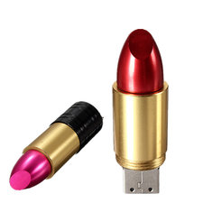
Encrypt the configuration
Starting from PS version 5.0, the applied configuration is encrypted by default
But the MOF-files aren’t, and they contain all passwords used
You could keep it this way, if you transfer all configurations using a secure channel
Secure channels are “creating the configuration and applying it locally” and “move the configuration with cleverly concealed USB flash drive”
We’ll reuse the SimpleComputer-example to add a computer to a domain
File: SimpleComputer with Certificate.ps1
Notes:
https://docs.microsoft.com/en-us/powershell/dsc/securemof
https://blogs.technet.microsoft.com/ashleymcglone/2015/12/18/using-credentials-with-psdscallowplaintextpassword-and-psdscallowdomainuser-in-powershell-dsc-configuration-data/

Slide 4
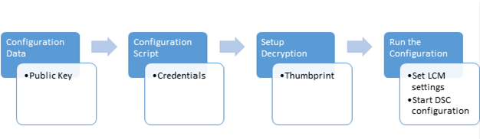
Overall process
Setup the certificates
Target node has the certificate
Configuration computer has the public key and thumbprint
Create a configuration data block that contains the key and thumbprint
Create a configuration script that
Contains the actual configuration
Sets up decryption
Run the configuration

Slide 5
We have two computers
Target computer: the one who will be subjected to the configuration
Cl4-win10
Authoring computer: the one we’ll use to create the configuration
The host
$p1 = Get-Credential "Player 1" # R1234-56
$cl4 = New-PSSession -VMName "cl4-win10" -Credential $p1
Enter-PSSession $cl4

Slide 6
Creating the certificate
Create the self signed certificate:
Export the public key:
Copy the exported file to the other computer
And import the certificate
$cert = New-SelfSignedCertificate -Type DocumentEncryptionCertLegacyCsp ` -DnsName 'DscEncryptionCert' -HashAlgorithm SHA256
$cert | Export-Certificate -FilePath "c:\temp\DscPublicKey.cer" -Force
Import-Certificate -FilePath "$env:temp\DscPublicKey.cer" `
-CertStoreLocation Cert:\LocalMachine\My

Slide 7
The configuration
The configuration doesn’t change
This is the good part: when writing configurations, the way they are distributed doesn’t matter
You could pull them
You could push them
You could encrypt them
You store them in a publicly available share
What changes is the way the configuration is turned into a MOF-file
Aka the compilation

Slide 8
Compiling the configuration
We’ve forgotten to store the thumbprint when importing the certificate
So, look for the certificate, and store the thumbprint
The configuration data
$cert = Get-ChildItem Cert:\LocalMachine\My |
where-object Subject -eq "CN=DscEncryptionCert"
$cert.Thumbprint
$cd = @{AllNodes = @( @{
NodeName = 'localhost’
PSDscAllowDomainUser = $true
Thumbprint = $cert.Thumbprint
CertificateFile = "c:\Scripts\Public Keys\DscPublicKey.cer"
} ) }

Slide 9
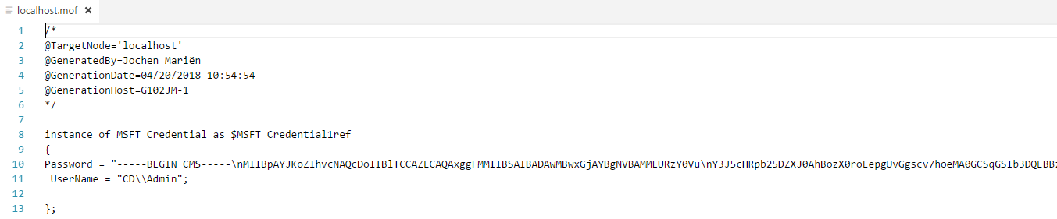


Slide 10
Applying the configuration
Copy all MOF-files to the target computer
Run the local configuration (to enable reboots)
Add the certificate thumbprint in the LCM-configuration
Which is bad news:
We could add it now, risking that we loose the “Reboot if needed”
We could have added the thumbprint in the configuration, making it specific for that computer (/certificate)
Set-DscLocalConfigurationManager -Path .\SimpleComputer
Get-DscLocalConfigurationManager

Slide 11
Adding it now
Also see file: LCM push configuration.ps1
Get the thumbprint:
New configuration (only LocalConfigurationManager-block)
Compile and apply
Note how “RebootIfNeeded” is back to false…
$cert = Get-ChildItem Cert:\LocalMachine\My |
where-object Subject -eq "CN=DscEncryptionCert"
Configuration LCMConfiguration
{ Node "localhost"
{ LocalConfigurationManager
{ CertificateID = $cert.Thumbprint
} } }

Slide 12
Add it in the configuration
A bit more work, but the better option
In the configuration
Add the thumbprint as a parameter (or insert it through the configuration data)
Add the “CertificateID” to the LocalConfigurationManager
Recompile (with the extra parameter), copy, reapply the LCM-config

Slide 13

Compile and run
Nothing new here, simply start the DSC configuration

Slide 14
Encryption
… is quite a lot of work
But you really should, especially since configurations don’t ‘add up’
If you want to add a setting to a configuration, you’ll need the current configuration to alter it
It would be great if you could integrate this with the company CA, and not be dependent on self-signed certificates
Another approach would be to create users with JEP (just enough permissions), so their credentials aren’t that important
Even common users can add up to 5 computers to a domain…

Slide 15
Run a configuration remotely (once)
What if we were to run only the “Start-DscConfiguration” on the remote computer
Without even making a connection first, ideally
Works if you copy the compiled configuration first
Alternative:
[Dis]advantages:
+ Works on any computer that is CIM-capable
+ No need to copy files
- Configuration needs to be tuned to the computername
Invoke-Command -Session $cl4 -scriptblock { Start-DscConf -path … }
Start-DscConfiguration -path … -CimSession $cimMS01

Slide 16
Wait, CIM?
CIM session are a lighter version of PSSessions
CIM is the ‘new’ WMI and, theoretically, any OS can understand CIM
The main difference for running a command over CIM: a connection is made to the CIM database, not to PowerShell
The target doesn’t need PowerShell installed
A CIM session is only openened when needed, not maintained
CIM and PSSession both use WinRM, but CIM can also use DCOM
Notes:
https://blogs.technet.microsoft.com/heyscriptingguy/2014/01/31/comparing-powershell-pssessions-and-cim-sessions/
https://technet.microsoft.com/en-us/library/dn448522(v=wps.630).aspx

Slide 17

Let’s start
File: Cim.ps1
Take any regular configuration, but change…
Where “172.20.1.1” is the name of the target computer
Also change it in the configuration data, if needed
On compilation, you’ll get the following files:
Node Localhost to Node "172.20.1.1”

Slide 18
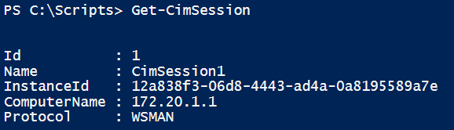
Run it remotely
Create the session
Credentials are the same type of variable as PSSessions
And run the configurations…
$cimMS01 = New-CimSession -Credential $credAdmin -ComputerName "172.20.1.1"
Set-DscLocalConfigurationManager -Path .\SimpleComputerRemote `
-CimSession $cimMS01
Start-DscConfiguration -path .\SimpleComputerRemote -CimSession $cimMS01 `
-Force -Wait -Verbose

Slide 19
But why?
The advantage is that we can make a single configuration for a lot of computers, and run this configuration on all those computers without logging on to these computers locally to copy files or run commands
Exercise: Testlab
You need to prestage 15 computers for a PowerShellcourse with a domain controller and a fileserver
Write a script that will setup both servers
Hint: you can reuse a lot of code we made earlier
Another hint: Using their IP-addresses will make life a lot easier

