Slide 1
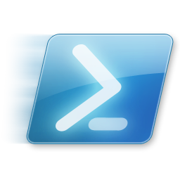
Windows PowerShell
System administration and automation in a Windows environment
-Desired State Configuration, part 4 -
Jochen Mariën

Slide 2
In this presentation
The pull server
The pull server database
Partial configurations

Slide 3

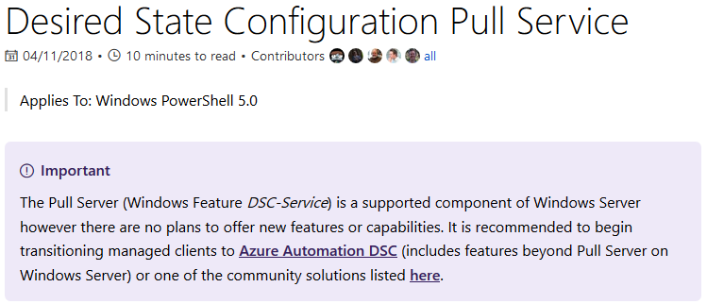
The pull server
Now, there are two codebases for DSC
One for PowerShell
One for PowerShell core
Maintaining two separate codebases for the same project is hard
So Microsoft is working towards one codebase that replaces the two existing ones
And in all the blog-posts regarding this, the pull-server is rarely mentioned
What is mentioned, is this:

Slide 4

Azure
DSC is strongly integrated with Azure, and running some servers in the cloud isn’t that bad an idea
But Azure isn’t free, and unlike for server operating systems (where there’s really only one option), there are a lot of cloud providers
But creating your entire configuration in Azure DSC makes transitioning to the competition difficult
But the blog posts say MS understands not all environments can go full cloud, so some support for pull servers will remain
We’ll go into pull servers as they are now, hoping for the best

Slide 5
Types of pull server
Web service
Has an Odata interface
Can include capabilities for target nodes to report back confirmation of success or failure
Generally advisable when you have a lot of servers to manage
SMB Service
Basically a share on a server
Less work to setup
Doesn’t need the soon to be deprecated DSC-service
Great in smaller environments
Notes:
https://docs.microsoft.com/en-us/powershell/dsc/secureserver

Slide 6
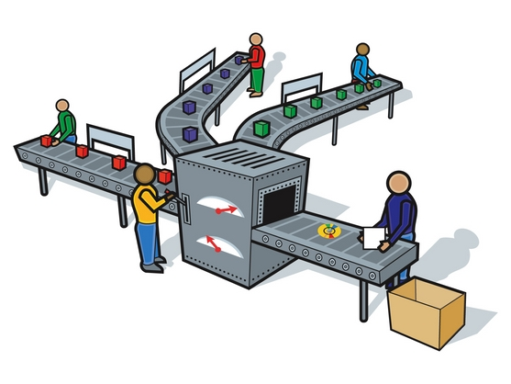



Setting up the pull server
File: Pull server setup.ps1
We’ll promote MS01 to our pull server
And FS01 to our client
Connect to MS01, and install the module xPSDesiredStateConfiguration
Unlike the example, we’ll setup a HTTP pull-server
Which is fine for labs, but not for production

Slide 7
Configure the pull server
To configure the pull server, an example configuration file is available
Look for Sample_xDscWebServiceRegistration.ps1
The script needs:
A node name, localhost is default and fine
A unique guid value, that can be generated using “New-Guid”
What the script does:
Installs the DSC-Service
Configures the server to use port 8080 and some more useful stuff
Exports the registration key (the random guid) to a file

Slide 8
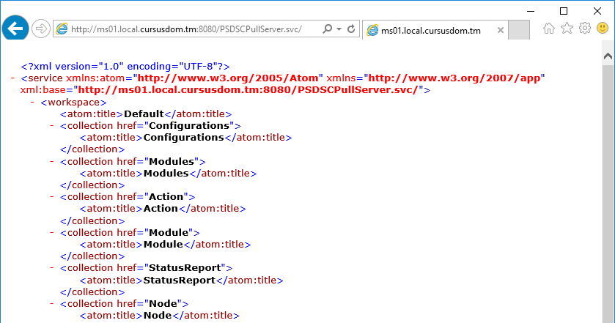
Is my pull server running?
Surf to http://[name of server]:8080/PSDSCPullServer.svc

Slide 9
Setup the client to listen
For the client, another script is available (in the same file as before)
The script needs:
A node name, localhost is default and fine
The exported unique random value from before
The name of the pull-server
The name of the configuration on the pull server that this computer will use
What the script does:
Configures the LCM to use Pull (and reboot, and refresh regularly)
Saves the guid and name for the server containing configurations
Saves the guid and name for the reporting server
Notes:
https://docs.microsoft.com/en-us/powershell/dsc/pullclientconfignames

Slide 10
Adding the configuration
The client is listening, so back to the server to create a configuration
To start of simply, let’s just create a folder…
configuration FS01
{
Import-DscResource –ModuleName 'PSDesiredStateConfiguration'
Node FS01
{
File Directory
{
Ensure = "Present" # You can also set Ensure to "Absent"
Type = "Directory" # Default is "File".
DestinationPath = "C:\SharedFolder"
}
}
}
FS01

Slide 11
Distributing the configuration
Comes down to moving the files with the correct name and a checksum to the right location
Correct name: the ClientConfigName from when installing the pull server
A checksum: New-DscChecksum
The right location: "$env:PROGRAMFILES\WindowsPowerShell\DscService\Configuration"
New-DscChecksum -ConfigurationPath .\FS01 -OutPath .\FS01 -Verbose -Force
Get-ChildItem .\FS01 -Filter FS01* | Copy-Item `
-Destination "$env:PROGRAMFILES\WindowsPowerShell\DscService\Configuration"

Slide 12
But has it worked?
Back to the client!
Get-ChildItem c:\ # c:\SharedFolder?
Get-DscConfiguration # output?
Test-DscConfiguration # true?

Slide 13
Exercise: Adding to the domain
FS01 isn’t a member of the domain yet
I’m going to let that sink in
Let’s add it
You’ll need to use the xComputer module
To compile the configuration
To apply the configuration
Preferably without installing it on the client first
Notes:
https://blogs.technet.microsoft.com/mhendric/2014/11/10/using-a-dsc-pull-server-to-deploy-the-xexchange-module-managing-exchange-2013-with-dsc-part-4/ and scroll down a lot

Slide 14
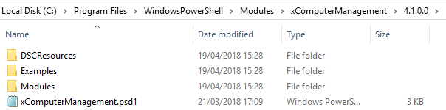
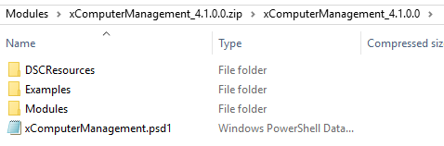
Solution: Distributing a module
Modules are downloaded in $env:PSModulePath
This contains three paths (;-separated), and the middle one is where the modules are installed when using Install-Module
The structure of an installed module:
The structure of the zipped module (ready to distribute):
Version-subfolder isn’t allowed

Slide 15
Solution: Distributing a module
After zipping the module (Compress-Archive)
Move it to the location selected when installing the Pull-server
Generate a checksum
And to have a client download it
Refer to it in a configuration
PS: Where are the modules installed?
$env:PSModulePath
Foreach($path in $env:PSModulePath.Split(";"))
{
Get-ChildItem $path
}

Slide 16
Exercise: add the DC to the pull server
We’ve already created the configuration for our domain controller
It would be easy to add this configuration to our pull-server, no?
Hint: Compile the MOF on the DC, otherwise you’ll have a lot of work installing modules

Slide 17
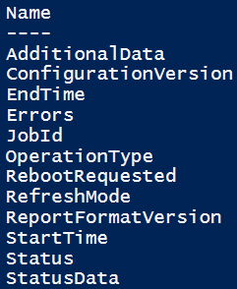
Reports from pull server
When setting up the client to listen to the pull-server, we’ve set it to use it as a report-server as well
In fact, these reports were the main advantage of using an IIS-pull server, vs an SMB-pull server
The reports sent to this server are saved in a database
This is also the database where registered computers are stored
You can, if you wish, replace it with a SQLServer database
Get the reports by sending a webrequest to the reportingserver
It returns json, that can be converted to an object
What properties are available?
Notes:
https://docs.microsoft.com/en-us/powershell/dsc/reportserver
https://docs.microsoft.com/en-us/powershell/dsc/queryservernodes

Slide 18
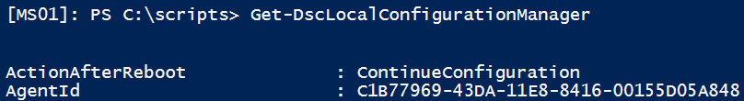
Getting the reports
Problem: to get the reports, you have to pass the agentID of the server the reports will be about
Getting the agentID?
Can’t I get the agentID’s from the server?
Not easily…
File: Reports.ps1

Slide 19
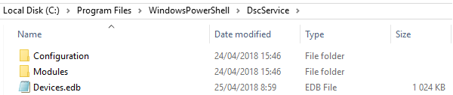
Hacking the database
Remember the database:
You could open it using a GUI-tool
https://www.nirsoft.net/utils/ese_database_view.html
Or using PowerShell
Someone made a module
First copy the database, with IIS stopped
Then investigate
File: Hacking the database.ps1

Slide 20
Partial configurations
You setup IIS, the developers control the settings for the site
The developers have their own testing-machines
Configured with a DSC-configuration
How can you use this DSC-configuration to configure the site, without changing the DSC-configuration you already have for the server?
Partial configurations!
Multiple Pull-configurations (from different servers)
Multiple Push-configurations
A combination of both
Notes:
https://docs.microsoft.com/en-us/powershell/dsc/partialconfigs

Slide 21
The example
FS01 gets the following config from the Pull-server
Folder c:\SharedFolder exists
Is member of domain
We’ll replace it by two different configurations
IIS is installed, with the management interface
A file called “index.htm” exists at c:\inetpub\wwwroot
File: Partial configuration.ps1

Slide 22
Exercise: Mixed partial configuration
Add the previous Pull-configuration for FS01 back into the full configuration

Slide 23


Slide 24
Followup
My email: Jochen.marien@thomasmore.be
Please send
Questions (not too difficult)
Real live examples (as difficult as possible)
Stuff you notice in three weeks I should have told you now

