Slide 1


VSCode & GIT
Michiel Verboven, Jochen Mariën

Slide 2
Git: What and why?
Version Control System (VCS) which tracks changes in computer files
Language independent: Java, Powershell, HTML, .txt ...
Non-central, distributed version control
Coordinating work between people in a project:
Who did what and when?
Merging file edits
Reverts
Local & remote repositories (repos)

Slide 3
Git: What and why?
Repos keeping track of code history
Take “snapshots” of your files = a “commit”
Possible to revisit any commit at any time
Workflow:
Work on a file, save
Work some more, save
Feel like it’s a good time to do a commit to your local repo
Add the file to the commit staging area
Commit the changes, with a message as comment
Repeat
Save... x4
“Hmm.. I’m happy after these few saved edits, let’s commit the changes to my local repo.”
Commit
LOCAL
“Ok I completed my part of the work. Let me push & do a merge request with the remote repo.”
Push
REMOTE

Slide 4
Git basics: CLI Commands
Local:
git init // Make and initialize local repo
git add <file> // Add file(s) to index (the pre-commit staging area)
git rm –cached <file> // Remove file(s) from the index
git status // Check status of index & folder
git commit // Commit changes present in the index, to the local repo
Remote:
git push // Push your local repo changes to the remote repo
git pull // Pull the latest changes from the remote to your local repo
git clone // Clone a remote repo into a new directory

Slide 5
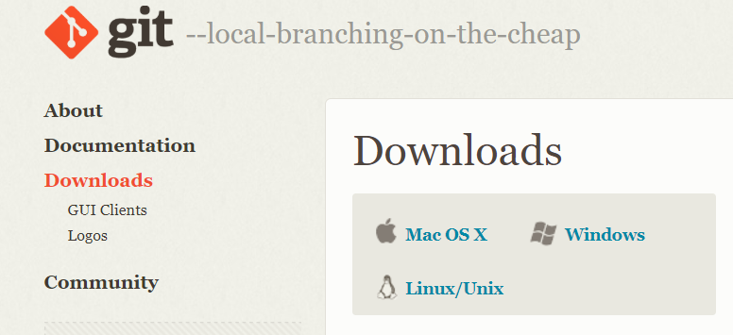
Git basics: Install
Install from: https://git-scm.com/downloads

Slide 6
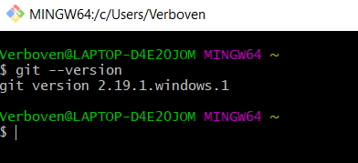

Git basics: Install
Open Git bash:
Also possible, open Git bash directly to a folder location

Slide 7
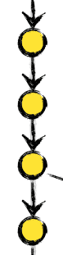
Git basics: First steps
Start a new repo for a project
git init
Create some files, for example index.html
Edit the file, save
Edit some more... save
git add index.html
git commit -m ‘Initial commit’
Create a new file, products.html
Edit products.html & edit index.html
git add .
git commit -m ‘Created products page and link from index’
Also think of a .gitignore file that holds all the names of files and directories that you never want to commit!

Slide 8
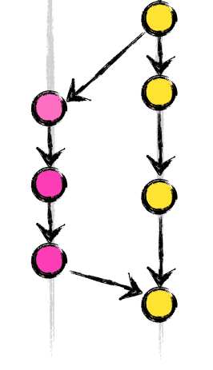
Git basics: Branches
What if I want to work an a (big) new piece of functionality?
git branch dialogbox
git checkout dialogbox
Edit index.html
git add .
git commit -m ‘Dialog box added’
Edit some more
git add .
git commit -m ‘Dialog box finalized’
git checkout master
git merge dialogbox -m ‘Merging new dialogbox’

Slide 9
Using Git for a large project: branching model
Large, real-life projects usually use a ‘branching model’
Example: https://nvie.com/posts/a-successful-git-branching-model/
Permanent branches:
Master: the live version
Develop: the main branch where the next version is under developement
Temporary branches, deleted when merged:
Hotfix branch: splits from the master and merges into the master
Release branches: based on the develop branch, stage between develop and master where bugfixes happen
Feature branches: branches where features get developed, merge into the develop branch

Slide 10
Demo: Basic usage with Bash

Slide 11
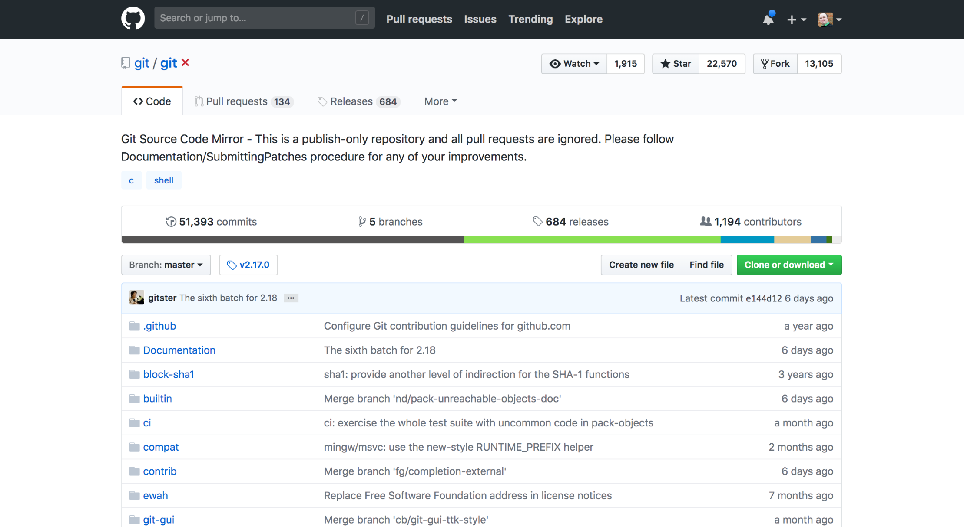
Remote repos: GitHub
Most used remote repo: https://github.com

Slide 12
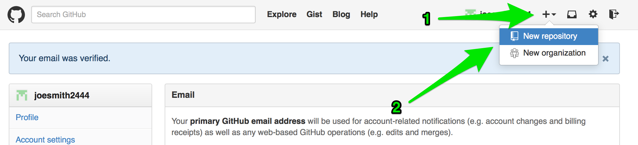
Remote repos: GitHub

Slide 13
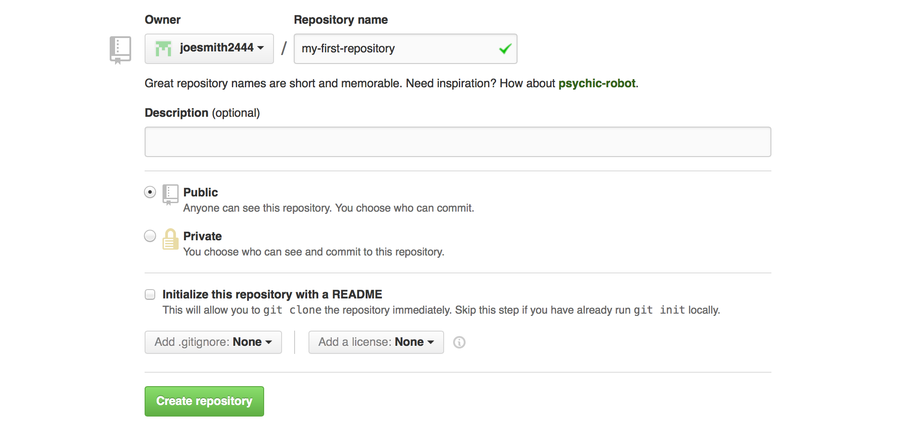
Remote repos: GitHub

Slide 14
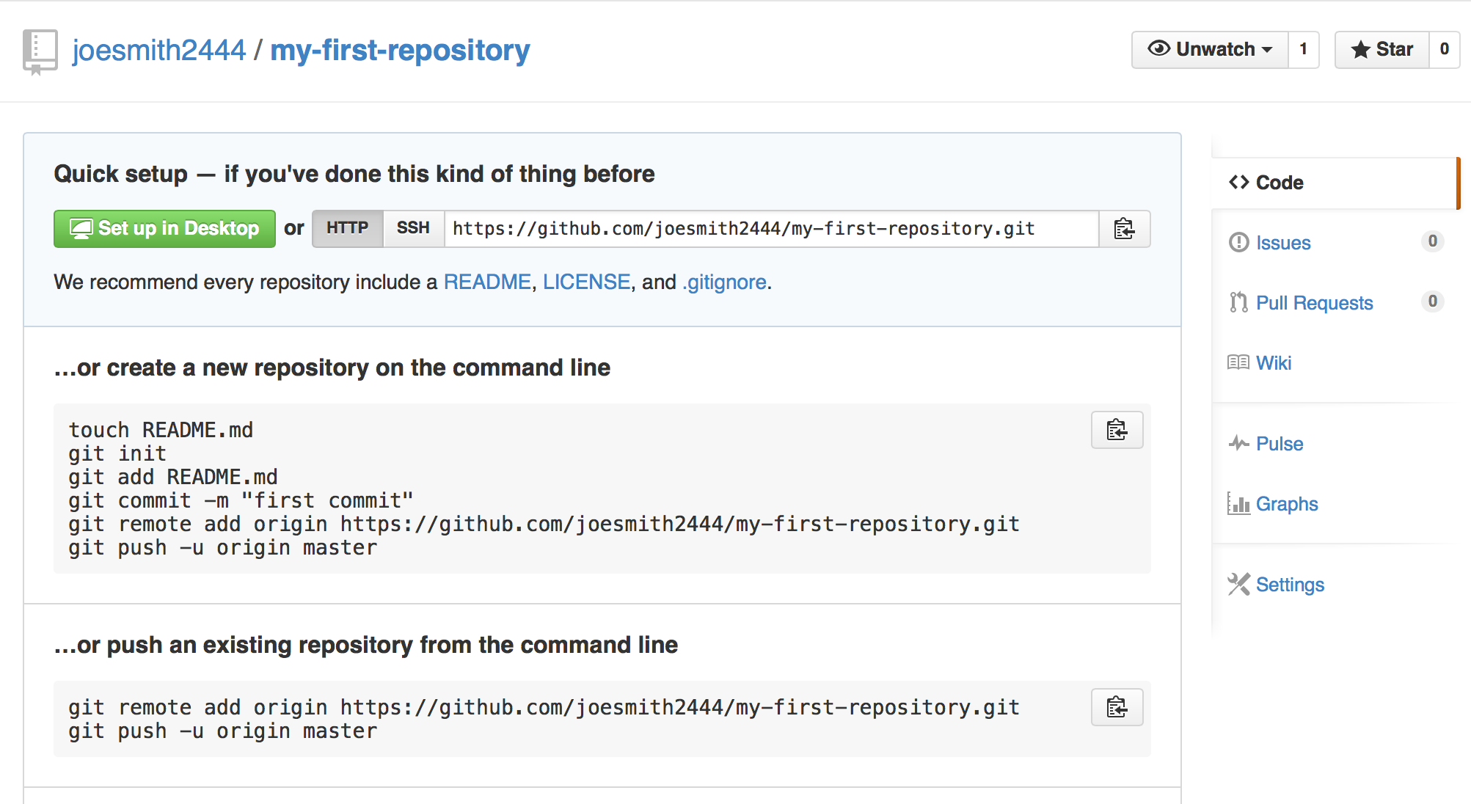
Remote repos: GitHub
Branches and pull requests on GitHub: https://guides.github.com/activities/hello-world/

Slide 15

Remote repos: GitLab
All the features of GitHub, plus:
Open-source, not owned by Microsoft
Free public and private repos
Different hosting plans
Full CI/CD
Protected branches, WIP status
Authentication levels, going beyond just read/write
...
https://gitlab.com

Slide 16
Demo: GitLab – Usage, features and issues / branches

Slide 17
Visual Studio Code: when and why?
When should you switch to VSCode?
When collaborating
When writing large scripts
When maintaining large libraries of scripts
When working on multiple computers
When working on a Mac/Linux
When shouldn’t you use VSCode?
When quickly checking something
When writing a script on a server for that server
Notes:
https://github.com/PowerShell/PowerShell/blob/master/docs/learning-powershell/using-vscode.md
https://blogs.msdn.microsoft.com/powershell/2015/11/16/announcing-powershell-language-support-for-visual-studio-code-and-more/

Slide 18


Visual Studio Code
Visual Studio Code is the new cross-platform multi language editor by Microsoft
It’s being used for web (html and javascript), python, …
It has Intellisense for any language (through extensions)
And it has integrated source control using Git
Two versions, side-by-side possible:
Normal
Only occasional stable builds
Insiders
New build every day with newest features, yet there is the occasional broken build

Slide 19
But… You shouldn’t be writing scripts on servers!
Assuming you need to do AD-stuff
Aka you need resources and modules from a server
Option A:
Install the AD-module locally
Create a drive to the AD you want to edit
Option B:
Remote into a DC of the AD you want to edit
Advantages
Test in the testing domain, deploy on production without moving the script
The script stays in a location where you’ll be able to find it later on (Git?)

Slide 20
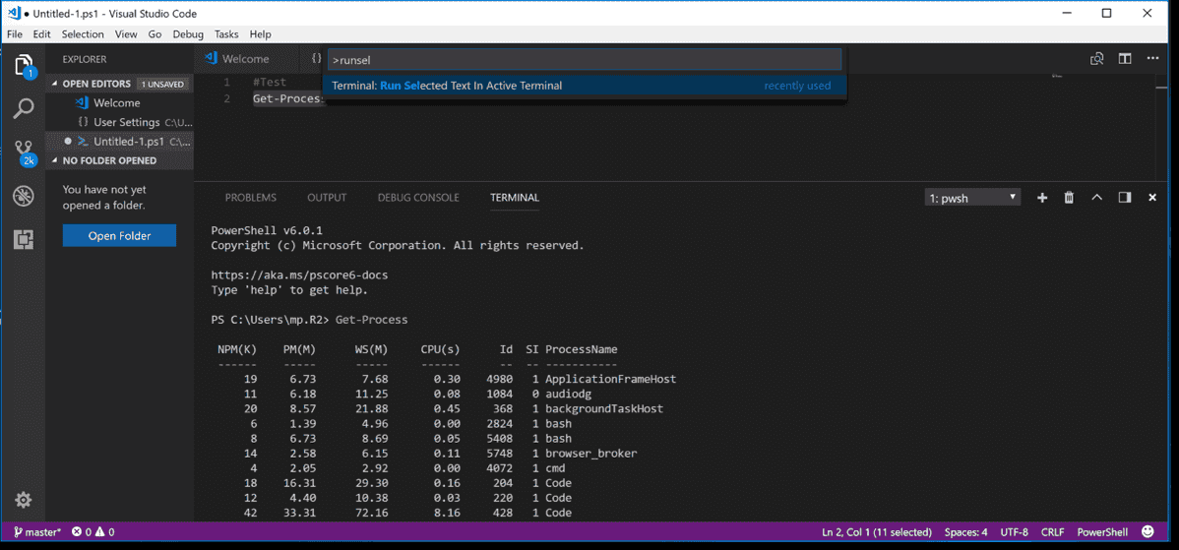
Command palette (Ctrl + Shift + P)
Editor
Integrated Terminal
Open tabs & folder
Extensions
Current GIT branch

Slide 21
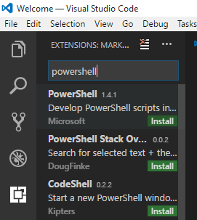
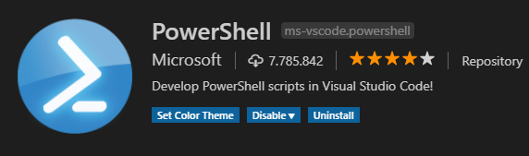
Installation
Download Visual Studio Code, and install
In VSCode, add the PowerShell extension
Click the square-icon on the left
Search for PowerShell
Install the extension made by Microsoft
Click the blue “Reload” button that replaces “Install”
Notes:
https://code.visualstudio.com/
https://git-scm.com/download/win

Slide 22
Demo: VSCode basics

Slide 23

Do I need VSCode?
Not really, only for the .md-files
MD: Markdown
ASCII-based files with minimal encoding that can be rendered as ‘good looking’-text files
All exercises are in markdown
To get the ‘good looking’-version:

Slide 24
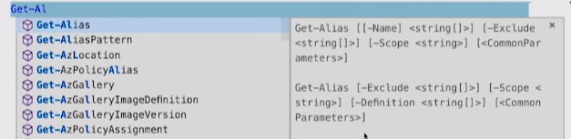
Features
Intellisense – Suggestions, completions

Slide 25
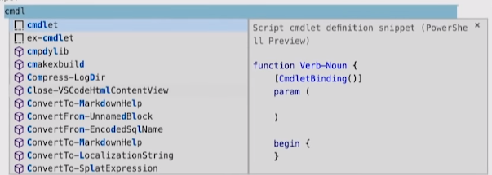
Features
Intellisense – Suggestions, completions
Snippets

Slide 26
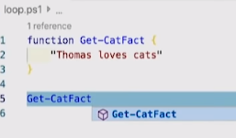
Features
Intellisense: Suggestions, completions
Snippets: Pre-made codeblocks
References CodeLens: Where is my function used?

Slide 27
Features
Intellisense: Suggestions, completions
Snippets: Pre-made codeblocks
References CodeLens: Where is my function used?
F8 to run selection
Open-EditorFile (psedit): Open file from Integrated Terminal
New-Editorfile: Open new file in editor, can be piped content
Cute stuff… Type ‘Color’ in the Command pallette
Example: >> Get-Process | New-EditorFile

Slide 28
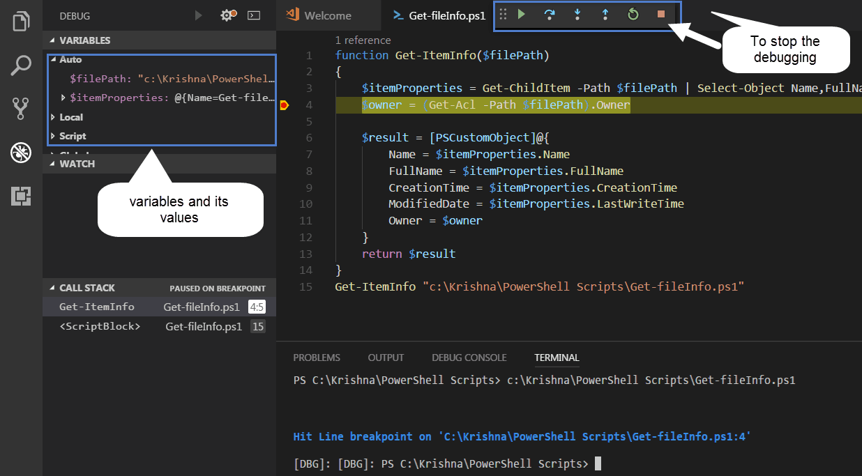
Features: Debugging
F5 to debug script
Place Breakpoints (red dots) where you need the script to pause
→ Click besides a line number in the side of the editor
While it is paused, get info about:
Parameters
Variables
Call stack
You can also use the integrated Terminal to check or even edit these!
Use Step-Over to skip to the next line of code in the script

Slide 30
Demo: Debugging & features

Slide 31
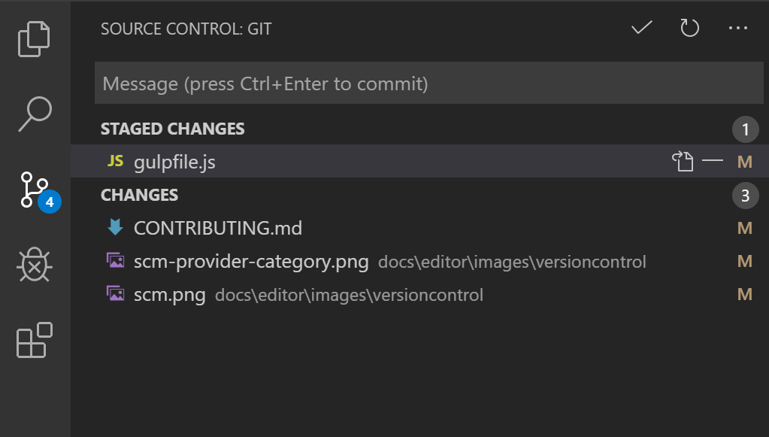
Git & VSCode
https://code.visualstudio.com/docs/editor/versioncontrol

Slide 32
Starting off
Open VSCode
Click View – command palette (Ctrl-Shift-P)
Type “Git: Clone”
As URL, type https://github.com/mjochen/PS-Basic-course and enter
Choose the local folder to create the working tree
A subfolder is automatically created
You can choose to open the rep (bottom right)

Slide 33
Alternative
Download the rep as ZIP-file
Unzip into a directory
Open the directory in VSCode

Slide 34
Resources
Basic tutorial: Git & GitHub
https://www.youtube.com/watch?v=SWYqp7iY_Tc
GitLab Docs: Adding members to projects
https://docs.gitlab.com/ee/user/project/members/
GitLab CI/CD: From Project Idea to Production & Deployment (if interested)
https://www.youtube.com/watch?v=rj0QrccYqGw
GitLab CI/CD: Deploy from GitLab to OpenShift free open source Kubernets Cluster (if interested)
https://www.youtube.com/watch?v=EwbhA53Jpp4
Great & advanced video’s from the yearly PowerShell summit at PowerShell.org
https://www.youtube.com/channel/UCqIw7UUwC5fUBFXYX68aMrQ

