Slide 1

Windows PowerShell
System administration and automation in a Windows environment
- Let’s do something useful -
Karin De Maertelaere, Jochen Mariën

Slide 2

https://garfield.com/comic
Garfield is nice
A day started with a cup of coffee and a Garfield comic is a good day
But what during that

Slide 3

https://garfield.com/comic
But only on workdays
So during the Christmas-break, we miss out on 15 days of Garfield

Slide 4

https://garfield.com/comic
And sure, we could just check the website and click the tiny ‘previous’-button, but we want the files locally

Slide 5
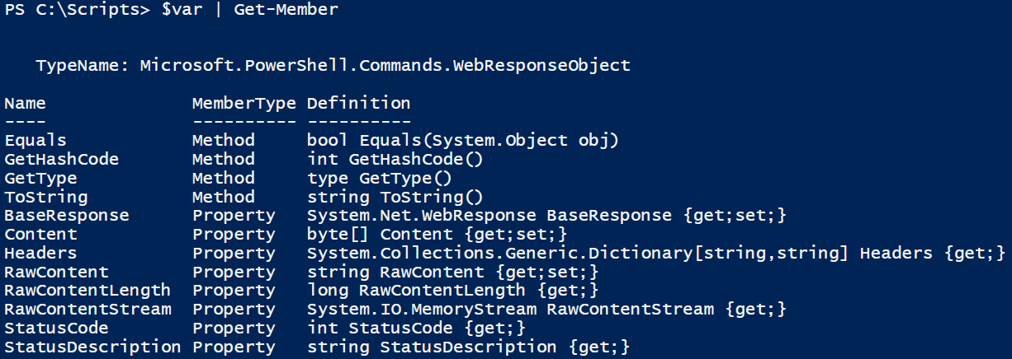
Test 1
Get the entire page, try to find the right image
Invoke-Webrequest
-url is https://garfield.com/comic
Catch the result in a variable
Check if the variable has the comic as an image
$url = "https://garfield.com/comic"
$var = Invoke-WebRequest -Uri $url
$var | Get-Member

Slide 6
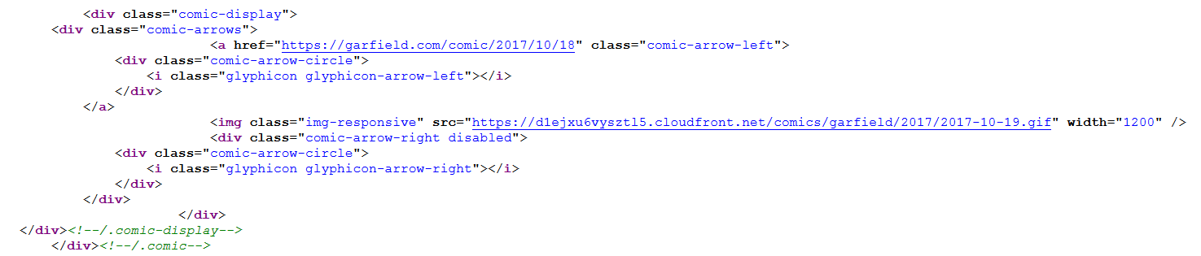
Test 2
Get to the image directly
View source
We could have gotten this from the variable, but it would have been tedious

Slide 7
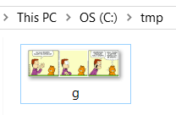
Test 2
Get to the image directly
$url = "https://d1ejxu6vysztl5.cloudfront.net/comics/garfield/2017/2017-10-19.gif"
Start-BitsTransfer -Source $url -Destination c:\tmp\g.gif

Slide 8
A loop
So we need a loop that loops through days
We’ll just do 15 days
This means, we always need 15 iterations
For-loop?
Doable, but what about the condition?
Also, not a very pretty for-loop, is it?
For($date = (Get-Date) ; $date - ? ; $date = $date.AddDays(-1))
{

Slide 9
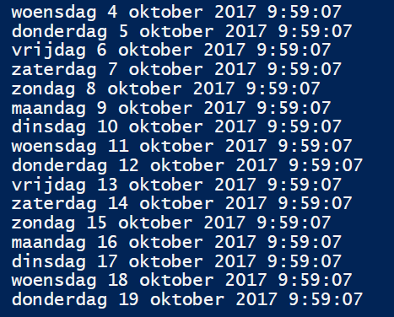
Another loop
So we start fifteen days ago
Repeat adding days (and downloading cartoons)
Until the day is today
$date = (Get-Date).AddDays(-15)
do
{
$date
$date = $date.AddDays(1)
}
while(((Get-Date)-$date)-gt 0)

Slide 10
An URL
We have a date-object, but need an URL
In the form of:
Meaning…
"https://d1ejxu6vysztl5.cloudfront.net/comics/garfield/2017/2017-10-19.gif"
$baseurl = "https://d1ejxu6vysztl5.cloudfront.net/comics/garfield/"
# /2017/2017-10-19
$extension = ".gif"

Slide 11
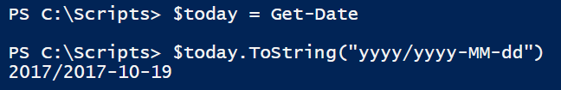
A date
We have a date object, and want the date in a certain format
toString!
Modifiers: https://docs.microsoft.com/en-us/dotnet/standard/base-types/custom-date-and-time-format-strings

Slide 12
Two more things
Paste the URL together
(Create and) paste the destination together
URL: $baseUrl + $date.toString(…) + $extension
Destination: a path, so Join-path of
C:\tmp\Garfield
The date as yyyy-MM-ddd + the extension

Slide 13

Tadaa!

