Slide 1

Windows PowerShell
System administration and automation in a Windows environment
- Windows Management Instrumentation -
Karin De Maertelaere, Jochen Mariën

Slide 2
Windows Management Instrumentation
Inquire, change and monitor configuration settings
of client pc’s and servers
of applications
of network components
…
of all objects (both local and remote)
Installed software or hardware, services, useraccounts, …
Everything for which a class exists
Examples: Win32_LogicalDisk.ps1, WMIinstances.ps1

Slide 3
WMI vs CIM
PS V2.0 | PS V3.0
WMI-cmdlets Get-Help *WMI* | CIM-cmdlets Get-Help *CIM*
Legacy of the past, no further investment by Microsoft | Microsoft invests in new functionalities and performance improvement
Communication through RPC’s -> through firewall with stateful inspection -> tricky to implement | Communication through WS-MAN via http or https
Many examples on the Internet | Simple and powerful cmdlets
Wrapper on top of WMI | Wrapper on top of WMI

Slide 4
WMI Service
Runs on all machines, accessible via
DCOM (Remote Procedure Call)
Get-Command -noun "*wmi*"
WSMAN
Get-Command -noun "*CIM*"
Benefits of CIM/WSMAN:
Natural way to manage remote machines
Response and distribution point for the WMI system of a machine
Only one point to communicate with -> consistent interface
Will work with any DMTF-compatible device

Slide 5
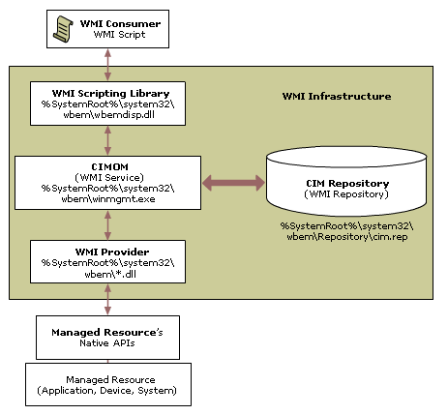

Slide 6
A namespace
Logical group of classes that belong together
Representing a specific technology or a specific administrative
Connecting to a namespace:
Example: Namespaces.ps1
Shows the default namespace (root\cimv2) and all CIM namespaces
Example: NameSpaceConnection.ps1
Connecting to one of the namespaces
Get-CIMInstance-Namespace root\cimv2 -Computername \\plato ` -ClassName Win32_Service -Filter " Name = 'BITS' "

Slide 7
WMI Classes
A namespace consists of classes
In a class, you can find useful information
Example: AllClasses.ps1
There are a lot of classes
Get-CimInstance -Namespace "root\cimv2" `
-ComputerName ". " -classname Win32_OperatingSystem

Slide 8
WMI Classes
Components
Properties: describe the object
Methods: describe the actions that can be performed on the object
Qualifiers: Provide additional information about a class, a property or a method
Hierarchically organized
Child classes inherit properties, methods and qualifiers and add their own properties, methods and qualifiers
Example: Methods.ps1

Slide 9
WMI
Love-hate
Love the fact that you can do everything with WMI
Hate the fact that it is very difficult to find the right class
The WMI explorer:
https://wmie.codeplex.com/
A PowerShellscript

Slide 10
Date conversion
WMI provides dates in UTC-format
Get-Cim… performes automatic conversion
Get-WmiObject -Class Win32_OperatingSystem -property LastBootUpTime
(Get-CimInstance -Class Win32_OperatingSystem `
-property LastBootUpTime).lastbootuptime

Slide 11
WQL Queries
Queries are written in the WMI Query Language
Looks a lot like normal SQL
Boolean operators AND and OR
Comparison operator IS NULL
Other operators =, >, <, >=, <=, <>
Soft comparison operator LIKE with wildcards %, [ ], ^, _
Keywords TRUE and FALSE

Slide 12
WQL Query examples
Selection of all properties of all instances of a class
“SELECT * FROM Win32_Service”
Selection of specific properties of all instances of a class
“SELECT Name , State FROM Win32_Service”
“SELECT StartMode FROM Win32_Service”
Selection of all properties of specific instances of a class
“SELECT * FROM Win32_Service WHERE State = ‘Stopped’ AND StartMode = ‘Auto’”
“SELECT * FROM Win32_Service WHERE AcceptPause = True “

Slide 13
