Slide 1

Windows PowerShell
System administration and automation in a Windows environment
- Let’s do something useful -
Karin De Maertelaere, Jochen Mariën

Slide 2

https://www.gocomics.com/garfield
Garfield is nice
A day started with a cup of coffee and a Garfield comic is a good day
But what during that

Slide 3

https://www.gocomics.com/garfield
But only on workdays
So during the Christmas-break, we miss out on 15 days of Garfield

Slide 4

https://www.gocomics.com/garfield
And sure, we could just check the website and click the tiny ‘previous’-button, but we want the files locally

Slide 5
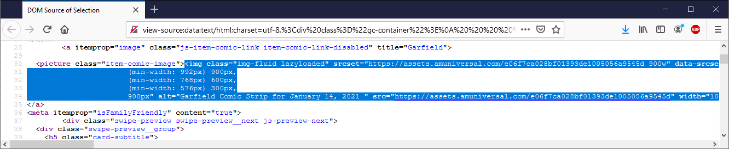
Can we download it?
Get to the image directly
View source

Slide 6
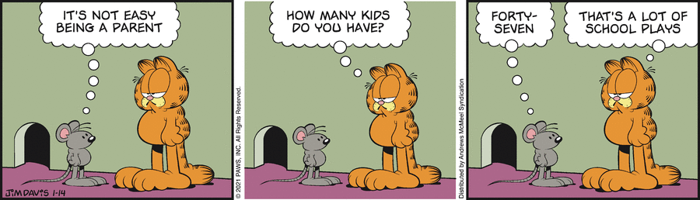
Can we download it?
Get to the image directly
The image is generated dynamically, Start-Bits won’t work…
Succes!
$url = " https://assets.amuniversal.com/e06f7ca028bf01393de1005056a9545d"
Start-BitsTransfer -Source $url -Destination c:\tmp\g.gif
Invoke-WebRequest -Uri $url -OutFile c:\tmp\g.gif

Slide 7
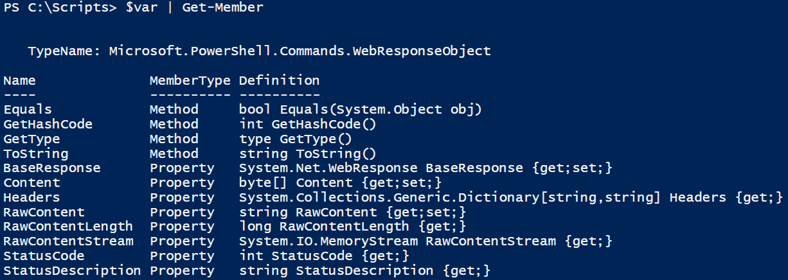
What is the URI?
Get the entire page, try to find the right image
Invoke-Webrequest
-url is https://www.gocomics.com/garfield
Catch the result in a variable
Check if the variable has the comic as an image
$url = "https://www.gocomics.com/garfield/2021/01/14"
$var = Invoke-WebRequest -Uri $url
$var | Get-Member

Slide 8
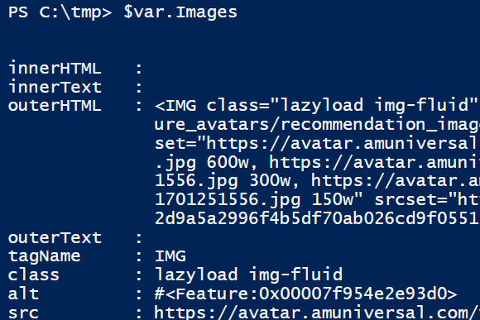
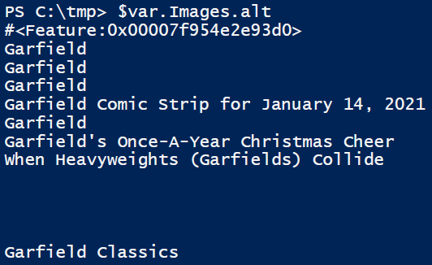
What is the URI?
There is an Images-property, check it out:
No, way to much information
Maybe just the alternative tekst:
Better!

Slide 9
Now for the URI…
Now download the file behind the image with the correct alt-text:
…and repeat for every day in a range of days…
$uri = ($var.Images | Where-Object alt -like "Garfield Comic Strip for*").src
Invoke-WebRequest -Uri $uri -OutFile c:\tmp\g1.gif

Slide 10
A loop
So we need a loop that loops through days
We’ll just do 15 days
This means, we always need 15 iterations
For-loop?
Doable, but what about the condition?
Also, not a very pretty for-loop, is it?
For($date = (Get-Date) ; $date - ? ; $date = $date.AddDays(-1))
{

Slide 11
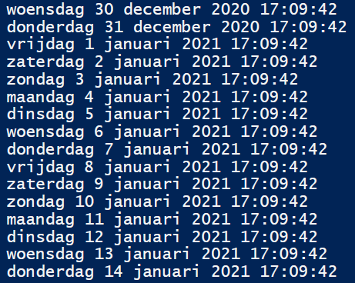
Another loop
So we start fifteen days ago
Repeat adding days (and downloading cartoons)
Until the day is today
$date = (Get-Date).AddDays(-15)
do
{
$date
$date = $date.AddDays(1)
}
while(((Get-Date)-$date)-gt 0)

Slide 12
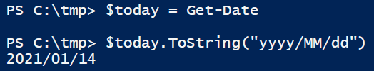
An URI
We have a date-object, but need an URL
In the form of https://www.gocomics.com/garfield/2021/01/14
We have a date object, and want the date in a certain format
toString!
Modifiers: https://docs.microsoft.com/en-us/dotnet/standard/base-types/custom-date-and-time-format-strings
$baseurl = "https://www.gocomics.com/garfield/"
# 2021/01/14

Slide 13
A couple more things
Paste the URl together
Find the image-URI
Create the filename (Join-Path of)
Location
“Garfield”
formatted date
“.gif”
Download the image

Slide 14
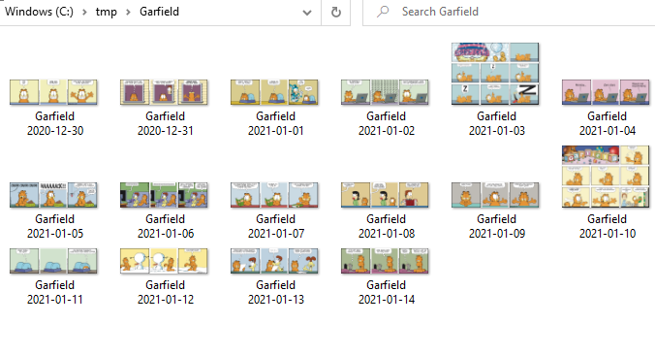
Tadaa!

