Slide 1


CV Bachai : A Web Based Resume Recommendation System
Department of Computer Science and Engineering
United International University
Final Year Design Project [ Group-A4] Section: A

Slide 2

Team Members
Md. Al Moktadir Chowdhury
Mehjabin Johra
Mohammad Farhan
Mostahid Ahmed
A. M. Kabbo Hossain
Hebron Hossain Hamim
011-162-029
011-171-037
011-171-039
011-171-050
011-171-052
011-171-095

Slide 3


Supervisor
Suman Ahmmed
Asst. Professor, Dept. of CSE
United International University
Course Teacher
Dr. Dewan Md. Farid
Associate Professor, Dept. of CSE
United International University

Slide 4

Outline
Introduction
Literature Review
Project Design & Diagrams
Environment Setup
UI Design
Project Management
Standards
Conclusion
Reference

Slide 5

Introduction
Problem Statement
Objective
Motivation
Project Overview

Slide 6
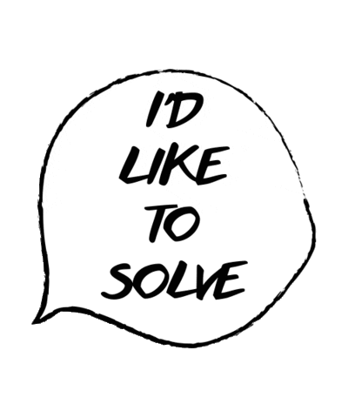
Problem Statement
Thousands of resumes piling up for a certain job.
Takes too much time to shortlist CV’s.
All resumes do not get fair treatment.
Institutions can not focus on all the resumes.

Slide 7

Objective
Job posting facility for recruiters.
Application feature for applicant.
Filtering appropriate cv respect to job.
Following a static approach for scoring.

Slide 8

Motivation
Stressful and complex manual recruitment.
Efficient automated process.
Saves time.
Free CV filtering.

Slide 9

Project Overview
Taking necessary information From applicants.
Shortlist CV’s according to job specification.
Ranking the resumes in synchronous with specified requirements.
Informing eligible candidate by E-Mail.

Slide 10


Project Overview
Form Template
Final Output
Form Fill-up
Database
Data
Processed Data
Scorer
Applicant
Figure : Graphical representation of scoring system

Slide 11

Literature Review & Analysis
Literature Review
Project Related Working
Benchmark Table
Gap Analysis
Requirement Analysis

Slide 12
Literature Review
Title : Web Application for Screening Resume.
Author: S.Amin, N. Jayakar, S. Sunny, P. Babu, M.Kiruthika and A.Gurjar [1]
Key Points:
Discussion on a development of an web app.
Scoring applicant based on their CV using Machine learning and Natural Language Processing.

Slide 13
Literature Review
Title: A Resume Recommendation Model for Online Recruitment.
Author: Z. Wang, X. Tang and D. Chen [2]
Key Points:
Development of an algorithm based on automatically modelling of user demands.
Used vector to present job and resume & GA to learn the recruitment record of a job.

Slide 14
Literature Review
Title : Skill Finder: Automated Job-Resume Matching System.
Author: Kalva, Thimma Reddy [3]
Key Points:
Used statistical classifier trained on identifying skills required from job description and resumes.
Develop an algorithm to match skills and rank candidates.

Slide 15





Project Related Working

Slide 16
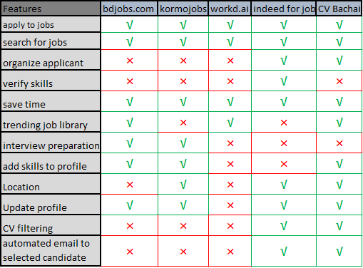
Benchmark Table

Slide 17

Gap Analysis
CV filtering, application for jobs and job posting are not found in the same platform.
Opportunity to propose an innovative solution.

Slide 18

Requirement Analysis
Major Functional Requirements
CV Filtering.
User Profile Management.
Apply to Job.
Job Search by Keywords.
Recruiter can Post New Job.
Registration.
Login.

Slide 19
The Unique Feature
CV filtering following a static approach.

Slide 20

Non-Functional Requirements
Responsive UI.
24*7 Availability.
Secure Database.
Quick Response Time.

Slide 21

Project Design & Diagrams
Context Diagram.
Dataflow Diagram.
Survey.

Slide 22
Context Diagram
CV Bachai: A web based resume recommendation syatem.
0
ADMIN
APPLICANT
RECRUITER

Slide 23
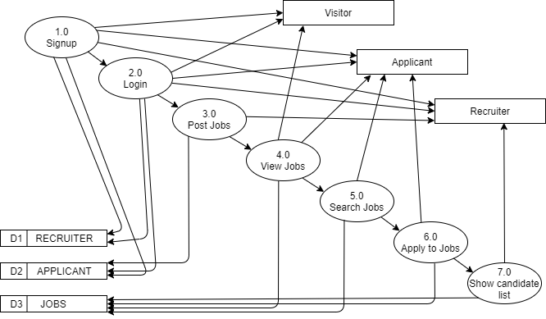
Dataflow Diagram

Slide 24
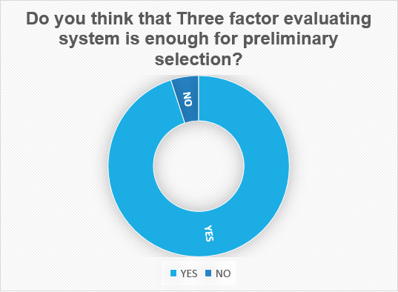
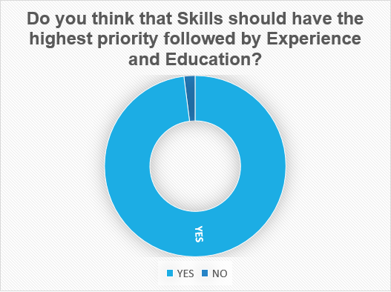
Survey

Slide 25

Environment Setup
Hardware Requirements.
Software Requirements.

Slide 26

Hardware Requirements
      Ram 8 GB.
Disk 100 GB.
GPU 8 GB.
CPU 2.4 GHZ processor.

Slide 27
Software Requirements
Language & Frameworks
Any browser like Chrome, Mozilla etc
Visual studio code editor
Jira
Google Colaboratory
Git & Github
Pythonanywhere.com
Logomaker
HTML5
CSS: Bootstrap 4
JavaScript
Python: Django
SQLite

Slide 28

UI Design
Home Page.
Jobs.
Apply to Job.
Ranking.

Slide 29
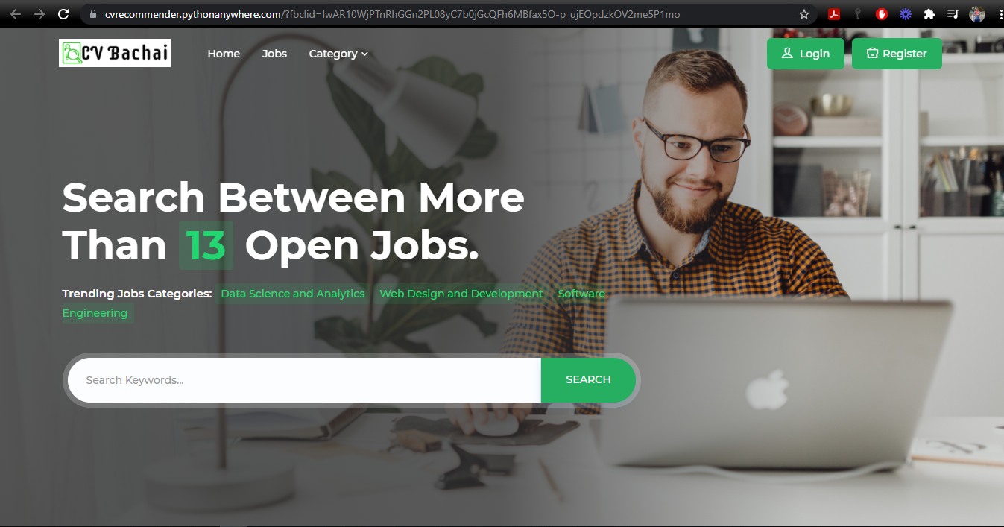
Home Page

Slide 30
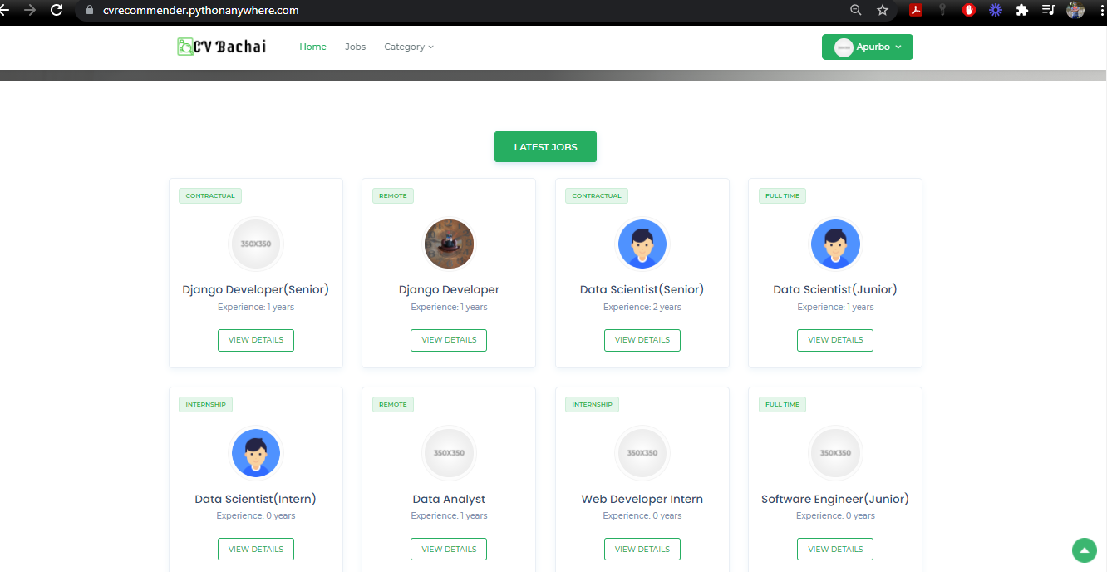
Jobs

Slide 31
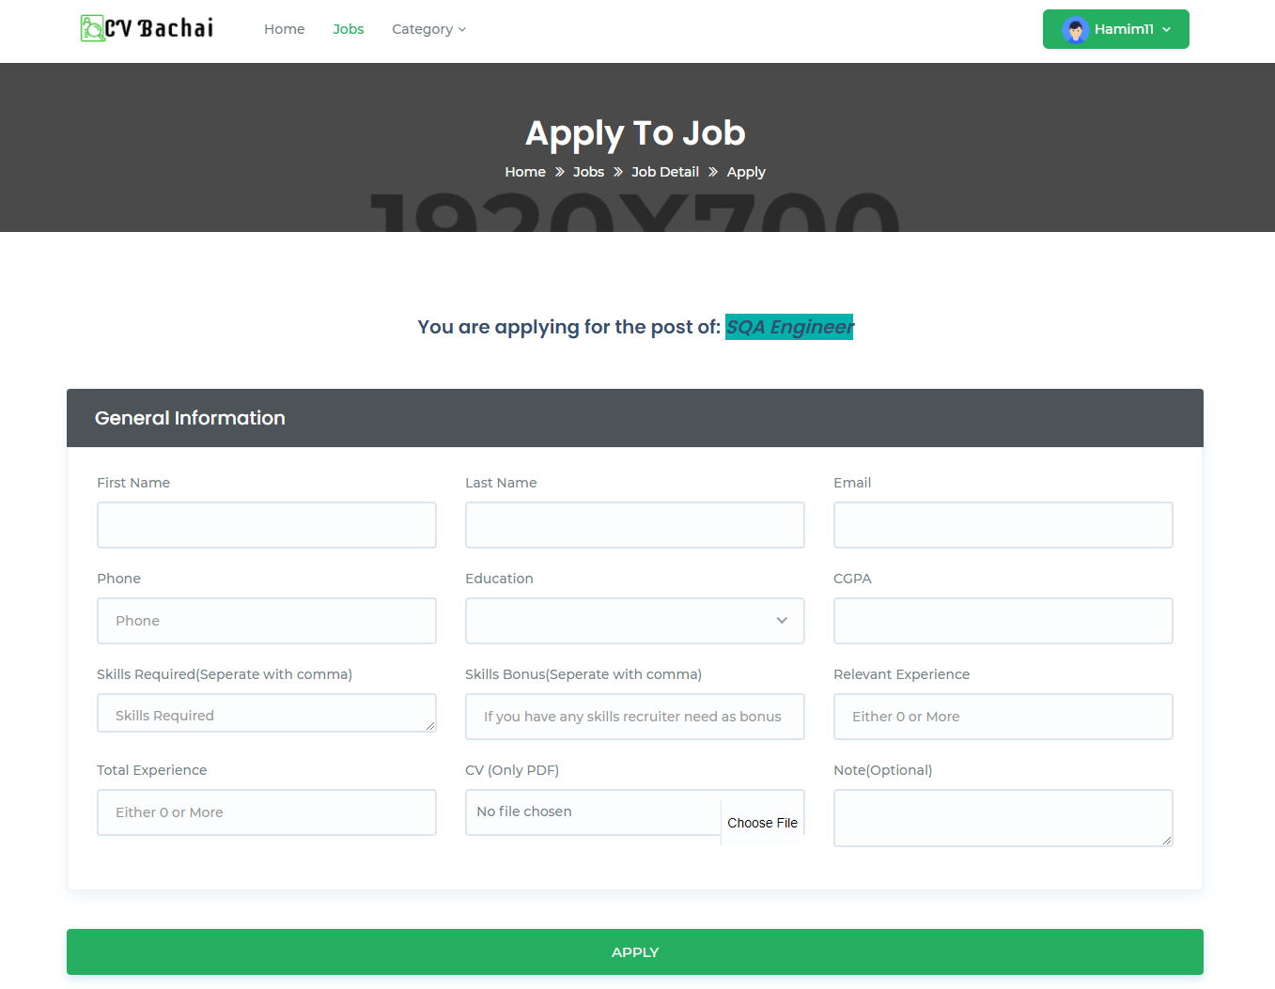
Apply To Job

Slide 32
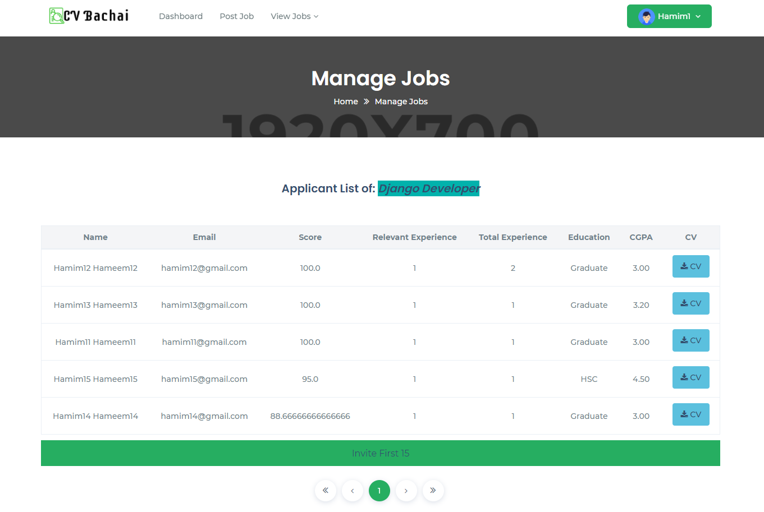
Ranking

Slide 33

Project Management
Project Methodology.
Testing & Evaluation.
Project Plan.
Project Schedule.

Slide 34


Methodology
Score = $\frac{\left|S\right|}{\left|Rs\right|}×50\%+\frac{E}{Re}×20\%+$ $\frac{Ex}{Rex}×30\%$
S = skillset of applicant
Rs = required minimum skillset of applicant
E = Education of applicant
Re = Required minimum education
Ex = Experience level
Rex = Required minimum experience level

Slide 35
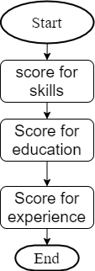
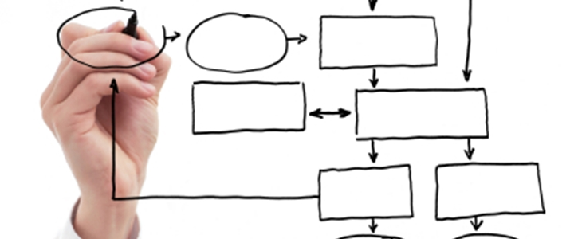
Methodology
Figure: Steps of scoring

Slide 36

Methodology
Why this Approach???
Lack of reliable dataset for machine learning approach.
Greater accuracy.

Slide 37

Testing & Evaluation
Our Testing Method:
Black Box Testing.
Back End Testing.

Slide 38
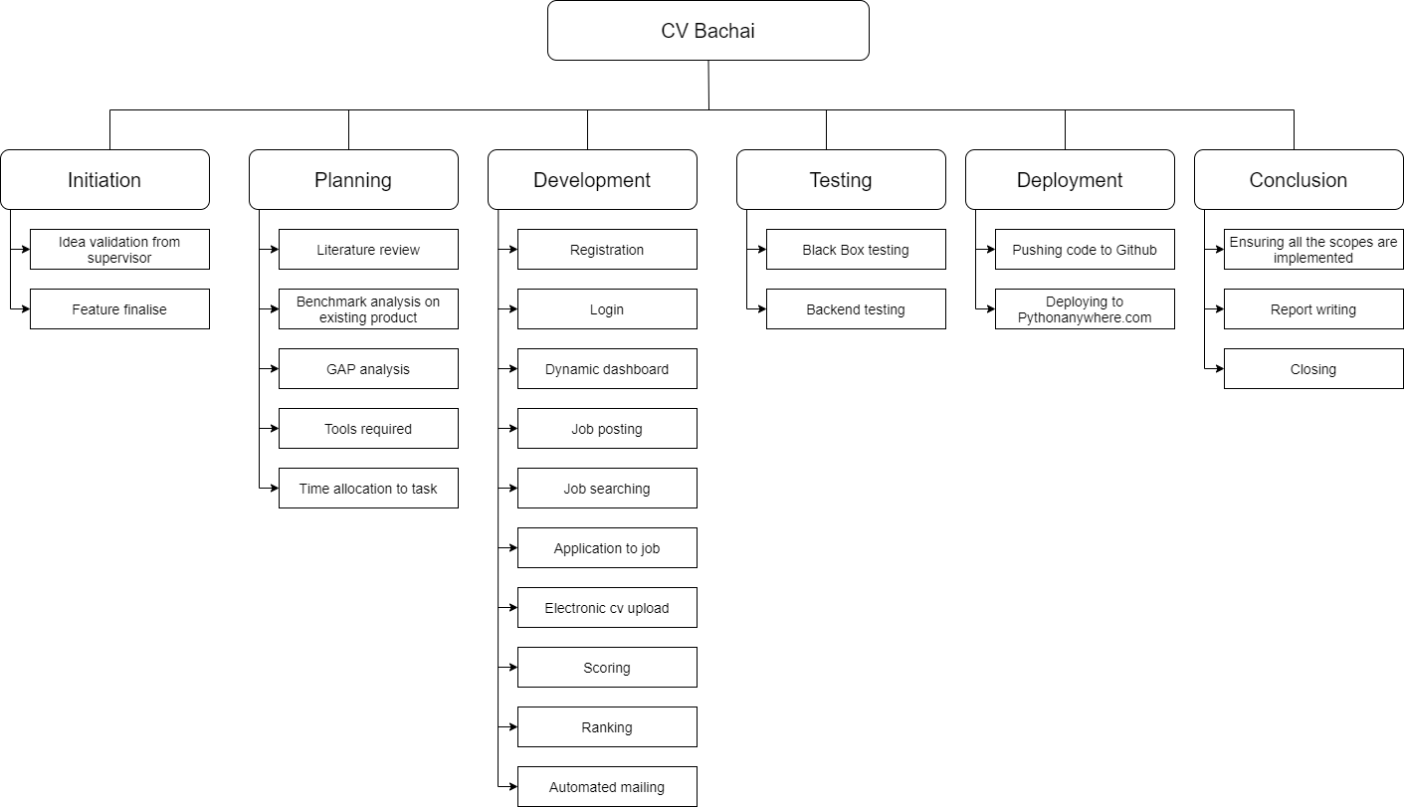
Project Plan

Slide 39
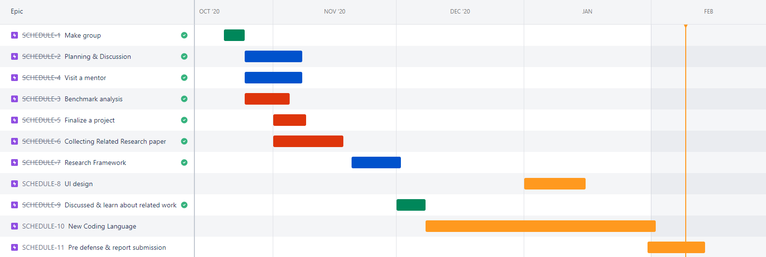
Project Schedule For FYDP - I

Slide 40
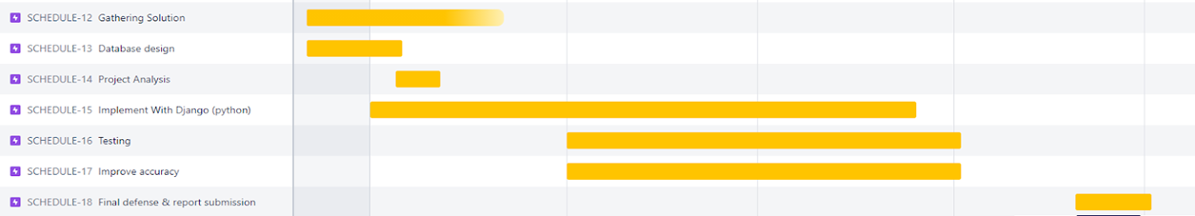
Project Schedule For FYDP - II

Slide 41

Standards & Design Constraint
Software Standards
  US ASCII - For Standard Data Transmission.
  PeP8 - Python Enhancement Proposal.
Communication Standards
  W3C – Used for Makeup Validation.
  HTTPS – For Making HTTP Request.

Slide 42

Standards & Design Constraint
Data Format
  PNG, JPG – For Image.
  PDF – For Document.
Paper Standards
  IEEE – Followed for Writing Paper.

Slide 43

Project Demonstration

Slide 44

Conclusion
Limitation.
Future Work.
Summary.

Slide 45

Limitations
No Android and IOS app.
Only English language support.
Time constraint.
Lack of expertise in skills.
Proper usable for CSE or IT Platform.

Slide 46

Future Work
Showing specific job post based on previous searches.
Implementation two factor authentication for login.
IOS and android version.

Slide 47

Summary
It has been a challenge to improve upon existing system.
Project is developed maintaining all possible standards of software engineering.
Software poses no potential threats to the society.
Promises to be a useful and time saving discovery.

Slide 48
References
1. S. Amin, N. Jayakar, S. Sunny, P. Babu, M. Kiruthika and A. Gurjar, ”Web Application for Screening Resume,” International Conference on Nascent Tech- nologies in Engineering (ICNTE), Mumbai, India, 2019, (pp. 1-7), doi:10.1109/ICNTE44896.2019.8945869.
2. Z. Wang, X. Tang and D. Chen, ”A Resume Recommendation Model for Online Recruitment,” 2015 11th International Conference on Semantics, Knowl- edge and Grids (SKG), Beijing, 2015, pp. 256-259, doi: 10.1109/SKG.2015.31.
3. Kalva, Thimma Reddy, ”Skill Finder: Automated Job-Resume Matching System” (2013). All Graduate Plan B and other Reports. 343.
4. De Alwis WN, Ratnayake HU. (2010, November). Recruitment Support System with CV Classifier Expert System. In Sri Lanka Association for Artifi- cial Intelligence (SLAAI),Proceeding of the seventh Annual Sessions (pp. 43-45).
5. Faerber, Frank; Weitzel, Tim; and Keim, Tobias, “An Automated Recom- mendation Approach to Selection in Personnel Recruitment”. (2003). American Conference on Information System(AMCIS) 2003 Proceedings. 302.
6. Wenxing Hong, Siting Zheng and Huan Wang, ”Dynamic user profile- based job recommender system,” 2013 8th International Conference on Com-puter Science& Education, Colombo, 2013, pp. 1499-1503, doi: 10.1109/ICCSE.2013.6554164.
7. Y. -C. Chou and H. -Y. Yu, ”Based on the application of AI technology in resume analysis and job recommendation,” 2020 IEEE International Conference on Computational Electromagnetics (ICCEM), Singapore, 2020, pp. 291-296, doi: 10.1109/ICCEM47450.2020.9219491.

Slide 49


