Slide 1
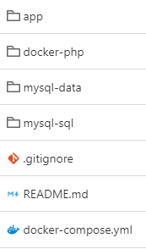




staging/production environment
Apache webserver + PHP 8.5
Central repository
pull
HTTPS
push / pull
push / pull
Internet
MySQL 9.7 DBMS
Developer
Developer
development environment
development environment
Apache webserver + PHP 8.5
Apache webserver + PHP 8.5
MySQL 9.7 DBMS
MySQL 9.7 DBMS

