Slide 1
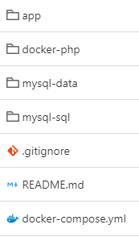




staging/production environment
Apache webserver + PHP 8.3
Central repository
pull
HTTPS
push / pull
push / pull
Internet
MySQL 8.4 DBMS
Developer
Developer
development environment
development environment
Apache webserver + PHP 8.3
Apache webserver + PHP 8.3
MySQL 8.4 DBMS
MySQL 8.4 DBMS

