Slide 1
School Registration system
Michael Jan
CS5254
Vanderbilt University

Slide 2
Workflows:
1. Registration
2. Professor approval and materials assigned
3. Billing and student payment

Slide 3
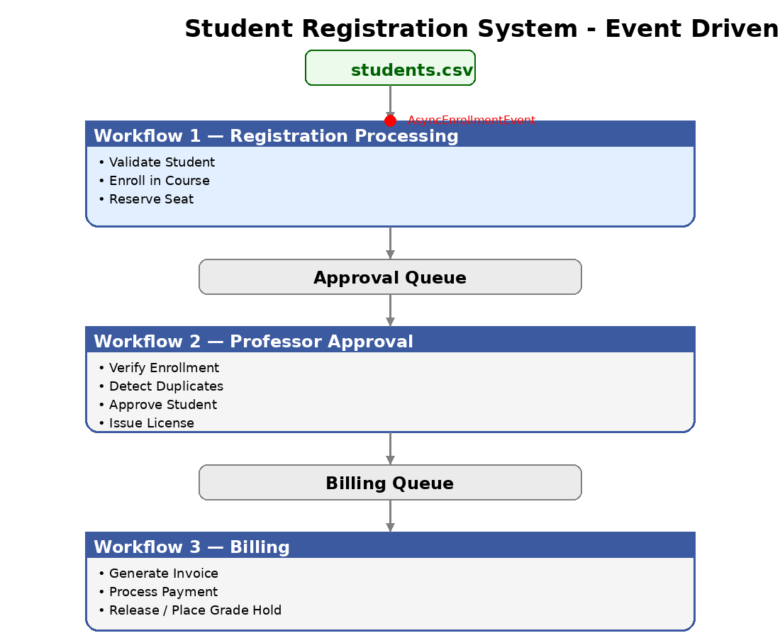

Slide 4
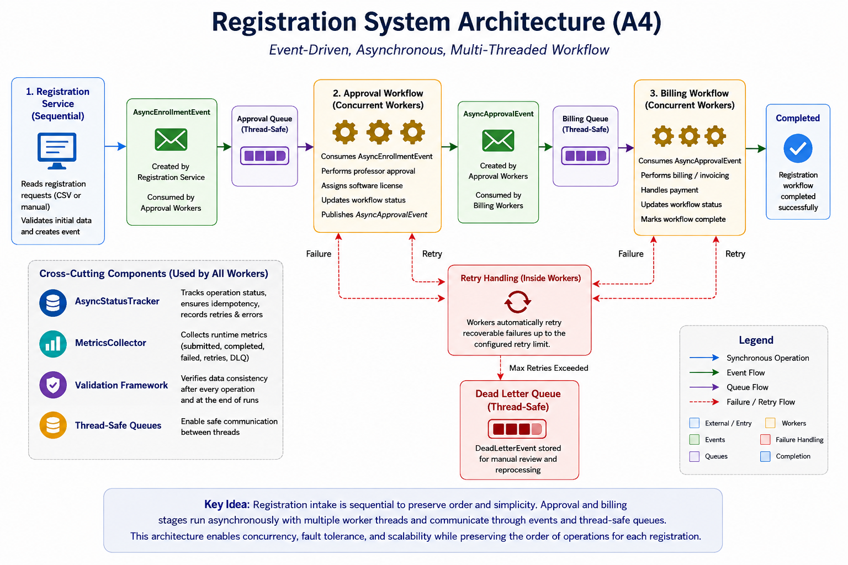

Slide 5
Events
Happy Event paths:
  AsyncEnrollmentEvent
    Created by Registration Service and consumed by Approval Worker
  AsyncApprovalEvent
    Created by Approval worker and consumed by Billing Worker
Not happy path event
  DeadLetterEvent
    Created when retry attempts have failed
Benefits:
  Components communicate through events instead of direct method calls.
  Reduces coupling between workflow stages.
  Makes the system easier to extend without rewriting existing components.
Notes:
"One of my biggest architectural decisions was moving from direct method calls to event-driven communication. Instead of one component directly invoking the next stage, each worker simply publishes an event describing what happened. The next worker independently consumes that event from a queue. This reduces coupling because workers no longer depend on one another directly, makes the workflow asynchronous, and allows new processing stages to be added with minimal changes to the existing architecture."

Slide 6
Threaded Workers
Approval Worker (AsyncApprovalWorker)
  Waits for an AsyncEnrollmentEvent.
  Performs the professor-approval stage.
  Updates workflow status.
  Creates or publishes an AsyncApprovalEvent.
Billing Worker (AsyncBillingWorker)
  Waits for an approved registration event.
  Performs billing or invoice processing.
  Updates workflow status.
  Passes the registration to the next stage.
Benefits
  Domain services enforce registration, approval, billing, and licensing rules.
  Workers control when operations happen, not how business rules are enforced.
  Keeps threading code from becoming mixed with the core object model.

Slide 7
Object Ownership
Domain Objects
  Own and protect their business state
  Enforce business rules and invariants
  Examples: Course, Student, Invoice
Services
  Perform business operations
  Coordinate changes between objects
  Examples: Billing, Licensing, Approval
Workers
  Process events asynchronously
  Do not own business data
  Coordinate workflow execution
Events
  Immutable messages between workers
  Carry workflow information
  Enable loose coupling
Notes:
"One of my biggest design goals was keeping responsibilities separate. Domain objects own and protect their own state, services perform the business operations, workers simply coordinate the asynchronous workflow, and events move information between workers. This separation made the system easier to understand, easier to maintain, and much easier to extend as the project evolved from Assignment 1 through Assignment 4."

Slide 8
Automated Validation Framework
Verifies workflow order, completion, retries, duplicates, and system invariants.
Provides repeatable evidence of correctness after every run.
More reliable than manually reviewing console output.
Design Goal:
  Keep responsibilities separate so the system remains correct, maintainable, testable, and easier to scale under concurrent execution.

Slide 9
Validation & Stress Results
Java Validation
6 / 6
tests passed
Python Validation
6 / 6
tests passed
Experimental Scenarios
13
per implementation
Total Experimental Runs
130
65 Java + 65 Python
Stress Coverage
Each of the 13 scenarios was executed five times per implementation.
Stress workloads included 250-operation and 1,000-operation cases.
Repeated execution exposed timing-dependent behavior that a single run could miss.
Failure / Recovery Evidence
Duplicate and out-of-order event handling
Transient failure with retry and recovery
Retry exhaustion and Dead Letter Queue containment
Missed-signal and lock-stall simulations

Slide 10
Java vs. Python Runtime Comparison
Area | Java | Python
Concurrency Model | Worker threads with BlockingQueue | threading.Thread with queue.Queue
Synchronization | synchronized and atomic counters | Lock / RLock
Async Model | Event-driven producer-consumer pipeline | Equivalent event-driven pipeline
Debugging / Runtime | Static typing and compiler checks | Faster iteration; more runtime checking
Validation | 6/6 tests passed | 6/6 tests passed
Both implementations preserve the same workflow and correctness properties
despite different runtime and synchronization mechanisms.

Slide 11
AI Review & Future Improvements
AI-Assisted Final Review
AI helped identify risks involving duplicates, ordering, retry behavior, failure containment, and documentation consistency.
Recommendations were independently verified through logs, metrics, validation tests, and repeated stress execution.
AI could identify potential risks, but it could not establish actual timing-dependent runtime behavior without direct execution.
Recommendations outside the scope of Assignment 4 were deferred.
What I Would Improve Next
Introduce a formal workflow state machine for explicit legal transitions.
Use durable messaging so queued events survive process failure.
Support distributed workers and more flexible worker scaling.
Expand observability with richer monitoring and operational metrics.

Slide 12

Thank You!

