Slide 1
INVESTMENT ASSIGNMENT SUBMISSION
Name: Manoj Joshi
Batch : Master in AI/ML
Cohort : 11

Slide 2
Project Brief
Spark funds needs advice on exploring investment opportunities in English speaking countries.
They would like to budget between 5 million to 15 million for investment and explore opportunities in these countries
Business Objective
Identifying best sectors , countries and suitable investment type for making investment.
They want to invest where others are investing the most ( Best sectors and best countries)
Goal of Data Analysis
Investment Type Analysis
Which kind of fund type is suitable for investment ( Venture, Seed, Angel, Private Equity) considering the fund constraints.
Country Analysis
Identifying English speaking countries having where most amount of investments are done.
Sector Analysis
Understanding distribution of investment across eight main sectors

Slide 3
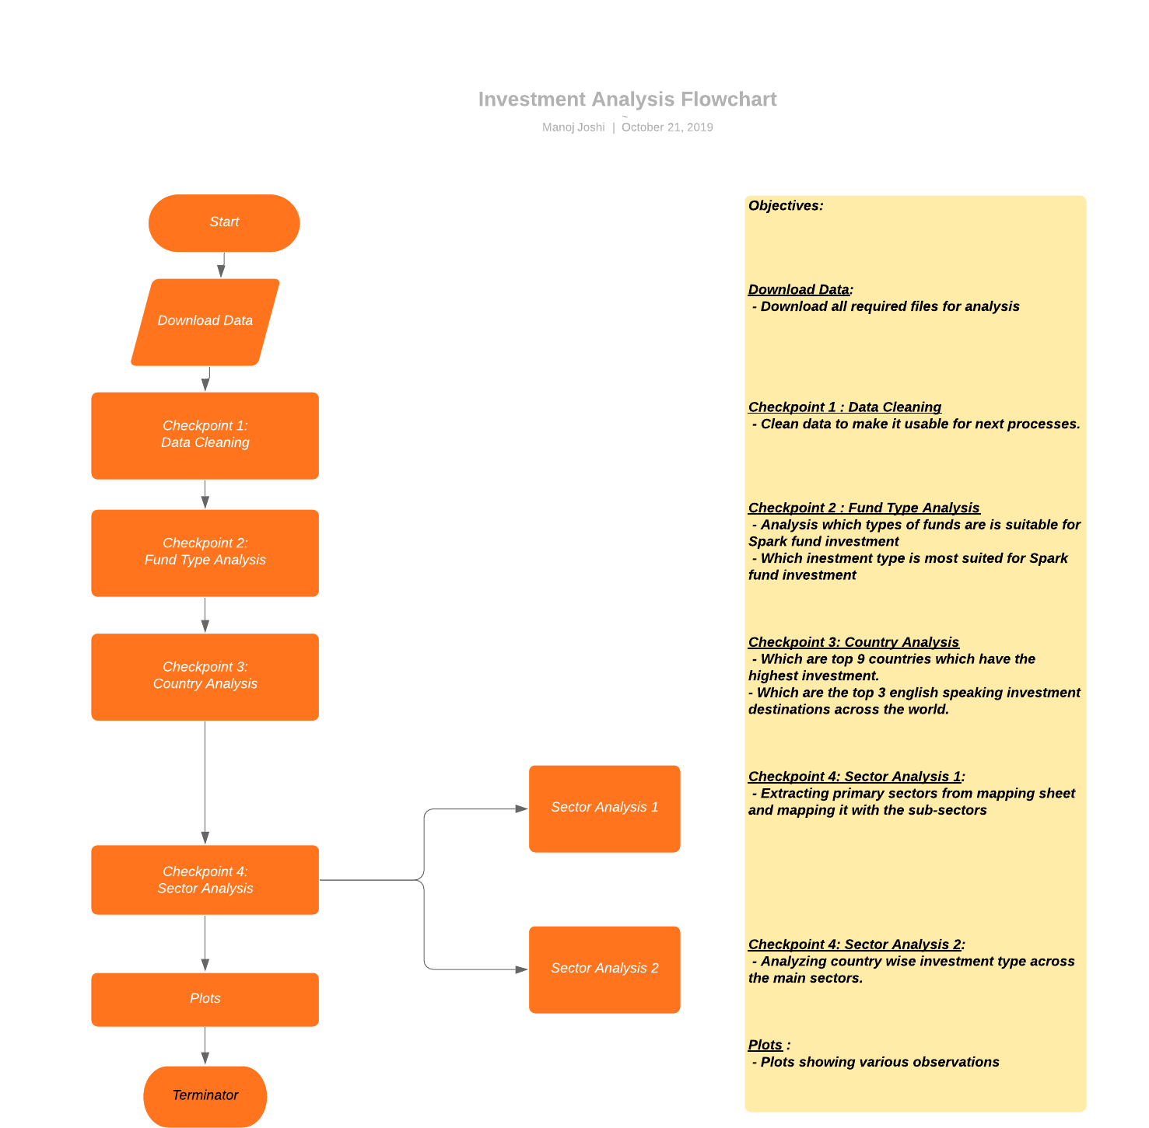
Investment Analysis Process

Slide 4
Data Cleaning
Understand the Data Set
Sl. No | Questions | Answer
1 | How many unique companies are present in rounds2? | 90247
2 | How many unique companies are present in the companies file? | 66102
3 | In the companies data frame, which column can be used as the unique key for each company? Write the name of the column. | permalink
4 | Are there any companies in the rounds2 file which are not present in companies ? Answer Y/N. | Y
5 | Merge the two data frames so that all variables (columns) in the companies frame are added to the rounds2 data frame. Name the merged frame master_frame. How many observations are present in master_frame ? | 114941

Slide 5
Fund Type Analysis
Average Values of Investments for Each of these Funding Types
Sl.No | Questions | Answer
1 | Average funding amount of venture type | $11.75M
2 | Average funding amount of angel type | $0.959M
3 | Average funding amount of seed type | $0.720M
4 | Average funding amount of private equity type | $73.3M
5 | Considering that Spark Funds wants to invest between 5 to 15 million USD per investment round, which investment type is the most suitable for them? | Venture fund type

Slide 6
Country Analysis
Analysing the Top 3 English-Speaking Countries
Sl.No | Questions | Answers
1 | Top English speaking country | USA (United States of America)
2 | Second English speaking country | GBR (Great Britain)
3 | Third English speaking country | CAN ( Canada)

Slide 7
Sector Analysis
Sector-wise Investment Analysis
Sl.no | Questions | USA (C1) | GBR (C2) | CAN (C3)
1 | Total number of Investments (count) | 62048 | 5019 | 2616
2 | Total amount of investment (USD) | $669 billion | $32.76 billion | $ 18 billion
3 | Top Sector name (no. of investment-wise) | Others | Others | Others
4 | Second Sector name (no. of investment-wise) | Cleantech/Semiconductors | Social,Finance, Analytics,Advertising | Cleantech/Semiconductors
5 | Third Sector name (no. of investment-wise) | Social,Finance, Analytics,Advertising | News,Search,Messaging | Social, Finance,Analytics,Advertising
6 | Number of investments in top sector (3) | 13754 | 1143 | 613
7 | Number of investments in second sector (4) | 11438 | 962 | 505
8 | Number of investments in third sector (5) | 9849 | 734 | 425
9 | For point 3 (top sector count-wise), which company received the highest investment? | Verizon Communications | SoftViaNet | Blackberry
10 | For point 4 (second best sector count-wise), which company received the highest investment? | Freescale Semiconductor | Helios Towers Africa | WSP Global

Slide 8
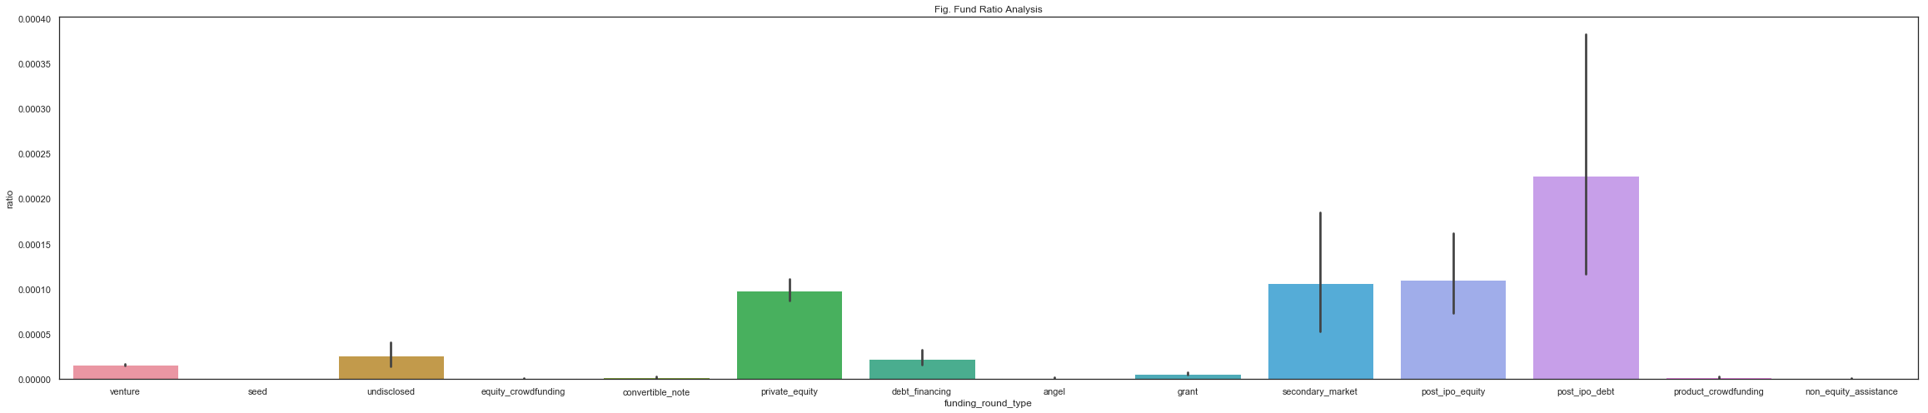
Fund ratio analysis
Observation
- Venture fund type is most suited for Investment considering the budget constraint of 5 million to 15 million

Slide 9
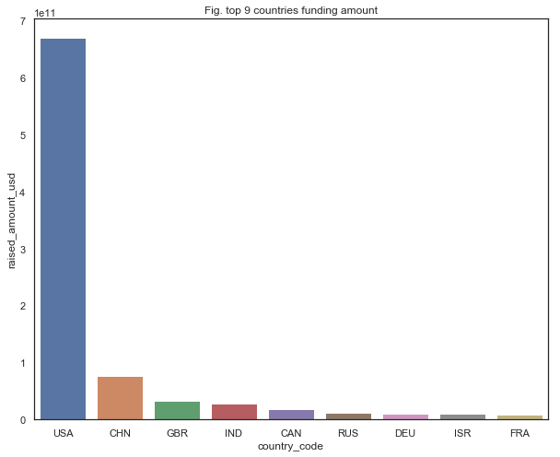
Country Analysis Plot
Observation
USA , Great Britain and Canada are top 3 English speaking countries where maximum investment is sent
China, though in top 3, is not a primarily English-speaking country.
India is not a primarily English-speaking country.

Slide 10
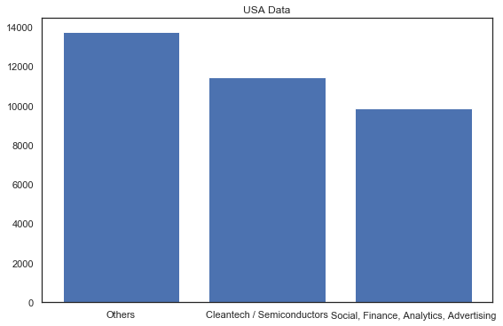
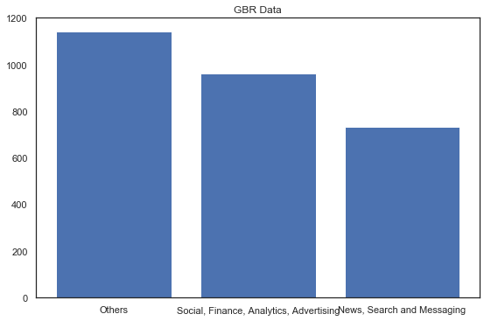
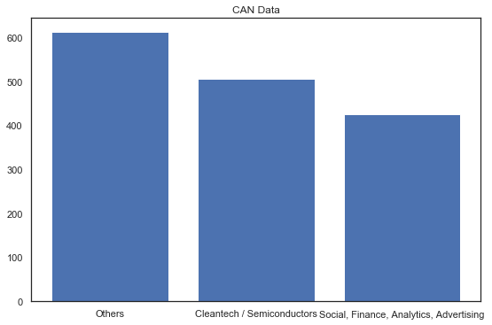
Country-wise Investment count plot
Observation
USA by far, has highest investment for their top 3 sectors.
Others is the leading main sector for all the 3 English speaking countries
Social, Finance, Analytics, Advertising is also leading in all 3 English speaking countries.

Slide 11
Conclusions
Venture fund type is most suited for investment purpose considering investment budget of $5 million to $15 million
USA , Great Britain and Canada are good investment locations
In all the three investment destinations, Others sectors has top investment.
In addition, In all the three investment destination, Social, Finance, advertising and Analytics is a sector which also shows some potential and fund can consider investing the same as well.

