Slide 1
Sveprisutno računarstvo - Projekat 3
Student:
Miloš Jovanović 1564

Slide 2
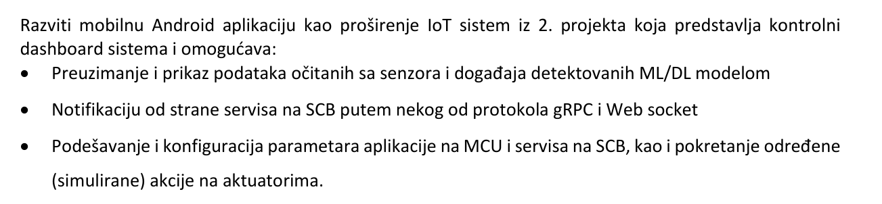

Slide 3
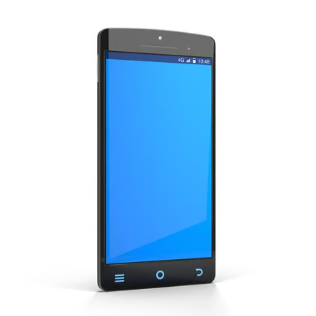

Slide 4




Slide 5
Komponente
Mosquitto
Influxdb
Grafana
DbForwarder (Python)
AlertManager (Python)
Ws (Python)
IoT-Control (Andoird)

Slide 6
Mqtt topics:
sensors/mq2
sensors/dht11
alerts/all
alerts/select
alerts/selected
esp32/status
esp32/cmd
esp32/cmd/blink

Slide 7
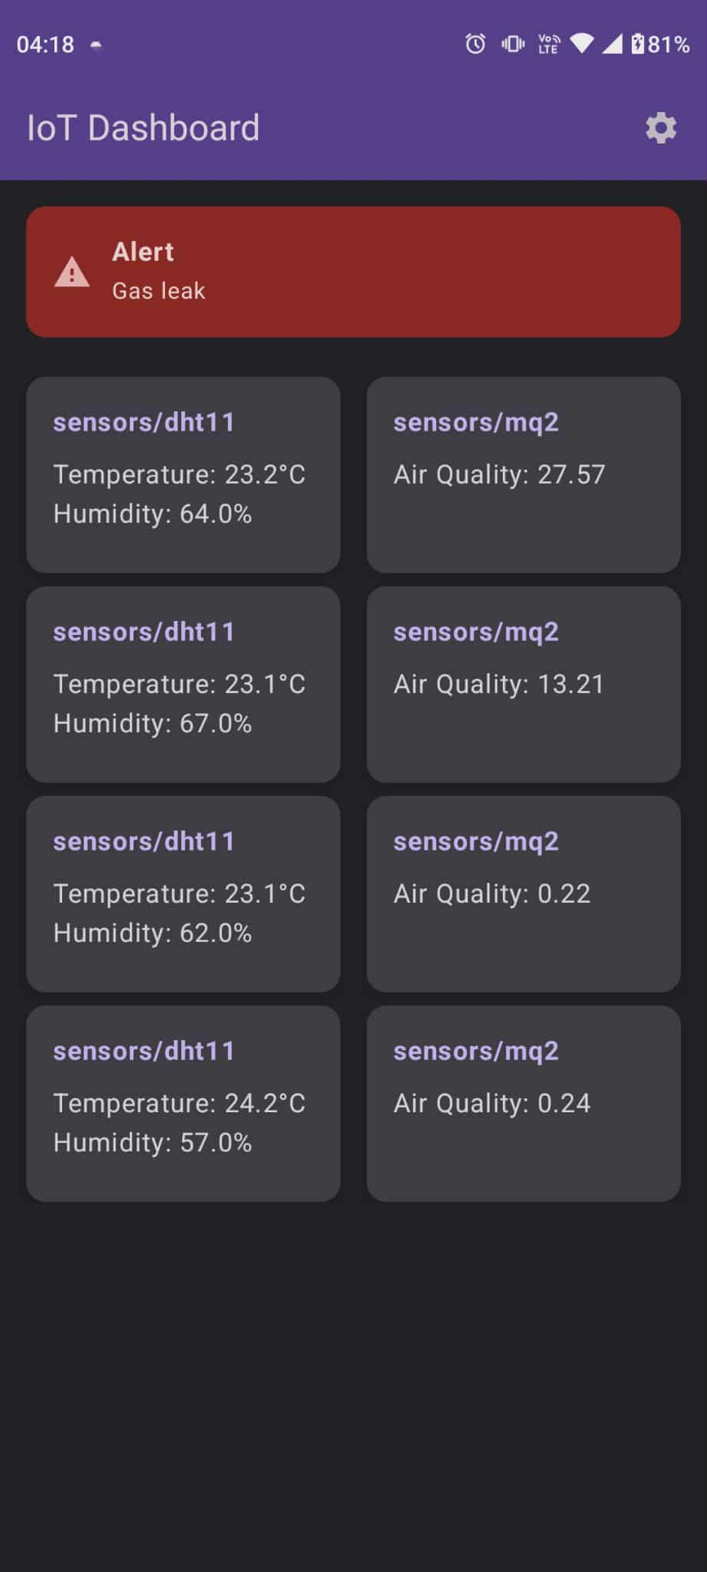
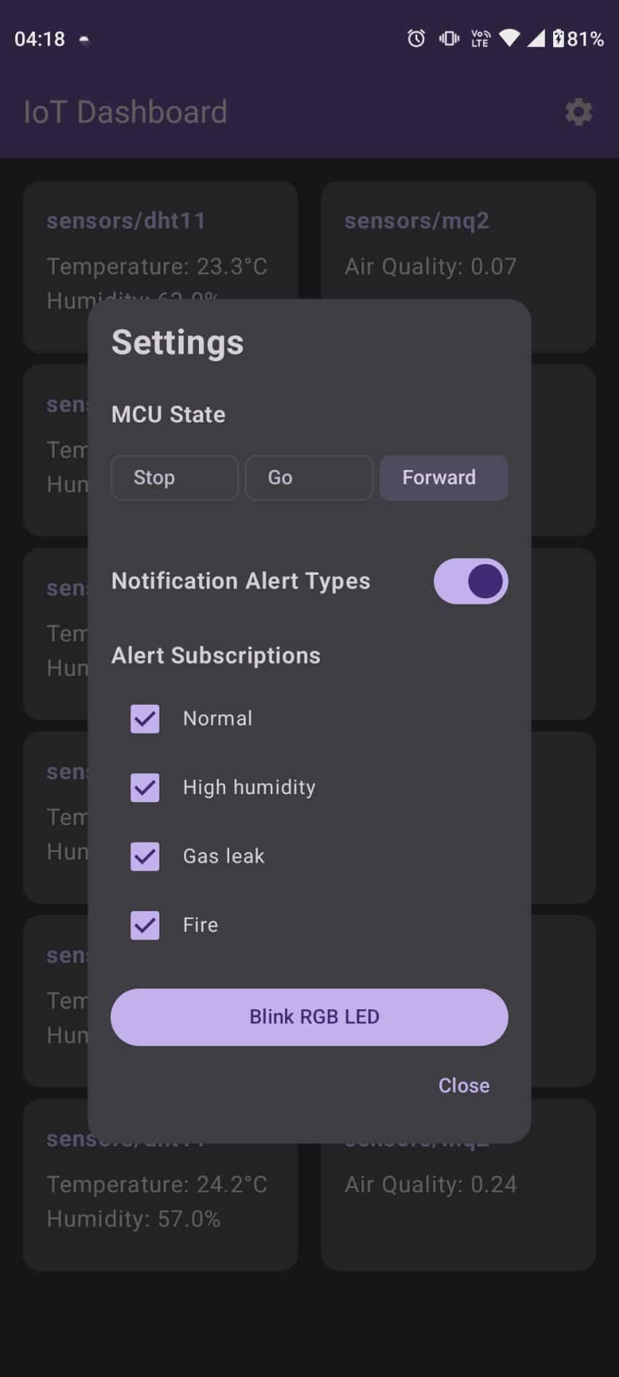
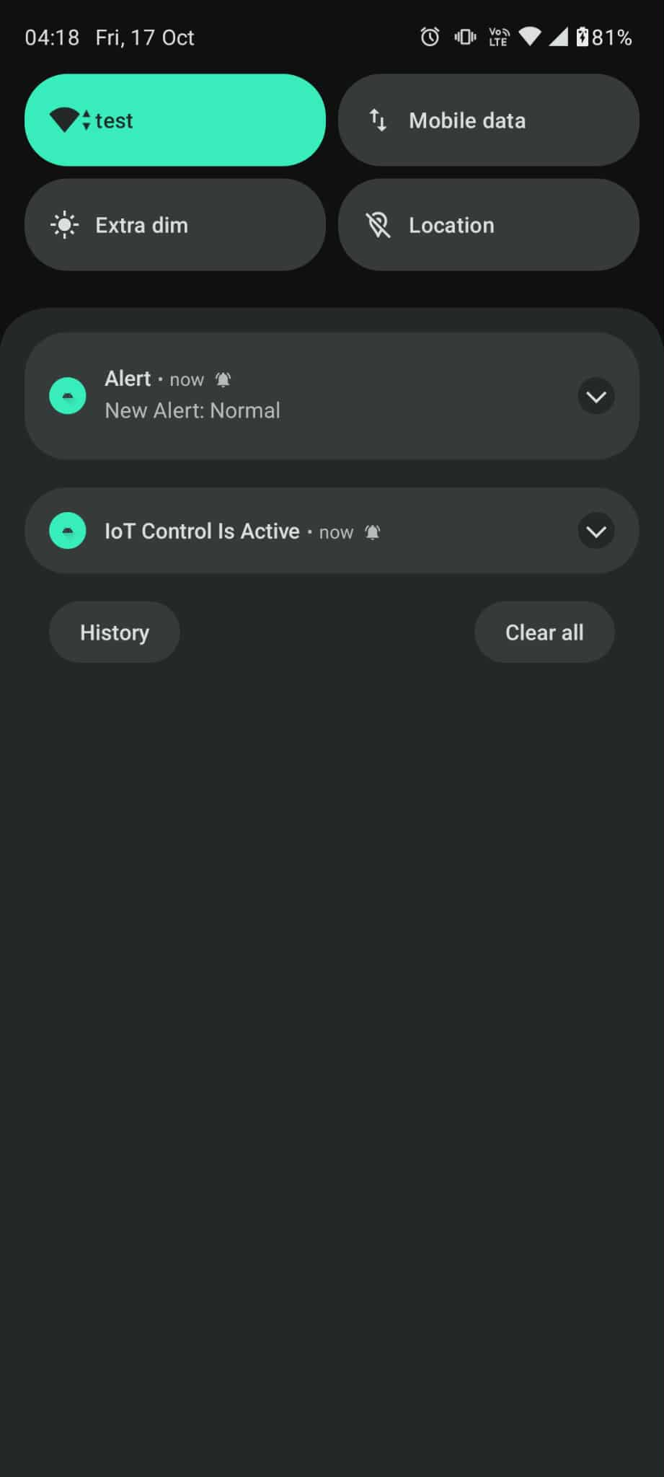

Slide 8
Demo

