Slide 1
ROTTEN TOMATOES WEB SCRAPING
By Marissa Joy
Notes:
Moviepass w/ bf
Look at critic vs audience → research questions

Slide 2

Research questions
Do critic or audience score have a bigger impact on box office profits?
Can I use Rotten Tomatoes to predict how much a recently released money will make?
Can I give movie companies an idea of where they need to focus their efforts in order to make more money?
Notes:
-other people do the same thing?
-

Slide 3
Data
Top 100 – movies that have received more than 40 critic reviews
Box Office Profits – domestic earnings
Ranking – movie ranking in top 100 list
Audience Rating – percentage of users who gave the movie a 3.5 or higher
Audience Review Count – number of users who left a review
Critic Rating – percentage of critics who rated the movie 80% or better
Critic Review Count – number of critics who reviewed
Genre – first genre listed
Runtime – movie length in minutes
Rating – MPAA Guidelines rating
Notes:
Not as much s expected
Box office missing → numbers movie dataset
Characters → factors
Baruto → wrapper RandomForest & removes those stat less relevant

Slide 4
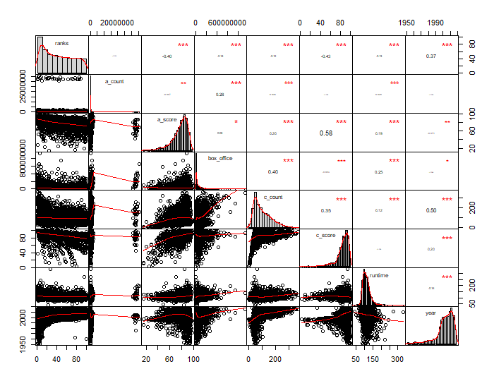
Exploratory analysis
Notes:
Visualization Corr Matrix:
abs val of corr / result of corr test
bivariate scatterplots, with a fitted line
vifcor function → VIF/corr
- var of coeff inflated when multi exists
Summary

Slide 5

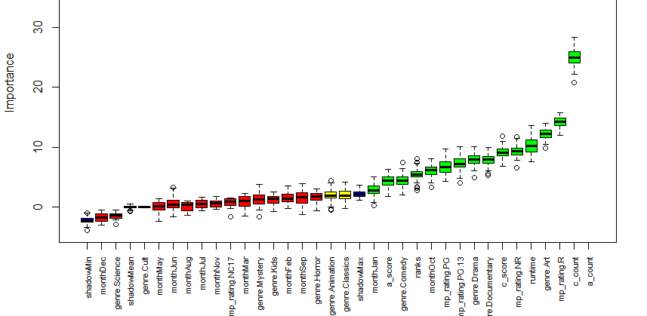
Notes:
Baruto –
Characters → factors

Slide 6
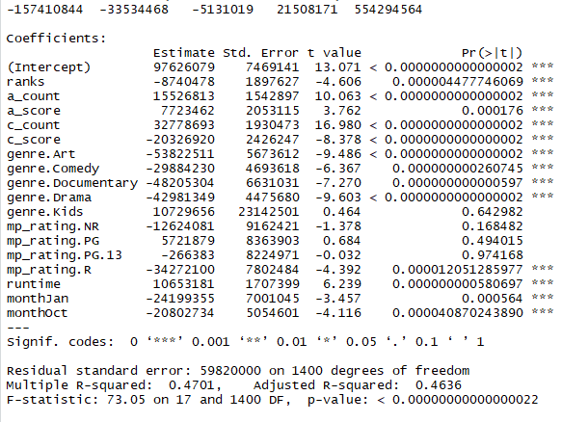

Regression Summary
Notes:
F-stat → test is significant
#look at residuals
#p-value is very small so reject H0 that predictors have no effect so
#we can use rotten tomatoes to predict box_office ranges

Slide 7
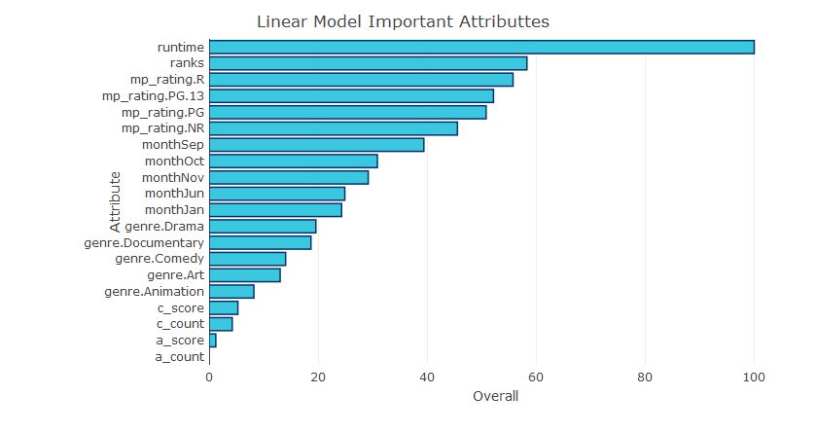
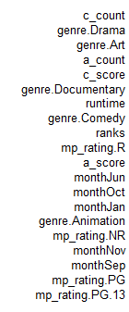
Most important
Notes:
CONC:
Collect more data
- People look at critics
-business where to focus efforts

