Slide 1
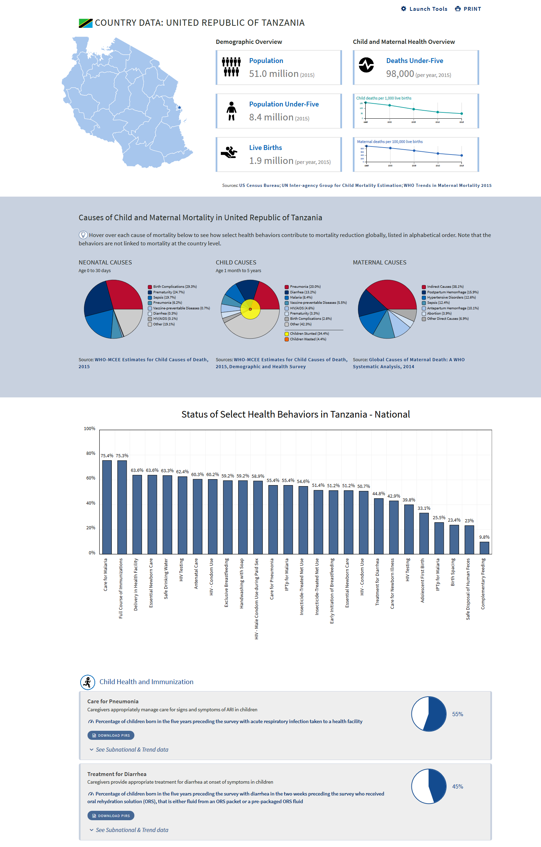


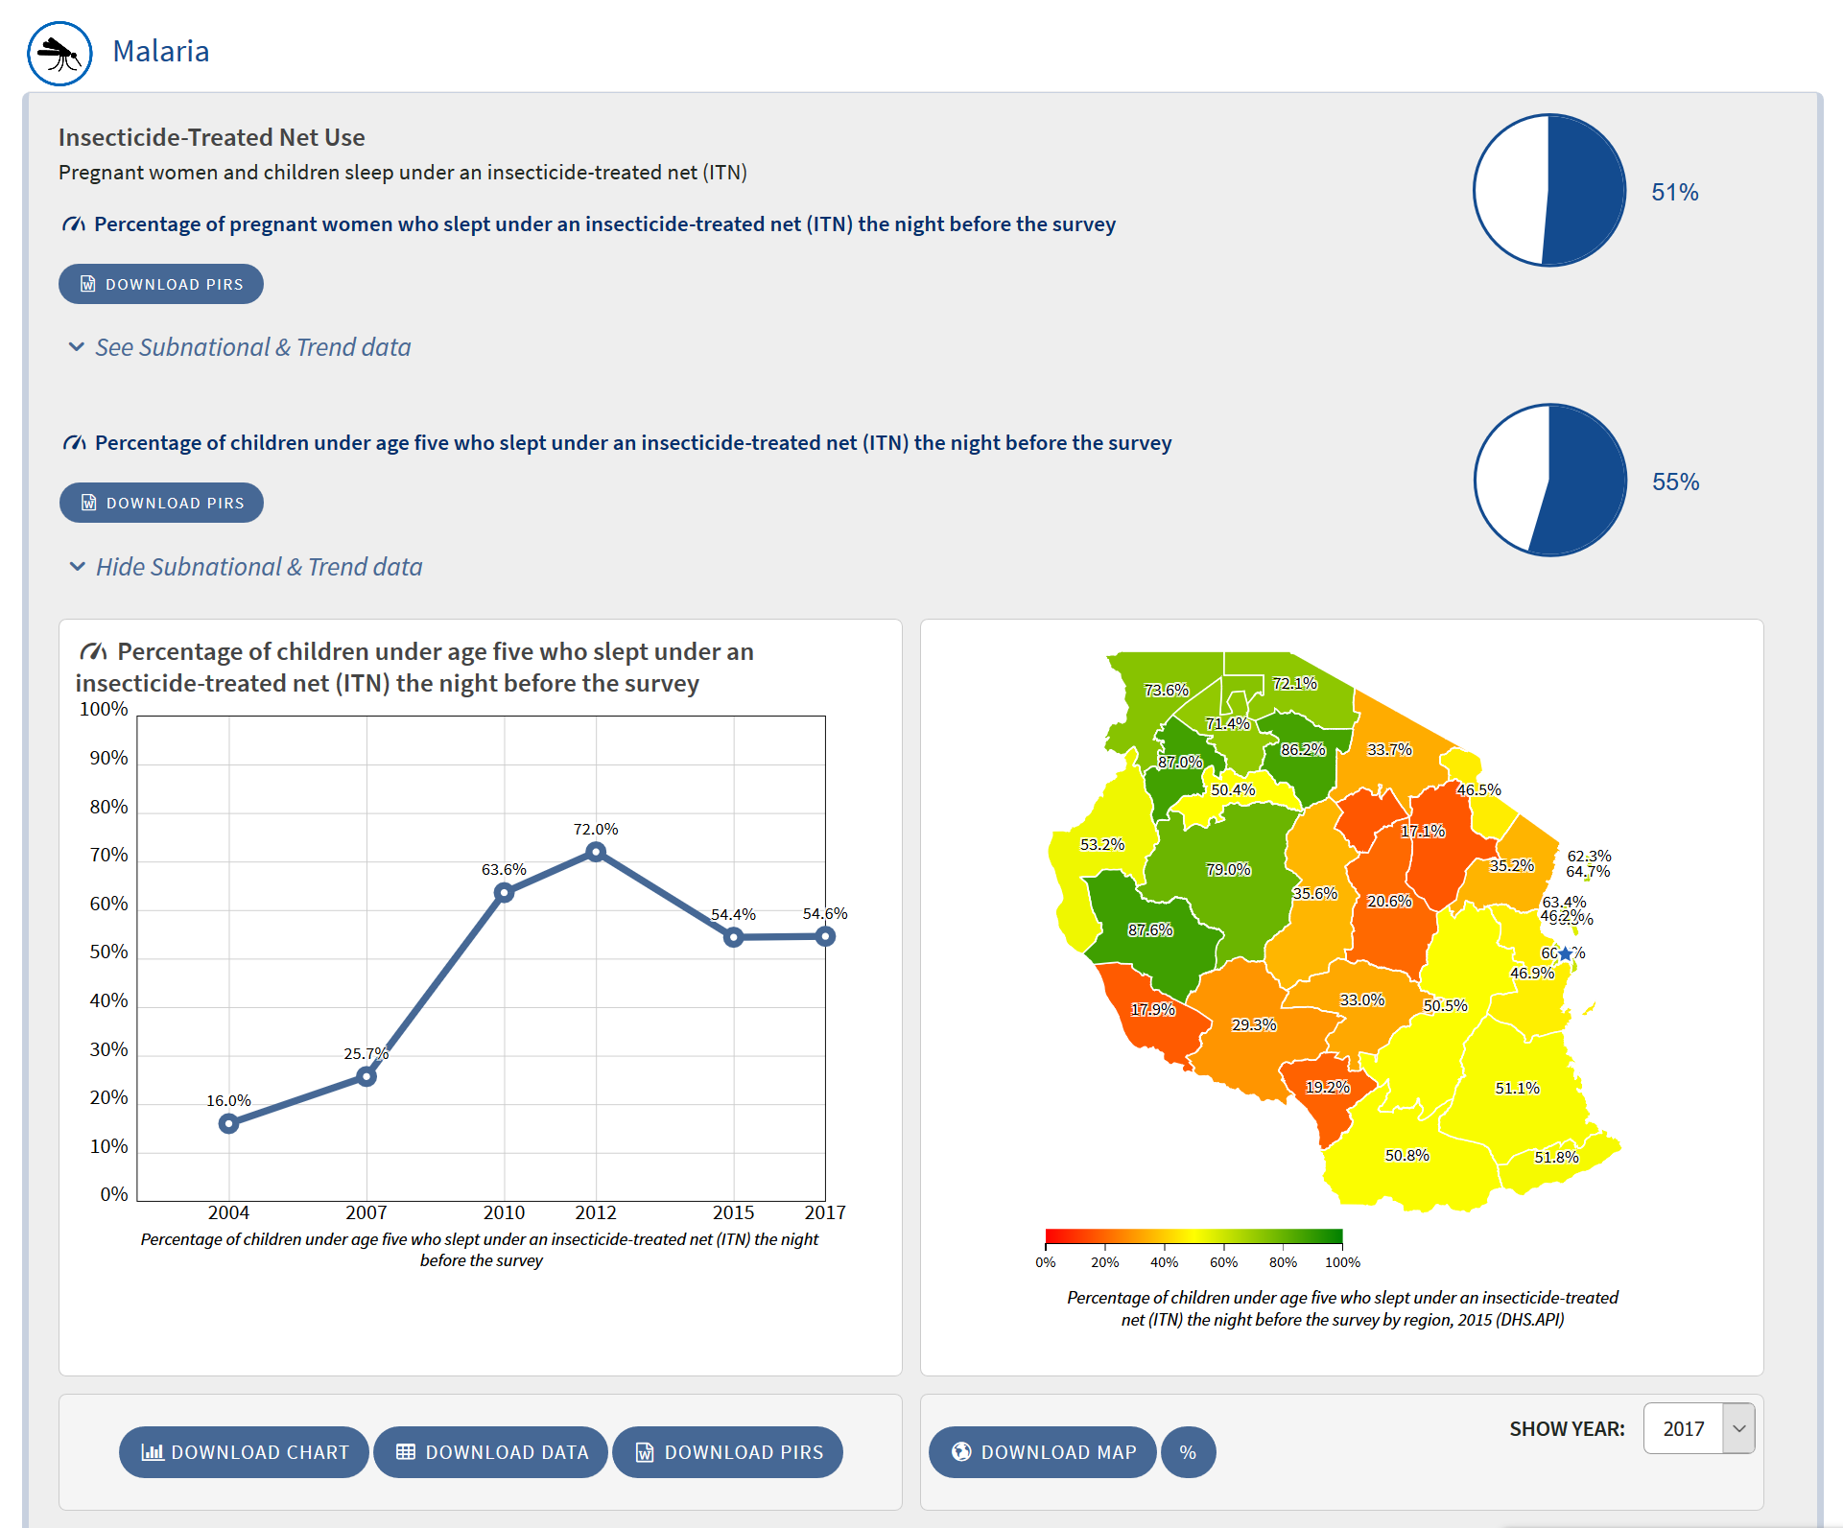
COUNTRY DATA for USAID MATERNAL & CHILD HEALTH PRIORITY BEHAVIORS

Slide 2
Dashboard Goal
How we organized underlying data
Why we chose this design
Impact it had on decision-making
Notes:
GOAL: Present BEHAVIORAL Indicators for 18 Behaviors that have the potential to reduce the # of women and children who die from preventable causes. It was important that we use existing open-source data sources. In this case, we decided to USAID DHS data to display baseline data over time in order to support USAID Missions to shift thinking of underlying behaviors vs. interventions and how to track those behaviors over time. In theory, we could pull in any data source and display it in the same way.
CHALLENGES: Needed global data that covered 26 Priority Maternal and Child Health countries
UNDERLYING DATA – Pulled from DHS API with click on 2 buttons, can pull in data for any country in the system; But Indicator Database call pull in indicators from any open source set or be manually entered and maintained
WHY WE CHOSE THIS DESIGN – Sustainability, Interoperability – USAID focused, but extendable to other data sets
IMPACT ON DECISION-MAKING – Although originally they wanted “real time tracking”, the real impact was shifting USAID Mission program officers to think about behavior-centered programming and now to track behavioral indicators vs. intervention driven indicators. This is a slower process, but the dashboards helped visualize how it can be done across several countries and potential for future uses.
WHY: Sustainability and help shift in thinking about using

Slide 3
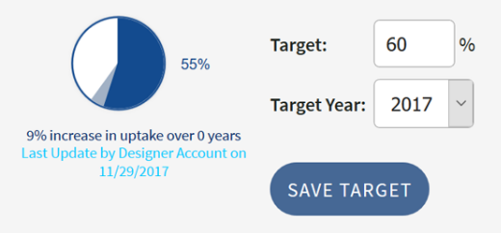
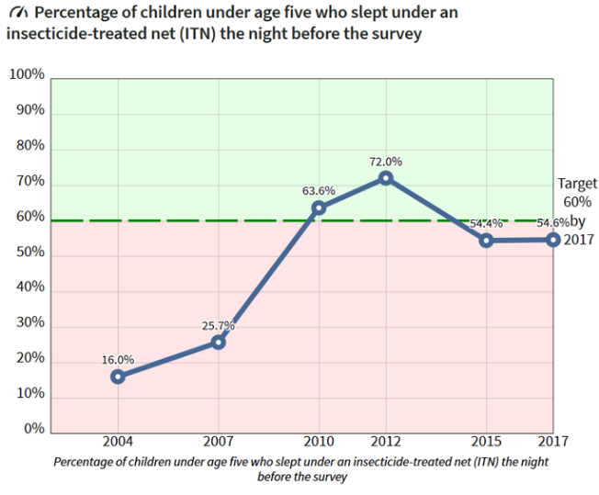
Logged in users can set targets which displays the same map with overlay of target on pie chart and trend data charts.

Slide 4
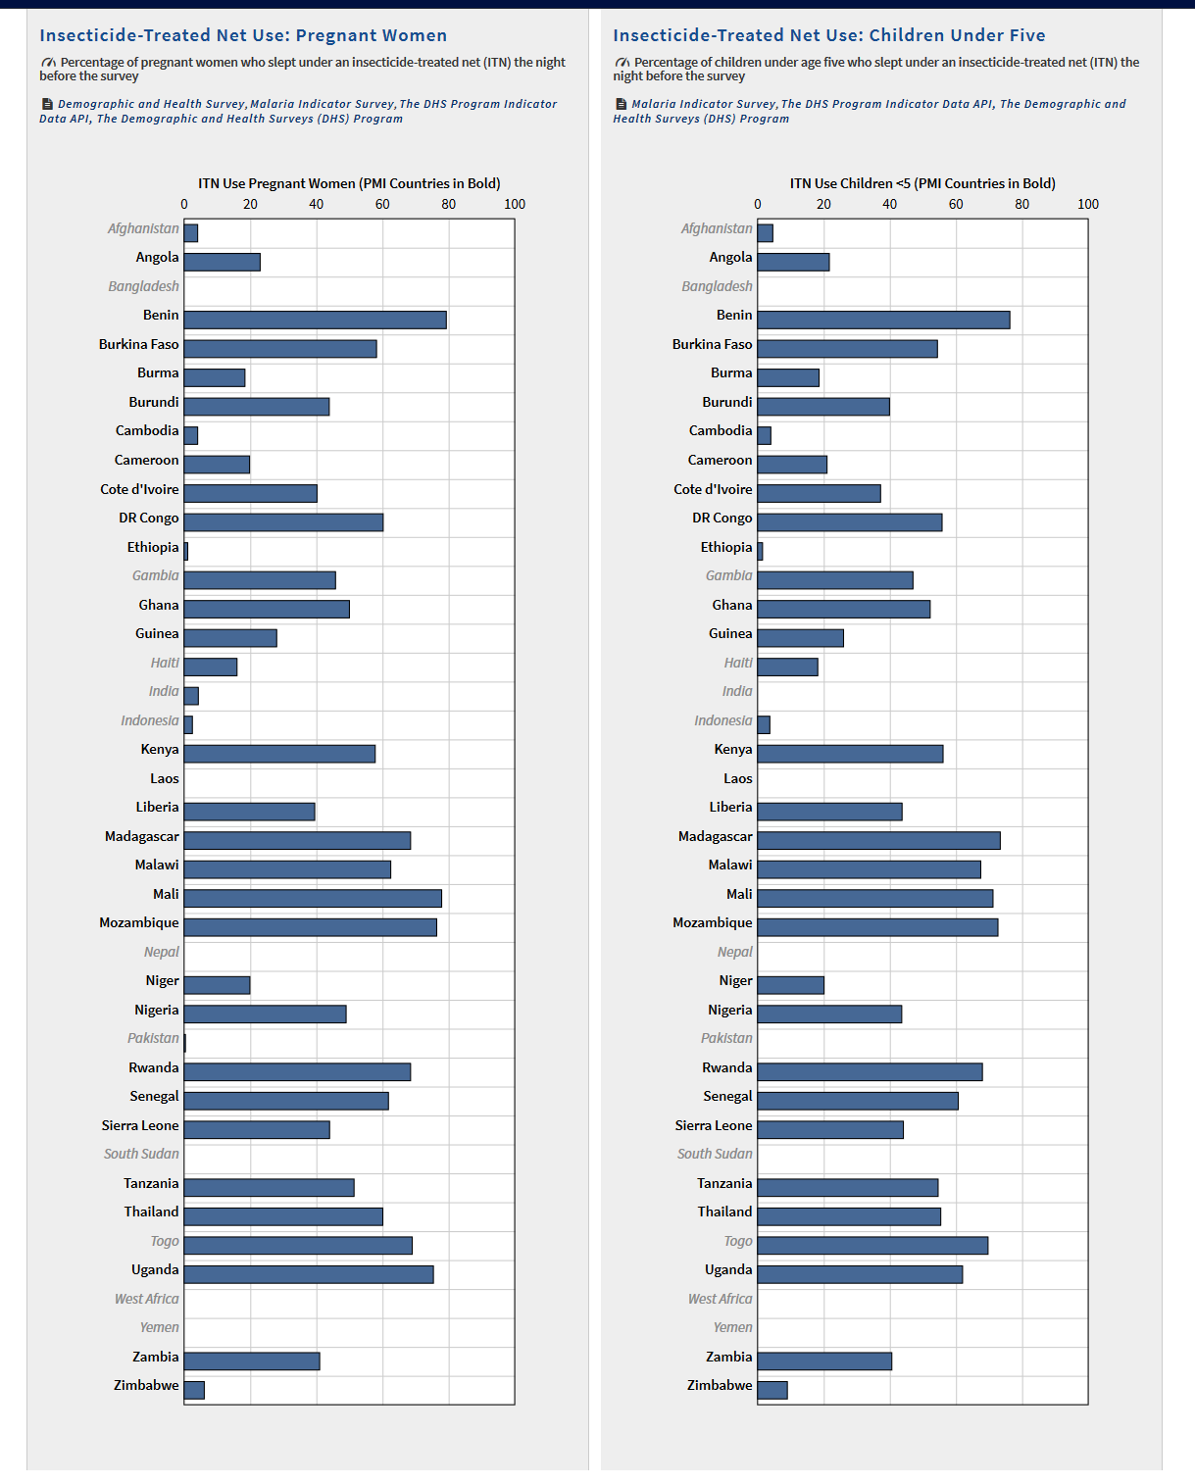
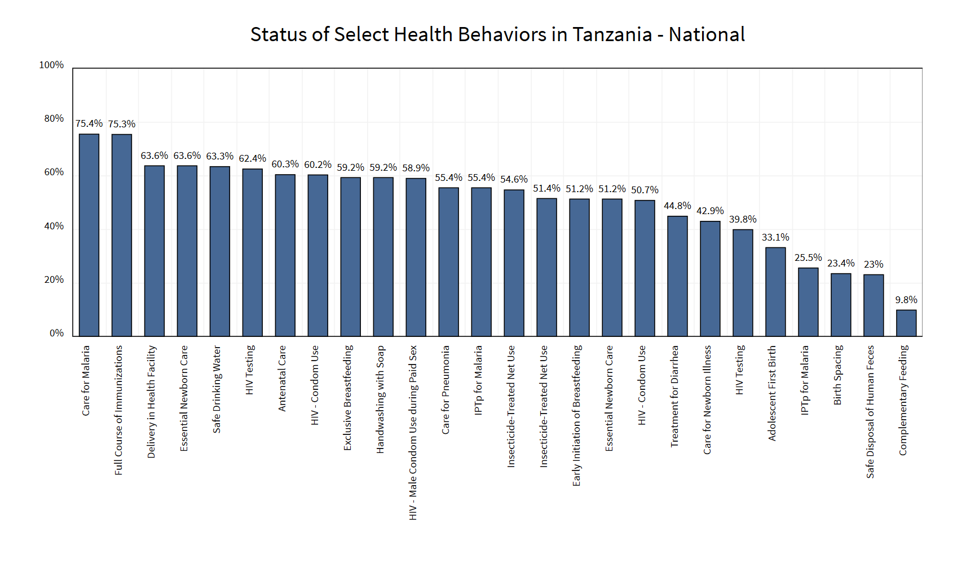
Same data shown across different life-saving behaviors by country and across different priority countries

