Slide 1
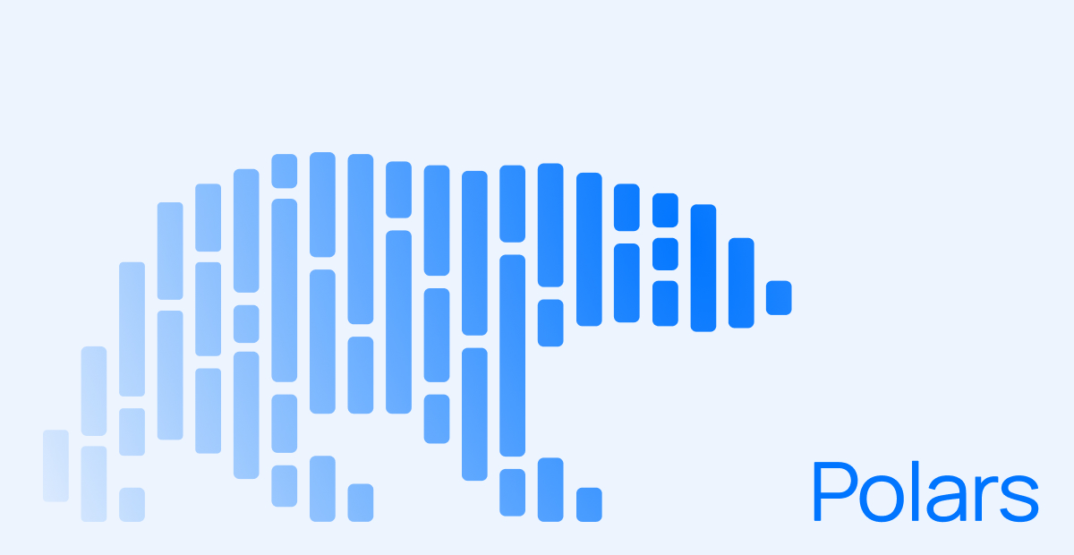
“Exploring Polars: A Fast and Modern DataFrame Library for Python”
Exploring
A fast and modern Data Frame library for Python
Advanced Programming – Midterm
Maria Jose Zuniga
Fall 2025

Slide 2

What is Polars
A DataFrame library (like Pandas) for data analysis and manipulation.
Created in 2019–2020 by Ritchie Vink (Netherlands).
Written in Rust, a systems programming language known for speed and safety.
Lets you work with large datasets quickly and efficiently.
In simple terms: it’s a faster, more modern version of Pandas.
Today it’s widely used in analytics, data engineering, and ML pipelines

Slide 3
Characteristics
Pandas is great for small data but becomes slow with big datasets.
Many operations run on one CPU core only.
Polars solves this by:
Using multi-threading automatically.
Optimizing queries before execution.
Reducing memory use through columnar storage.
Faster, safer, and more scalable

Slide 4
Use cases
Polars was built to:
🧠 Use multi-threading automatically,
⚙️ Optimize queries before running
💾 Handle data larger than RAM,
🧹 Simplify data cleaning and transformation
How it’s used today:
📊 Data analytics & aggregation for big CSVs or Parquet files.
🧼 Preprocessing for machine learning pipelines.
⚙️ ETL workflows combining different data sources.
🌎 Log, sensor, and public data analysis (like the WIC-PC dataset).
🗺️ Time series & geospatial analytics.

Slide 5
Polars versus Pandas
Aspect | Pandas | Polars
Language | Python (C backend) | Rust (faster, safer)
Execution | Single-threaded | Multi-threaded (uses all cores)
Evaluation | Eager (runs line by line) | Lazy (optimizes before running)
Performance | Slower on big data | 3–10× faster
Memory use | Higher | More efficient
Data model | Row-based | Columnar (better for analytics)
Scalability | Limited to memory | Handles larger-than-RAM data
Syntax | Very familiar | Similar + expressions
Best for | Small to medium data | Large, complex data & pipelines

Slide 6
Takeaways
Polars is ideal for large datasets or performance-critical tasks.
Pandas is still better for smaller, exploratory work.
Both libraries can coexist depending on project scale.

Slide 7
Loading and inspecting data
Quick look at the dataset using Polars — a high-performance DataFrame library built on Apache Arrow.
import polars as pl
df_pl = pl.read_csv(”Name_of_you_dataset")
df_pl.head(3)

Slide 8
Filtering & selecting data
In the case of the dataset we used, filtering the data to include only 2020 and female participants, keeping relevant columns for analysis.
df_pl_filtered = (
df_pl
.filter(pl.col("YearEnd") == 2020)
.filter(pl.col("Stratification1") == "Female")
.select(["LocationAbbr", "Data_Value"])
)

Slide 9
Grouping & aggregating
In the case of the dataset we used, with this code we can aggregating by state: calculating the average overweight percentage among female toddlers.
pl_state_avg = (
df_pl_filtered
.group_by("LocationAbbr")
.agg(pl.col("Data_Value").mean().alias("avg_overweight"))
)

Slide 10
Lazy API
Using Polars’ Lazy API — defers computation until .collect() for optimized, parallel execution.
lazy_df = df_pl.lazy()
result = (
lazy_df
.filter(pl.col("YearEnd") == 2020)
.group_by("LocationAbbr")
.agg(pl.col("Data_Value").mean())
).collect())

Slide 11
“Exploring Polars: A Fast and Modern DataFrame Library for Python”
Exploring
A fast and modern Data Frame library for Python
Advanced Programming – Midterm
Maria Jose Zuniga
Fall 2025

