Slide 1
Designs for vocab app
Paul Yang
8-28-12
Current solid colors used for backgrounds are going to be replaced with better graphics. Open to suggestion for how to do this.
At this point, the app is set up to have a basic screen that has the word and definition. Initially, the definition will be covered up and the user will have the option of viewing a hint. When the user is ready, the cover is dismissed and the definition is revealed.
View 1 shows the vocab word with the definition covered. The hint button can be tapped to reveal the hint.
View 2 shows the vocab word with the definition revealed. The cover can be brought back with the review hint button.

Slide 2
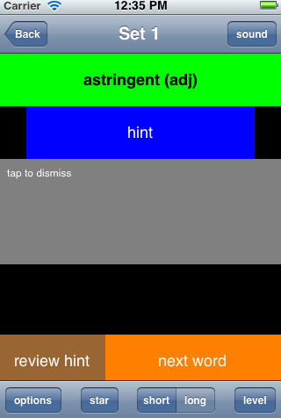
View 1 (definition covered up)
Nav bar: Back button, Set number, Sound button for word pronounciation
TextView to display current vocab word
Hint button, can be tapped to reveal user defined hint in gray text box below
Black “screen” covering up definition. Will slide down off screen when user taps it (unless hint button is tapped).
Review hint button is not necessary on this screen, next word button will stretch across all the way

Slide 3
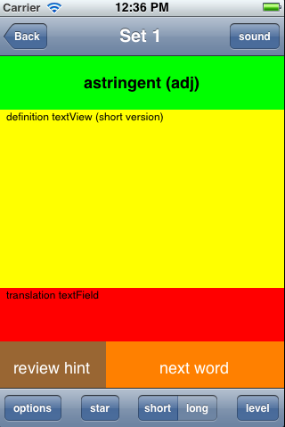
View 2 (revealing definition)
Toolbar (bottom) buttons:
Options button – brings up options screen
Star button – bring up action sheet for starting a slideshow, writing in a hint, moving the word to another set
Short/Long segmented control – select short tab for viewing concise definition, long tab for viewing longer definition
Level button – bring up action sheet or slider bar to rate the difficulty of the word, either easy, medium, hard, or discard
TextView for definition:
-- can have short, concise version, or long, verbose verion
-- may include synonyms
TextView for translation
Buttons for bringing up hint screen, going onto the next word

