Slide 1
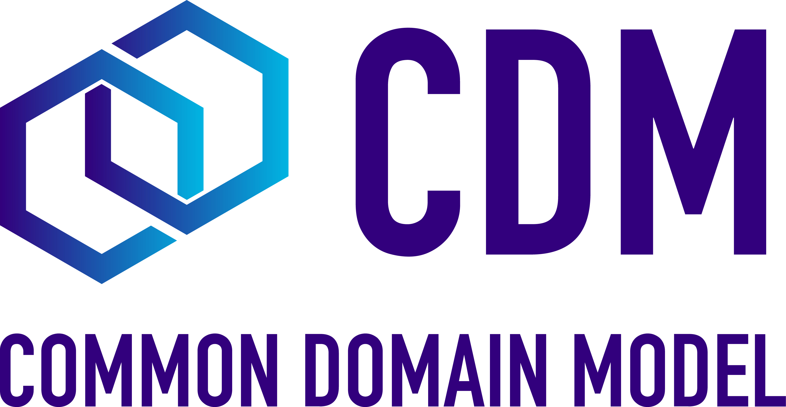
Common Domain Model – An Overview
October 2023

Slide 2
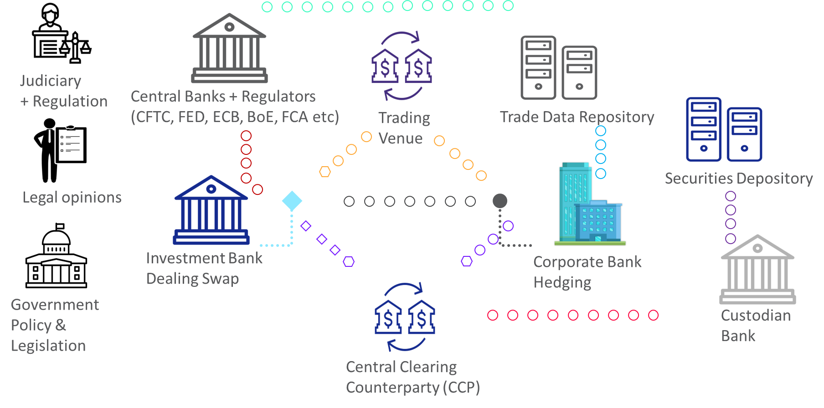
Catalyst for Change: Current Market Structure Challenges
All parties store trade data in different formats & make lifecycle changes to these records inconsistently
Differences in booking models lead to real-world events in those models producing different outcomes:
Reconciliation breaks
Valuation differences
Collateral disputes
Reporting mismatches
Operational inefficiency
Settlement failures
Barriers to automation
What is the true ‘truth’ at any point in time?

Slide 3
What is the CDM?
The Common Domain Model (CDM) is a standardized, machine-readable and machine-executable blueprint for how financial products are traded and managed across the transaction lifecycle
Dimensions of the CDM:
Product
Definitions of tradeable products qualified by their economic terms
Event
Data structures to represent the lifecycle events of financial transactions
Legal Agreement
Digital representation of the legal agreements that govern transactions
Process
Translates the technical standards that support those industry processes into a standardized machine-readable and machine-executable format
Reference Data
Reference data components that are specifically needed to model the other dimensions
Mapping
Mapped to a set of alternative data representations including FIX, FpML, ISO20022
The CDM is NOT an application in and of itself, but can be implemented within one
Composability allows for re-use of components for efficiency

Slide 4
CDM vs. FpML
While both the CDM & FpML are standards, they can and will co-exist
The CDM is not a data format for messaging or storage – it is a logical model describing relationships between pieces of data
The CDM can be expressed in various forms, including XML and JSON and other standard formats such as FpML, FIX & ISO20022 for exchange and storage of information
FpML does not define standards for event and workflow processing; the CDM prescribes the validation logic to express these more specifically

Slide 5
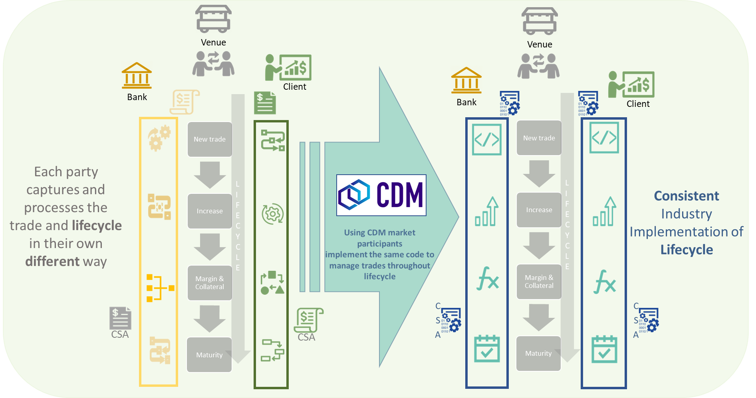
Benefits: Consistency of representation

Slide 6
Core Benefits
Efficiency
Transparency
Accelerated Innovation
Enhance interoperability, reduce reconciliations and promote straight-through processing
Promote transparency and alignment between regulators and market participants
Create an environment for
innovation in financial markets
A mutualized, free, open-source standardized digital blueprint on how to represent financial transactions, performance and business events
Extensible to compose financial instruments by assembling reusable components. Already covers robustly derivatives and securities financial transactions
Scalable as event-driven model that encapsulates primitive components that will de facto make the fabric of complex business and operational processes
Operational and functional to codify the contract mechanics and business logic of legal agreements
Unambiguous in digitizing functionally complex business and regulatory logic into code
Directly approachable as published in both human-readable and machine-executable languages
Implementable across several strategic uses cases in capital markets for better automation and greater consistency – eg, trade management systems, clearing, digital documentation, collateral management and regulatory reporting

Slide 7
History of the CDM
2017
ISDA Publishes
CDM Design Paper
RFQ for Technology Partner
Mar 2019
CDM 2.0 released
Interest Rate and Credit Derivatives
Initial Margin CSA
Opened access to market
Jun 2021
First non-derivatives product class contributed by ISLA:
Securities Lending MVP
Nov/Dec 2022
First production use:
DRR for CFTC reporting
CDM 3.0
Further product, event and workflow coverage
Jul 2023
CDM 4.0
ICMA contributes Repos
2016
2017
2018
2019
2020
2021
2022
2023
Sep 2016
ISDA publishes white paper on Future of Derivatives Processing
Jun 2018
Version 1.0 released
Conceptual pilot
2020
Addition of all IM
& VM CSAs
FX and Equity derivatives
Nov 2021
MoU- ISDA, ICMA, ISLA
Enshrine Collaboration on CDM
Feb 2023
CDM migrated to FINOS
Open-source community
Q4 2023
CDM 5.0
ETD & Commodity
Derivatives
ISLA GMSLA Clause Library
Further Repo & Bond enhancements
Increasing momentum through industry contributions

Slide 8




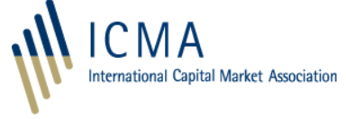
Trade Association Collaboration
Align Functional Roadmaps
Combined governance policy
Best-practice led Governance
Open-Source Community of Members
Joint steering forum
Open-Source Repository
Associations are collaborating towards the same future goal, to benefit the whole industry
An open-source model mutualises cost of development between TAs and contributing firms while retaining best practice governance
MoU in 2021 enshrined collaboration publicly
Working groups were opened to each others’ members
TAs appointed FINOS to provide a repository with a view to fostering the growth of an open-source community for the CDM, with migration completed early 2023

Slide 9
Product Coverage
The scope of contractual products in the current model are summarized below:
Interest rate derivatives:
Interest Rate Swaps (incl. cross-currency swaps, non-deliverable swaps, basis swaps, swaps with non-regular periods, ...)
Swaptions
Caps/floors
FRAs
OTC Options on Bonds
Credit derivatives:
Credit Default Swaps (incl. baskets, tranche, swaps with mortgage and loans underliers, ...)
Options on Credit Default Swaps
Equity derivatives:
Equity Swaps (TRS, PRS, single name/index/basket, VarSwap, VolSwap, Dispersion, Correlation, Dividend Swap)
Options & Forwards
Foreign Exchange derivatives:
FX Swap, Forward, NDF, Options
Commodity derivatives:
Swaps, options, swaptions
The use of common elements allow for representation of multiple types of products and events in the trade workflow with minimal incremental work. Thus, this coverage list does not represent an exhaustive list of all possible combinations of elements or events

Slide 10
Product & Event Coverage
The scope of contractual products and events in the current model are summarized below:
Securities Lending:
Single underlier, cash collateralised, open/term security loan
Repurchase Agreements:
Open Term, Fixed Term, Fixed Rate, Floating Rate
Events:
Allocation, Re-allocation
Cash, Security transfers, DVP settlement
Clearing events
Compression
Increase and decreases/returns
Novations- full, partial
Terminations- full, partial
Renegotiation
Reset
Execution
Stock Split
Index Transition
Determination of corporate action and credit events
The use of common elements allow for representation of multiple types of products and events in the trade workflow with minimal incremental work. Thus, this coverage list does not represent an exhaustive list of all possible combinations of elements or events

Slide 11
Legal Document Coverage
ISDA Documentation
ISDA Documentation
ISLA have also contributed their Clause Library and Taxonomy for the GMSLA 2010/2018

Slide 12
Roadmap & Ongoing Initiatives
Derivatives:
DRR driven items- Q4 2023:
ETD & Commodity derivatives including position reporting
Trade Valuation report
Margin reporting
Collateral driven items- Q1 2024
Enhancements to collateral models
Additions of earlier CSAs to Legal document model
Securities Finance:
Enhancements for partial and failed settlements- 2024
Locate process for securities lending- Q4 2023
Clearing workflows for Repo
SFTR and US OFR Repo reporting
Incorporation of ICMA Bond Data Taxonomy
Technical Implementation:
Working groups are looking at:
Standardising Serialisation
Improving interaction with Reference Data lists
Formalising Release process and governance
As at Oct 2023

Slide 13
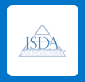
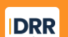
ISDA Extensions to CDM
ISDA Foundations
Digital Regulatory Reporting
Legal Agreement/documentation – including market master agreements, definitions, contract, etc.
Reporting – including models for derivatives reg reporting
ISDA Licences
event – including workflow & position
CDM under open source license at FINOS
product – the product model
ISDA has created two extensions to the core CDM: DRR and ISDA Foundations
observable - asset & event (e.g. credit event) – basic building blocks to construct products
base - common elements: date & time, static data etc.

Slide 14
Use Cases

Slide 15




Collateral - Today’s Challenge
Guidelines outlined under BCBS/IOSCO and Basel III were translated by each regulatory regime spearheading collateral management as a key function in capital markets for both bilateral and cleared OTC. Compliance has increased processing volumes significantly and will continue to do so, the need for automation in collateral management processing. The industry is faced with many challenges which has led to fragmented implementations and operational inefficiencies.
INDUSTRY PARTICIPANTS
Calculation Dependencies Margin Monitoring Margin Allocation Documentation
Collateral Segregation Establishing Custody Accounts Eligibility Schedules
Risk Control Optimisation Regulatory Compliance Reconciliation
Dispute Management Efficient Settlement
Broker/ Dealers
Lack of industry standards - Every industry participant left to implement their own version
Buy Side
Loss of inter-operability between solutions
Pervasive reconciliation issues and other operational inefficiencies
Vendors
Custodians

Slide 16
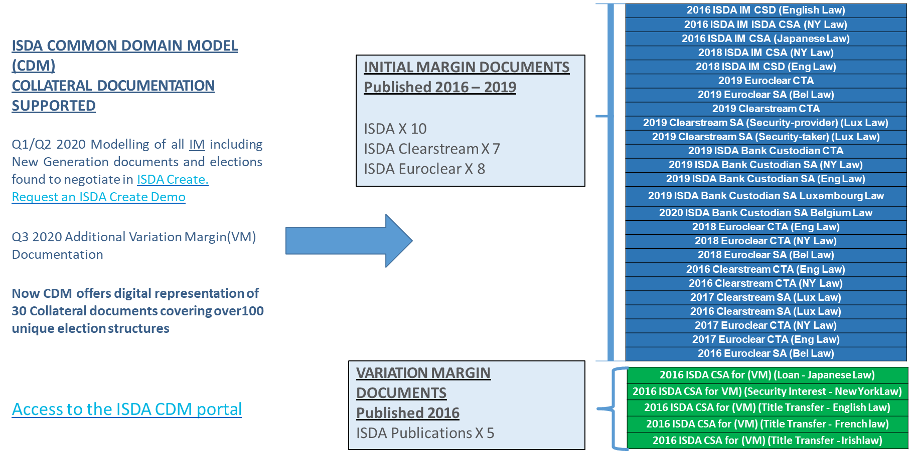
Collateral- Documentation Model Representation 2020/2021

Slide 17
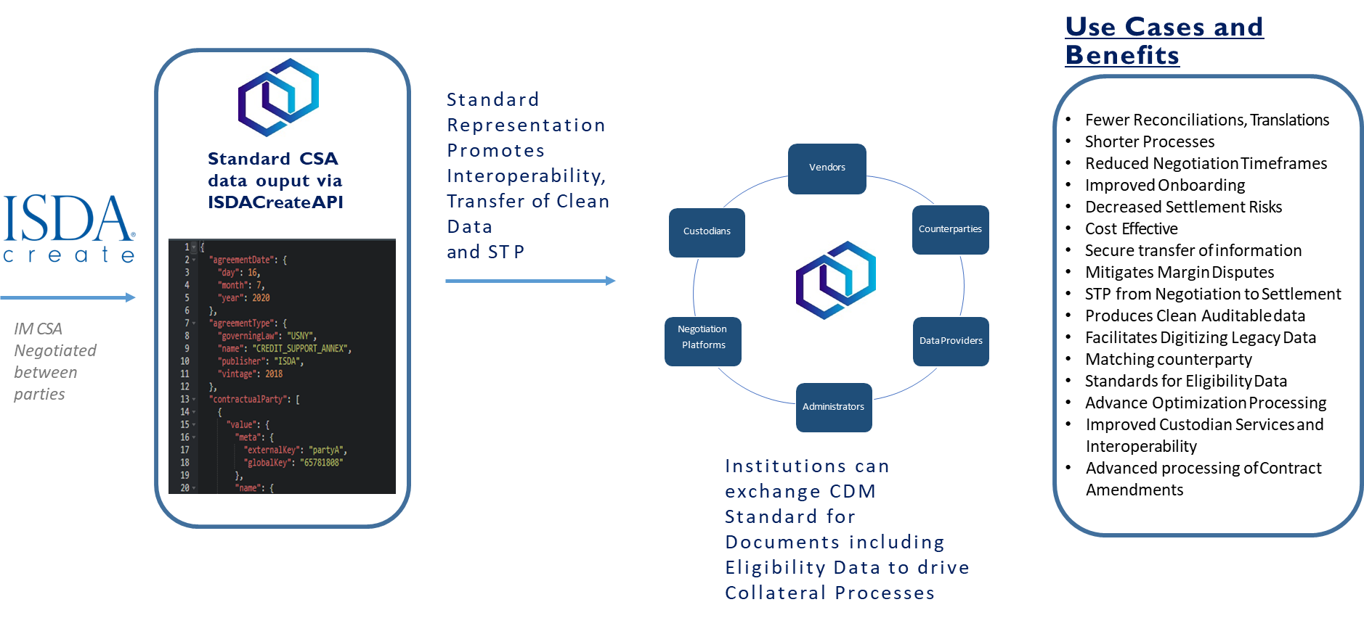
Collateral- Benefits of CDM Standard Documentation

Slide 18
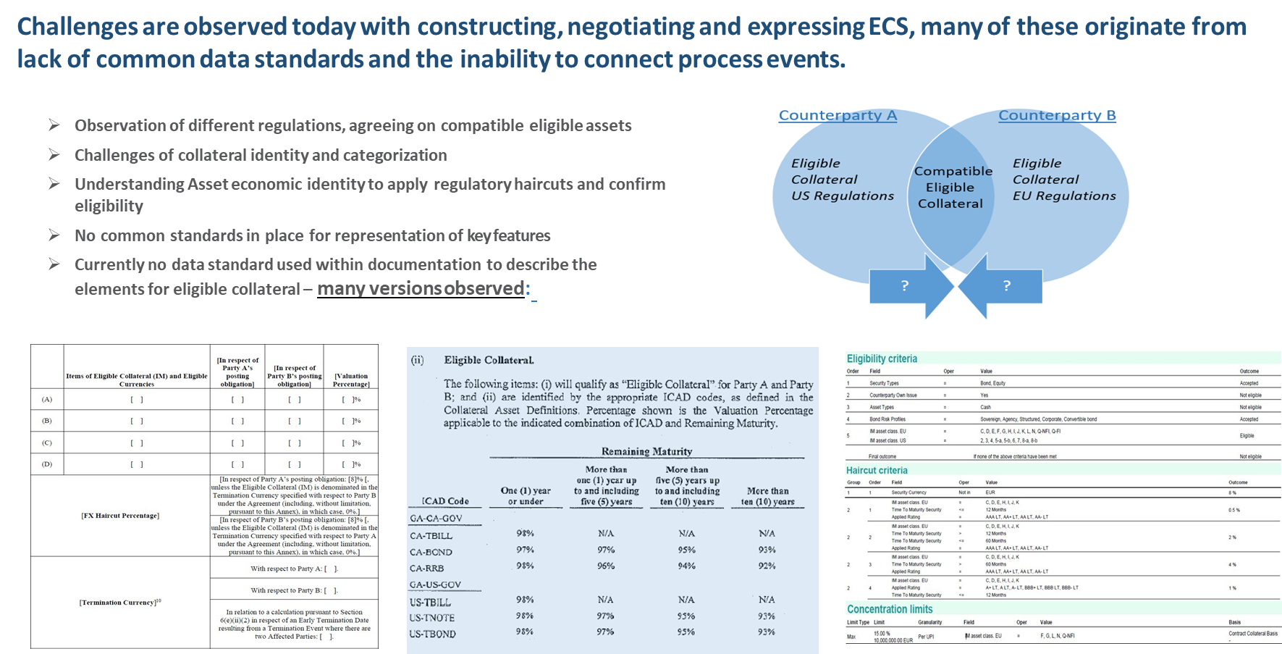
Collateral- ECS Challenges – No Standard Data Format

Slide 19
Collateral- Eligible Collateral Schedules
CDM Digital structure KEY data points:
Eligible Collateral
Issuer Criteria
Asset Type
Asset/ Product Identifier
Concentration Limits/Wrong Way Risk
Maturity Type/Range
Agency Rating
Valuation Percentage Haircut
Country of Origin
Sovereign/Central Bank
Quasi Government
Corporate
Regional Government
Funds
Special Purpose Vehicles
Denominated Currency
Security
Cash
Commodity
Other
Source ID-
(ISIN/ CUSIP)
Taxonomy
(ICAD / ISO-CFI)
Options to apply Concentration Limits by
Issuer
Product
Country of Origin
Currency
Agency Ratings
By Percentage or Value
Original Maturity
Remaining Maturity
From Issuance
Period Range (Lower & Upper)
Rating is flexible to be provided for
Asset/ Product
ISSUER
SOVEREIGN
Reference Agency
Multiple Agency
Rating
Mismatch Specify (Lowest/Highest/ Agency override)
Regulatory Haircut
FX Haircut
Margin Percentage
Additional H/C
Debt
Equity
Fund
Warrant
Certificate
Letter of Credit
Other

Slide 20
Collateral- Structure to define Asset Types and Identify Issuers
ISDA CDM will offer the flexibility to identify collateral asset types, with particular focus on securities, as most common form found in collateral schedules. However, this can be extended to cover many otherassets.
Regional Governments, Local Authorities, Municipals
Asset Type
Cash
Security
Commodity
Other
With recourse to Sovereign
Without recourse to
Sovereign
Either
Debt Security
Equity and Equity-linked Security
Fund Unit
Other
List of Eligible Sovereigns
List of Eligible Issuers
With the functional flexibility to capture detail of its identity including specific issuer name and use of common identifiers
Other issuer types include:
Sovereign Central Banks
Corporate
Supranational Debt
SPV and Funds

Slide 21
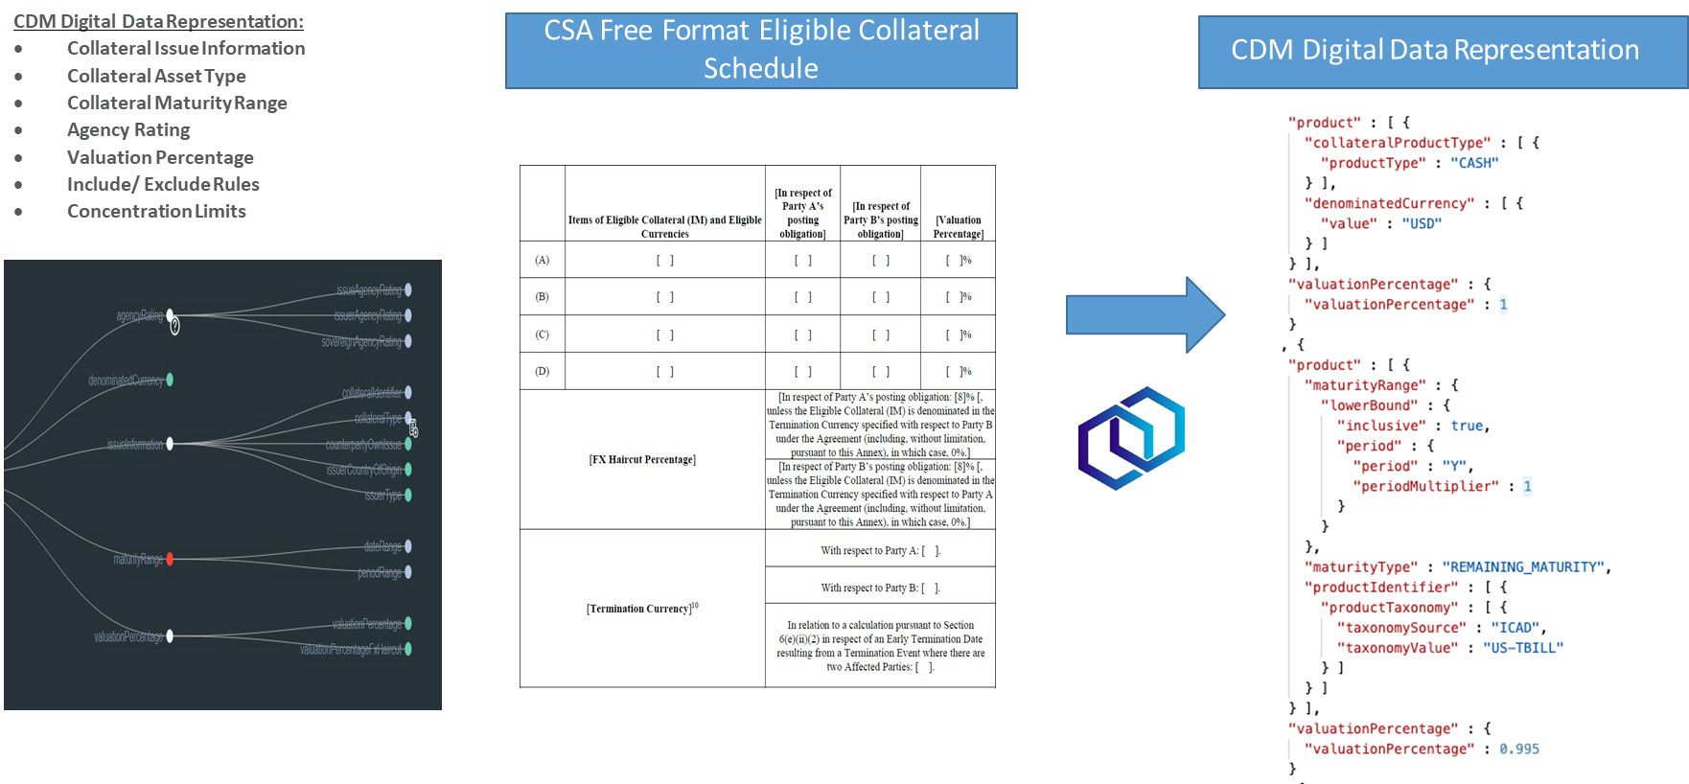
Collateral- CDM Eligibility Schedules Representation
CDM offers standard data references points required for many industry forms of ECS. The structure enables consistent expression of data with the ability to apply various include/exclude rules and complex concentration limits. ISDA has demonstrated translation of several ECS provided by members into digital output

Slide 22
Collateral- Eligible Collateral Schedules
An Eligible Collateral Schedule is represented in the CDM through the specification of criteria that can be used to “filter” whether a piece of collateral is eligible or not.
Asset Type – is used to specify criteria related to the nature of the asset, such as its type (cash, equity, debt, etc), country of origin or denominated currency
Issuer Type – is used to specify criteria related to the issuer of the asset, such the type of issuer (government, corporate, etc), specific issuer name, or agency rating
Treatment – is used to specify the valuation percentage, any concentration limits and whether the criteria specify inclusion or exclusion conditions
The combination of these terms allows a wide variety of eligible collateral types to be represented and can be applied across industry use cases for OTC, Securities Lending, Repo, Cleared and ETD. s
Solving problems for Global Banks, Custodians, Data Providers, Vendors and connecting solutions.
Standard data for Eligible Collateral information facilitates DLT, Smart Contract and technology to be built to add further efficiencies to processes

Slide 23
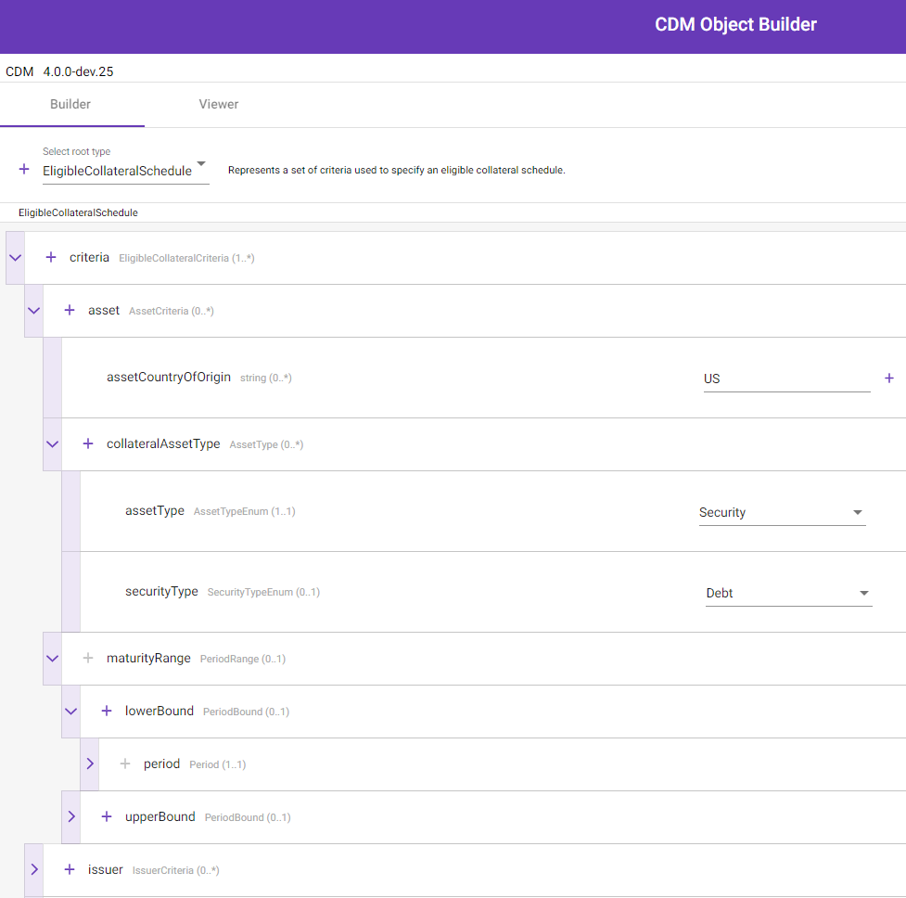
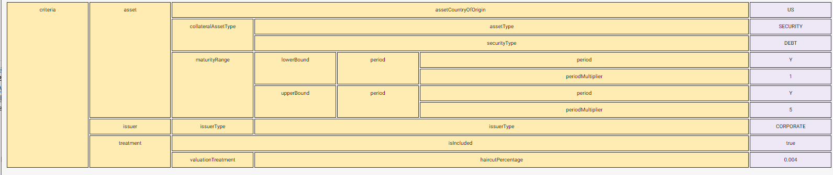
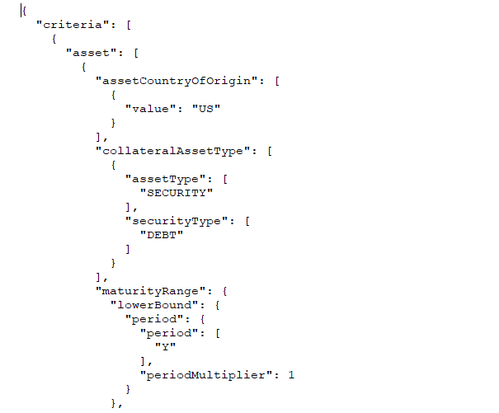
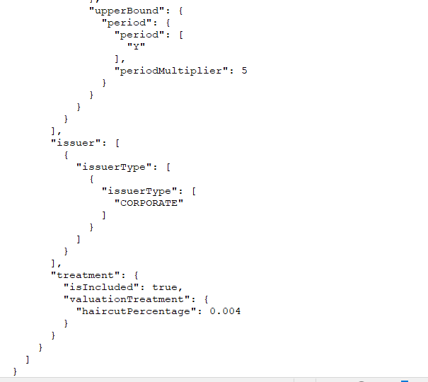
Collateral- CDM Object Builder
REGnosys on behalf of ISDA have developed a user interface (UI) this allows you to create CDM Eligible Collateral schedule information using drop down functions. The user can create, import, share or inspect in CDM JSON and view in a tabular format. The Object Builder will be contributed to FINOS in 2023
Vendors
Custodians
Counterparties
Negotiation Platforms
Data Providers
Administrators
The UI can be used for predefined common eligibility profiles to import and edit and producing industry compatible consumable data output. The current UI gives the user the ability to also validate and construct many version of eligible collateral as CDM data and has the scope to be development further and built into services for use cases beyond collateral

Slide 24
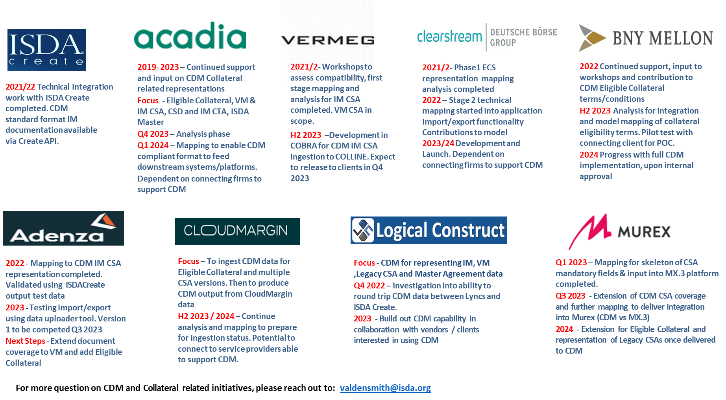
Collateral- Commitment to CDM Integration

Slide 25
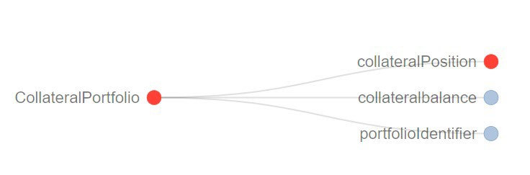
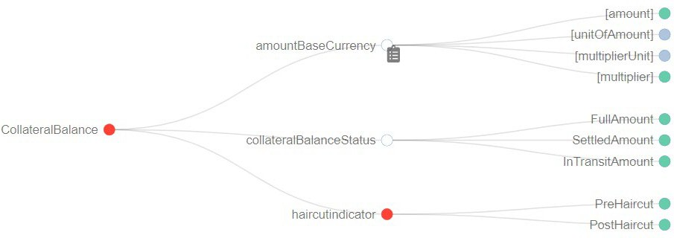
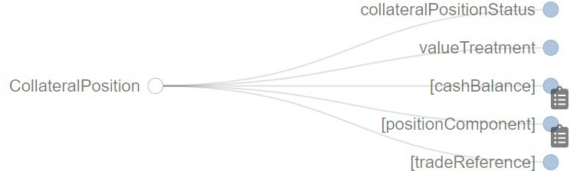
Collateral- CDM Margin Call / Positions / Balances and Exposure
Data to support the Collateral Margin Call process and its related components for Collateral Balance , Collateral Positions and Exposure are now represented in the CDM.
A foundational structure to support the data required for the margin call process including:
Standard margin call action labels
Base details for margin call data types and attributes to support unique features for issuance and response
Collateral positions and ability to list collateral assets for responding to margin demands and for information purposes
Collateral balance data requirements and aggregate values for margin call data and reporting

Slide 26
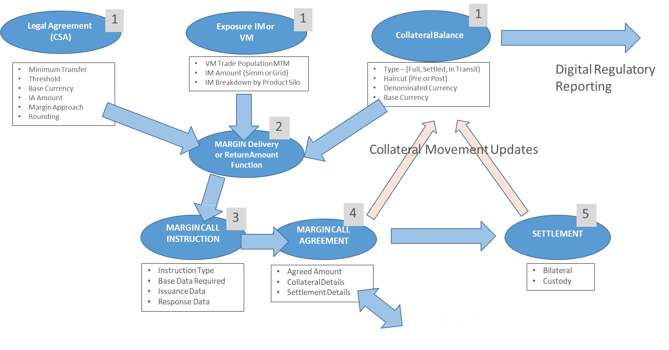
Collateral- Margin Call connection to other CDM components

Slide 27
Collateral- Processing Standards in CDM- What next?
2023/2024 - CDM Collateral Initiatives Objectives:
Documentation Extensions: 1995 VM CSA
ISDA Master Agreement Amendment Agreements
Support Adoption of CDM Documentation and ECS into Production Environments of External Platforms
Validate CDM Data Structure for Margin Call Issuance and Response Standards
Engage with Members for Support and Adoption
Collaboration with other Trade Associations to extend CDM
Repo and Securities Lending Collateral Process

Slide 28
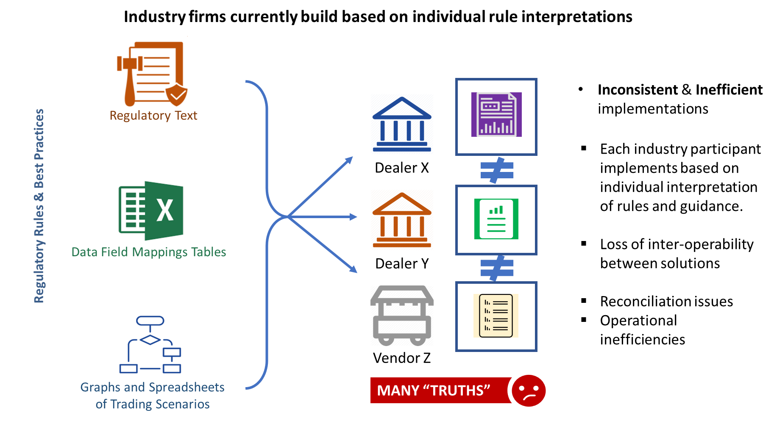
Digital Regulatory Reporting
Trade Reporting Rule Implementation Today

Slide 29
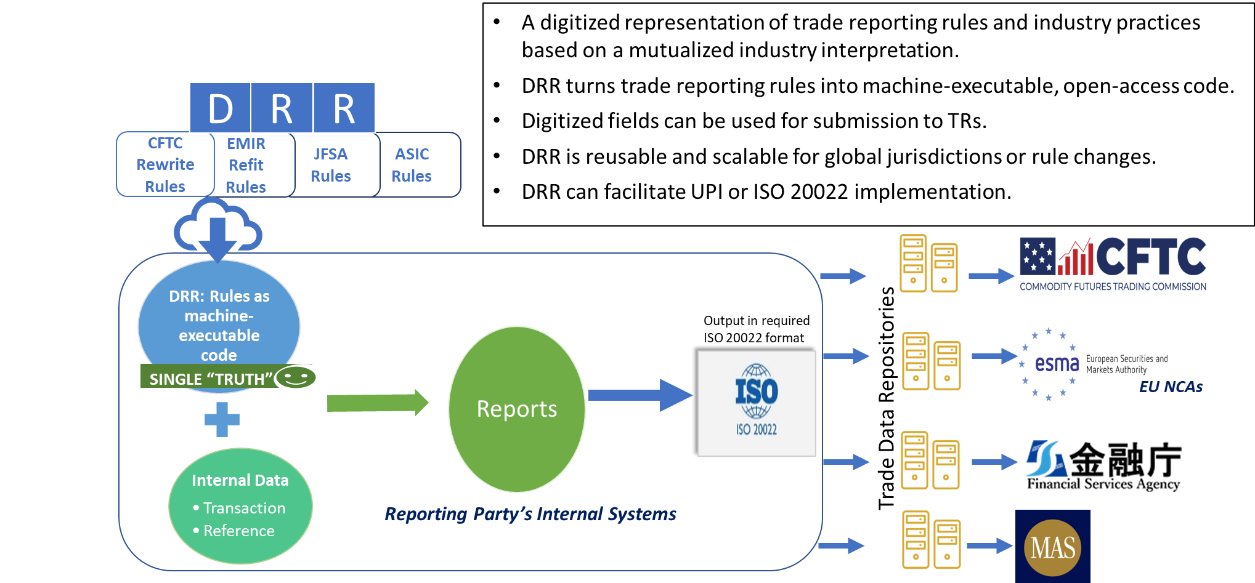
Digital Regulatory Reporting
Trade Reporting Rule Implementation Using the DRR

Slide 30
Digital Regulatory Reporting
Trade Reporting Rule Implementation Using the DRR
Mutualize regulatory reporting compliance effort
Rule interpretations and compliance effort is spread across the industry
Gives you an unambiguous rule interpretation
Reflects rules, guidance and industry best practices in an unambiguous way within the DRR model
DRR is open-access and increases transparency
Defines core regulatory reporting ruleset only once
Thereafter, only incremental efforts are required to extend the DRR model to other jurisdictions and future changes to reporting rules
Significant resource and cost savings
Through the mutualized effort, firms leveraging DRR using the CDM will reap significant compliance, reporting and implementation project savings
The DRR will be accessible to regulators and market participants
And such updates will be delivered through centralized DRR model changes

Slide 31
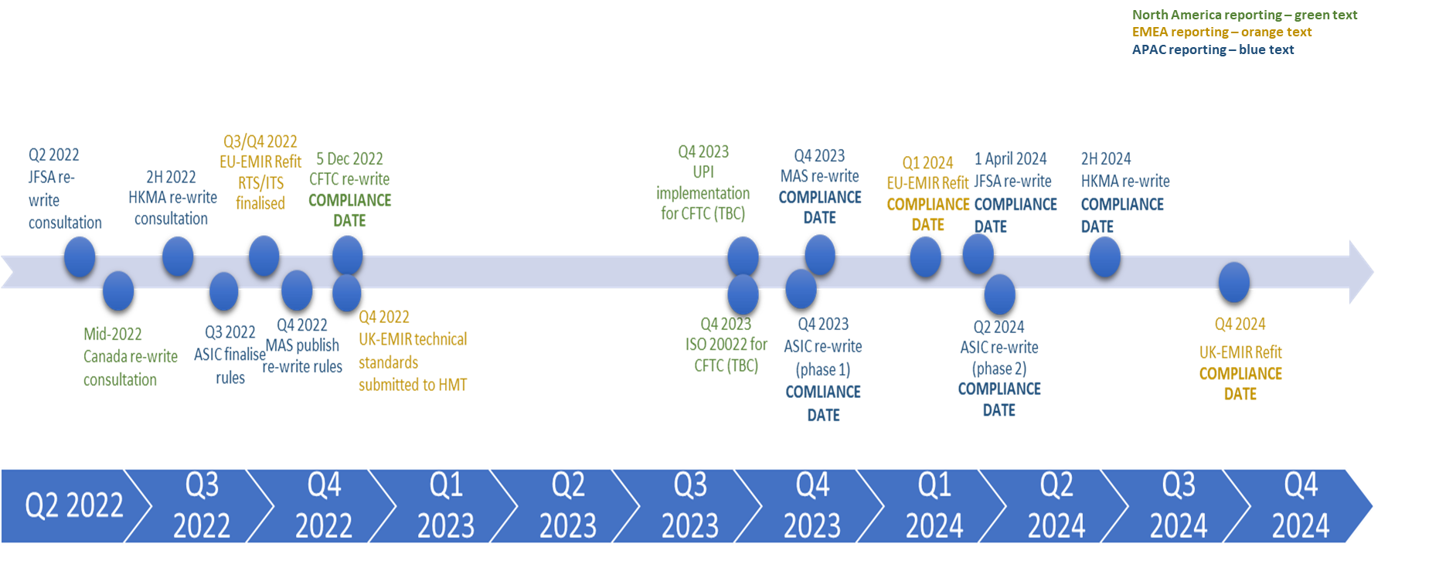
Digital Regulatory Reporting
DRR Roadmap

Slide 32







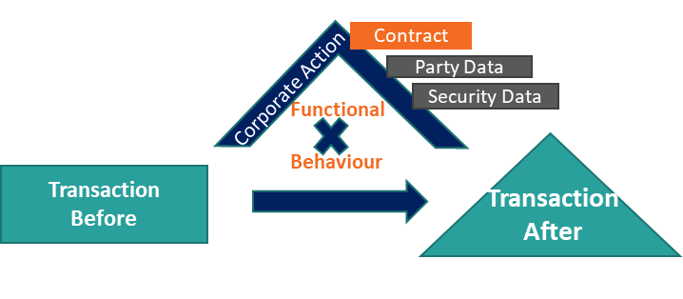



Integrating CDM and Legal Agreements
Hard Copy or
Unstructured Soft Copy
Structured Digital Document
CDM Legal Agreement
CDM Product/Transaction
Legal
Agmt
Clause Library & Taxonomy
Legal Agmt
Legal Agmt
Securities loan
Auto Early Term wording
Aggregation wording
Corp Action wording
……
Auto Early Term variant 1 wording
Aggregation variant 5 wording
Corp Action variant 3 wording
…….
Version
Auto Early Term variant 1 business outcome
Aggregation variant 5 business outcome
Corp Action variant 3
…….
Quantity
Security
Collateral Type
Duration
Legal Agreement
………
Encode
Legal agreement
is linked
to loan
2-way translation
UI <-> database
Machine
Read/Create
CDM Event Function
Component in legal agreement informs functional behaviour
Current document software capability
Future document software capability
Mandatory
Corp Action
Input transaction
Input ref data
Input legal agreement
Transformation function
………
Human user-based world
Digital computer-based world
Future Development Work
32

Slide 33
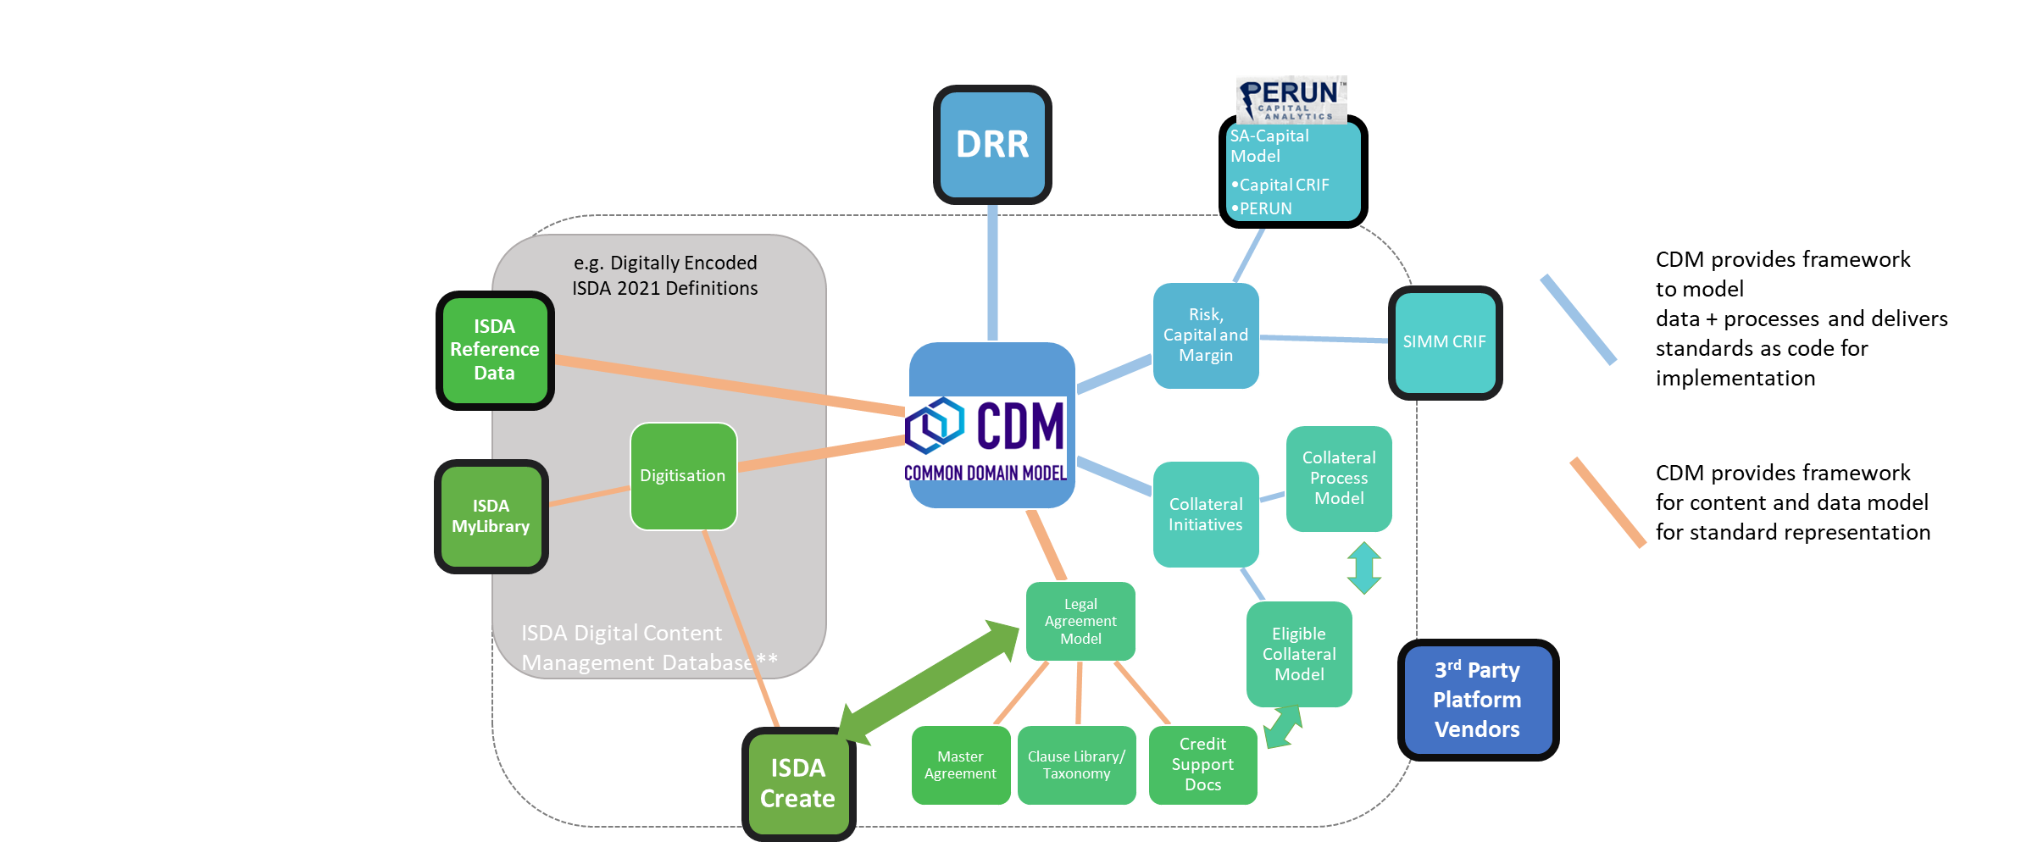
Further Use Cases: Ecosystem
CDM presents opportunities to interact with entire eco system of other applications and standards provided by trade bodies

Slide 34
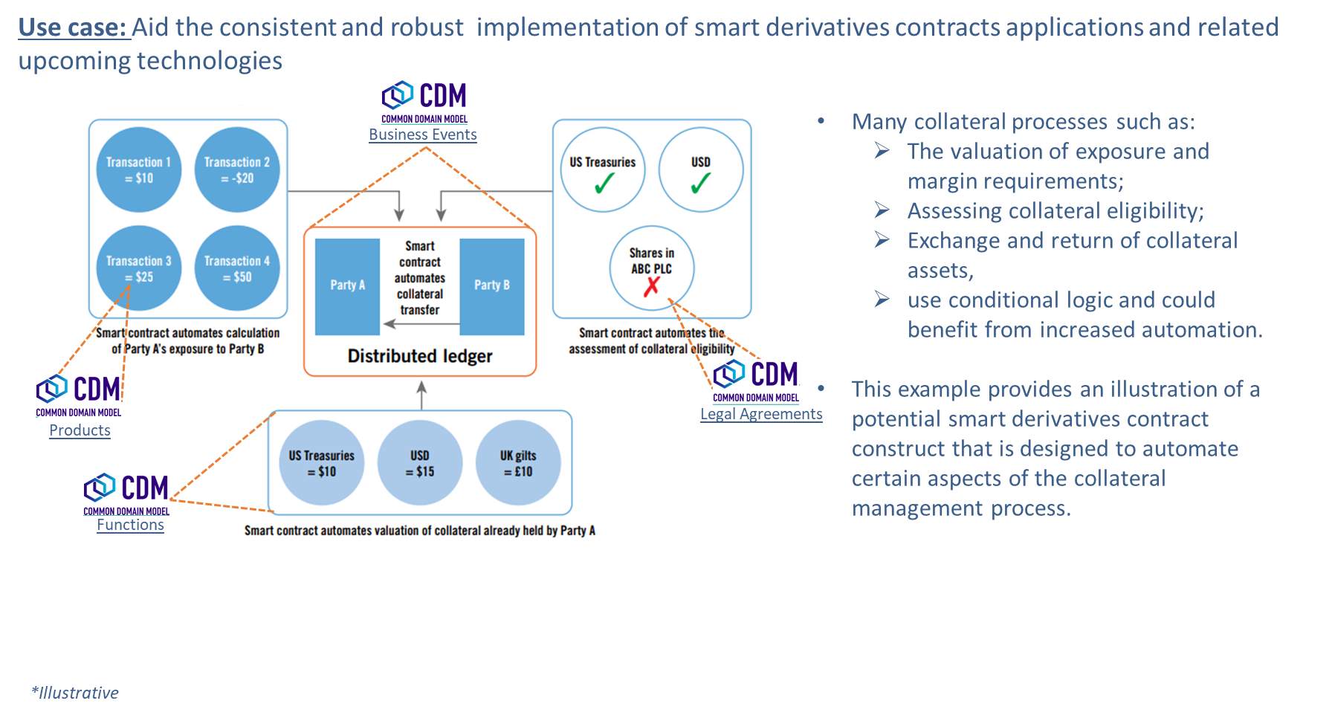
Further Use Cases: Smart contract technology support

Slide 35
Further Use Cases
Integration with CRIF standard for FRTB, SIMM, and SA-CVA reporting
Transcribe legally prescribed functional clauses from ISDA Def into machine readable and human readable codified functions
Facilitate more efficient re-use of data e.g. data template for large volume of increases of an Equity portfolio swap
Set a standard for the efficient digitalisation of collateral related margin process
Assert and mutualise the standardised encoding and capacity for implementation of legal clauses supporting the life cycle events of derivative transactions.
Express the CCP clearing handbook book that regulates the registration and clearing of a transaction into a machine readable and executable code that can be automatically generated.
Support more consistent implementation of market infrastructures processes such as clearing in tally with upcoming new innovative technologies (DLT, Cloud, Smart Contract, etc)
Match and store consistent trade representations that feed in “real time” FO trading systems using DLT and detect inconsistencies if any.
Aid the standardized representation of SSIs

Slide 36
Get Involved

Slide 37
How to get involved- Community Structure
Defines and monitors overall roadmap, setting annual priorities
Decides support for resourcing initiatives proposed by TAWG, CRWG or DWGs
Approves new FINOS WGs
Decides matters of Governance & Operating Model for FINOS CDM WGs
Final release approval
Monthly
Steering WG
(SWG)
Approvals, Direction
Approvals, Direction
Assembles releases
Initial release proposal approval
Arbitrates disputes arising from DWG contributions
Guardians and enforcers of design principles and guidelines
Triages and facilitates long-dated PRs and Issues
Fortnightly, with sub-groups as required
Contribution Review Working Group
(CRWG)
Initiative Proposals, Updates, Escalation of Critical Issues
Technology Architecture WG (TAWG)
Defines and works on items related to technical aspects and architecture e.g. language distributions, packaging, libraries, serialization, reference data architecture, integration with other data standards
Interacts with CRWG like a DWG
Monthly, with sub-groups as required
Dispute Escalation, Design guidance requests
Technical Issue guidance requests
Guidance, Solutions
Guidance, Feedback, Re-work requests
Domain WGs (DWGs)
Modelling, design and execution of work items within their domain scope
Contributions compliant with guidelines and consistency across CDM
Updates on/feeds domain based work items and plans into overall roadmap set by steering
Meets around every 2 weeks as needed
List of DWGs & their Scope as at Oct 23:
Collateral- Collateral schedules & processes
Repo & Bonds- Repo & bond products
Securities Lending- Securities Lending
Derivatives Products and Business Events (DBPE)- Derivatives products of a non-structured/exotic nature
Structured Products- Structured & Exotic Derivatives
DRR Peer Review- Digital Regulatory Reporting (Derivatives regimes)
ISDA Legal Agreements- ISDA Legal Agreement modelling
FINOS groups
ISDA WGs
ISLA WGs
ICMA WGs

Slide 38
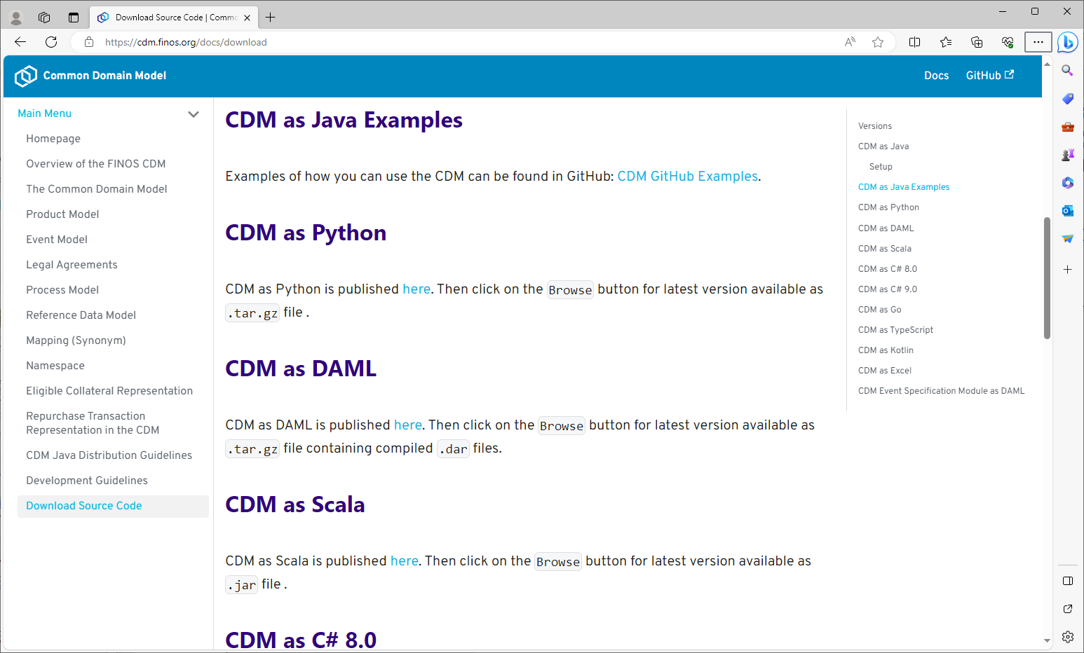
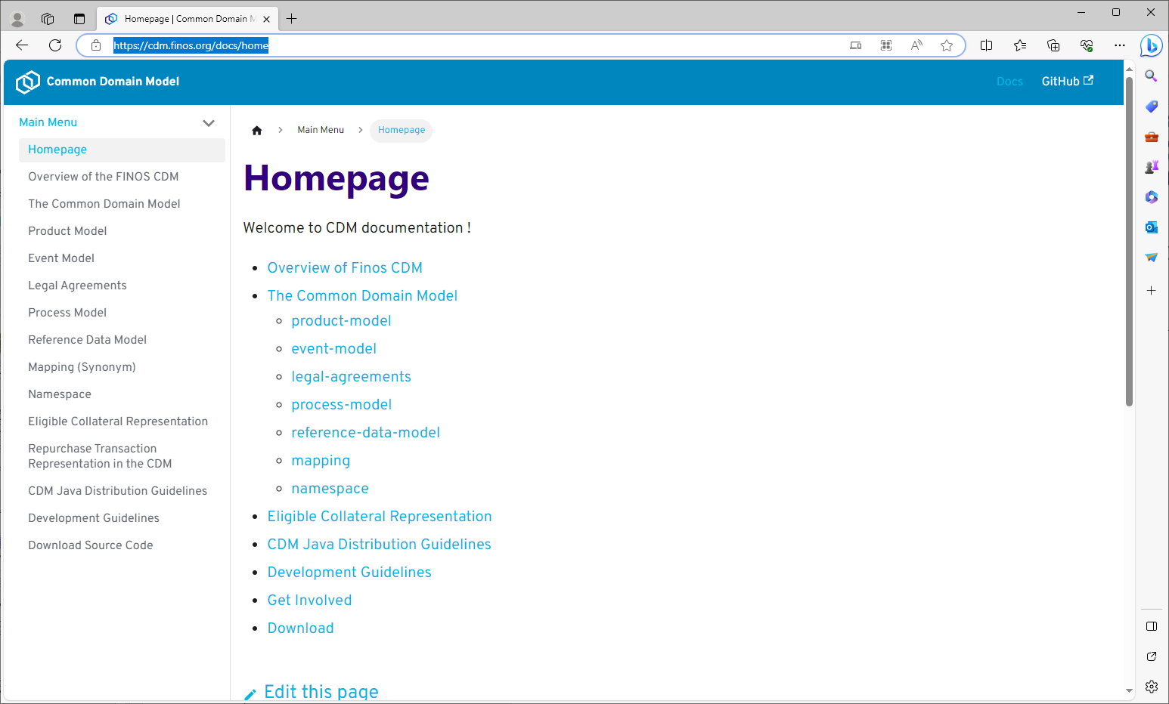
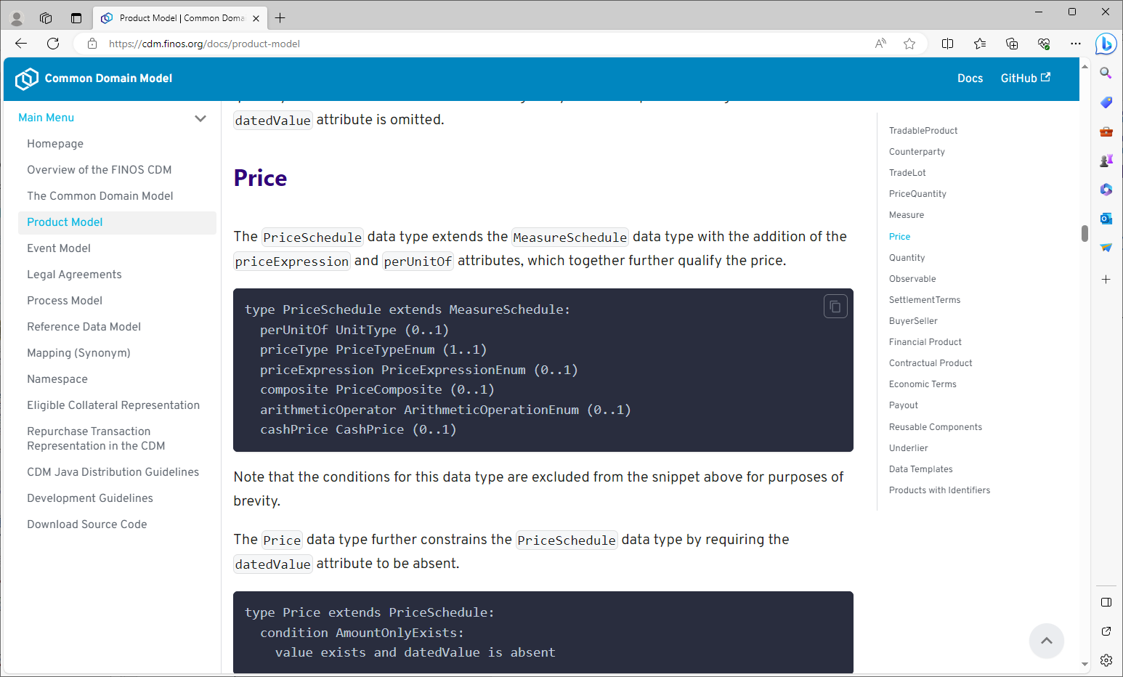
How to get involved
Info hub for FINOS including user documentation downloadable distributions: Homepage | Common Domain Model (finos.org)

Slide 39



The Common Domain Model is brought to you by:

