Slide 1

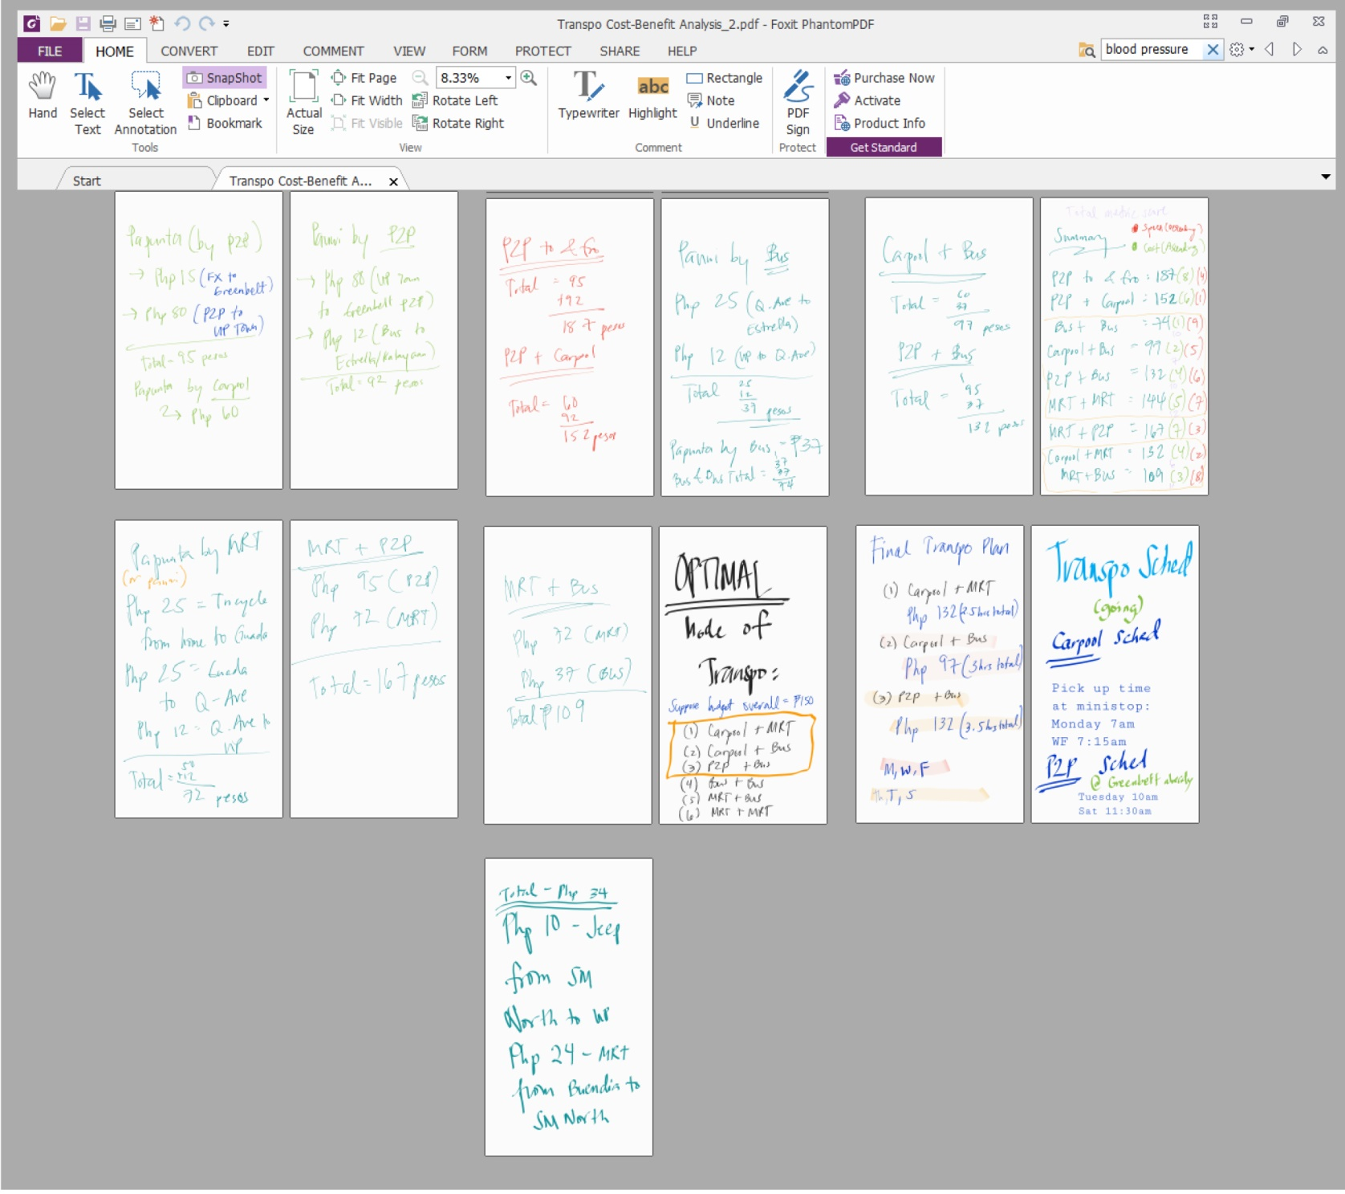

Slide 2


KATIPUNAN.com

Slide 3

PRESENT THE DESIGN
OF YOUR WEBSITE
1.-
Itself is what the end-user derives value from also can refer to the information provided through the medium
2.-
Itself is what the end-user derives value from also can refer to the information provided through the medium
3.-
Itself is what the end-user derives value from also can refer to the information provided through the medium

Slide 4
THE PROBLEM
Traffic causing longer commute hours, that in effect, making the economy lost billions of pesos in opportunity cost each year
Opportunity cost involves time lost that should be spent with family or self
PWD’s not given opportunity to work, especially those who are limp, mute, deaf
Because of lost opportunity time, people fail to be a part of the community

Slide 5
OUR SOLUTION
“An app that brings the world to your fingertips and lets you control your own life at your own pace”

Slide 6
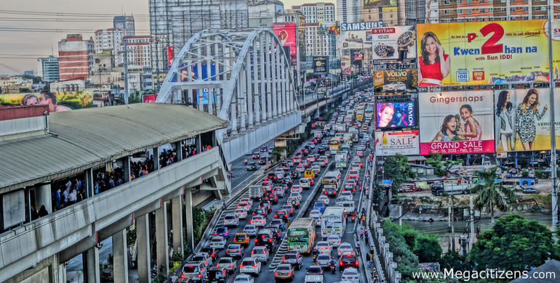

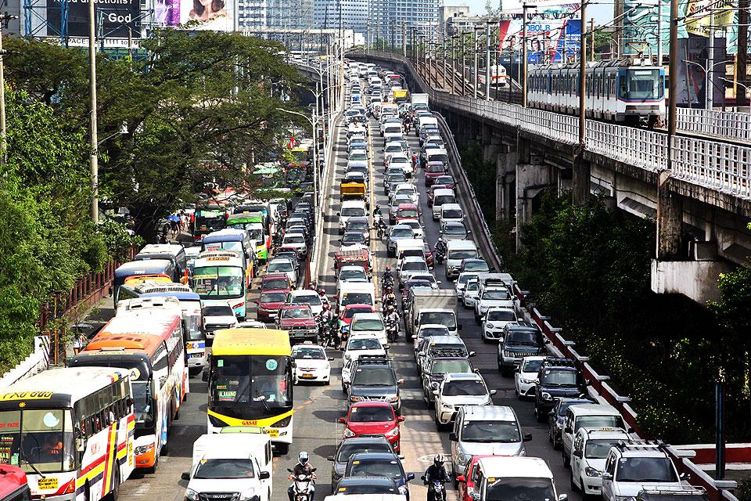
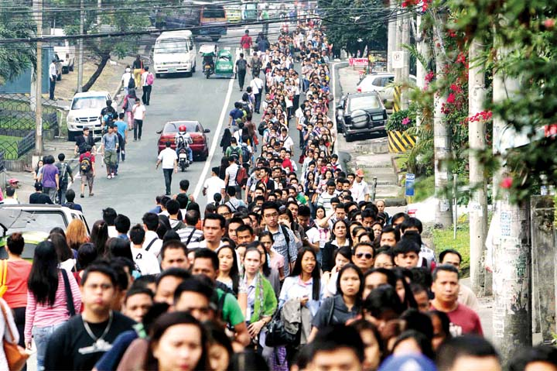
“Why Now?”
“Are you one of them?”

Slide 7

KATIPUNAN
Your all-in-one, one-stop app for managing your time and achieving work-life balance

Slide 8

APP FEATURES
Personal Life Planner – personal Gantt chart
5
Work Management App
Community Involvement and Citizen’s Desk
Virtual Queuing App
Personal planner is updated for every activity/event inputted

Slide 9
THE BUSINESS MODEL

Slide 10
12,800,000 people in Metro Manila alone
Source: PSA 2015

Slide 11
7,680,000 commute to and from work everyday
Source: PSA 2015

Slide 12
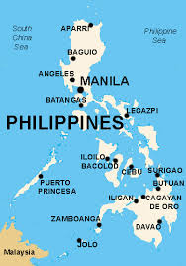
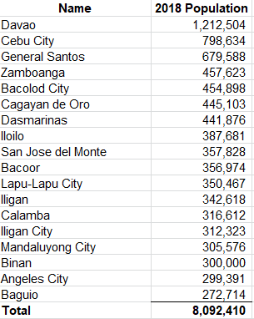
Major Philippine Cities and Population
USA
19,450000

Slide 13
4,800,000 commute to and from work everyday
Source: World Population Review 2018

Slide 14
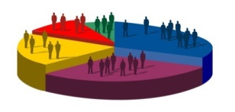
TARGET MARKET AND SEGMENTS
Telecommuters
Workers/Employees
A platform where they can manage their work – chat, email, schedules, etc – in one place
An app where they can manage their day to day schedule with just one click
OUR SOLUTION: Work Management System
OUR SOLUTION: Time Management App with Virtual Queueing
A platform where they can be in touch with the community they belong to
PWD’s
A platform that can help them work away from home
OUR SOLUTION: Community Involvement System with Citizen’s Desk
OUR SOLUTION: Work Management System

Slide 15
THE BUSINESS MODEL
1.-
Selling advertisement slots of the website to potential advertisers; use of Google Ad Sense; maintained through Content Strategy or regular update and refresh of app content
Affiliate Marketing
Advertising
2.-
Partnering with apps with similar target market; sponsorships from related websites or apps
3.-
Generating “leads” for other companies; use of big data analytics
“Lead” Generation
Customization
4.-
Customized services to various markets/clients; it’s all about the experience

Slide 16
FUTURE PLANS
Automated Transcribing of Teleconferencing Highlights
Personal Gantt
Game-like Structure
Mobile App

Slide 17
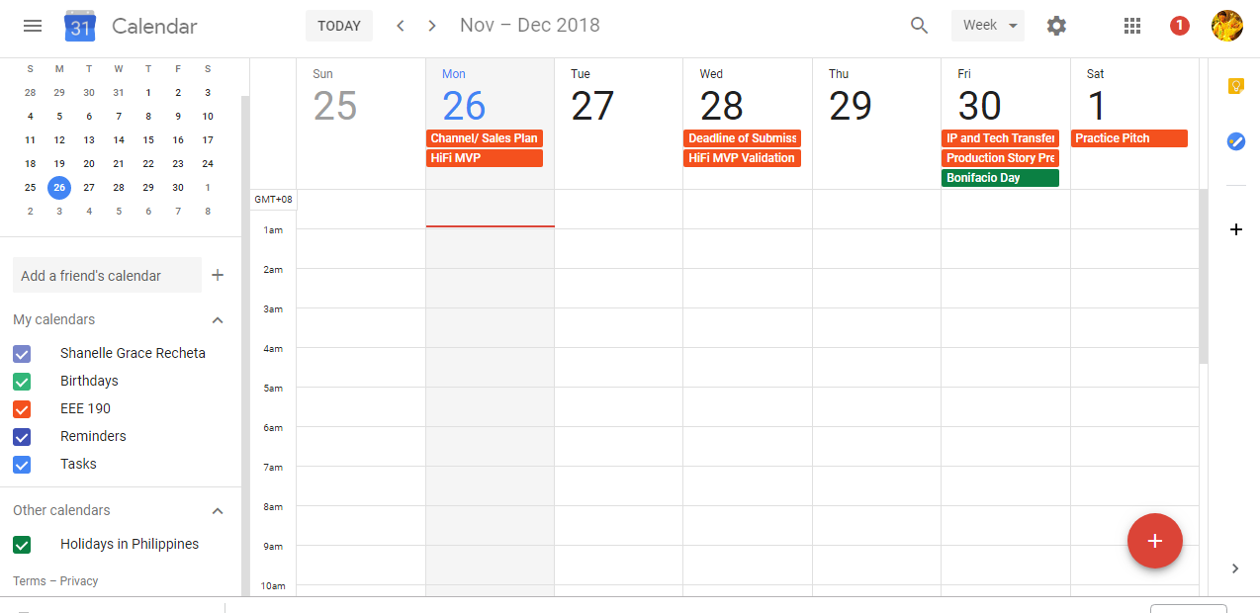
Personal Gantt Chart
Work
Community
Self
Family

Slide 18
GAME LIKE STRUCTURE
Automatic Transcription
tasks - treated like levels - can only be accessed one at a time as a current task moves from backlog to validated (tasks are locked until priority cards are accomplished)
Employees have stats (can increase/decrease like health/damage points in a game but relates to their actual performance/efficiency)
TPR is partly affected by the employee’s community involvement rating
an audio recorder like in soundcloud where anyone can transcribe a highlight on a specific time elapsed of the audio recording then anyone can comment on that transcription segment in real time (for those working remotely, a mechanism similar to FB live)

Slide 19
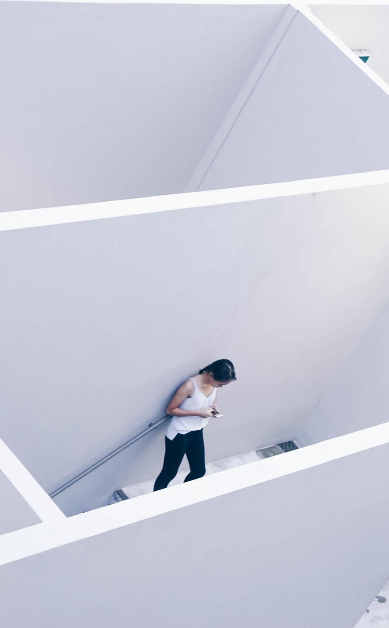
PRICING - FREEMIUM
INDIVIVIDUALS
CORPORATE/GROUP
Free lite version for individuals
Additional prices for every personalized and additional add-ons
Different pricing based on number of users
Offering will be based on group brackets
Another premium would be removal of ads for a number of days
Updated every sixth months or depending on the updates made by the system administrators

Slide 20
POTENTIAL OUTCOMES
Best-Case Scenario
Realistic-Case Scenario
Worst-Case Scenario
Market Leader, Generates Millions of Revenue per Year
Captures 5-10% of the Market
Remains as staggering app, and used only by few people

Slide 21
Thanks!
Any questions?

