Slide 1
Contexts & Dependency Injection for Java
CDI
CDI 2.0
JSR-365
Michael Remijan

Slide 2






Find me online
CDI
mjremijan@yahoo.com
@mjremijan
https://github.com/mjremijan/
http://mjremijan.blogspot.com
http://linkedin.com/in/mjremijan
https://www.strava.com/athletes/5759474

Slide 3



Find me at work
CDI
System Architect, Federal Reserve Bank, St. Louis
Adjunct Instructor,
Southwestern Illinois College
Author,
EJB3 In Action, 2nd Edition

Slide 4
Outline
CDI
Slides/Code https://github.com/mjremijan/ferris-cdi-presentation
Resources
History
Reference Implementation (RI)
This time…
Live coding…
Michael Remijan mjremijan@yahoo.com @mjremijan github.com/mjremijan/ferris-cdi-presentation

Slide 5



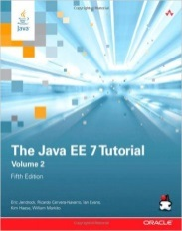
Resources
CDI
Project
http://www.cdi-spec.org
JSR (CDI 2.0)
https://jcp.org/en/jsr/detail?id=365
Weld
http://weld.cdi-spec.org
EE 7 Tutorial
https://docs.oracle.com/javaee/7/tutorial
Michael Remijan mjremijan@yahoo.com @mjremijan github.com/mjremijan/ferris-cdi-presentation

Slide 6

Resources
CDI
Maven (9 Nov 2015)
<dependency>
<groupId>org.jboss.weld.se</groupId>
<artifactId>weld-se-core</artifactId>
<version>3.0.0.Alpha13</version>
</dependency>
Michael Remijan mjremijan@yahoo.com @mjremijan github.com/mjremijan/ferris-cdi-presentation

Slide 7

History
CDI
EE 5 (2006)
@EJB
EE 6 (2009)
CDI 1.0, JSR-299
EE 7 (2013)
CDI 1.1, JSR-346
EE 8 (2017)
CDI 2.0, JSR-365
Michael Remijan mjremijan@yahoo.com @mjremijan github.com/mjremijan/ferris-cdi-presentation

Slide 8

Reference Implementation (RI)
CDI
Weld is the reference implementation of CDI: Contexts and Dependency Injection for the Java EE Platform which is the Java standard for dependency injection and contextual lifecycle management and one of the most important and popular parts of the Java EE platform.
Weld is integrated into many Java EE application servers such as WildFly, JBoss Enterprise Application Platform, GlassFish, Oracle WebLogic Server, WebSphere Application Server and others. Weld can also be used in a Servlet-only environment (Tomcat, Jetty) or plain Java SE environment.
Michael Remijan mjremijan@yahoo.com @mjremijan github.com/mjremijan/ferris-cdi-presentation

Slide 9

Reference Implementation (RI)
CDI
Apache OpenWebBeans delivers an implementation of the Contexts and Dependency injection for Java EE (CDI) 1.2 Specification (JSR346). OpenWebBeans is TCK compliant and works on Java SE 6 or later.
Apache OpenWebBeans is
Fast - we aggressively use caches internally and deliver great performance
Modular - OpenWebBeans Core is purely JavaSE, additional EE functionality gets added via 'Modules'
Industry Proven - Many projects use OpenWebBeans in production.
Community Oriented - Please visit our mailing list and we will help you moving your project forward
Michael Remijan mjremijan@yahoo.com @mjremijan github.com/mjremijan/ferris-cdi-presentation

Slide 10
This time…
CDI
Start container in Java SE
Basic (DI)
Interfaces and classes
Shared project
Lifecycle callbacks
Deployment exceptions
Qualifiers
Producer/Disposer
InjectionPoint
Events
Interceptor
Decorator
Michael Remijan mjremijan@yahoo.com @mjremijan github.com/mjremijan/ferris-cdi-presentation

Slide 11
Maybe next time?
CDI
Context
Application, Session, Conversation
WebApp
Needed anymore with HTML5 and Microservices?
Stereotype
Annotation of annotations
Alternative
Bean replacement
Deployment time overrride
beans.xml
Testing, environments
Specialization
Stricter Alternative
Transactional Event
Bind to transaction phases
Parameterized types
Instance<>
Much more….
Michael Remijan mjremijan@yahoo.com @mjremijan github.com/mjremijan/ferris-cdi-presentation

Slide 12
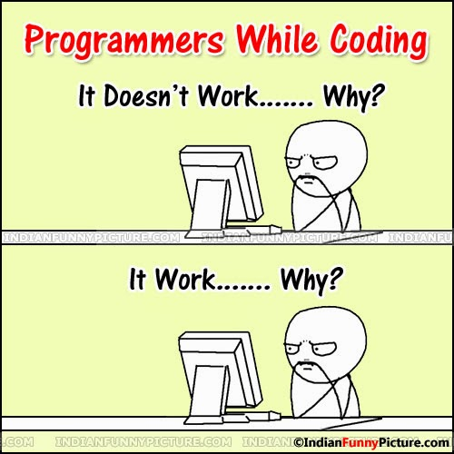
Live coding…
CDI
Michael Remijan mjremijan@yahoo.com @mjremijan github.com/mjremijan/ferris-cdi-presentation

Slide 13
Tips
CDI
Name classes appropriately
*Producer
*Event
*Interceptor
*Decorator
*Observer ??
Packaging
Layer vs. Function?
Keep event priority values centralized
Interface
Michael Remijan mjremijan@yahoo.com @mjremijan github.com/mjremijan/ferris-cdi-presentation

