Slide 1
Mjr-mid term planning
Euricom Best Practices

Slide 2
Agenda
Product Owner
Estimates
User Stories
Prioritization Techniques
Mid Term Planning
RAID

Slide 3
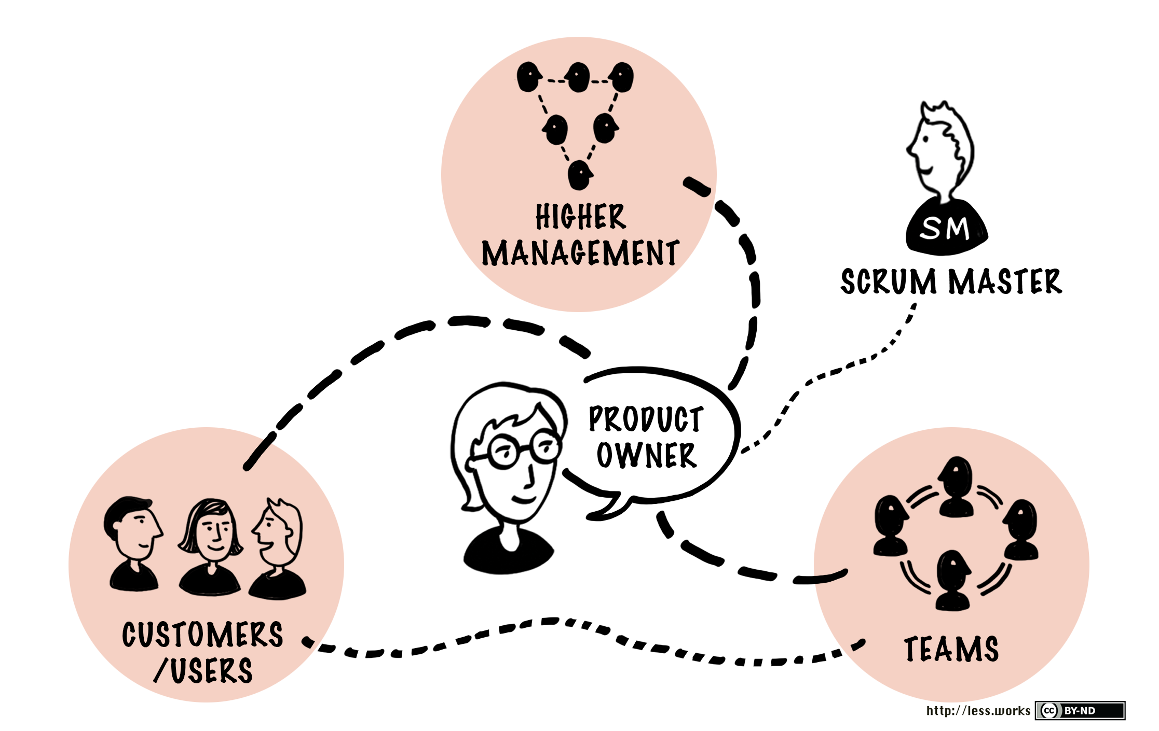

Slide 4
Optimizing the value of the work the Development Team does
Notes:
Manage the return on investment (ROI)
Establishes baseline target ROI
Measures project against this baseline
Prioritizes product backlog to maximize ROI
Calls for releases
Decides when to call for an official release of a potentially shippable product increment
Can shift a release forward or backward to maximize ROI based on new knowledge
Establish the vision

Slide 5
User stories
A user story is a software system requirement formulated as one or two sentences in the everyday language of the user
The epic user story provides a high level description of a business subject area or process. An epic user story should be disassembled into many user stories.
A theme is collection of related user stories.

Slide 6
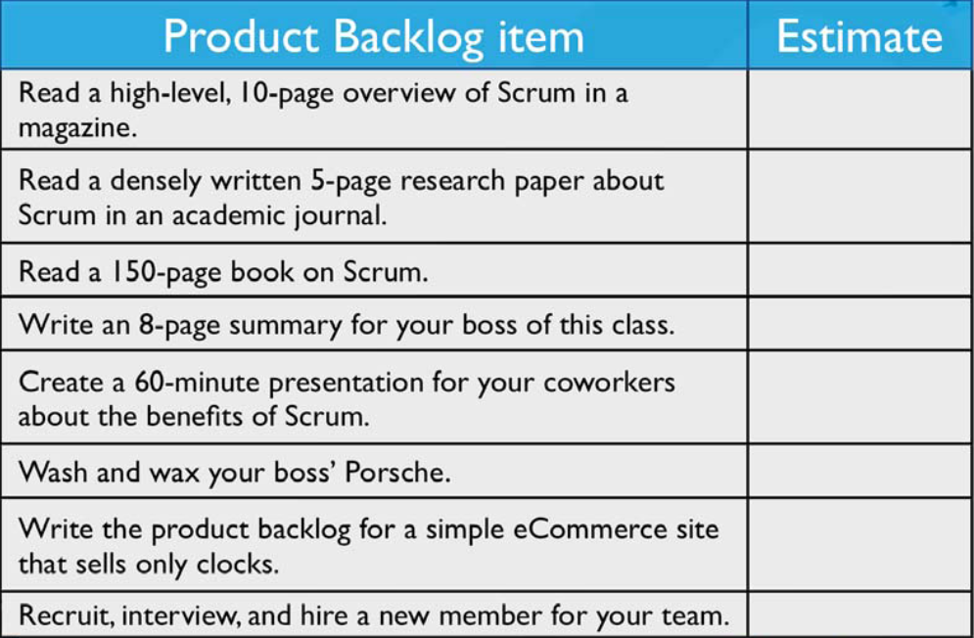
ESTIMATES
Notes:
Wie moet er inschatten ?
Story points of uren ?

Slide 7
Backlog Prioritization techniques
MoSCoW
Return on Investment (ROI)
Benefit Cost Ratio (BCR)
Highest Paid Person’s Opinion (HiPPO)
Buy a Feature
Technology Risk Based
User Voice
Business Value Based
Kano
Cost of Delay
Story Mapping
Scorecard
https://foldingburritos.com/product-prioritization-techniques/

Slide 8
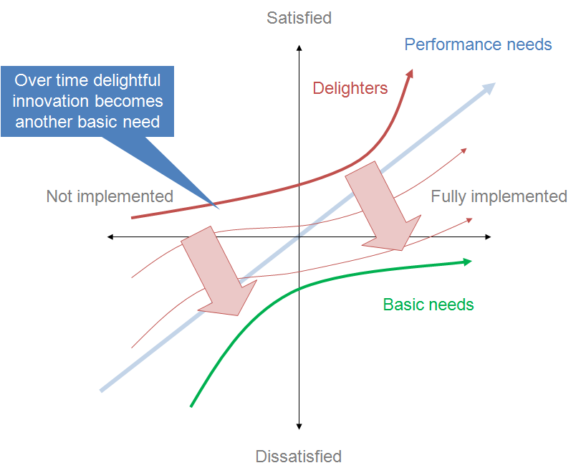
Kano model

Slide 9
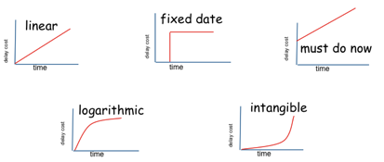
Cost of Delay

Slide 10
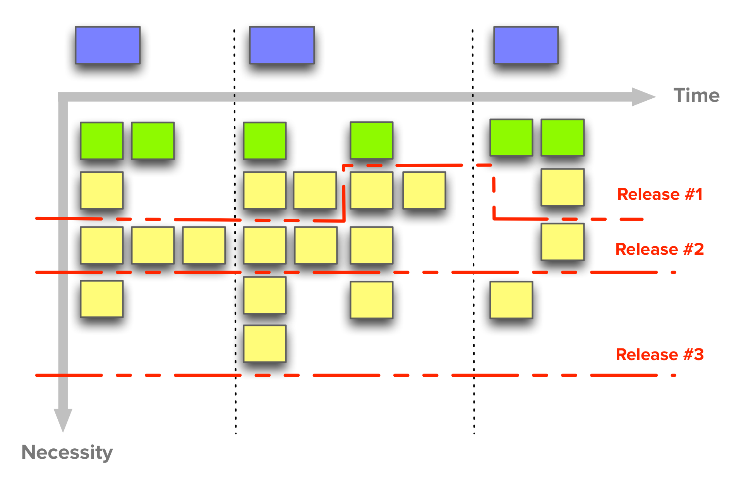
Story Mapping

Slide 11
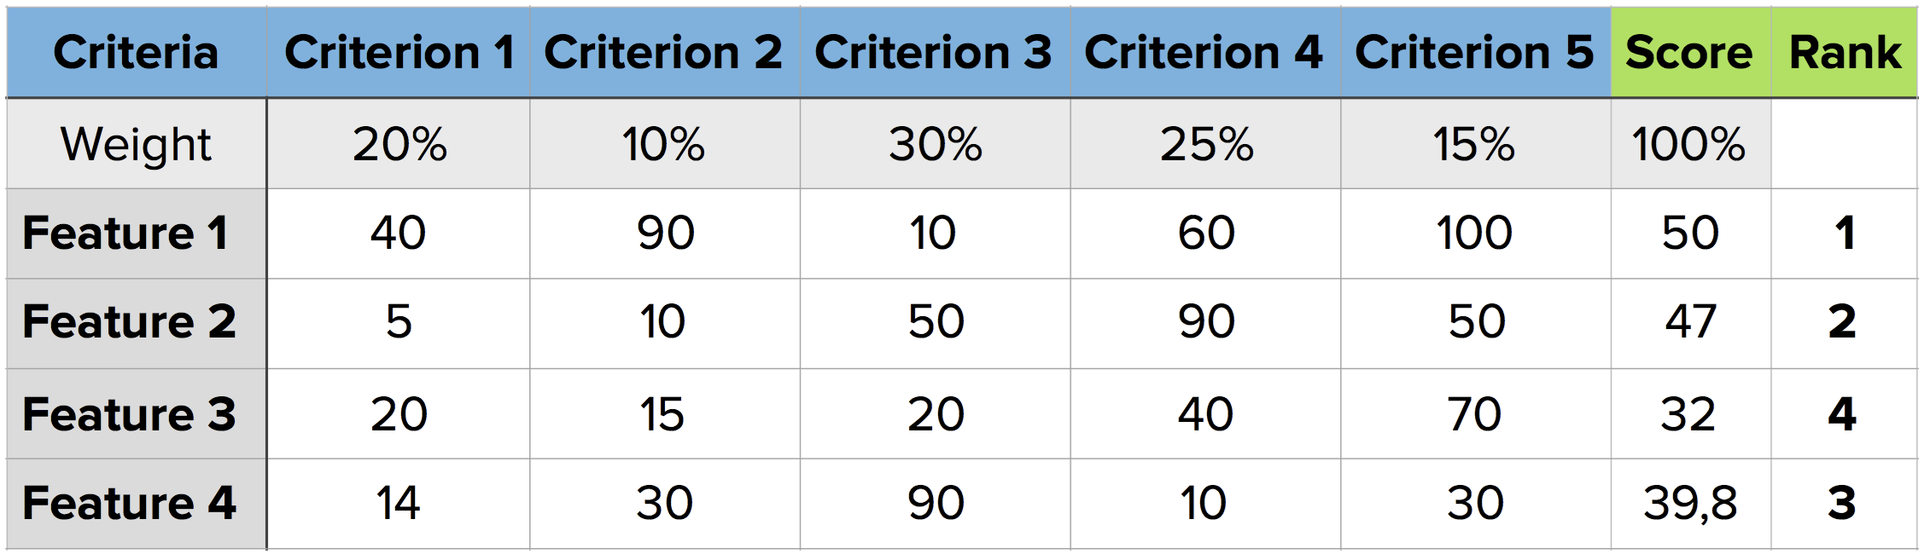
Scorecard

Slide 12


Slide 13
RAID
Risks
Assumptions
Issues
Dependencies

Slide 14
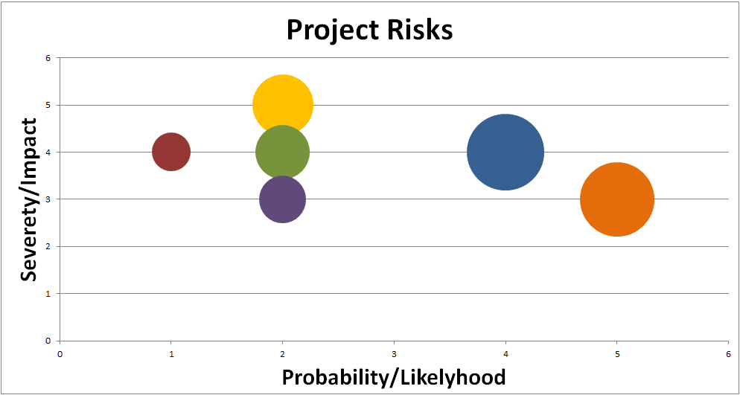
Risks
http://www.andreasbylund.com/managing-risk-as-a-project-manager-simple-excel-model/

Slide 15
Assumptions
ASSUMPTION IS THE MOTHER OF ALL SCREW-UPS.
…BUT PROVEN ASSUMPTION THROUGH TESTED HYPOTHESIS MOVES PROJECTS ON

Slide 16

Issues

Slide 17
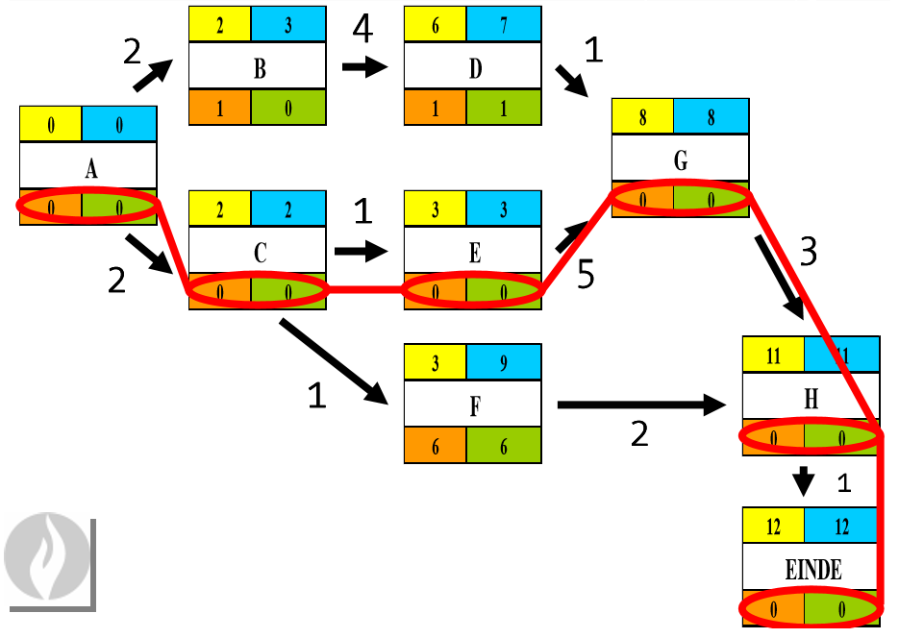
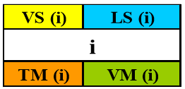
Dependencies
Matrix
Chant
Pert

