Slide 1



Using Git within RStudio
Paulina Jedynak, PhD
github.com/paujedynak
Environmental Epidemiology lab
gricad-gitlab.univ-grenoble-alpes.fr

Slide 2
Using Git within RStudio
This demo will be based on Windows OS and GitHub platform but do not worry – most of the procedures are common for different systems and platforms

Slide 3
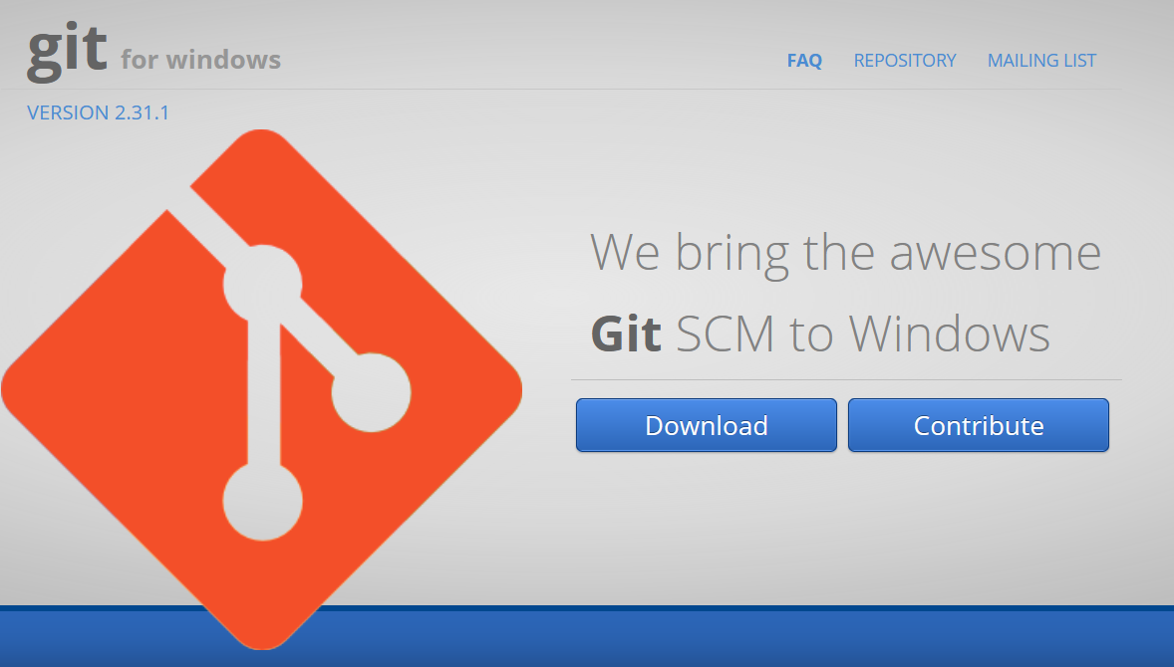
Using Git within RStudio
This demo will be based on Windows OS and GitHub platform but do not worry – most of the procedures are common for different systems and platforms
After this workshop you should be able to:
Install all the necessary software to use Git version control with RStudio
Configure Git to communicate with an online repository (e.g. GitHub)
‘Stage’, ‘commit’, ‘push’ and ‘pull’ your code to the online repository
More details on each step discussed here you will find at: happygitwithr.com
If you prefer less details but straight to the poing, try cfss.uchicago.edu/setup/git-with-rstudio

Slide 4
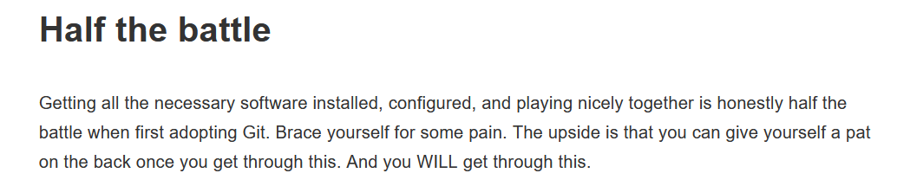

1. Initial installations
Source: https://happygitwithr.com
Notes:
Git is an installable and executable software (like an R or RStudio) while GitHub is a website, an online repository, where information (e.g. code) can be stored. Git (software) can communicate with different online repositories (e.g. GitHub or GitLab) but these are independent tools.

Slide 5
1. Initial installations
Install or upgrade RStudio
Notes:
Git is an installable and executable software (like an R or RStudio) while GitHub is a website, an online repository, where information (e.g. code) can be stored. Git (software) can communicate with different online repositories (e.g. GitHub or GitLab) but these are independent tools.

Slide 6
1. Initial installations
Install or upgrade RStudio
Register an online account where the ‘remote’ version of your repositories will be kept. As an example I will use the GitHub platform but several other platforms exist
github.com
gitlab.com
gricad-gitlab.univ-grenoble-alpes.fr (login with AGALAN credentials)
…
NOTE: Git != GitHub
Notes:
Git is an installable and executable software (like an R or RStudio) while GitHub is a website, an online repository, where information (e.g. code) can be stored. Git (software) can communicate with different online repositories (e.g. GitHub or GitLab) but these are independent tools.

Slide 7
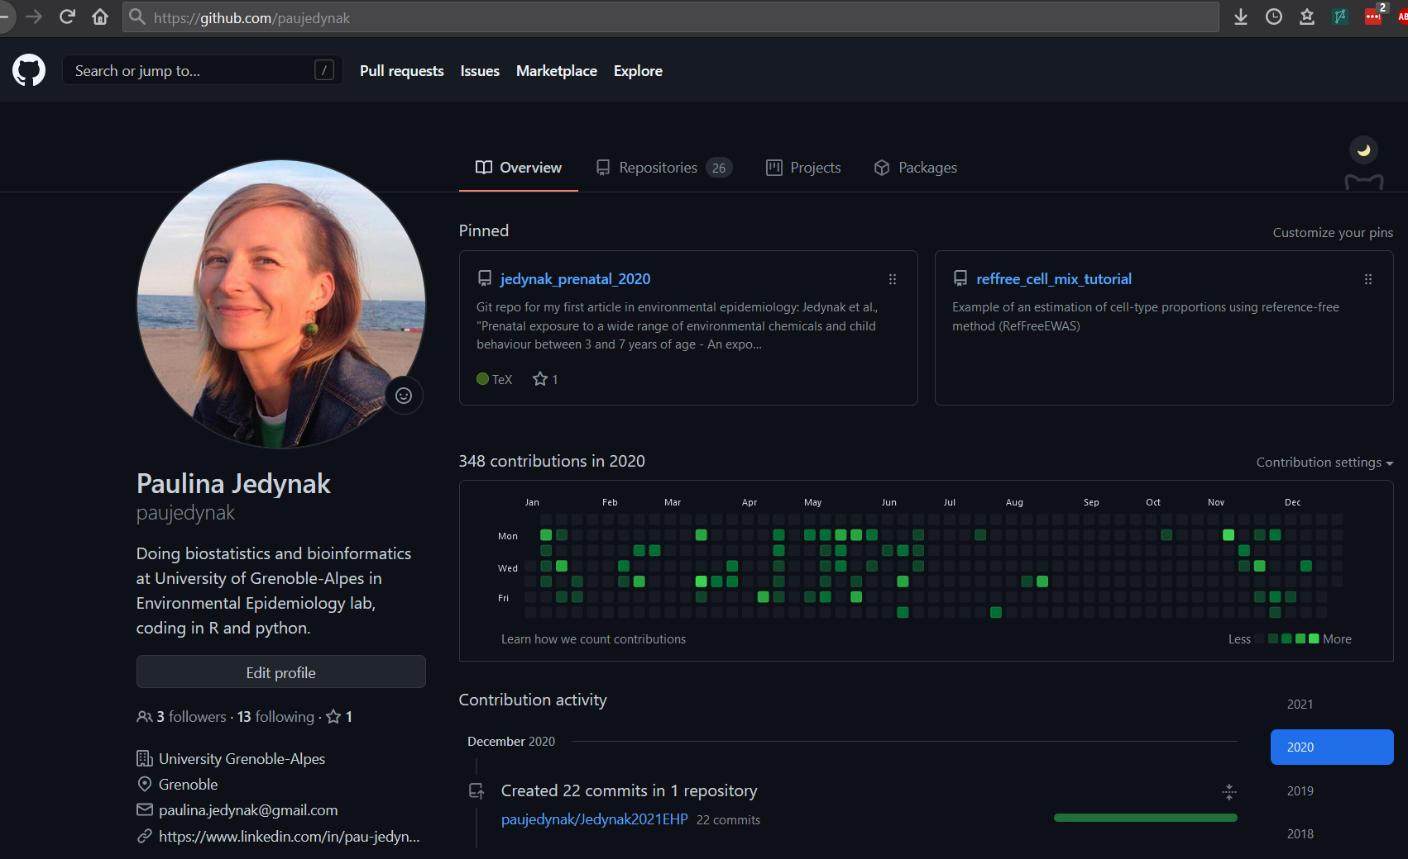
Can be easily changed at any time

Slide 8
1. Initial installations
Install or upgrade RStudio
Register an online account where the ‘remote’ version of your repositories will be kept. As an example I will use the GitHub platform but several other platforms exist
Install Git software on your machine (accept the default setup options!)
git-scm.com/downloads
You can check if you already have Git by typing where.exe git (Windows)
or which git (Mac, Linux) in the shell
Notes:
Git is an installable and executable software (like an R or RStudio) while GitHub is a website, an online repository, where information (e.g. code) can be stored. Git (software) can communicate with different online repositories (e.g. GitHub or GitLab) but these are independent tools.

Slide 9
1. Initial installations
Install or upgrade RStudio
Register an online account where the ‘remote’ version of your repositories will be kept. As an example I will use the GitHub platform but several other platforms exist
Install Git software on your machine (accept the default setup options!)
git-scm.com/downloads
You can check if you already have Git by typing where.exe git (Windows)
or which git (Mac, Linux) in the shell
Open RStudio
Notes:
Git is an installable and executable software (like an R or RStudio) while GitHub is a website, an online repository, where information (e.g. code) can be stored. Git (software) can communicate with different online repositories (e.g. GitHub or GitLab) but these are independent tools.

Slide 10
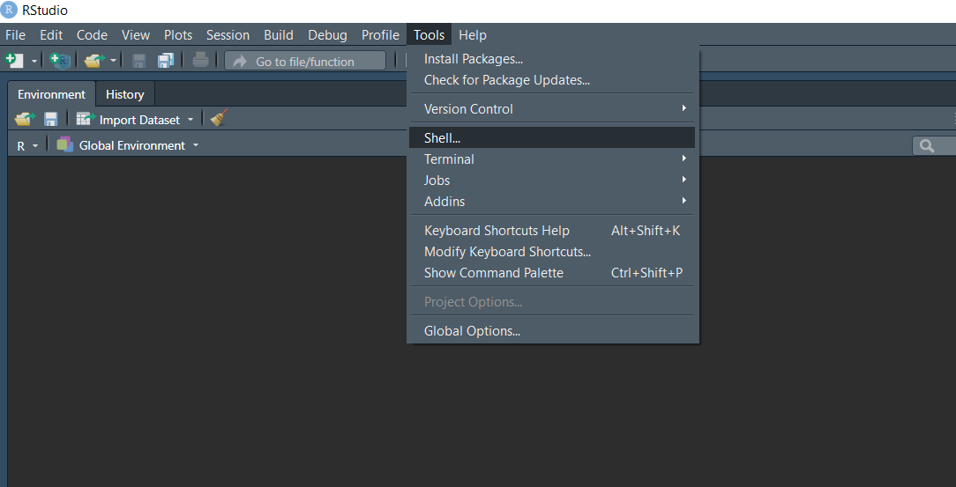
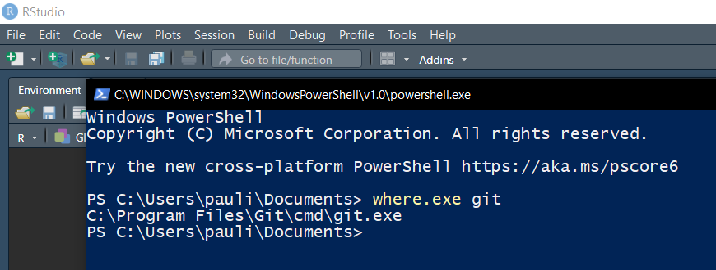
1. Initial installations
Restart/ reopen RStudio!!
Notes:
This command may be useful if Git is installed but RStudio cannot find it (especially for other than Windows users).

Slide 11
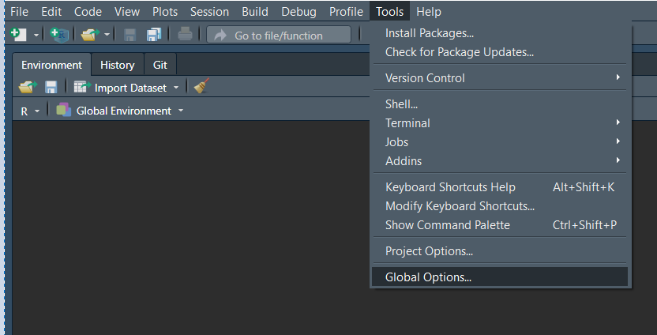
1. Initial installations
Make sure the RStudio “sees” Git (in Windows, after installation Git should be recognized automatically)
Notes:
This command may be useful if Git is installed but RStudio cannot find it (especially for other than Windows users).

Slide 12
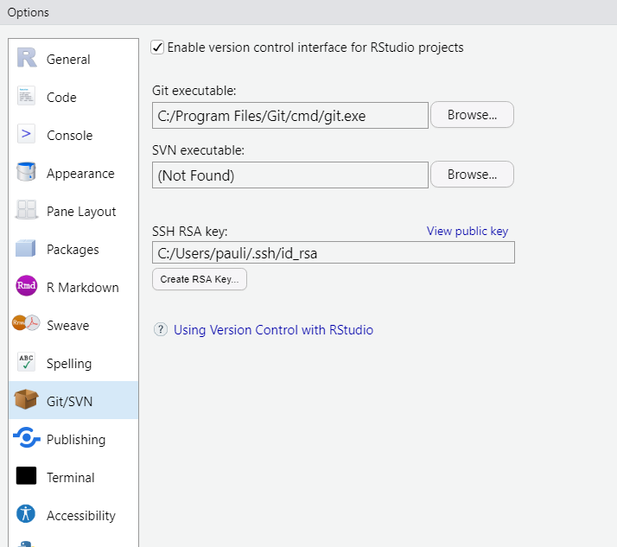
1. Initial installations
Make sure the RStudio “sees” Git (in Windows, after installation Git should be recognized automatically)
If this field is empty you need to provide the location of the git.exe file. To find it
type where.exe git (Windows)
or which git (Mac, Linux) in the shell
Notes:
This command may be useful if Git is installed but RStudio cannot find it (especially for other than Windows users).

Slide 13
1. Initial installations
Make sure the RStudio “sees” Git (in Windows, after installation Git should be recognized automatically)
Restart/ reopen RStudio!!
If this field is empty you need to provide the location of the git.exe file. To find it
type where.exe git (Windows)
or which git (Mac, Linux) in the shell
Notes:
This command may be useful if Git is installed but RStudio cannot find it (especially for other than Windows users).

Slide 14

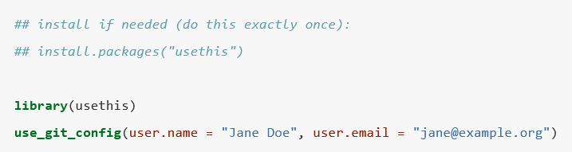
2. Introduce yourself to Git

Slide 15
2. Introduce yourself to Git
This does not have to be your GitHub user name
This must be the email associated with GitHub account

Slide 16
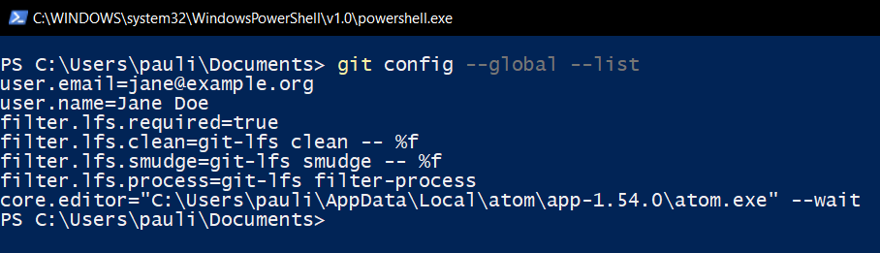
2. Introduce yourself to Git
You may check whether Git understood what you typed by using the command
git config --global –list (again in the shell)

Slide 17
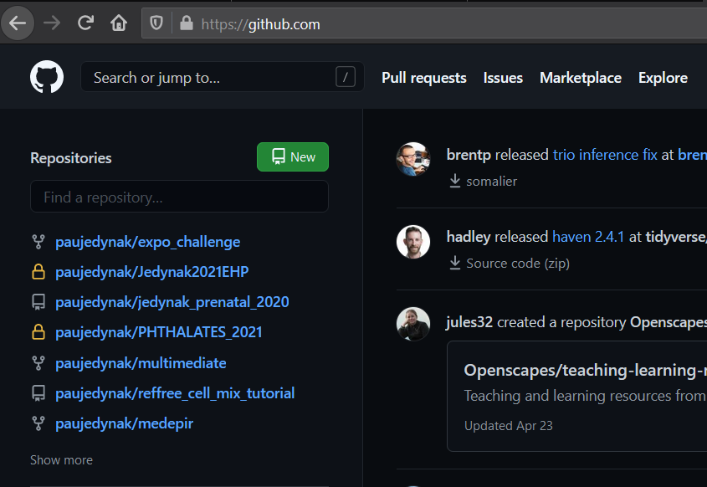
3. Connect to GitHub
Go to https://github.com and make sure you are logged in
Click green “New” button. Or, if you are on your own profile page, click first on “Repositories”, then click the green “New” button

Slide 18
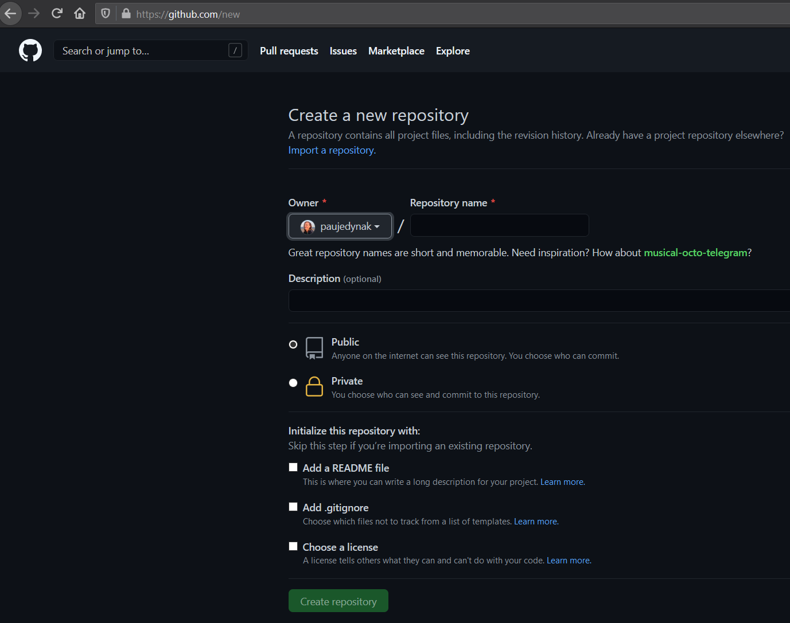
3. Connect to GitHub
Go to https://github.com and make sure you are logged in
Click green “New” button. Or, if you are on your own profile page, click first on “Repositories”, then click the green “New” button

Slide 19
3. Connect to GitHub
Go to https://github.com and make sure you are logged in
Click green “New” button. Or, if you are on your own profile page, click first on “Repositories”, then click the green “New” button
How to fill this in:
Repository name: e.g. test
1

Slide 20
3. Connect to GitHub
Go to https://github.com and make sure you are logged in
Click green “New” button. Or, if you are on your own profile page, click first on “Repositories”, then click the green “New” button
How to fill this in:
Repository name: e.g. test
Description: optional but useful
1
2

Slide 21
3. Connect to GitHub
Go to https://github.com and make sure you are logged in
Click green “New” button. Or, if you are on your own profile page, click first on “Repositories”, then click the green “New” button
How to fill this in:
Repository name: e.g. test
Description: optional but useful
Choose visibility: public or private*
1
2
3
*Up to 3 collaborators

Slide 22
3. Connect to GitHub
Go to https://github.com and make sure you are logged in
Click green “New” button. Or, if you are on your own profile page, click first on “Repositories”, then click the green “New” button
How to fill this in:
Repository name: e.g. test
Description: optional but useful
Choose visibility: public or private*
Optional: add README if needed; add .gitignore file** with R template
1
2
3
*Up to 3 collaborators
**Enables ‘hiding’ some files from being traced by Git
4

Slide 23
3. Connect to GitHub
Go to https://github.com and make sure you are logged in
Click green “New” button. Or, if you are on your own profile page, click first on “Repositories”, then click the green “New” button
How to fill this in:
Repository name: e.g. test
Description: optional but useful
Choose visibility: public or private*
Optional: add README if needed; add .gitignore file** with R template
Click green button “Create repository”
1
2
3
*Up to 3 collaborators
**Enables ‘hiding’ some files from being traced by Git
4
5

Slide 24
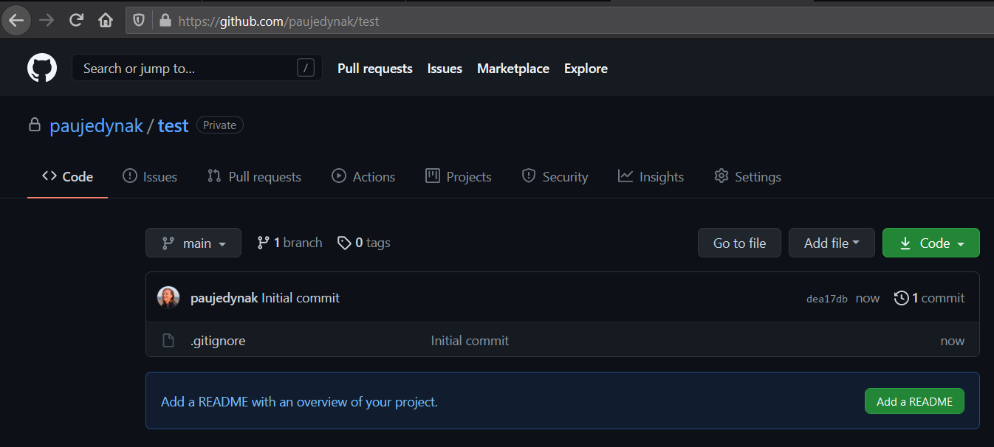
3. Connect to GitHub

Slide 25
3. Connect to GitHub

Slide 26
3. Connect to GitHub
Click the Code button

Slide 27
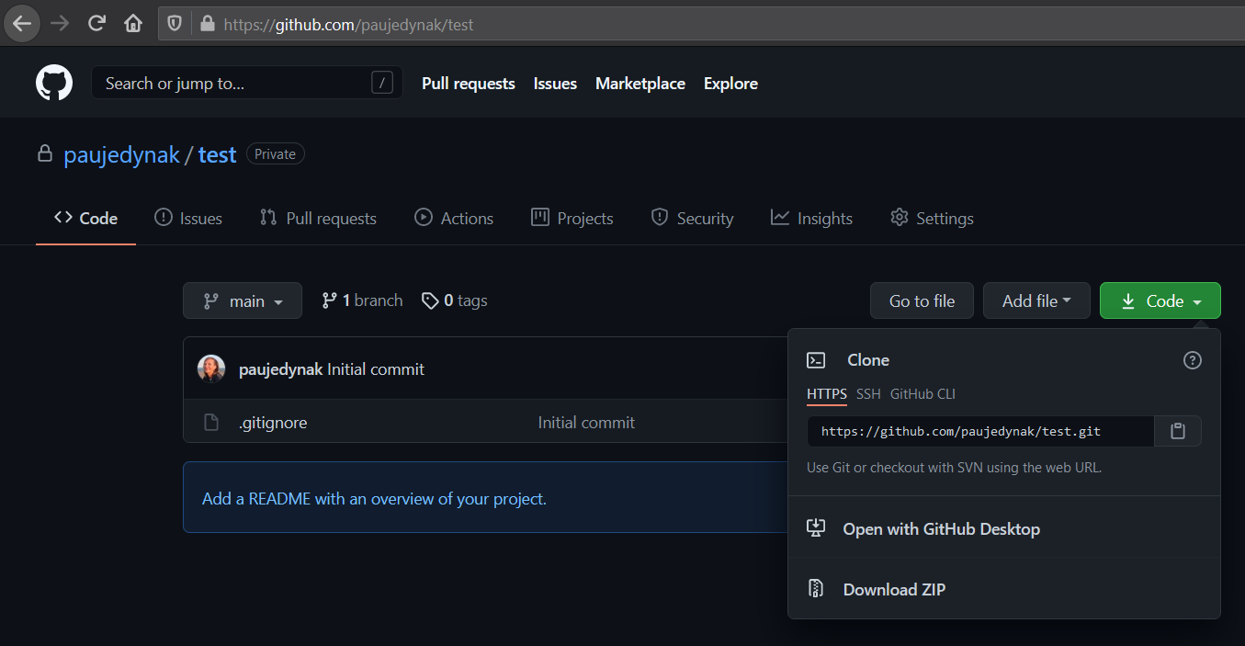
Click the Code button
Copy the link from the HTTPS tab to your Clipboard

Slide 28
Click the Code button
Copy the link from the HTTPS tab to your Clipboard
IF YOU CANNOT FIND THE ‘CODE’ BUTTON, DON’T PANIC!
It means you created an empty repository (without README, .gitignore or any other file). As soon you add a file to the repo (e.g. README), the button will appear

Slide 29
4. Clone the repo to your local machine
Now you have 2 options depending if you are starting a new R Project or you already have an existing R Project that you want to connect with Git

Slide 30
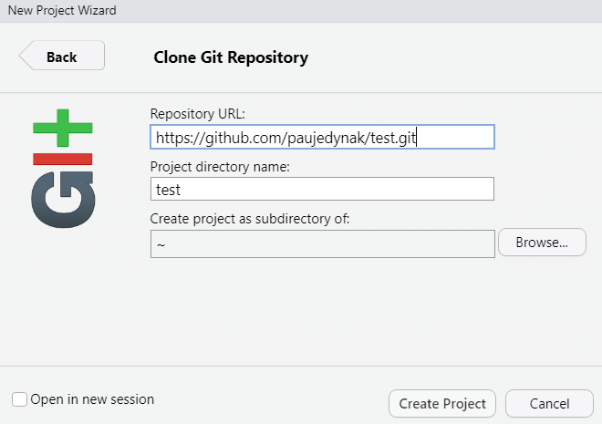
4. Clone the repo to your local machine
Brand new R Project:
In RStudio >> File >> New Project…
Choose Version Control
Choose Git
Paste the link to your repository into the Repository URL field (the Project directory name will be filled automatically)
Click Browse… to choose the location where your new Project will be created
Click Create Project

Slide 31
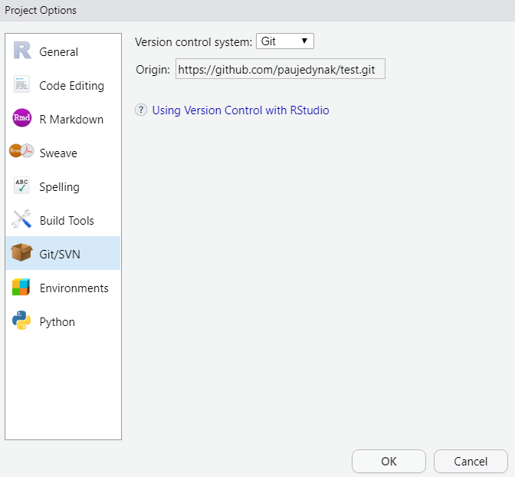
4. Clone the repo to your local machine
Brand new R Project:
In RStudio >> File >> New Project…
Choose Version Control
Choose Git
Paste the link to your repository into the Repository URL field (the Project directory name will be filled automatically)
Click Browse… to choose the location where your new Project will be created
Click Create Project

Slide 32
4. Clone the repo to your local machine
Brand new R Project:
In RStudio >> File >> New Project…
Choose Version Control
Choose Git
Paste the link to your repository into the Repository URL field (the Project directory name will be filled automatically)
Click Browse… to choose the location where your new Project will be created
Click Create Project
You can commit, push and pull…

Slide 33
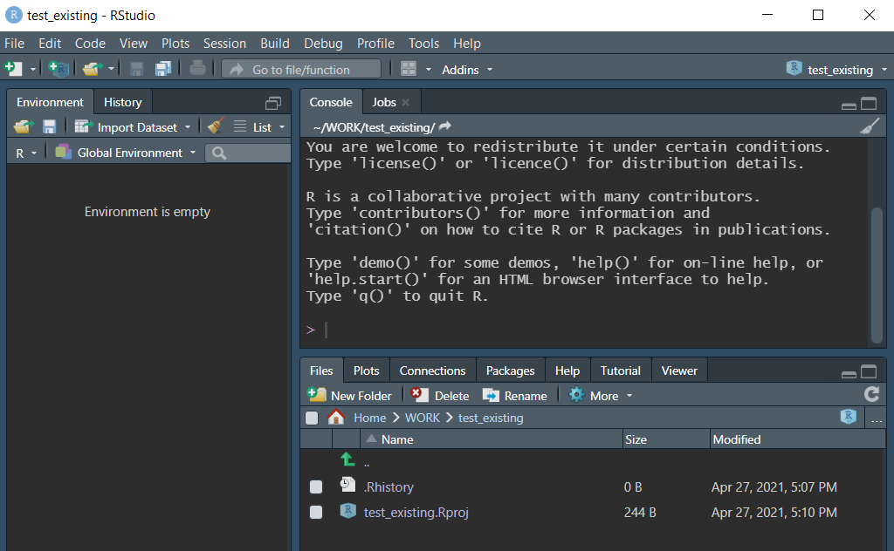
5. Connect Git to an existing R project
Existing R Project:
Open an existing Project

Slide 34
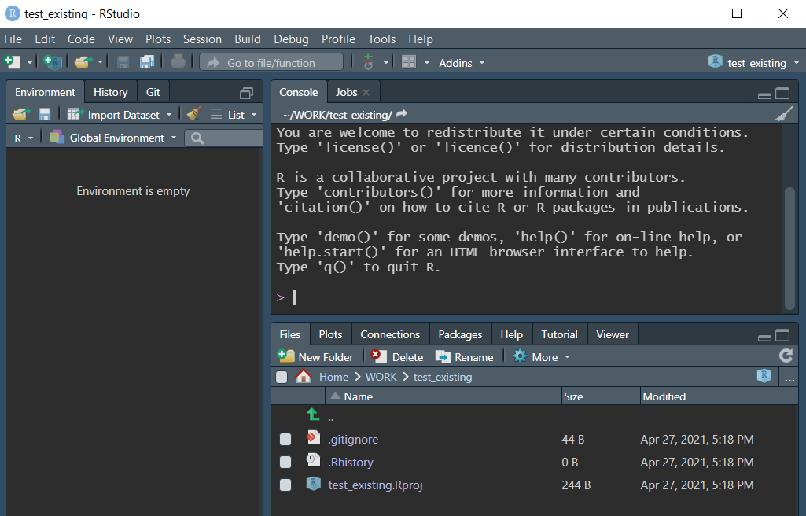
5. Connect Git to an existing R project
Existing R Project:
Open an existing Project
Tools >> Version Control >> Project Setup…
Choose Git as Version control system
Accept the following prompts

Slide 35
5. Connect Git to an existing R project
Existing R Project:
Open an existing Project
Tools >> Version Control >> Project Setup…
Choose Git as Version control system
Accept the following prompts
At this stage your version control works only locally (it is not connected with an online repository) – you may want to keep it like this or you may want to link it to the remote repository

Slide 36
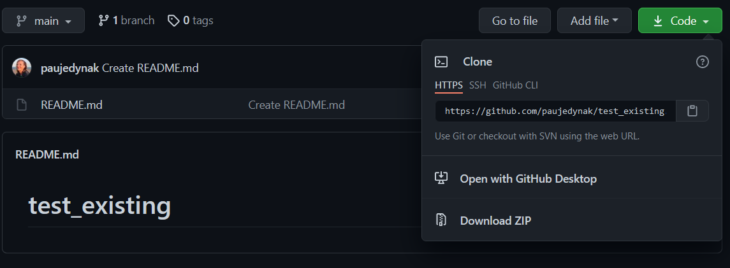
5. Connect Git to an existing R project
Connect to an online repository:
Create a remote repository as explained earlier in this presentation (3. Connect to GitHub). IMPORTANT: repo name must match your existing Project name
Copy the repo link to your Clipboard

Slide 37
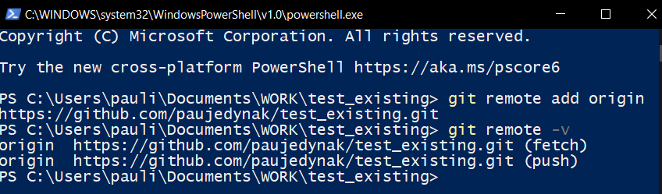
5. Connect Git to an existing R project
Connect to an online repository:
Create a remote repository as explained earlier in this presentation (3. Connect to GitHub). IMPORTANT: repo name must match your existing Project name
Copy the repo link to your Clipboard
Add remote URL to your existing Project using shell by typing:
Check the remote URL using shell by typing:
git remote add origin https://github.com/username/reponame.git where username is your GitHub username and reponame is your GitHub repository name
git remote -v

Slide 38
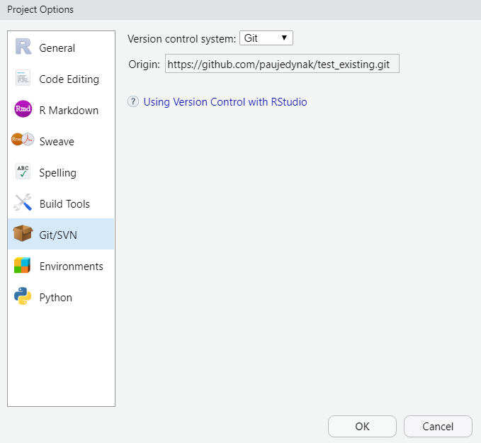
5. Connect Git to an existing R project
Connect to an online repository:
Create a remote repository as explained earlier in this presentation (3. Connect to GitHub). IMPORTANT: repo name must match your existing Project name
Copy the repo link to your Clipboard
Add remote URL to your existing Project using shell by typing:
Check the remote URL using shell by typing:
git remote -v

Slide 39
5. Connect Git to an existing R project
Connect to an online repository:
Create a remote repository as explained earlier in this presentation (3. Connect to GitHub). IMPORTANT: repo name must match your existing Project name
Copy the repo link to your Clipboard
Add remote URL to your existing Project using shell by typing:
Check the remote URL using shell by typing:
IF THIS FIELD IS EMPTY OR ‘PUSH’ AND ‘PULL’ BUTTONS ARE GREYED OUT (INACTIVE), DON’T PANIC!
Restart / reopen RStudio. If the problem persists, make some commit and make a push setting the upstream by typing in the shell:
git push origin master -u
git remote -v

Slide 40
5. Connect Git to an existing R project
Connect to an online repository:
Create a remote repository as explained earlier in this presentation (3. Connect to GitHub). IMPORTANT: repo name must match your existing Project name
Copy the repo link to your Clipboard
Add remote URL to your existing Project using shell by typing:
Check the remote URL using shell by typing:
You can commit, push and pull…
git remote -v

Slide 41

6. Commit, push and pull
MAKE A COMMIT every time you finish a valuable chunk of work, probably many times a day

Slide 42
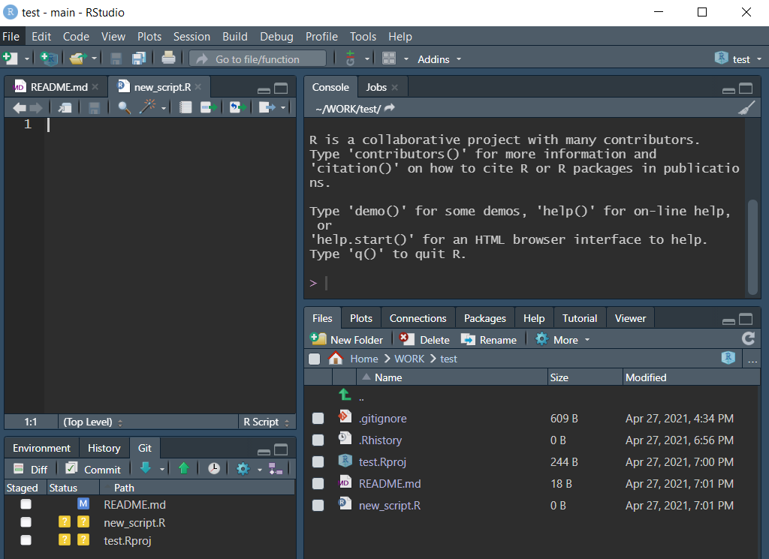
6. Commit, push and pull
All files within the Project are ‘observed’ by Git, unless added to the .gitignore file
If there are any changes in the Project – new files created (new_script.R), any SAVED changes made to the content of existing files (README.md) etc., Git will keep notifying you and will let you decide if to start tracking them (new files) or commit changes (modified files)

Slide 43
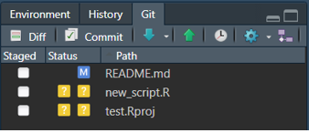
6. Stage, commit, push and pull
CREATING NEW FILES, MODYFYING EXISTING ONES
Git informes you that new files appeared in the Project (? ? = ‘unknown’ status)

Slide 44
6. Stage, commit, push and pull
CREATING NEW FILES, MODYFYING EXISTING ONES
Git informes you that new files appeared in the Project (? ? = ‘unknown’ status)
Git informes you that changes were made to a file (M = ‘modified’ status)

Slide 45
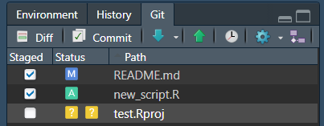
6. Stage, commit, push and pull
CREATING NEW FILES, MODYFYING EXISTING ONES
Git informes you that new files appeared in the Project (? ? = ‘unknown’ status)
Git informes you that changes were made to a file (M = ‘modified’ status)
STAGING
By ticking files you stage them (it is a necessary step before a commit) so you let Git know which files will be included in your next commit
By staging a new file (new_script.R) you let Git know you want it to start tracking this file (A = ‘adding for tracking’ status)
By staging a modified file (README.md) you let Git know you want to capture the file content modification

Slide 46
6. Stage, commit, push and pull
CREATING NEW FILES, MODYFYING EXISTING ONES
Git informes you that new files appeared in the Project (? ? = ‘unknown’ status)
Git informes you that changes were made to a file (M = ‘modified’ status)
STAGING
By ticking files you stage them (it is a necessary step before a commit) so you let Git know which files will be included in your next commit
By staging a new file (new_script.R) you let Git know you want it to start tracking this file (A = ‘adding for tracking’ status)
By staging a modified file (README.md) you let Git know you want to capture the file content modification
After you staged all the files, click ‘Commit’ button

Slide 47
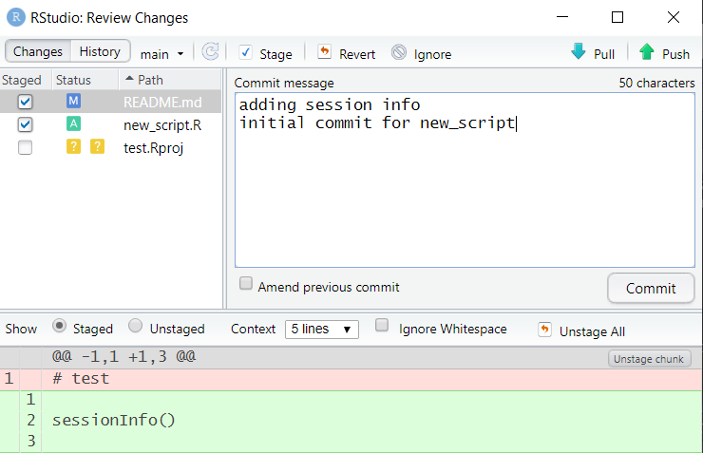
6. Stage, commit, push and pull
COMMIT
A new window pops-out where you need to provide an informative description of the commit (Commit message) so in the future you can easily find the commit by name
No need to include date in the commit, it is automatically dated

Slide 48
6. Stage, commit, push and pull
COMMIT
A new window pops-out where you need to provide an informative description of the commit (Commit message) so in the future you can easily find the commit by name
No need to include date in the commit, it is automatically dated
Clicking on a staged file (README.md) we can see the changes made in the file (deleted lines in red, modified/new lines in green)
Clicking ‘Commit’ button captures an image of the code in a particular time point

Slide 49
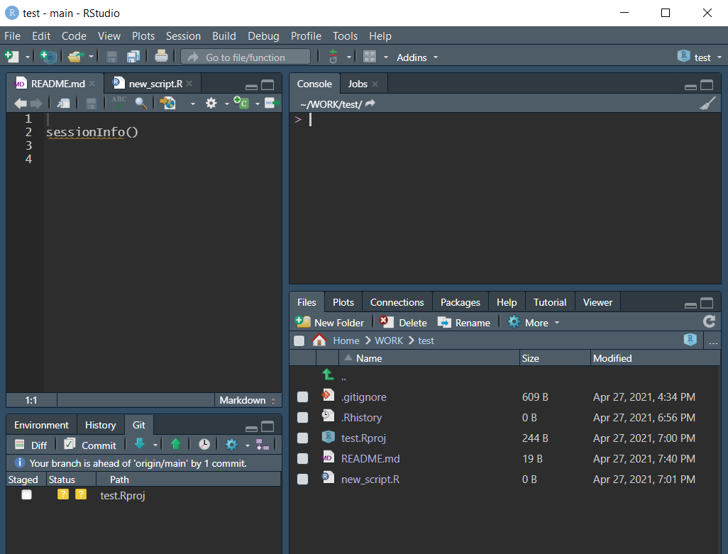
6. Stage, commit, push and pull
PUSH
After the commit, the staged files disappear

Slide 50
6. Stage, commit, push and pull
PUSH
After the commit, the staged files disappear
You are also informed that your local repository is ahead of the remote one by one commit (your local version is newer than the online one by one commit)
You do not need to push each time you make a commit, you can do it e.g. at the end of the day

Slide 51
6. Stage, commit, push and pull
PUSH
After the commit, the staged files disappear
You are also informed that your local repository is ahead of the remote one by one commit (your local version is newer than the online one by one commit)
You do not need to push each time you make a commit, you can do it e.g. at the end of the day
To push your code to the online repository, click on the green ‘Push’ button

Slide 52
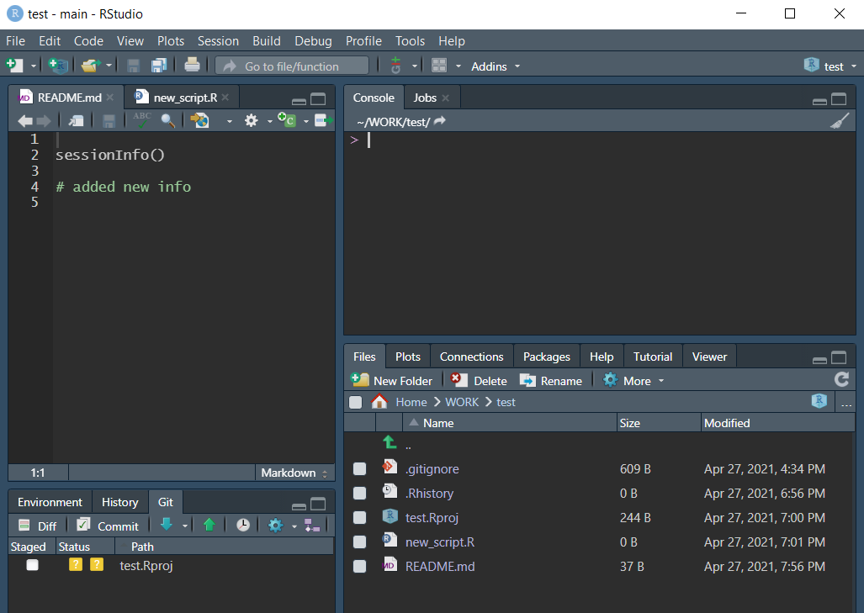
6. Stage, commit, push and pull
PULL
If you want to e.g. synchronize your work between machines (e.g. your computer at work and another one at home), on the machine where your work is outdated, click the blue ‘Pull’ button
Pulling will ‘download’ new versions of your tracked files and replace/ merge with the old ones

Slide 53
6. Stage, commit, push and pull
PULL
If you want to e.g. synchronize your work between machines (e.g. your computer at work and another one at home), on the machine where your work is outdated, click the blue ‘Pull’ button
Pulling will ‘download’ new versions of your tracked files and replace/ merge with the old ones
Do not worry (too much) about overwriting some important files – Git will inform you if there are any conflicts
If you work on several machines and do Push and Pull frequently, get used to starting your work by making a Pull (you will avoid conflicts)

Slide 54
7. Reversing a commit (or peak in history)

Slide 55
7. Reversing a commit (or peak in history)

Slide 56
7. Reversing a commit (or peak in history)

Slide 57
Summary
Git is a great tool if you want to share work within projects (e.g. several persons committing to the same project – NO MORE SENDING CODE BY EMAIL!!!)
Different collaborators (or your different machines) have the same version of the code plus they have access to all the changes made by any user (or by you in different time points)
Using Git allows you to reverse an error/ retrieve deleted files or chunks of code relatively easily (the more disciplined you are, the easier it becomes)
Ideally, when using Git, you should be consequent: make frequent commits that are named in an informative way and contain logically linked chunks of work. At the beginning it may not be easy, we have all been there
The longer you work with Git, the less often you discover that all the files disappeared from your Project directory and you have no idea where they went. At the end, in the 90% of cases they reappear ☺

Slide 58
Thank you for your attention
Paulina Jedynak, PhD
github.com/paujedynak
Environmental Epidemiology lab
gricad-gitlab.univ-grenoble-alpes.fr

