Slide 1
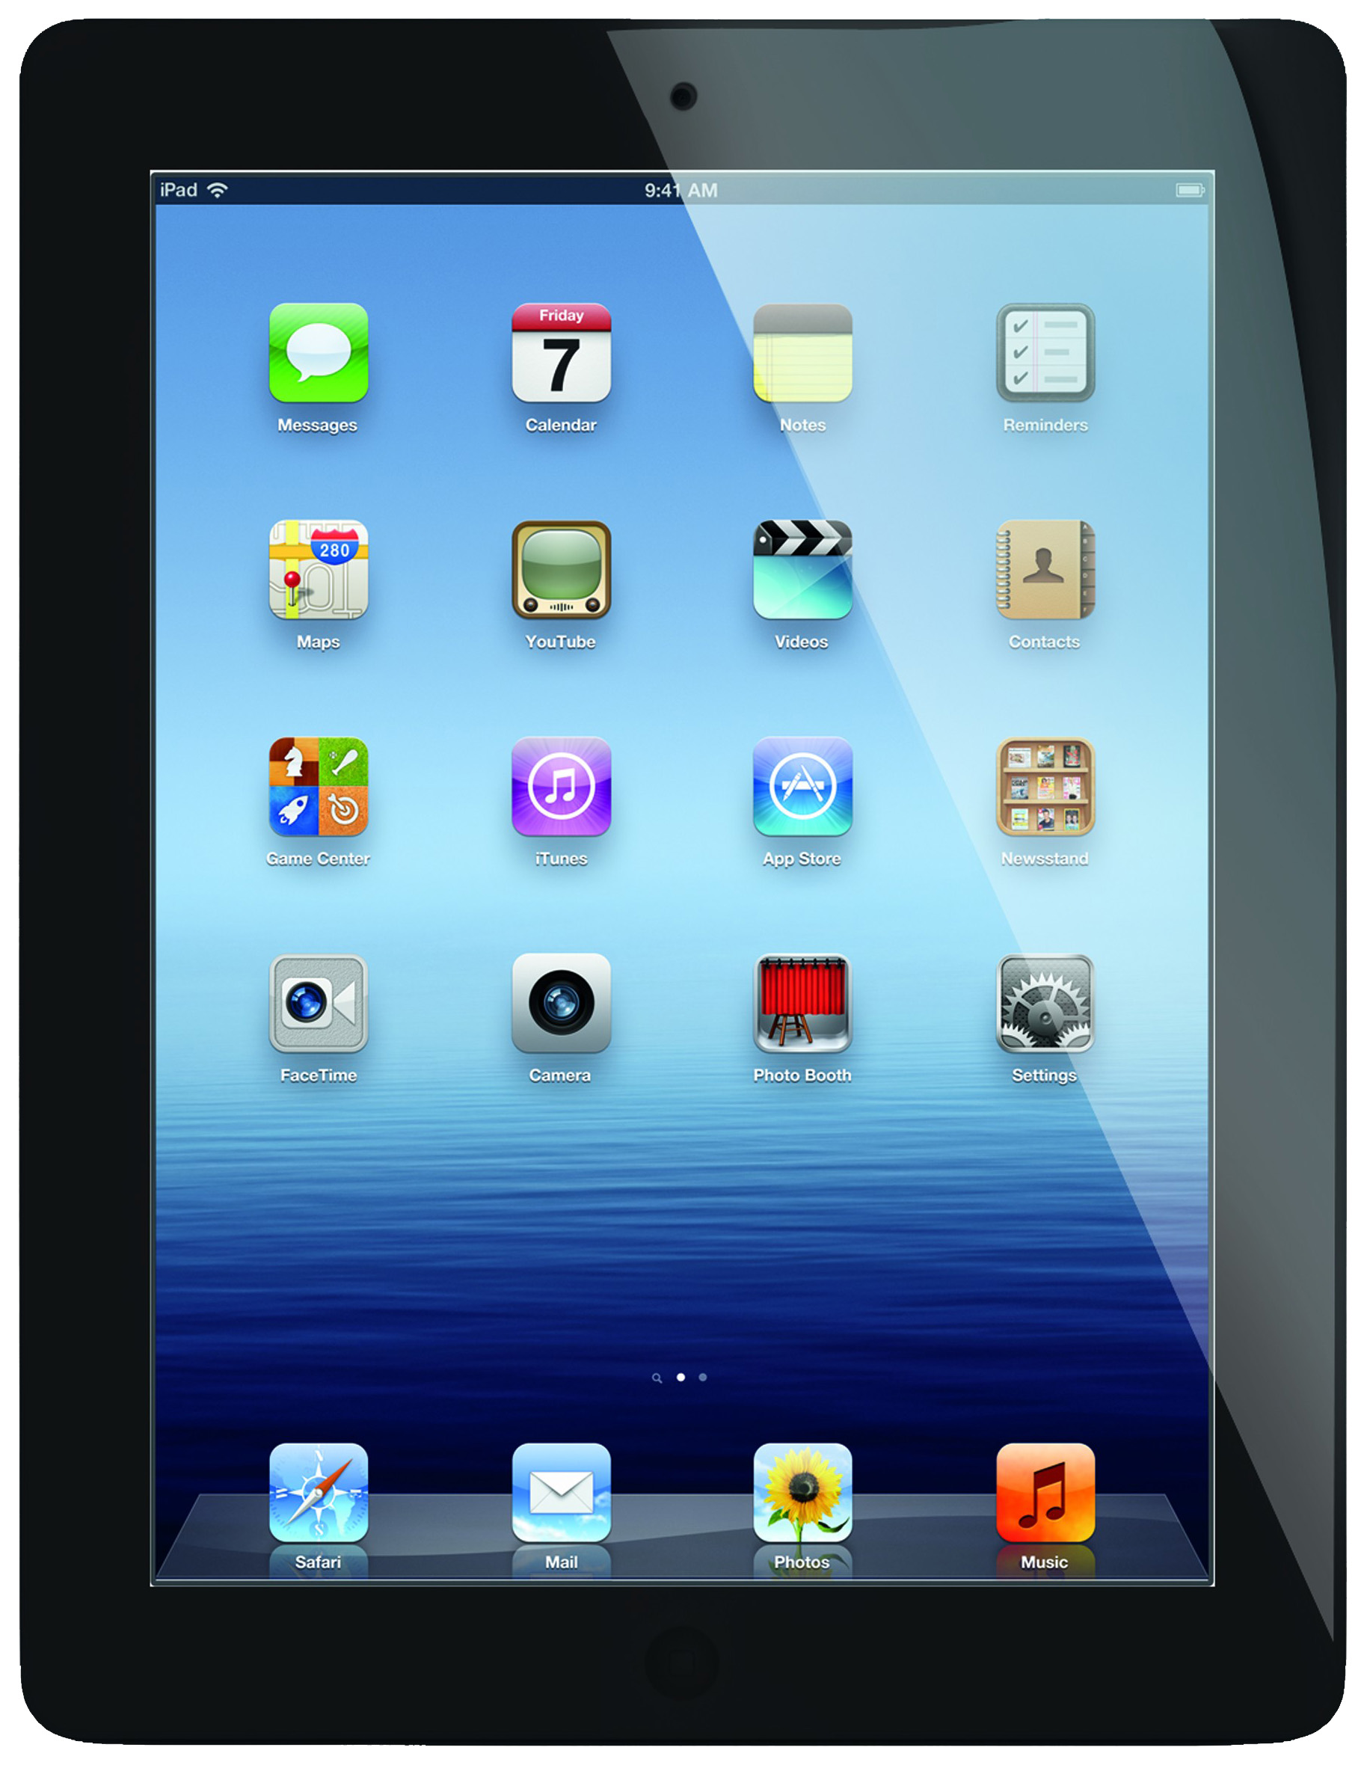
Teacher (Server)
Classroom
Distributed System

Slide 2
Teacher (Server)
Car Example
Car
Blinker Control
Steering Wheel
Accelerator
Brakes
Gear Shifter
Gas Gauge
Light Control

Slide 3
Sensors Available
Accelerometer
Three-Axis Gyro
Camera (Front and Back)
Barometer / Air Pressure Sensors
Proximity Sensor
Ambient Light Sensor
Bluetooth
Wi-Fi
Magnetometer
Used to measure the strength and/or direction of the magnetic field in the vicinity of the device

