Slide 1
analog driven development re-harnessing the conceptual mind
2014-04-15
matthew james swann
auburn university

Slide 2
readme.md
( α ) FutureLab – the venue of advancement
( β ) test driven development discourse
( γ ) conceptualization discourse
( δ ) analog driven development discourse and execution
( ε ) conclusions
( ω ) f.a.q.

Slide 3
( α ) FutureLab :: the venue of advancement
history
Walt Woltosz, ‘77 aerospace
team of scientists
‘90’s platforms – visual basic, C
‘single click’ program
current
team of students
android mobile devices – java 7.0
reversioned and revisioned retaining intention

Slide 4
( α ) FutureLab :: the venue of advancement

Slide 5
( α ) FutureLab :: the venue of advancement

Slide 6
( β ) test driven development discourse :: first baseline – structure and discipline
test driven design paradigm
source code verified against tests previously scripted
unit testing for atomic pieces of source code
extreme programming
test-first concepts in ’99
Kent Beck
credited patron of the process
TDD By Example, 2003

Slide 7
( β ) test driven development discourse
t.d.d. technique
i – make a test for an atomic piece of code
ii – run all tests and verify the new test fails
all other tests should be passing
iii – make changes to the source via feature or function install
iv – run all tests and verify that every test now passes
in the event of failure: diagnose, isolate and repair breaks
either in tests or source
v – clean up code
refactor to remove duplication
documentation – inline or otherwise

Slide 8
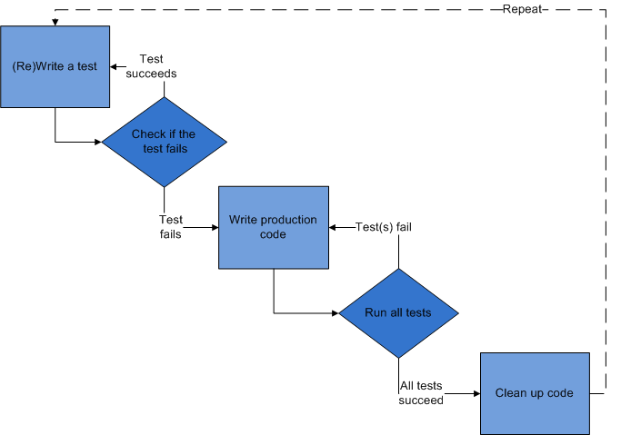
( β ) test driven development discourse
~source :: http://en.wikipedia.org/wiki/Test-driven_development

Slide 9
( β ) test driven development discourse
greater purpose
to answer questions regarding development status
“ how confident am I that this piece of code actually works? ”
input verification initialization
internal logic mechanics algorithmic behavior ( white box )
error handling logic graceful failures
output verification algorithmic return ( black box )
“ is the piece of code actually finished? ”
… if I know I’ve built rigorous tests from use cases,
and my source passes those tests…

Slide 10
( γ ) conceptualization discourse :: second baseline – nature of inquiry
inquiry – structured and disciplined discovery
concepts
symbolic representations mapped to other symbolic representations
physical manifestation versus functional usage
chair :: used for single person seating
sofa :: used for multiple person seating, or napping while laying down
symbolic layering
logical chain of abstraction, from general to specific
furniture :: chair :: comfy chair :: comfy office chair with wheels and a heated seat
temporal relationship of thought and expression
non-reflexive, non-spontaneous, and entirely volitional
“what to have for lunch?”
“what test to write for this source?”

Slide 11
( γ ) conceptualization discourse :: symbols reliant upon related concepts
spoken language as conceptual encoding
Don Quixote by Miguel de Cervantes Saavendra
a spanish story versus a story in spanish
spanish versus english
bound literary work constructed of printed words on paper
libro
book
programming language as conceptual encoding
java versus python
value assignment
this.value = 4;
self.value = 4
looping
for ( int i = zero ; i < list.size( ) ; i++ ) { //do some cool things here }
for i in list : #do the very same cool things here

Slide 12
( γ ) conceptualization discourse :: first order mapping
first order map – mechanism for intelligent discovery
determines a specific direction to travel when solving a problem
The Nature of Inquiry, James Blochowicz, PhD
map examples
the kitten and the fireplace
how to get warm without getting hot
Kelper’s study on elliptical orbit
start with a set hypotheses known to fail
circle and oval
compare these failures to observed results
refine hypothesis in light of observations and comparisons

Slide 14
definitions part one
production code
executed code designed to fulfill requirements of a given project
‘source code’
programming
line by line translation of a conceptual abstraction into source code
software development process
methodology by which software is created in a structured and disciplined manner

Slide 15
test
atomic verification of singular unit of production code
test code
scaffolding by which production code will be measured and thereby verified
test harness
collection of tests, generally gathered to match the package structure of the production code itself
test driven development {t.d.d.}
software development process employing a test-first programming strategy

Slide 16
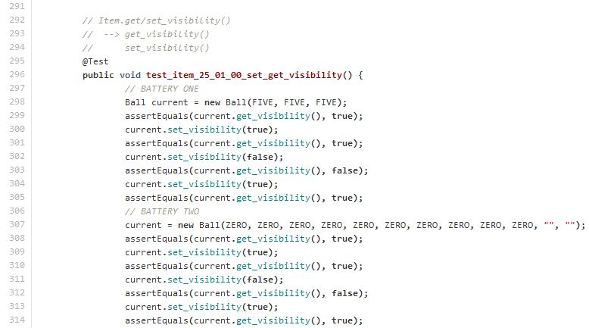
{ atomic test }
project :: future_lab directory :: src/Testing/Item_Suite.java language :: java 7.0 & junit 4.0

Slide 17
t.d.d. discourse
greater purpose
to answer questions regarding development status
“ how confident am I that this piece of code actually works? ”
input verification
error handling
internal mechanics
output verification
“ is the piece of code actually finished? ”
… if I know I’ve built rigorous tests from use cases,
and my source passes those tests…

Slide 18
t.d.d. execution
stage one – ‘ add a test ’
creation of test from use cases before writing any source code
purpose
to write a test that will run, but will also fail
justification
to be able to answer “ am I done? ”
non-failing test means no t.d.d.
functionality already written
bad test

Slide 19
stage one cont’d – ‘ add a test ’
creation of novel test
simple setters or getters
constructor equivalence
light-weight algorithm install
modification of existing test
requirements changes
multi-phase heavy-weight algorithm install
python example
phase one – verification of parameters
phase two – error handling
phase three – verification of external looping via tracking variable/mechanism
phase four – verification of internal looping via tracking variable/mechanism
phase five – verification of finalized output

Slide 20
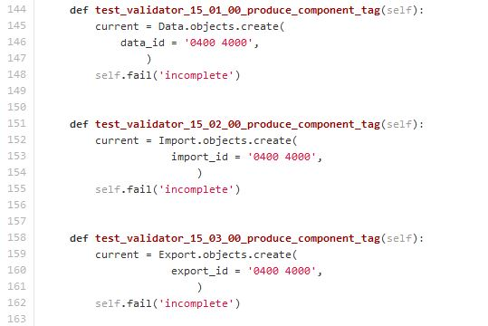
{ skeleton trio }
project :: retribution directory :: component/tests.py
language :: django 1.4 & python 2.7

Slide 21
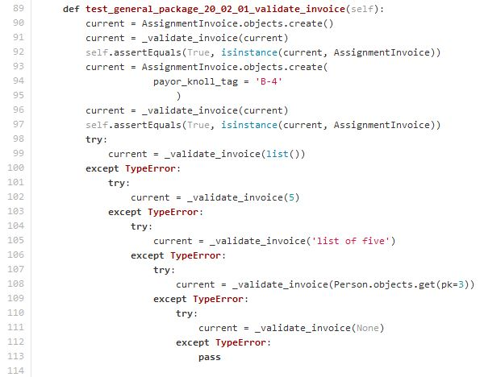
{ validation test }
project :: knollgrass directory :: invoice/tests.py
language :: django 1.4 & python 2.7

Slide 22
stage two – ‘ run all tests ’
run entire test harness
purpose
ensure previously created tests all pass
ensure currently created test fails during run
justification
tests are the driving force in t.d.d.
tests are the confidence metric in t.d.d.

Slide 23
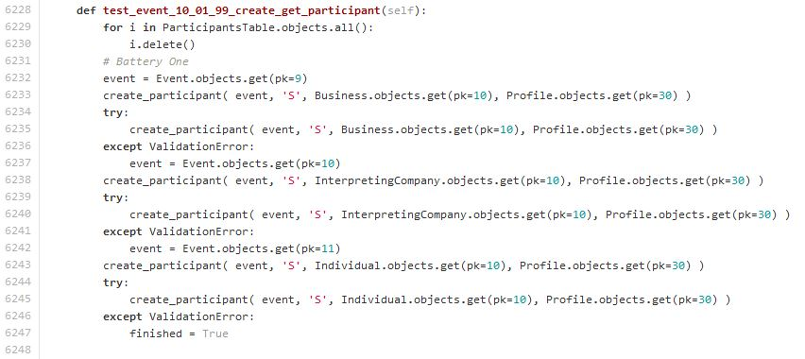
{ long test }
project :: knollgrass directory :: assignment/tests.py
language :: django 1.4 & python 2.7

Slide 24
stage three – ‘ write production code ’
write the production code necessary to fulfill project requirements matching currently created test
purpose
installation of production code is obviously necessary
justification
assignment
deadline
grade
money
resolution of boredom
impressing some…

Slide 25
stage four – ‘ run tests ’
purpose
verify correctness of production code against previously scripted tests
justification
need appropriately working product
stage five – ‘ refactor and re-run tests ’
purpose
cleanup documentation, loose ends, re-structuring of functions, etc
test run – ensure stability and correctness
justification
clarification, efficiency, readability while retaining verified correctness

Slide 26
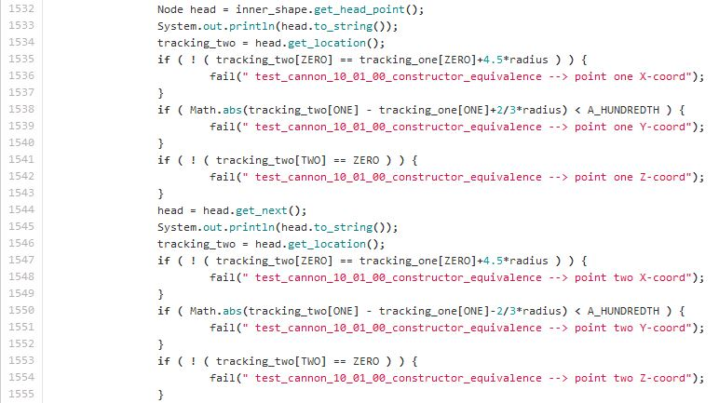
{ explicit failures }
project :: future_lab directory :: src/Testing/Item_Suite.java
language :: django 1.4 & python 2.7

Slide 27
{ t.d.d. graphic }
~ source
http://en.wikipedia.org/wiki/Test-driven_development

Slide 28
definitions part two
analog
non-digital, therefore computer-less
involving continuous space
writing implement
object by which analog or continuous space documents are written
i.e. : pen, pencil, dry-erase marker
writing surface
object on which analog documents are written
i.e. : paper (comes out of a printer), whiteboard

Slide 29
non-panicked analog design
formal analog software design disassociated from the pressure of deadlines
analog test driven development {a.t.d.d.}
non-panicked analog design of complex situational tests that strongly exercise the limitations of the software
generally large enough to require well designed test data
subsequently, analog design of complex software components or algorithms
… without a computer in the room

Slide 30
a.t.d.d. discourse
greater purpose
to answer questions regarding development status
“ how confident am I that this package will work as intended? ”
function and data dependencies
solving only the necessary problems
pre-emptive refactoring
pre-emptive debugging
package vs. package interfacing
“ is the package actually finished? ”
… if I know I’ve built a paper-based test battery,
and my source passes the java/python encoded tests…

Slide 31
a.t.d.d. execution
stage one – ‘ escape technology ’
removal of one’s self from biases of syntax, IDE’s, frameworks, etc.
purpose
remove the tools that would force your code to be written in a certain way
remove the villains that would immediately begin to box out creativity
justification
programming languages are simply a mechanism for representing a conceptual solution… not a requirement for any solution
the human mind is easily distracted by technology
the human mind is easily trained to solve problems in a certain way

Slide 32
stage two – ‘ prepare to settle in ’
find a comfortable space, bring something to write with and something to write on
show up with at least one conceptual problem that needs solved
purpose
to mentally and physically prepare to attack something difficult
justification
a complex logic problem deserves time and respect
if the problem involves a grade, a job, money… it deserves time and respect

Slide 33
stage three – ‘ the event – phase one ’
sketch the problem as it exists conceptually within the human mind
formalize conceptual understanding of the problem
purpose
creation of physical problem foundation
justification
Kepler’s resolution of elliptical orbits
first trial circle, knowing it was incorrect
second trial oval, knowing it was incorrect
third trial combination of the information gathered from failed trials

Slide 34
stage four – ‘ the event – phase two ’
challenge the foundation created to represent the problem
amend the sketch to include all use cases for the given problem
purpose
‘break’ the sketch or ‘enhance’ the sketch
add outlying cases
add potentially hard to code or resolve scenarios so long as they exist within the project requirements
justification
though the human mind may begin with solid conceptual understanding of the problem at hand, it must be able to resolve the entire problem space
any bare minimum solution to a sketch that involves all use cases, will yield the minimum viable solution to the project requirements and nothing more

Slide 35
stage five – ‘ the event – phase three ’
pseudo code a resolution to the sketch itself
purpose
to preserve the integrity of the time and effort thoroughly exploring the problem
blueprint the algorithm to solve the problem at large
justification
the whole point of this exercise is to solve a problem… should probably write that solution down as it stands ( you won’t remember… i promise )
beginning to formalize a resolution to one problem allows the human mind to more clearly begin comprehending the next problem

Slide 36
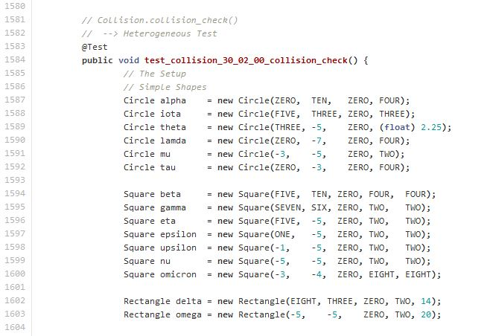
{ setup – internal }
project :: future_lab directory :: src/Testing/Event_Suite.java
language :: java 7.0 & junit 4.0

Slide 37
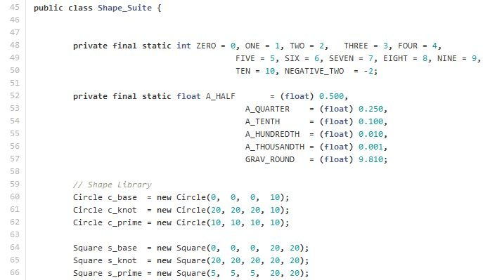
{ setup – external }
project :: future_lab directory :: src/Testing/Shape_Suite.java
language :: java 7.0 & junit 4.0

Slide 38
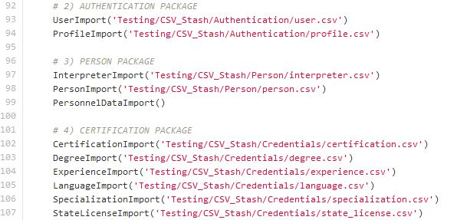
{ testdata import harness }
project :: knollgrass directory :: testing/Big_Momma.py
language :: django 1.4 & python 2.7

Slide 39
a.t.d.d. discourse cont’d
humans conceptually attack almost every problem
consider architecture
how big does this building need to be
how do I want the building to look
what is my budget for the building
what is the purpose of the building
how long until the building needs to open
reconsidering architecture
no blueprints
no formal project layout
6 months later –
holy cow… there’s a stair case in the elevator shaft… how the….

Slide 40
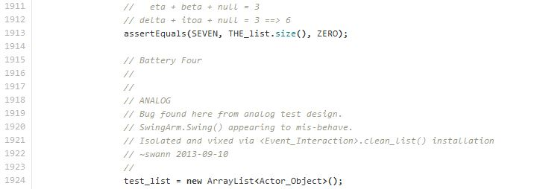
{ bug found when translating analog tests }
project :: future_lab directory :: src/Testing/Item_Suite.java
language :: java 7.0 & junit 4.0

Slide 41
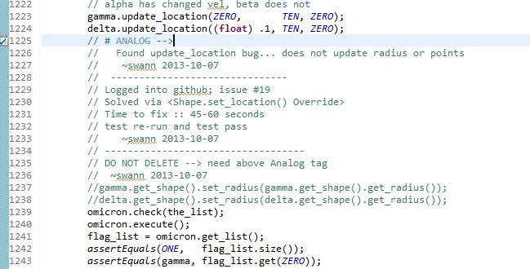
{ bug found when translating analog tests }
project :: future_lab directory :: src/Testing/Event_Suite.java
language :: java 7.0 & junit 4.0

Slide 42
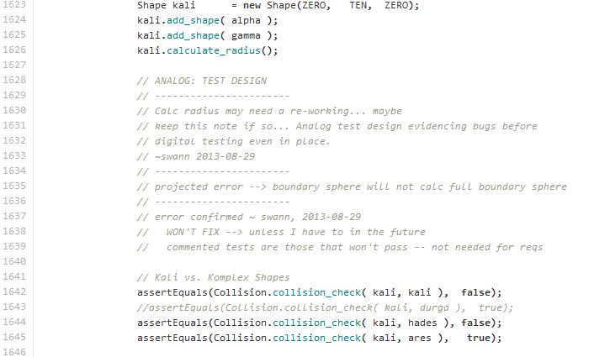
{ won’t fix when translating analog tests }
project :: future_lab directory :: src/Testing/Event_Suite.java
language :: java 7.0 & junit 4.0

Slide 43
comparative discourse
t.d.d.
preferentially chosen for smaller tasks with little to no design overhead
involves a machine every time
a.t.d.d.
preferentially chosen for large design work
requires the human to remember he or she is still a human and doesn’t need to be at a keyboard to solve a logic problem
mutually exclusive?
no, in fact when one get’s good at both they feed into each other
dualistic implementation yields improved results

Slide 44
t.d.d. yields
improved confidence in existing software artifact
improved understanding of existing artifact status
test harness existence for any refactoring or requirement changes
small scope assurance for minimum viable product
small scope debugging
a.t.d.d. yields
improved confidence in designed software artifact
improved understanding of designed artifact status
large scope assurance for minimum viable product
early stage isolation of ‘ power ’ vs. ‘ support ’ functionality
pre-emptive debugging
pre-emptive refactoring

Slide 45
f.a.q.
Questions…

Slide 46
consider a cookout
when to start the grill is based on when people will arrive
what beer to throw in a cooler matches a beer the guests like to drink
the time of the event may be based on ‘ the big game ’
re-considering a cookout without a plan or concept as to what is going on
start the grill now, we definitely need it at some point anyway
when do I need x, y, z?
send someone to the store but don’t let him check the fridge
what are x, y, z? and are they even needed?
flip the channel to ESPN desportes even though no one speaks spanish
didn’t read the documentation?
desportes has that ‘other’ futbol ?!!!?!!???
but I don’t know python……

