Slide 1
analog driven development re-harnessing the conceptual mind
2014-04-15
matthew james swann
auburn university

Slide 2
readme.md
( α ) FutureLab – the venue of advancement
( β ) test driven development discourse
( γ ) conceptualization discourse
( δ ) analog driven development discourse and execution
( ε ) conclusions
( ω ) f.a.q.

Slide 3
<prologue>
what is a.d.d.
why is a.d.d.

Slide 4
( α ) FutureLab :: the venue of advancement
history
Walt Woltosz, ‘77 aerospace
team of scientists
‘90’s platforms – visual basic, C
‘single click’ program
current
team of students
android mobile devices – java 7.0
reversioned and revisioned retaining intention

Slide 5
( α ) FutureLab :: the venue of advancement

Slide 6
( α ) FutureLab :: the venue of advancement

Slide 7
( β ) test driven development discourse :: first baseline – structure and discipline
test driven design paradigm
source code verified against tests previously scripted
unit testing for atomic pieces of source code
extreme programming
test-first concepts in ’99
Kent Beck
credited patron of the process
TDD By Example, 2003

Slide 8
( β ) test driven development discourse :: first baseline – structure and discipline
t.d.d. technique
i – make a test for an atomic piece of code
ii – run all tests and verify the new test fails
all other tests should be passing
iii – make changes to the source via feature or function install
iv – run all tests and verify that every test now passes
in the event of failure: diagnose, isolate and repair breaks
either in tests or source
v – clean up code
refactor to remove duplication
documentation – inline or otherwise

Slide 9
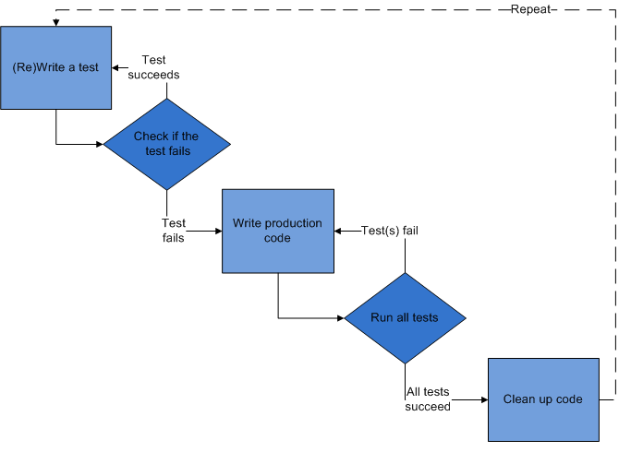
( β ) test driven development discourse :: first baseline – structure and discipline
~source :: http://en.wikipedia.org/wiki/Test-driven_development

Slide 10
( β ) test driven development discourse :: first baseline – structure and discipline
greater purpose
to answer questions regarding development status
“ how confident am I that this piece of code actually works? ”
input verification initialization
internal logic mechanics algorithmic behavior ( white box )
error handling logic graceful failures
output verification algorithmic return ( black box )
“ is the piece of code actually finished? ”
… if I know I’ve built rigorous tests from use cases,
and my source passes those tests…

Slide 11
( γ ) conceptualization discourse :: second baseline – nature of inquiry
inquiry – structured and disciplined discovery
concepts
symbolic representations mapped to other symbolic representations
physical manifestation versus functional usage
chair :: used for single person seating
sofa :: used for multiple person seating, or napping while laying down
symbolic layering
logical chain of abstraction, from general to specific
furniture :: chair :: comfy chair :: comfy office chair with wheels and a heated seat
temporal relationship of thought and expression
non-reflexive, non-spontaneous, and entirely volitional
“what to have for lunch?”
“what test to write for this source?”

Slide 12
( γ ) conceptualization discourse :: symbols reliant upon related concepts
spoken language as conceptual encoding
Don Quixote by Miguel de Cervantes Saavendra
a spanish story versus a story in spanish
spanish versus english
bound literary work constructed of printed words on paper
libro
book
programming language as conceptual encoding
java versus python
value assignment
this.value = 4;
self.value = 4
looping
for ( int i = zero ; i < list.size( ) ; i++ ) { //do some cool things here }
for i in list : #do the very same cool things here

Slide 13
( γ ) conceptualization discourse :: first order mapping
first order map – mechanism for intelligent discovery
determines a specific direction to travel when solving a problem
The Nature of Inquiry, James Blachowicz, PhD
map examples
the kitten and the fireplace
how to get warm without getting hot
Kelper’s study on elliptical orbit
start with a set hypotheses known to fail
circle and oval
compare these failures to observed results
refine hypothesis in light of observations and comparisons

Slide 14
( δ ) analog development discourse :: similarities to t.d.d.
similarities to t.d.d.
structure of individual tests
‘the setup’ – collection of actors
target behavior – functional tested
assertions – validity of output versus requirements
structure of test harness
package by package; module by module
definitive and obvious organization
happy path – 00 block designations
internal mechanics
target behavior
assertions
sad path – 99 block designations
error handling
input validation

Slide 15
( δ ) analog development discourse :: differences from t.d.d.
purpose
t.d.d. :: “speed over efficiency” :: greedy heuristic ‘a’
a.d.d. :: efficiency over speed :: greedy heuristic ‘b’
insight
t.d.d. :: cannot harness insight, so abandon the thought
a.d.d :: kick start insight using natural strengths of the human mind; visualizations
scope
t.d.d. :: one test at a time :: focus on atomic behavior
a.d.d. :: as many tests as needed :: focus on environmental behavior

Slide 16
( δ ) analog development discourse && first order mapping
initial question
“how to an idea out of that guy’s head… and into this phone?”
what are we building? why, why are we building that?
the bridge analogy
secondary question
“what tools and materials do we have… and what do we need?”
language(s) and a.p.i.
existing artifact and prototypes
current project status
tertiary question
“how do we get from our current status to where we need to be?”
via first order mapping
via physical visualization and tinkering

Slide 17
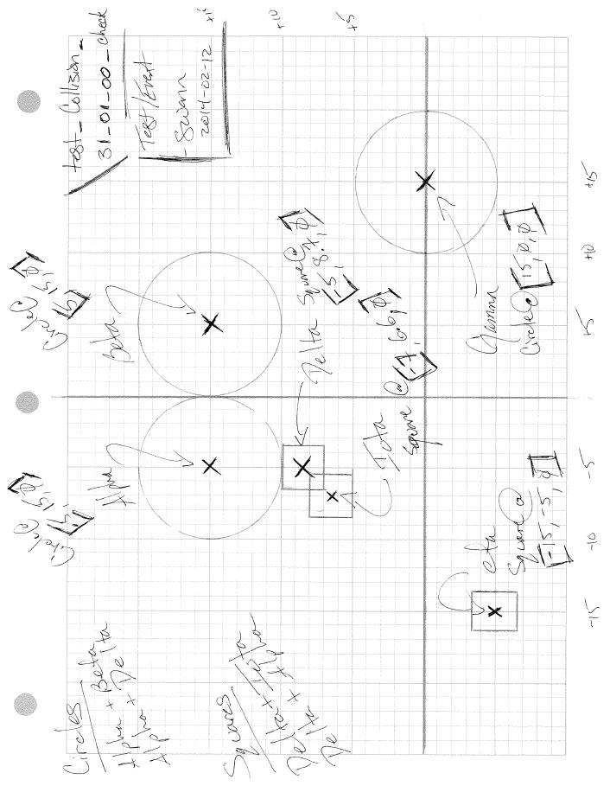
( δ ) analog development evidence :: test_collision_31_00_00_check (analog aspect)

Slide 18
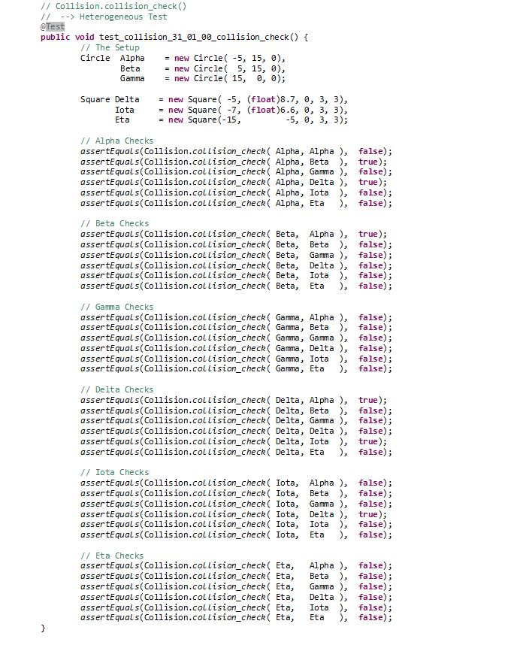
( δ ) analog development evidence :: test_collision_31_00_00_check (digital aspect)

Slide 19
( δ ) analog development execution :: the analog process, part one
the analog process – mental presence
i – escape technology
removal of the computer
remove the bias
remove the crutch
ii – intellectually prepare
begin churning cognitive inertia
documentation and requirements
engineering notes and design documents
phone call

Slide 20
( δ ) analog development execution :: the analog process, part two
the analog process – developmental process
iii – sketch the problem and a potential solution
conceptually represent a solution
reflection of developer’s working knowledge
iv – repair the sketch in light of requirements
add missing use cases for the environment
reconcile working knowledge base with needed knowledge
“what did we miss? what pieces aren’t we paying attention to?”
v – pseudo-code the solution
definition of algorithmic logic
isolation of support logic
bridge between the human mind and machine instruction

Slide 21
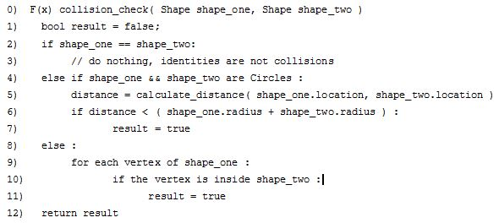
( δ ) analog development execution :: the analog process :: pseudo-code first pass

Slide 22
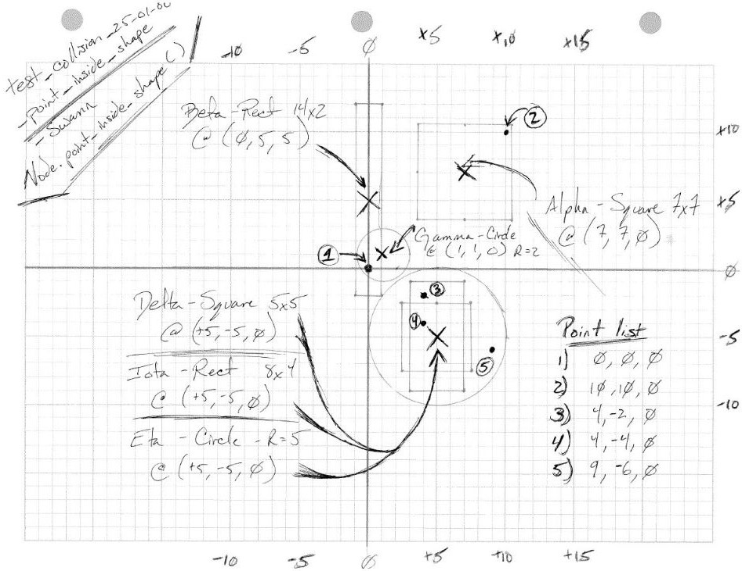
( δ ) analog development execution :: the analog process, secondary discovery

Slide 23
( δ ) analog development validation :: class normalization and layered design
Text and figure?

Slide 24
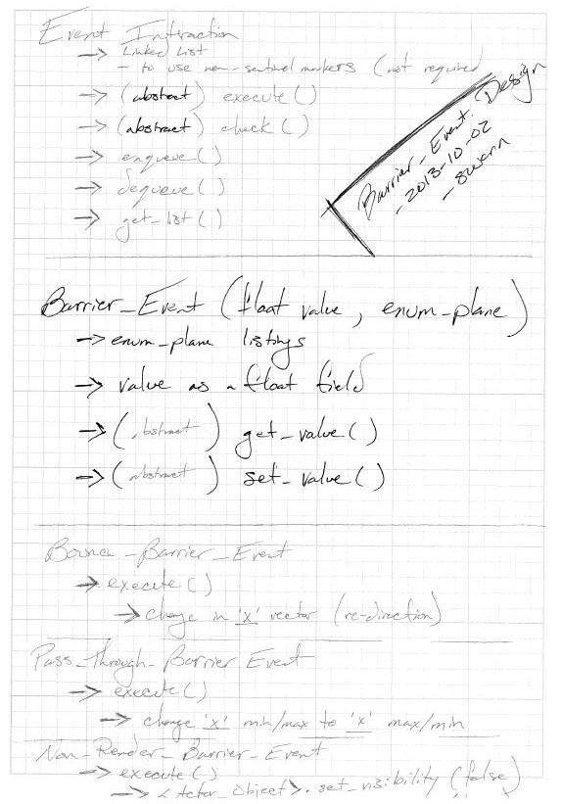
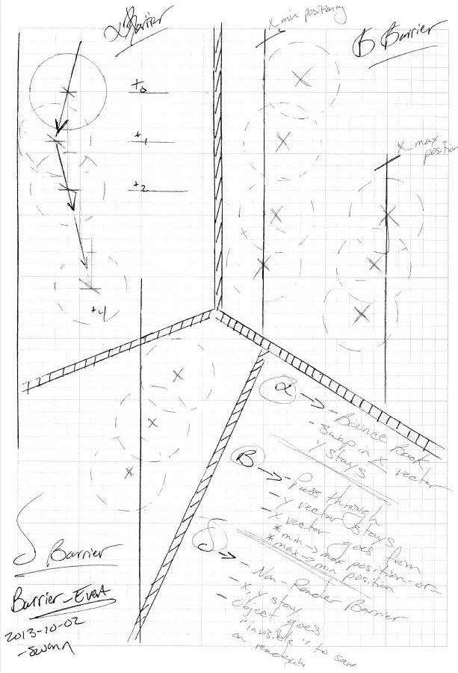

Slide 25
( δ ) analog development validation :: relative math and test scenario flexibility
Text and figures

Slide 26
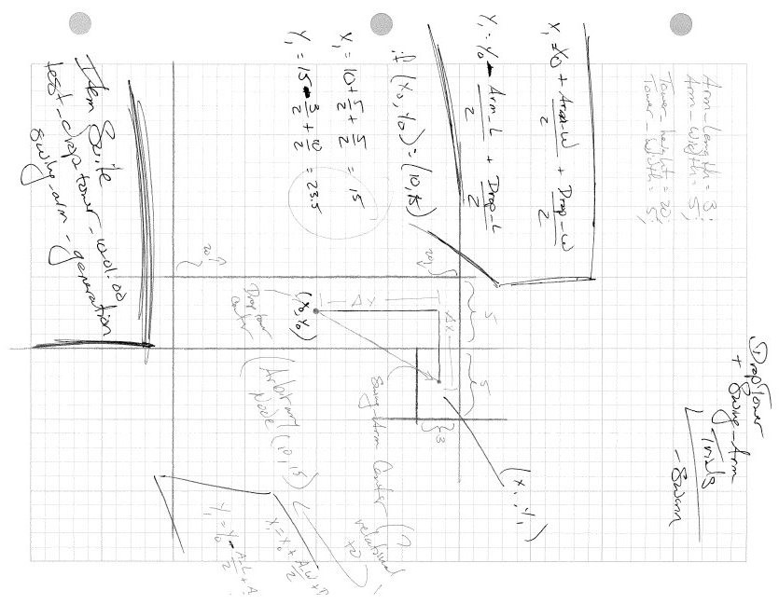

Slide 27
( δ ) analog development validation :: self reconnaissance and thewon’t fix
Text and figures

Slide 28
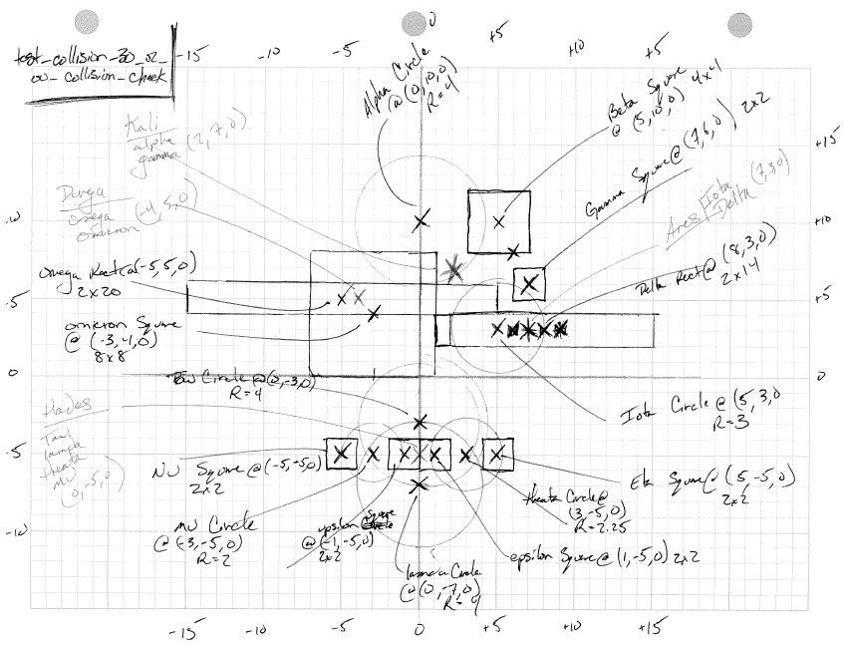
( δ ) analog development validation :: self reconnaissance

Slide 29
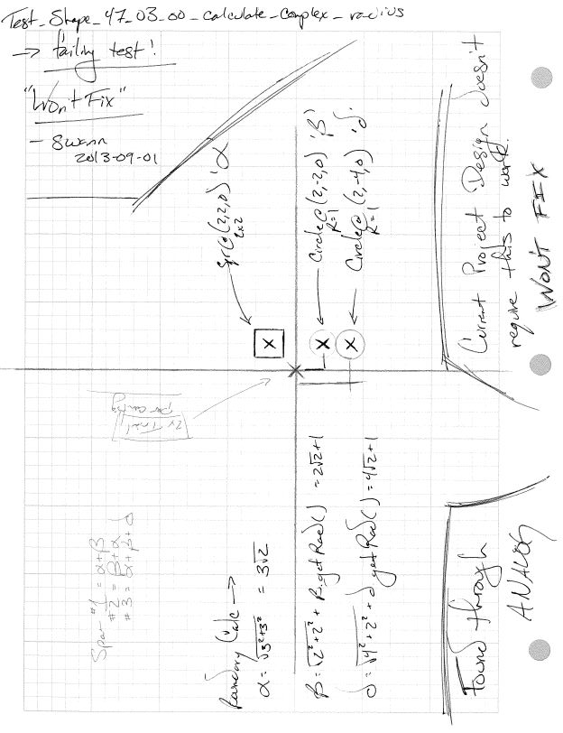
( δ ) analog development validation :: thewon’t fix

Slide 30
( ε ) conclusions :: in summary
a.d.d. yields
improved confidence in designed software artifact
improved understanding of designed artifact status
large scope assurance for minimum viable product
early stage isolation of ‘ power ’ vs. ‘ support ’ functionality
pre-emptive debugging
pre-emptive refactoring

Slide 31
( ε ) conclusions :: future consideration
stuff

Slide 32
( ω ) frequently asked questions
have at it

Slide 33
t.d.d. yields
improved confidence in existing software artifact
improved understanding of existing artifact status
test harness existence for any refactoring or requirement changes
small scope assurance for minimum viable product
small scope debugging
a.t.d.d. yields
improved confidence in designed software artifact
improved understanding of designed artifact status
large scope assurance for minimum viable product
early stage isolation of ‘ power ’ vs. ‘ support ’ functionality
pre-emptive debugging
pre-emptive refactoring

