Slide 1
Decision Support Systems and Business Intelligence
Chapter 4:
Business Reporting,
Visual Analytics, and Business
Performance Management

Slide 2
Business Reporting Definitions and Concepts
Report = Information → Decision
Report?
Any communication artifact prepared to convey specific information
A report can fulfill many functions
To ensure proper departmental functioning
To provide information
To provide the results of an analysis
To persuade others to act
To create an organizational memory…

Slide 3
What is a Business Report?
A written document that contains information regarding business matters.
Purpose: to improve managerial decisions
Source: data from inside and outside the organization (via the use of ETL)
Format: text + tables + graphs/charts
Distribution: in-print, email, portal/intranet
Data acquisition → Information generation → Decision making → Process management

Slide 4
Business Reporting

Slide 5
Key to Any Successful Report
Clarity …
Brevity …
Completeness …
Correctness …
Report types (in terms of content and format)
Informal – a single letter or a memo
Formal – 10-100 pages; cover + summary + text
Short report – periodic, informative, investigative

Slide 6
Types of Business Reports
Metric Management Reports
Help manage business performance through metrics (SLAs for externals; KPIs for internals)
Can be used as part of Six Sigma and/or TQM
Dashboard-Type Reports
Graphical presentation of several performance indicators in a single page using dials/gauges
Balanced Scorecard-Type Reports
Include financial, customer, business process, and learning & growth indicators

Slide 7
Components of Business Reporting Systems
Common characteristics
OLTP (online transaction processing)
ERP, POS, SCM, RFID, Sensors, Web, …
Data supply (volume, variety, velocity, …)
ETL
Data storage
Business logic
Publication medium
Assurance

Slide 8
Data and Information Visualization
“The use of visual representations to explore, make sense of, and communicate data.”
Data visualization vs. Information visualization
Information = aggregation, summarization, and contextualization of data
Related to information graphics, scientific visualization, and statistical graphics
Often includes charts, graphs, illustrations, …

Slide 9
Different Types of Charts and Graphs
Which one to use? Where and when?
Basic Charts and Graphs
Line Chart
Bar Chart
Pie Chart
Scatter Plot
Bubble Chart
Specialized Charts and Graphs
Histogram
Gantt Chart
PERT Chart
Geographic Map
Bullet Graph
Heat Map / Tree Map
Highlight Table

Slide 10
Visual Analytics
A recently coined term
Information visualization + predictive analytics
Information visualization
Descriptive, backward focused
“what happened” “what is happening”
Predictive analytics
Predictive, future focused
“what will happen” “why will it happen”
There is a strong move toward visual analytics

Slide 11
Performance Dashboards
Performance dashboards are commonly used in BPM software suites and BI platforms
Dashboards provide visual displays of important information that is consolidated and arranged on a single screen so that information can be digested at a single glance and easily drilled in and further explored

Slide 12
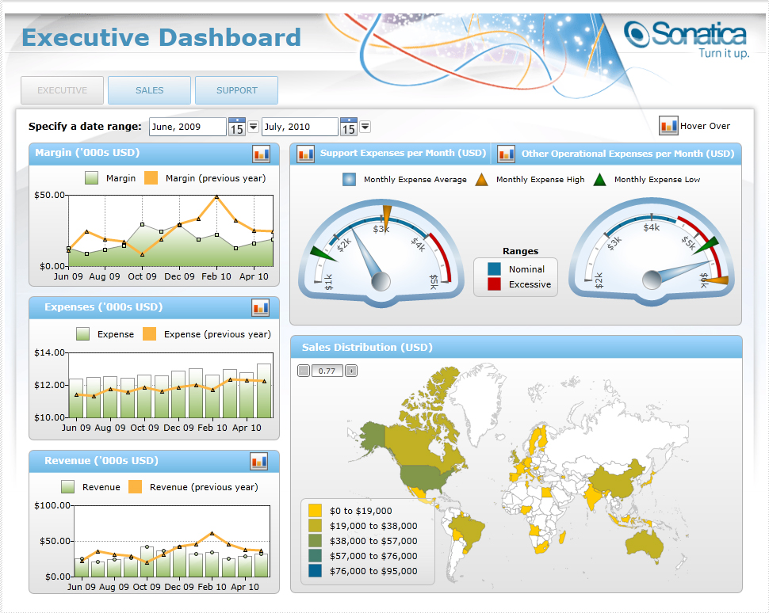
Performance Dashboards

Slide 13
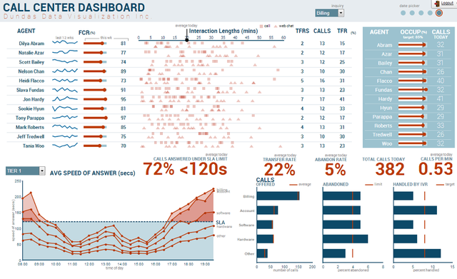
Performance Dashboards

Slide 14
Performance Dashboards
Dashboard design
The fundamental challenge of dashboard design is to display all the required information on a single screen, clearly and without distraction, in a manner that can be assimilated quickly
Three layer of information
Monitoring
Analysis
Management

Slide 15
Best Practices in Dashboard Design
Benchmark KPIs with Industry Standards
Wrap the Metrics with Contextual Metadata
Validate the Design by a Usability Specialist
Prioritize and Rank Alerts and Exceptions
Enrich Dashboard with Business-User Comments
Present Information in Three Different Levels
Pick the Right Visual Constructs
Provide for Guided Analytics

Slide 16
Business Performance Management (BPM)
Business Performance Management (BPM) is…
A real-time system that alerts managers to potential opportunities, impending problems and threats, and then empowers them to react through models and collaboration.
Also called corporate performance management (CPM by Gartner Group), enterprise performance management (EPM by Oracle), strategic enterprise management (SEM by SAP)

Slide 17
Business Performance Management (BPM)
BPM refers to the business processes, methodologies, metrics, and technologies used by enterprises to measure, monitor, and manage business performance.
BPM encompasses three key components
A set of integrated, closed-loop management and analytic processes, supported by technology …
Tools for businesses to define strategic goals and then measure/manage performance against them
Methods and tools for monitoring key performance indicators (KPIs), linked to organizational strategy

Slide 18
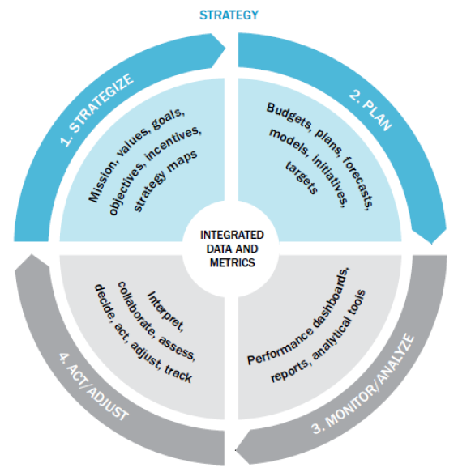
A Closed-Loop Process to Optimize Business Performance
Process Steps
Strategize
Plan
Monitor/analyze
Act/adjust
Each with its own process steps

Slide 19
Strategize: Where Do We Want to Go?
Strategic planning
Common tasks for the strategic planning process:
Conduct a current situation analysis
Determine the planning horizon
Conduct an environment scan
Identify critical success factors
Complete a gap analysis
Create a strategic vision
Develop a business strategy
Identify strategic objectives and goals

Slide 20
Plan: How Do We Get There?
Operational planning
Operational plan: plan that translates an organization’s strategic objectives and goals into a set of well-defined tactics and initiatives, resources requirements, and expected results for some future time period (usually a year).
Operational planning can be
Tactic-centric (operationally focused)
Budget-centric plan (financially focused)

Slide 21
Monitor/Analyze: How Are We Doing?
A comprehensive framework for monitoring performance should address two key issues:
What to monitor?
Critical success factors
KPIs and other targets
How to monitor?
Reports
Frequent communication of current performance

Slide 22
Act and Adjust: What Do We Need to Do Differently?
Success (or mere survival) depends on new projects: creating new products, entering new markets, acquiring new customers (or businesses), or streamlining some process.
Many new projects and ventures fail!
What is the chance of failure?
60% of Hollywood movies fail
70% of large IT projects fail, …

Slide 23
Performance Measurement
Performance measurement system
A system that assists managers in tracking the implementations of business strategy by comparing actual results against strategic goals and objectives
Comprises systematic comparative methods that indicate progress (or lack thereof) against goals

Slide 24
KPIs and Operational Metrics
Key performance indicator (KPI)
A KPI represents a strategic objective and metrics that measure performance against a goal
Distinguishing features of KPIs
Strategy
Targets
Ranges
Encodings
Time frames
Benchmarks

Slide 25
Performance Measurement
Key performance indicator (KBI)
Outcome KPIs vs. Driver KPIs
(lagging indicators (leading indicators
e.g., revenues) e.g., sales leads)
Operational areas covered by driver KPIs
Customer performance
Service performance
Sales operations
Sales plan/forecast

Slide 26
Performance Measurement System
Balanced Scorecard (BSC)
A performance measurement and management methodology that helps translate an organization’s financial, customer, internal process, and learning and growth objectives and targets into a set of actionable initiatives
"The Balanced Scorecard: Measures That Drive Performance” (HBR, 1992)

Slide 27
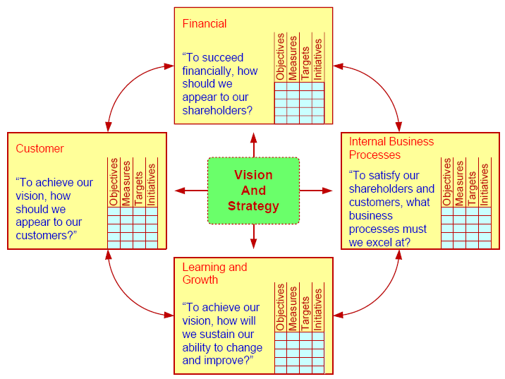
Balanced Scorecard
The meaning of “balance” ?

