Slide 1
Data Analytics bootcamp Monday - Day 3
Dr. Michael Salé – Winter 2018

Slide 2
agenda
Basics of databases and data storage
Concept of relational databases
Normalization
Why are databases normalized?
Databases versus data warehouses (functional area storage v. staging)
Purpose of data warehouses
ETL
SQL (workshop)

Slide 3
What is a database?
A database is just a way to store data in a structure manner – in such a way that it is easy to access and manage that data and it is logically coherant.
Data is organized into rows, columns and tables, and it is indexed to make it easier to find relevant information.
Data gets updated, expanded and deleted as new information is added.
Databases process workloads to create and update themselves, querying the data they contain and running applications against it.
Most databases are related to one functional area of an enterprise (usually).

Slide 4
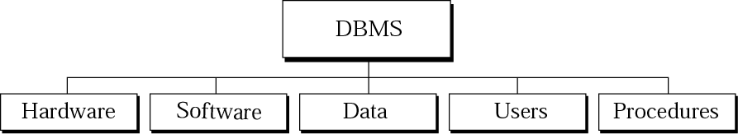
DBMS
DBMS – Database Management System
defines, creates, and maintains a database.
Allows users controlled access to data in the database.
A combination of 5 components:
Hardware
Software
Data
Users
Procedures

Slide 5
Dbms components
Hardware – the physical computer system that allows physical access to data.
Software – the actual program that allows users to access, maintain, and update physical data.
Data – stored physically on the storage devices
Users –
End users - Normal user and DBA (Database Administrator)
Application programs
Procedures – a set of rules that should be clearly defined and followed by the users

Slide 6
Flavors of databases
Microsoft SQL Server
Oracle
MySQL (by Oracle)
IBM DB2
Microsoft SQL Server
The above are all traditional relational DBMS
There are also NOSQL databases types
Big Data are NOT stored in traditional DBMS solutions.

Slide 7
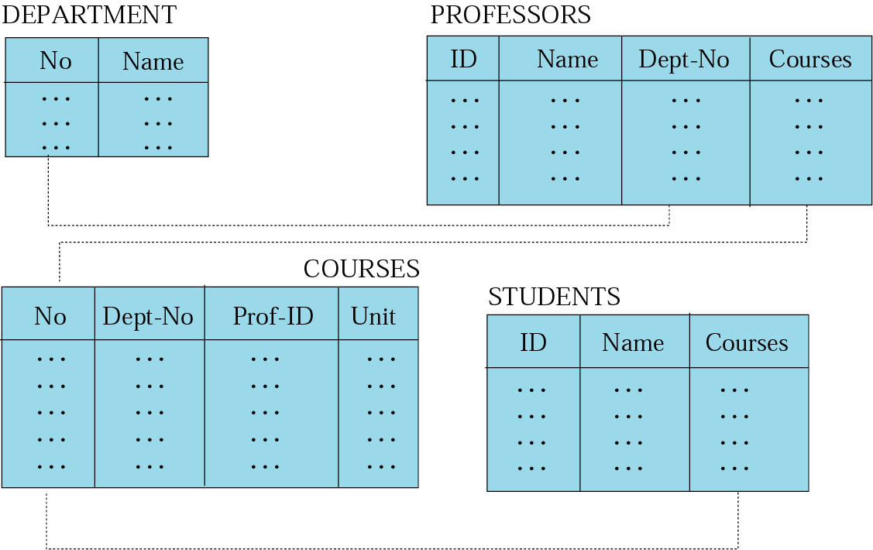
Relational databases
Data are organized in two-dimensional tables called relations.
The tables are related to each other.
The most popular model.

Slide 8
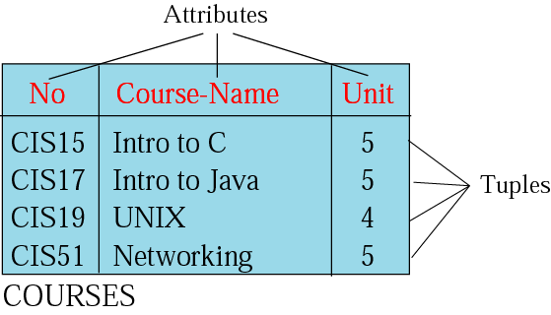
What is a relation?
Name – each relation in a relational database should have a name that is unique among other relations.
Attribute – each column in a relation.
The degree of the relation – the total number of attributes for a relation.
Tuple – each row in a relation.
The cardinality of the relation – the total number of rows in a relation.

Slide 9
normalization
The database community has developed a series of guidelines for ensuring that databases are normalized.
These are referred to as normal forms and are numbered from one (the lowest form of normalization, referred to as first normal form or 1NF) through five (fifth normal form or 5NF).
In practical applications, you'll often see 1NF, 2NF, and 3NF along with the occasional 4NF.
We won’t really discuss 4 or 5NF.
There are problems with normalized databases in analytics.
Excellent wiki article describing normalization: https://en.wikipedia.org/wiki/Database_normalization

Slide 10
First normal – 1nf
First normal form (1NF) sets the very basic rules for an organized database:
Eliminate duplicative columns from the same table.
Create separate tables for each group of related data and identify each row with a unique column or set of columns (the primary key).

Slide 11
Second normal – 2nf
Second normal form (2NF) further addresses the concept of removing duplicative data:
Meet all the requirements of the first normal form.
Remove subsets of data that apply to multiple rows of a table and place them in separate tables.
Create relationships between these new tables and their predecessors through the use of foreign keys.

Slide 12
Third normal – 3nf
Third normal form (3NF) goes one large step further:
Meet all the requirements of the second normal form.
Remove columns that are not dependent upon the primary key.

Slide 13
Why are databases normalized?
Codd says (who’s Codd?)
The objectives of normalization beyond 1NF (first normal form) were stated as follows by Codd: To free the collection of relations from undesirable insertion, update and deletion dependencies;
To reduce the need for restructuring the collection of relations, as new types of data are introduced, and thus increase the life span of application programs;
To make the relational model more informative to users;
To make the collection of relations neutral to the query statistics, where these statistics are liable to change as time goes by.— E.F. Codd, "Further Normalization of the Data Base Relational Model"

Slide 14
Purpose of Data Warehouses
A database (repository) that has been setup specifically to support decision making.
Has no value by its mere existence.
Gains value when your users utilize/hit the system to:
Generate reports
Run analytics
Data mining
Build an executive information system
Write SQL queries, etc.

Slide 15
Purpose of Data Warehouses
It provides the ”single version of the truth”
Integrates data from multiple source systems for purposes of decision making which uses the whole picture.

Slide 16
Generations of Data Management
First Generation (1970’s) – Transactions and decision support happened in the same database –application-centric.

Slide 17
Generations of Data Management
Second Generation (1980’s-90’s) – Traditional data warehousing with support for enterprise-wide applications – data-centric.
Subject-oriented (think data marts)
Non-volatile
Historical/time-variant
Historical data is kept over long periods of time
Most current data is attained through use of an Operational data store

Slide 18
Characteristics of Traditional DWs
Subject oriented
Integrated
Time-variant (time series)
Nonvolatile
Summarized
Not normalized
Metadata
Web based, relational/multi-dimensional
Client/server, real-time/right-time/active...

Slide 19
Generations of Data Management
Second Generation (cont’d)
Scalability is very important
Difference between DW and just a big DB?
Much larger volumes of data (10x, 20x, 100x) more than a transaction processing system
Increasing volumes of users (must be ready for a huge user hit) – ex: professor/class size
More and more complex queries
Without this, everything crashes.

Slide 20
Generations of Data Management
Second Generation (cont’d)
This DW is designed for all types of analytics.
Slicing and dicing data, OLAP, advanced queries
“How many packages of pretzels were sold in Poughkeepsie on promotion by Peter last week?”

Slide 21
Generations of Data Management
Third Generation (2000’s and today) – Real-time data warehouses
Provides zero-latency data
Business event occurs Recording of event
Does everything need to be real-time?
Concept of “right-time” data warehousing

Slide 22
Time Horizons of Decision Making
Strategic Decisions – 2nd Gen supports
Tactical Decisions – 2nd Gen supports
Operational Decisions – 2nd Gen cannot support – we data more quickly
Examples: - High-roller status at a casino - Web behavior changes options immediately

Slide 23
Why Real-Time?
Users always want more current data.
Enterprise Application Integration (EAI) – software that is event-triggered by changes in the operational system and extracts data from these systems, performs transformation if necessary, and trickle-feeds this data into the DW.
Why is this so important?

Slide 24
Response Time and Value

Slide 25
Capture Latency – Refresh Interval
Full copy/bulk loading updates – everything gets updated - “slurp and burp"
Incremental updates – delta feeds – only what has changed
Trickle-feed/event-driven updates – streams of transactions being fed into DW

Slide 26
Analysis Latency – Deliver Data
How quickly can we get the data to the users after analysis?
May need to re-architect data movement from the warehouse to dependent data marts
Need to manage mixed workloads – strategic and tactical queries
Need to utilize alerts

Slide 27
Decision Latency – Action Taken
How quickly can we react on the information we receive?
Rules-driven processes that act on behalf of users
Automated fraud detection
Credit rating system
Sometimes we also need to teach the users how to process the information they get and use the tools better – reduces latency

Slide 28
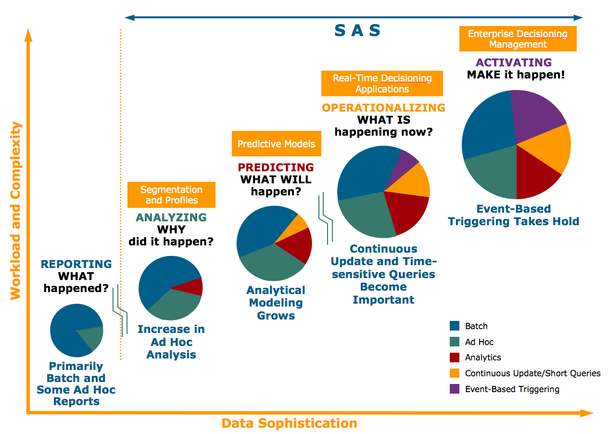
Evolution of DWS

Slide 29
Other DW Components
Operational data stores (ODS)
A type of database often used as an interim area for a data warehouse
Oper marts - an operational data mart.
Enterprise data warehouse (EDW)
A data warehouse for the enterprise.
Metadata: Data about data.
In a data warehouse, metadata describe the contents of a data warehouse and the manner of its acquisition and use

Slide 30
A Generic DW Framework

Slide 31
etl
ETL (Extract, Transform and Load) is a process in data warehousing responsible for pulling data out of the source systems and placing it into a data warehouse. ETL involves the following tasks:
extracting the data from source systems (SAP, ERP, other operational systems), data from different source systems is converted into one consolidated data warehouse format which is ready for transformation processing.

Slide 32
etl
transforming the data may involve the following tasks:
applying business rules (so-called derivations, e.g., calculating new measures and dimensions),
cleaning (e.g., mapping NULL to 0 or "Male" to "M" and "Female" to "F" etc.),
filtering (e.g., selecting only certain columns to load),
splitting a column into multiple columns and vice versa,
joining together data from multiple sources (e.g., lookup, merge),
transposing rows and columns,
applying any kind of simple or complex data validation (e.g., if the first 3 columns in a row are empty then reject the row from processing)

Slide 33
etl
loading the data into a data warehouse or data repository other reporting applications

Slide 34
sql
Structured Query Language – a language to add, update, and delete (basically manage) relational databases (and data warehouses)
Mostly universal across flavors (some exceptions)

Slide 35
Common sql commands
Select
Insert
Update
Delete
We also use where clauses, joins, ordering, grouping, wildcards, and functions to make these statements even more powerful.
Well-designed databases ensure that cascading is built in. This means that if you delete a record in a main table and there are related records in other tables, those records will also be deleted. – avoid orphaned records

Slide 36
joins

