Slide 1
Decision Support Systems and Business Intelligence
Chapter 8:
Web Analytics, Web Mining, and Social Analytics

Slide 2
Web Mining Overview
Web is the largest repository of data
Data is in HTML, XML, text format
Challenges (of processing Web data)
The Web is too big for effective data mining
The Web is too complex
The Web is too dynamic
The Web is not specific to a domain
The Web has everything
Opportunities and challenges are great!

Slide 3
Web Mining
Web mining (or Web data mining) is the process of discovering intrinsic relationships from Web data (textual, linkage, or usage)
Is it the same as data mining on data generated on the Internet?
Web data?
Content, Link, Log, …
Web Mining versus Web Analytics
Look at the simple taxonomy on the next slide

Slide 4
Web Mining

Slide 5
Web Content/Structure Mining
Mining the textual content on the Web
Data collection via Web Crawlers/Spiders
Web pages include hyperlinks
Authoritative pages
Hubs
hyperlink-induced topic search (HITS) alg.

Slide 6
Search Engines
Google, Bing, Yahoo, …
For what reason do you use search engines?
Search engine is a software program that searches for documents (Internet sites or files) based on the keywords (individual words, multi-word terms, or a complete sentence) that users have provided that have to do with the subject of their inquiry
They are the workhorses of the Internet

Slide 7
Structure of a Typical Internet Search Engine

Slide 8
Anatomy of a Search Engine
Development Cycle
Web Crawler
Document Indexer
Steps
Step 1 – Pre-Processing the Documents
Collecting, organizing, and storing
Step 2 – Parsing the Documents
Step 3 – Creating the Term-by-Document Matrix
How to represent the values (numeric, binary, …)
Term Frequency / Inverse Document Frequency

Slide 9
Anatomy of a Search Engine
Response Cycle
Query Analyzer
Document Matcher/Ranker
How does Google do it?
Googlebot
Google indexer
Google Query Processor

Slide 10
Search Engine Optimization (SEO)
It is the intentional activity of affecting the visibility of an e-commerce site or a Web site in a search engine’s natural (unpaid or organic) search results
Part of an Internet marketing strategy
Based on knowing how a search engine works
Content, HTML, keywords, external links, …
Indexing based on …
Webmaster submission of URL
Proactively and continuously crawling the Web

Slide 11
Methods for Search Engine Optimization
Search engine recommended techniques (White-Hat SEO)
Producing results based on good site design, accurate content (for users, not engines)
Search engine disapproved techniques (Black-Hat SEO)
Spamdexing? (search spam, search engine spam, or search engine poisoning)
Deception (what is shown is different to human and machine/spider)

Slide 12
Web Usage Mining
→ Web Analytics!
Extraction of information from data generated through Web page visits and transactions…
data stored in server access logs, referrer logs, agent logs, and client-side cookies
user characteristics and usage profiles
metadata, such as page attributes, content attributes, and usage data
Clickstream data, clickstream analysis

Slide 13
Web Usage Mining
Web usage mining applications
Determine the lifetime value of clients
Design cross-marketing strategies across products
Evaluate promotional campaigns
Target electronic ads and coupons at user groups based on user access patterns
Predict user behavior based on previously learned rules and users' profiles
Present dynamic information to users based on their interests and profiles
…

Slide 14
Web Usage Mining (Clickstream Analysis)

Slide 15
Web Analytics Metrics
Provides near-real-time data to deliver invaluable information to …
Improve site usability
Manage marketing efforts
Better document ROI, …
Web analytics metric categories:
Web site usability: How were they using my Web site?
Traffic sources: Where did they come from?
Visitor profiles: What do my visitors look like?
Conversion statistics: What does all this mean for the business?

Slide 16
Web Analytics Metrics - Web Site Usability
Web Site Usability
Page views
Time on site
Downloads
Click map
Click paths
Traffic Source
Referral Web sites
Search engines
Direct
Offline campaigns
Online campaigns

Slide 17
Web Analytics Metrics - Web Site Usability
Visitor Profiles
Keywords
Content groupings
Geography
Time of day
Landing page
Conversion Statistics
New visitors
Returning visitors
Leads
Sales/conversions
Abandonment rates

Slide 18
Web Analytics Maturity Model
Maturity → degree of proficiency, formality, and optimization of business models
Business Intelligence Maturity Model (TDWI)
Management Reporting ➔ Spreadmarts ➔ Data Marts ➔ Data Warehouse ➔ Enterprise Data Warehouse ➔ BI Services
Business Analytics Maturity Model (INFORMS)
Descriptive Analytics ➔ Predictive Analytics ➔ Prescriptive Analytics
Web analytics maturity model → next slide…

Slide 19
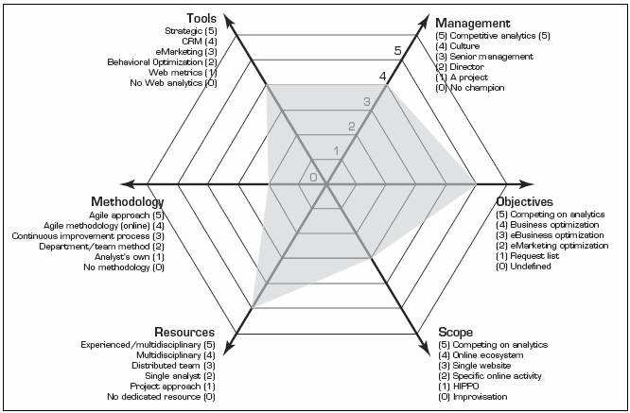
Web Analytics Maturity Model

Slide 20
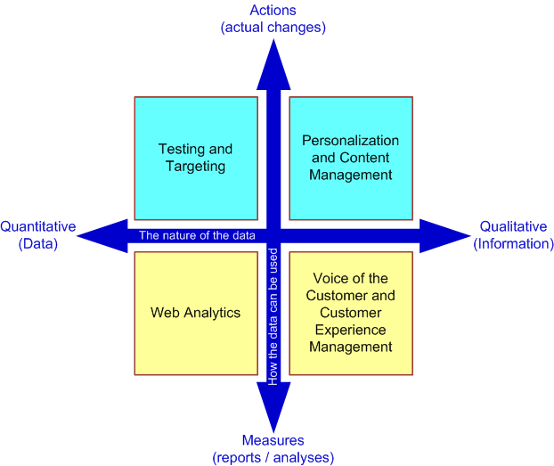
Putting It All Together—A Web Site Optimization Ecosystem
Two-Dimensional View of the Inputs for Web Site Optimization
Goal:
Customer Experience Management (CEM)
Voice of Customer (VOC)

Slide 21
Web Mining Success Stories
Amazon.com, Ask.com, Scholastic.com, …
A Process View of the Web Site Optimization Ecosystem

Slide 22
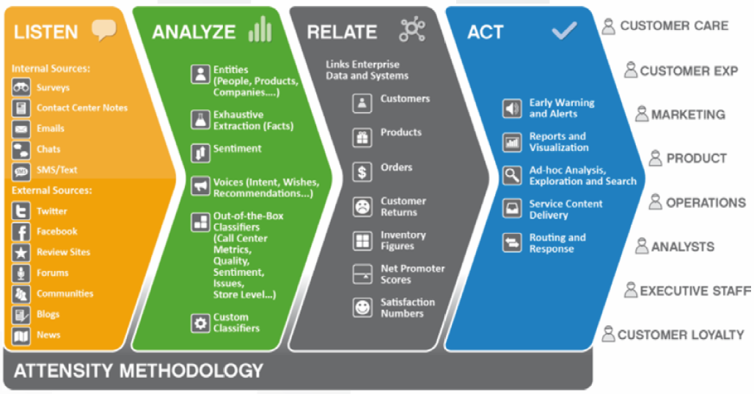
Voice of the Customer Strategy Framework (Attensity.com)

Slide 23
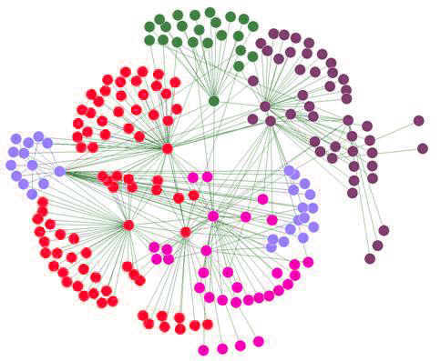
Social Analytics Social Network Analysis
Social Network - social structure composed of individuals linked to each other
Analysis of social dynamics
Interdisciplinary field
Social psychology
Sociology
Statistics
Graph theory

Slide 24
Social Analytics Social Network Analysis
Social Networks help study relationships between individuals, groups, organizations, societies
Self organizing
Emergent
Complex
Typical social network types
Communication networks, community networks, criminal networks, innovation networks, …

Slide 25
Social Analytics Social Network Analysis Metrics
Connections
Homophily
Multiplexity
Network closure
Propinquity
Segmentation
Cliques and social circles
Clustering coefficient
Cohesion
Distribution
Bridge
Centrality
Density
Structural holes
Tie strength

Slide 26
Social Media Definitions and Concepts
Enabling technologies of social interactions among people
Relies on enabling technologies of Web 2.0
Takes on many different forms
Internet forums, Web logs, social blogs, microblogging, wikis, social networks, podcasts, pictures, video, and product reviews
Different types of social media
Based on media research and social process

Slide 27
Different Types of Social Media
Collaborative projects (e.g., Wikipedia)
Blogs and microblogs (e.g., Twitter)
Content communities (e.g., YouTube)
Social networking sites (e.g., Facebook)
Virtual game worlds (e.g., World of Warcraft), and
Virtual social worlds (e.g., Second Life)
--Kaplan and Haenlein (2010)

Slide 28
Social versus Industrial Media
Web-based social media are different from traditional/industrial media, such as newspapers, television, and film
Differentiating characteristics
Quality
Reach
Frequency
Accessibility
Usability
Immediacy
Updatability

Slide 29
How Do People Use Social Media?
Different engagement levels

Slide 30
Social Media Analytics
It is the systematic and scientific ways to consume the vast amount of content created by Web-based social media outlets, tools, and techniques for the betterment of an organization’s competitiveness
Fastest growing movement in analytics
Social Media
Tweeter
Facebook
LinlkedIn
…
Insights
Solutions
Course of Actions
…

Slide 31
Social Media Analytics
HBR Analytic Services survey (HBR, 2010)
75% of the companies did not know where their customers are talking about them
31% do not measure effectiveness of social media
only 23% are using social media analytics tools
7% are able to integrate social media into marketing
Measuring the Social Media Impact
Descriptive analytics – simple counts/statistics
Social network analysis
Advanced analytics – predictive analytics, text mining

Slide 32
Best Practices in Social Media Analytics
Think of measurement as a guidance system, not a rating system
Track the elusive sentiment
Continuously improve the accuracy of text analysis
Look at the ripple effect
Look beyond the brand
Identify your most powerful influencers
Look closely at the accuracy of your analytic tool
Incorporate social media intelligence into planning

Slide 33
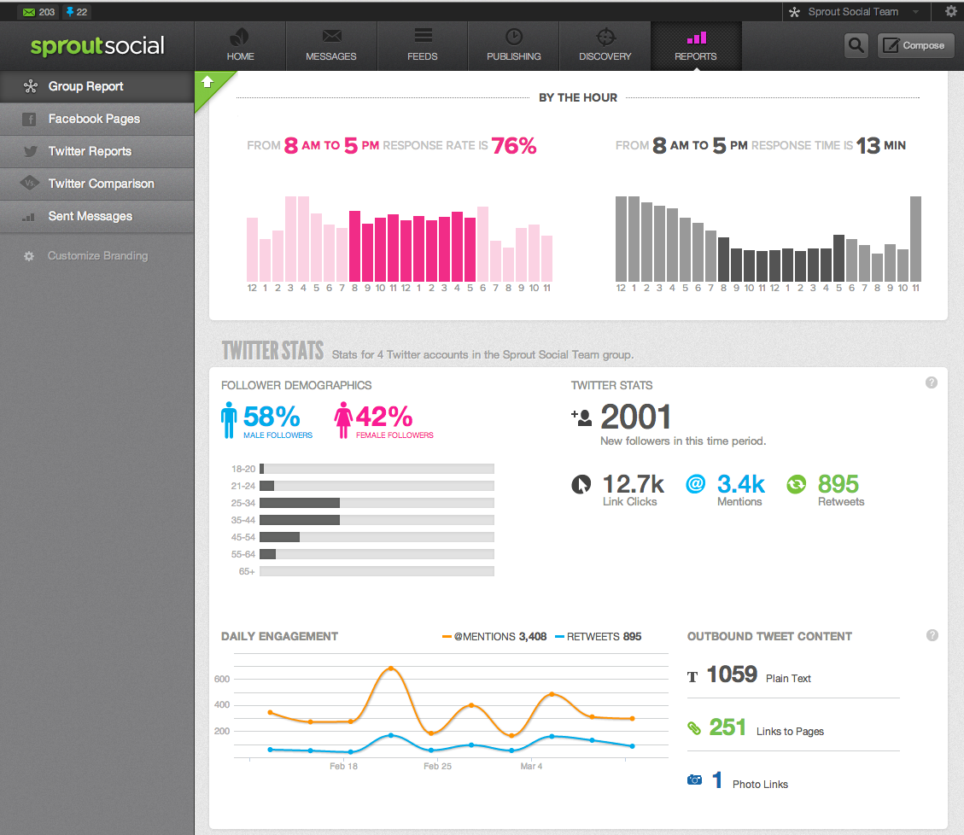
Social Media Analytics

