Slide 1
Decision Support Systems and Business Intelligence
Chapter 6:
Techniques for Predictive Modeling

Slide 2
Neural Network Concepts
Neural networks (NN): a brain metaphor for information processing
Neural computing
Artificial neural network (ANN)
Many uses for ANN for
pattern recognition, forecasting, prediction, and classification
Many application areas
finance, marketing, manufacturing, operations, information systems, and so on

Slide 3
Biological Neural Networks
Two interconnected brain cells (neurons)

Slide 4
Processing Information in ANN
A single neuron (processing element – PE) with inputs and outputs

Slide 5
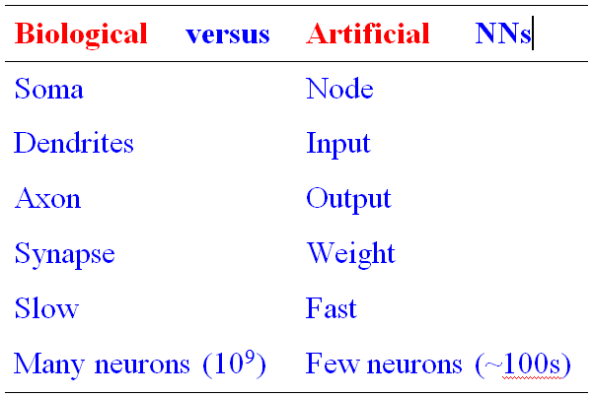
Biology Analogy

Slide 6
Elements of ANN
Processing element (PE)
Network architecture
Hidden layers
Parallel processing
Network information processing
Inputs
Outputs
Connection weights
Summation function

Slide 7
Elements of ANN
Neural Network with One Hidden Layer

Slide 8
Elements of ANN
Summation Function for a Single Neuron (a), and
Several Neurons (b)

Slide 9
Elements of ANN
Transformation (Transfer) Function
Linear function
Sigmoid (logical activation) function [0 1]
Tangent Hyperbolic function [-1 1]
Threshold value?

Slide 10
Neural Network Architectures
Architecture of a neural network is driven by the task it is intended to address
Classification, regression, clustering, general optimization, association, ….
Most popular architecture: Feedforward, multi-layered perceptron with backpropagation learning algorithm
Used for both classification and regression type problems
Others – Recurrent, self-organizing feature maps, Hopfield networks, …

Slide 11
Neural Network Architectures Feed-Forward Neural Networks
Feed-forward MLP with 1 Hidden Layer

Slide 12
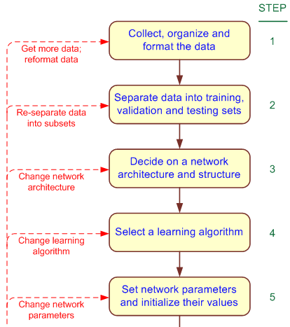
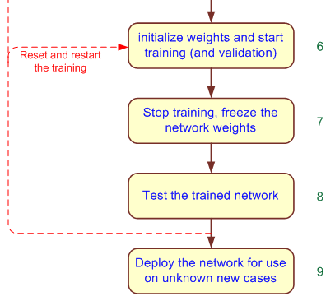
Development Process of an ANN

Slide 13
An MLP ANN Structure for the Box-Office Prediction Problem

Slide 14
Testing a Trained ANN Model
Data is split into three parts
Training (~60%)
Validation (~20%)
Testing (~20%)
k-fold cross validation
Less bias
Time consuming

Slide 15
AN Learning Process A Supervised Learning Process
Three-step process:
1. Compute temporary outputs.
2. Compare outputs with desired targets.
3. Adjust the weights and repeat the process.

Slide 16
Backpropagation Learning
Backpropagation of Error for a Single Neuron

Slide 17
Backpropagation Learning
The learning algorithm procedure
Initialize weights with random values and set other network parameters
Read in the inputs and the desired outputs
Compute the actual output (by working forward through the layers)
Compute the error (difference between the actual and desired output)
Change the weights by working backward through the hidden layers
Repeat steps 2-5 until weights stabilize

Slide 18
Illuminating The Black Box Sensitivity Analysis on ANN
A common criticism for ANN: The lack of transparency/explainability
The black-box syndrome!
Answer: sensitivity analysis
Conducted on a trained ANN
The inputs are perturbed while the relative change on the output is measured/recorded
Results illustrate the relative importance of input variables

Slide 19
Sensitivity Analysis on ANN Models
For a good example, see Application Case 6.3
Sensitivity analysis reveals the most important injury severity factors in traffic accidents

