Slide 1
Decision Support Systems and Business Intelligence
Chapter 7:
Text Analytics, Text Mining, and Sentiment Analysis

Slide 2
Text Mining Concepts
85-90 percent of all corporate data is in some kind of unstructured form (e.g., text)
Unstructured corporate data is doubling in size every 18 months
Tapping into these information sources is not an option, but a need to stay competitive
Answer: text mining
A semi-automated process of extracting knowledge from unstructured data sources
a.k.a. text data mining or knowledge discovery in textual databases

Slide 3
Text Analytics and Text Mining

Slide 4
Data Mining versus Text Mining
Both seek for novel and useful patterns
Both are semi-automated processes
Difference is the nature of the data:
Structured versus unstructured data
Structured data: in databases
Unstructured data: Word documents, PDF files, text excerpts, XML files, and so on
Text mining – first, impose structure to the data, then mine the structured data.

Slide 5
Text Mining Concepts
Benefits of text mining are obvious, especially in text-rich data environments
e.g., law (court orders), academic research (research articles), finance (quarterly reports), medicine (discharge summaries), biology (molecular interactions), technology (patent files), marketing (customer comments), etc.
Electronic communication records (e.g., Email)
Spam filtering
Email prioritization and categorization
Automatic response generation

Slide 6

Text Mining Application Area
Information extraction
Topic tracking
Summarization
Categorization
Clustering
Concept linking
Question answering

Slide 7
Text Mining Terminology
Unstructured or semi-structured data
Corpus (and corpora)
Terms
Concepts
Stemming
Stop words (and include words)
Synonyms (and polysemes)
Tokenizing

Slide 8
Text Mining Terminology
Term dictionary
Word frequency
Part-of-speech tagging
Morphology
Term-by-document matrix
Occurrence matrix
Singular value decomposition
Latent semantic indexing

Slide 9
Natural Language Processing (NLP)
Structuring a collection of text
Old approach: bag-of-words
New approach: natural language processing
NLP is …
a very important concept in text mining
a subfield of artificial intelligence and computational linguistics
the studies of "understanding" the natural human language
Syntax versus semantics-based text mining

Slide 10
Natural Language Processing (NLP)
What is “Understanding” ?
Human understands, what about computers?
Natural language is vague, context driven
True understanding requires extensive knowledge of a topic
Can/will computers ever understand natural language the same/accurate way we do?

Slide 11
Natural Language Processing (NLP)
Challenges in NLP
Part-of-speech tagging
Text segmentation
Word sense disambiguation
Syntax ambiguity
Imperfect or irregular input
Speech acts
Dream of AI community
to have algorithms that are capable of automatically reading and obtaining knowledge from text

Slide 12
Natural Language Processing (NLP)
WordNet
A laboriously hand-coded database of English words, their definitions, sets of synonyms, and various semantic relations between synonym sets.
A major resource for NLP.
Need automation to be completed.
Sentiment Analysis
A technique used to detect favorable and unfavorable opinions toward specific products and services
SentiWordNet

Slide 13
NLP Task Categories
Information retrieval, information extraction
Named-entity recognition
Question answering
Automatic summarization
Natural language generation & understanding
Machine translation
Foreign language reading & writing
Speech recognition
Text proofing, optical character recognition

Slide 14
Text Mining Process
Context diagram for the text mining process

Slide 15
Text Mining Process
The three-step text mining process

Slide 16
Text Mining Process
Step 1: Establish the corpus
Collect all relevant unstructured data (e.g., textual documents, XML files, emails, Web pages, short notes, voice recordings…)
Digitize, standardize the collection (e.g., all in ASCII text files)
Place the collection in a common place (e.g., in a flat file, or in a directory as separate files)

Slide 17
Text Mining Process
Step 2: Create the Term-by-Document Matrix (TDM)

Slide 18
Text Mining Process
Step 2: Create the Term-by-Document Matrix (TDM)
Should all terms be included?
Stop words, include words
Synonyms, homonyms
Stemming
What is the best representation of the indices (values in cells)?
Row counts; binary frequencies; log frequencies;
Inverse document frequency

Slide 19
Text Mining Process
Step 2: Create the Term–by–Document Matrix (TDM)
TDM is a sparse matrix. How can we reduce the dimensionality of the TDM?
Manual - a domain expert goes through it
Eliminate terms with very few occurrences in very few documents (?)
Transform the matrix using singular value decomposition (SVD)
SVD is similar to principle component analysis

Slide 20
Text Mining Process
Step 3: Extract patterns/knowledge
Classification (text categorization)
Clustering (natural groupings of text)
Improve search recall
Improve search precision
Scatter/gather
Query-specific clustering
Association
Trend Analysis (…)

Slide 21
Sentiment Analysis Overview
Sentiment → belief, view, opinion, conviction
Sentiment analysis → opinion mining, subjectivity analysis, and appraisal extraction
The goal is to answer the question:
“What do people feel about a certain topic?”
Explicit versus Implicit sentiment
Sentiment polarity
Positive versus Negative
… versus Neutral?

Slide 22
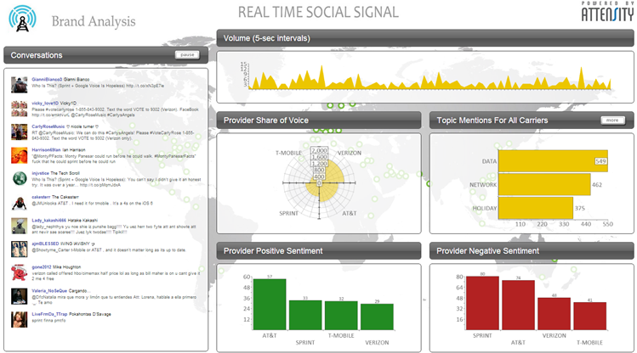
Example – Real-Time Social Signal (by Attensity)

Slide 23
Sentiment Analysis Applications
Voice of the customer (VOC)
Voice of the Market (VOM)
Voice of the Employee (VOE)
Brand Management
Financial Markets
Politics
Government Intelligence
… others

Slide 24
Sentiment Analysis Process

Slide 25
Sentiment Analysis Process
Step 1 – Sentiment Detection
Comes right after the retrieval and preparation of the text documents
It is also called detection of objectivity
Fact [= objectivity] versus Opinion [= subjectivity]
Step 2 – N-P Polarity Classification
Given an opinionated piece of text, the goal is to classify the opinion as falling under one of two opposing sentiment polarities
N [= negative] versus P [= positive]

Slide 26
Sentiment Analysis Process
Step 3 – Target Identification
The goal of this step is to accurately identify the target of the expressed sentiment (e.g., a person, a product, an event, etc.)
Level of difficulty → the application domain
Step 4 – Collection and Aggregation
Once the sentiments of all text data points in the document are identified and calculated, they are to be aggregated
Word → Statement → Paragraph → Document

Slide 27

Sample

Slide 28
Sentiment Analysis Difficulties
Aggregating multiple moods in one statement
Sarcasm
Misspellings, poor punctuation, poor grammar, improper use of words
Identifying the subject of a sentiment (object identification)
Opinion orientation classification

Slide 29
Sentiment Analysis Methods for Polarity Identification
Polarity Identification – P vs. N
Can be made at the level of word, term, sentence, paragraph, document
Two competing methods
Using a lexicon
WordNet [wordnet.princeton.edu]
SentiWordNet [sentiwordnet.isti.cnr.it]
Using pre-classified training documents
Data mining / machine learning

Slide 30
P-N Polarity and S-O Polarity

Slide 31
Sentiment Analysis and Speech Analytics
Speech analytics – analysis of voice
Content versus other Voice Features
Two Approaches
The Acoustic Approach
Intensity, Pitch, Jitter, Shimmer, etc.
The Linguistic Approach
Lexical: words, phrases, etc.
Disfluencies: filled pauses, hesitation, restarts, etc.
Higher semantics: taxonomy/ontology, pragmatics
Many uses and use cases exist

