Slide 2
r_{g}
R_{con}
Path 2: Lattice Diffusion
Path 5: Lattice Diffusion
Path 1: Surface Diff.
R_{n}
Path 3: Evaporation
Path 4: Boundary Diffusion
Path 6: Lattice Diffusion

Slide 3
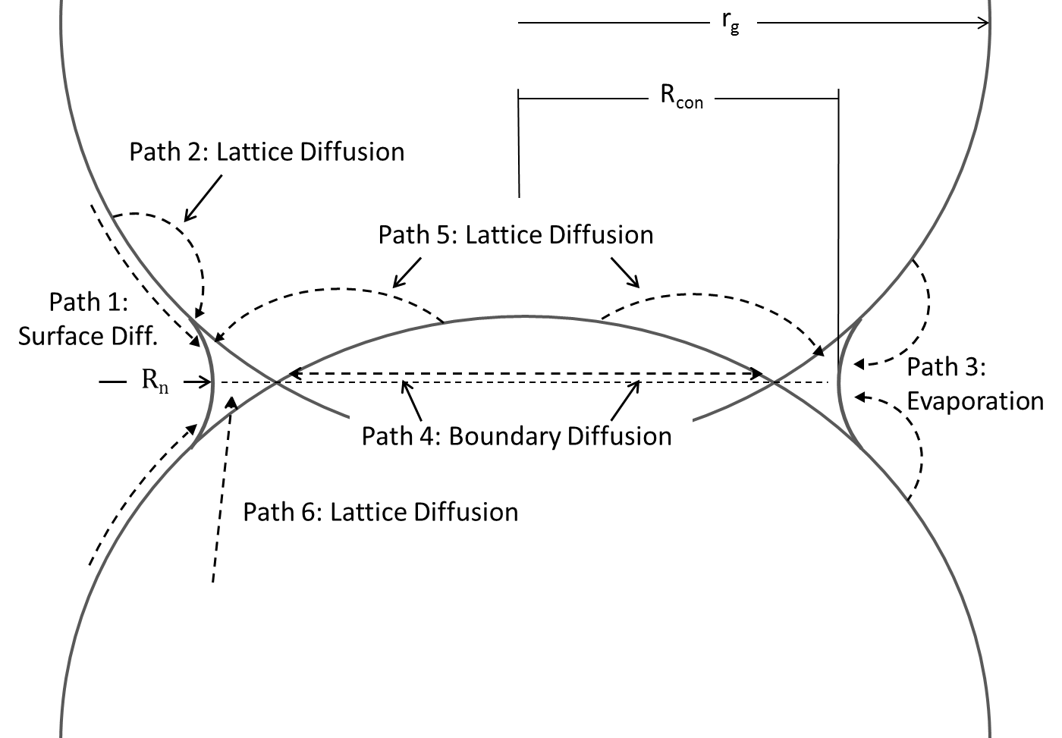

Slide 4
