Slide 1

A Parking Guidance and Information System for TinyOS
CSE 521S Final Presentation
By Matthew Lindsay, Patrick McBryde, and Michael Schultz

Slide 2
Project (Re-)Introduction
"However, [the World Wide Web] could start a revolution in information access." (Tim Berners-Lee, 1991)
  When driving to a new location, what do you want most?
    How do I get there/what does it look like? Google Maps.
    Where should I park when I get there? Hope.
  Parking can be highly inefficient and extremely frustrating
    A driver should be able to find a spot easily
    No aimless circling of a parking lot
  We can use today's technology to improve this situation!

Slide 3
Project Goals
  Develop a WSN to monitor each parking spaces in an area
    Take advantage of low(-ish) cost TelosB motes
    Use external connector to connect sensor(s)
  Reliable data delivery over wireless sensor network
    Using Collection Tree Protocol
  Aggregate data for visitors and management to use
    Web interface + published JSON format for queries

Slide 4
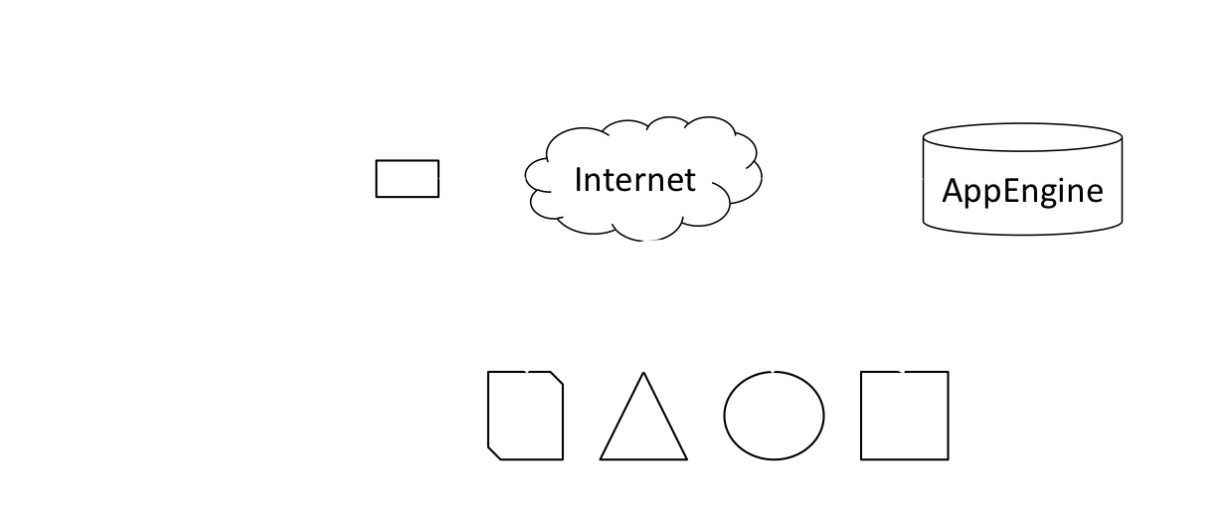
Design
  High-level view of system design

Slide 5
Hardware
  TelosB
    Ultra low power
    IEEE 802.15.4 compliant
    Integrated sensors
  LV-MaxSonar-EZ1 - Ultrasonic Rangefinder
    Supply voltage 2.5V to 5.5V
    Detects objects from 6 inches out to 254 inches with 1 inch resolution (0-6 inches range as 6 inches)
    Output formats include pulse width, analog voltage, and serial digital
  Web Connected *nix computer
    Macbook Pro

Slide 6
Software
  Motes
    Sensor
      TinyOS
      Collects data from multiple sensors.
      Updates base-station every 15 Seconds.
    Base-Station
      BaseStation app included with TinyOS install
  Base-Station
    The base-station collects sensor data from the wireless sensor network and transfers what is needed to the AppEngine. This includes occupancy, light levels, and temperature.
    Uses JSON to wrap sensor data and CURL to perform HTTP put to server.

Slide 7
Backend Aggregator
  AppEngine uses Google's infrastructure for web apps
  Allows our application to scale well (within constraints)
  When data comes in ...
    extract it and update the space and lot stats
    log changes in the parking lot and parking space
    tell client success or failure
  When data goes out ...
    get data from all spaces in a lot
    find lots near to target lot
    chart historical data (by request)
Information is money!

Slide 8
Frontend Display(s)
  Status of selected lot + map of nearby (~2 miles) lots
    Markers let you see status of those lots too
  Chart of average use over time interval for date range
    i.e., from 5am to 7am in the last week
  Exported in JSON format for integration with other apps
    Lot information + Per space information
(You'll see these in the demo!)

Slide 9
Experimentation
  To verify the system works we performed a test using a real vehicle and parking space.
    Link to video of system test.
  What could be improved.
    Vehicle detection: increase the ultrasonic rangefinder supply voltage and add a second rangefinder sensor.
    Rangefinder sampling decreased to save power.
    Power consumption by the TelosB could be greatly improved.
  Day long simulation to test backend and chart interface
    Random activity every 60--120 seconds
    Increased activity from 6:00-7:00, 12:00-13:00, and 18:00-19:00

Slide 10
Demo

Slide 11
Related Work
  Streetline
    San Francisco startup
    Began deploy with SFpark in Summer 2010
    Results pending
    Great for us: validates the work and creates the market
  Signal-Park
    Older, more traditional approach
    Sonar detector per space in garage
    Wired to central computer for collection
    Not really publicly available information

Slide 12
Conclusions
  We created a functioning parking guidance and information system for TinyOS
    Hardware
    Scalable Infrastructure
      RESTful API for apps
  With more resources and time this could be a viably solution for existing parking areas

Slide 13
Questions

Slide 14
Resources
LV-MaxSonar-EZ1 Data Sheet

