Slide 1
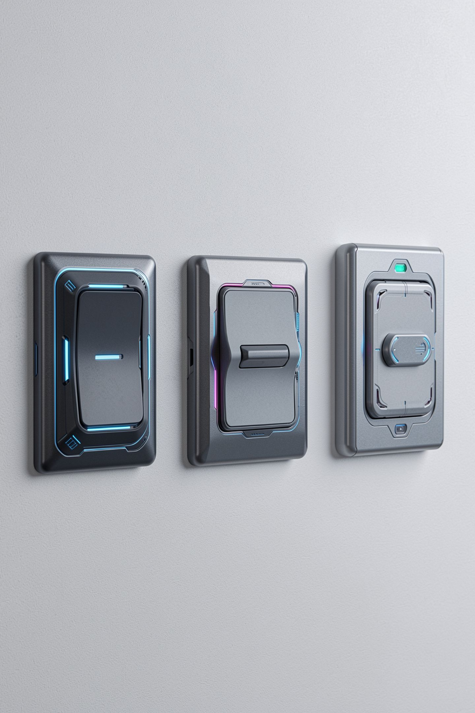
Same Number, Three Ways to Write It

Slide 2
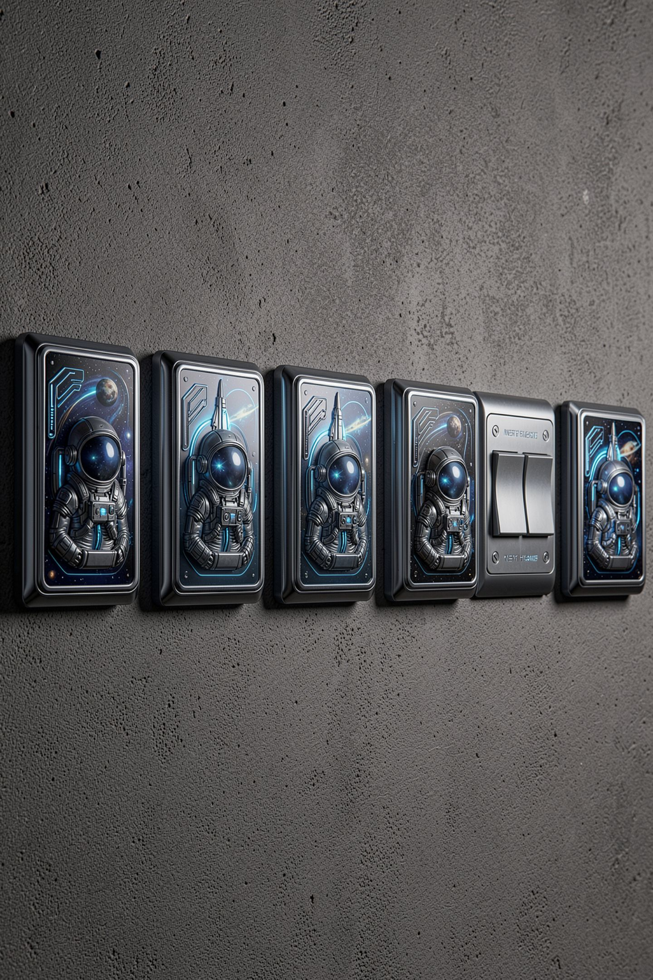
Eight light switches
Each switch is on or off
How many arrangements can eight make
Work it out, do not guess
The answer explains half of computing
MCCTC | AI Automation & Software Development
Notes:
Before we touch Python today, answer the bell ringer question out loud. Eight switches, each on or off. One switch gives two arrangements. Two give four. Each new switch doubles it. Eight switches give two hundred fifty six. That number is not arbitrary. It is a byte, and every limit you have ever seen that says 255 or 256 comes from counting switches. Today you learn to read the switches directly.

Slide 3
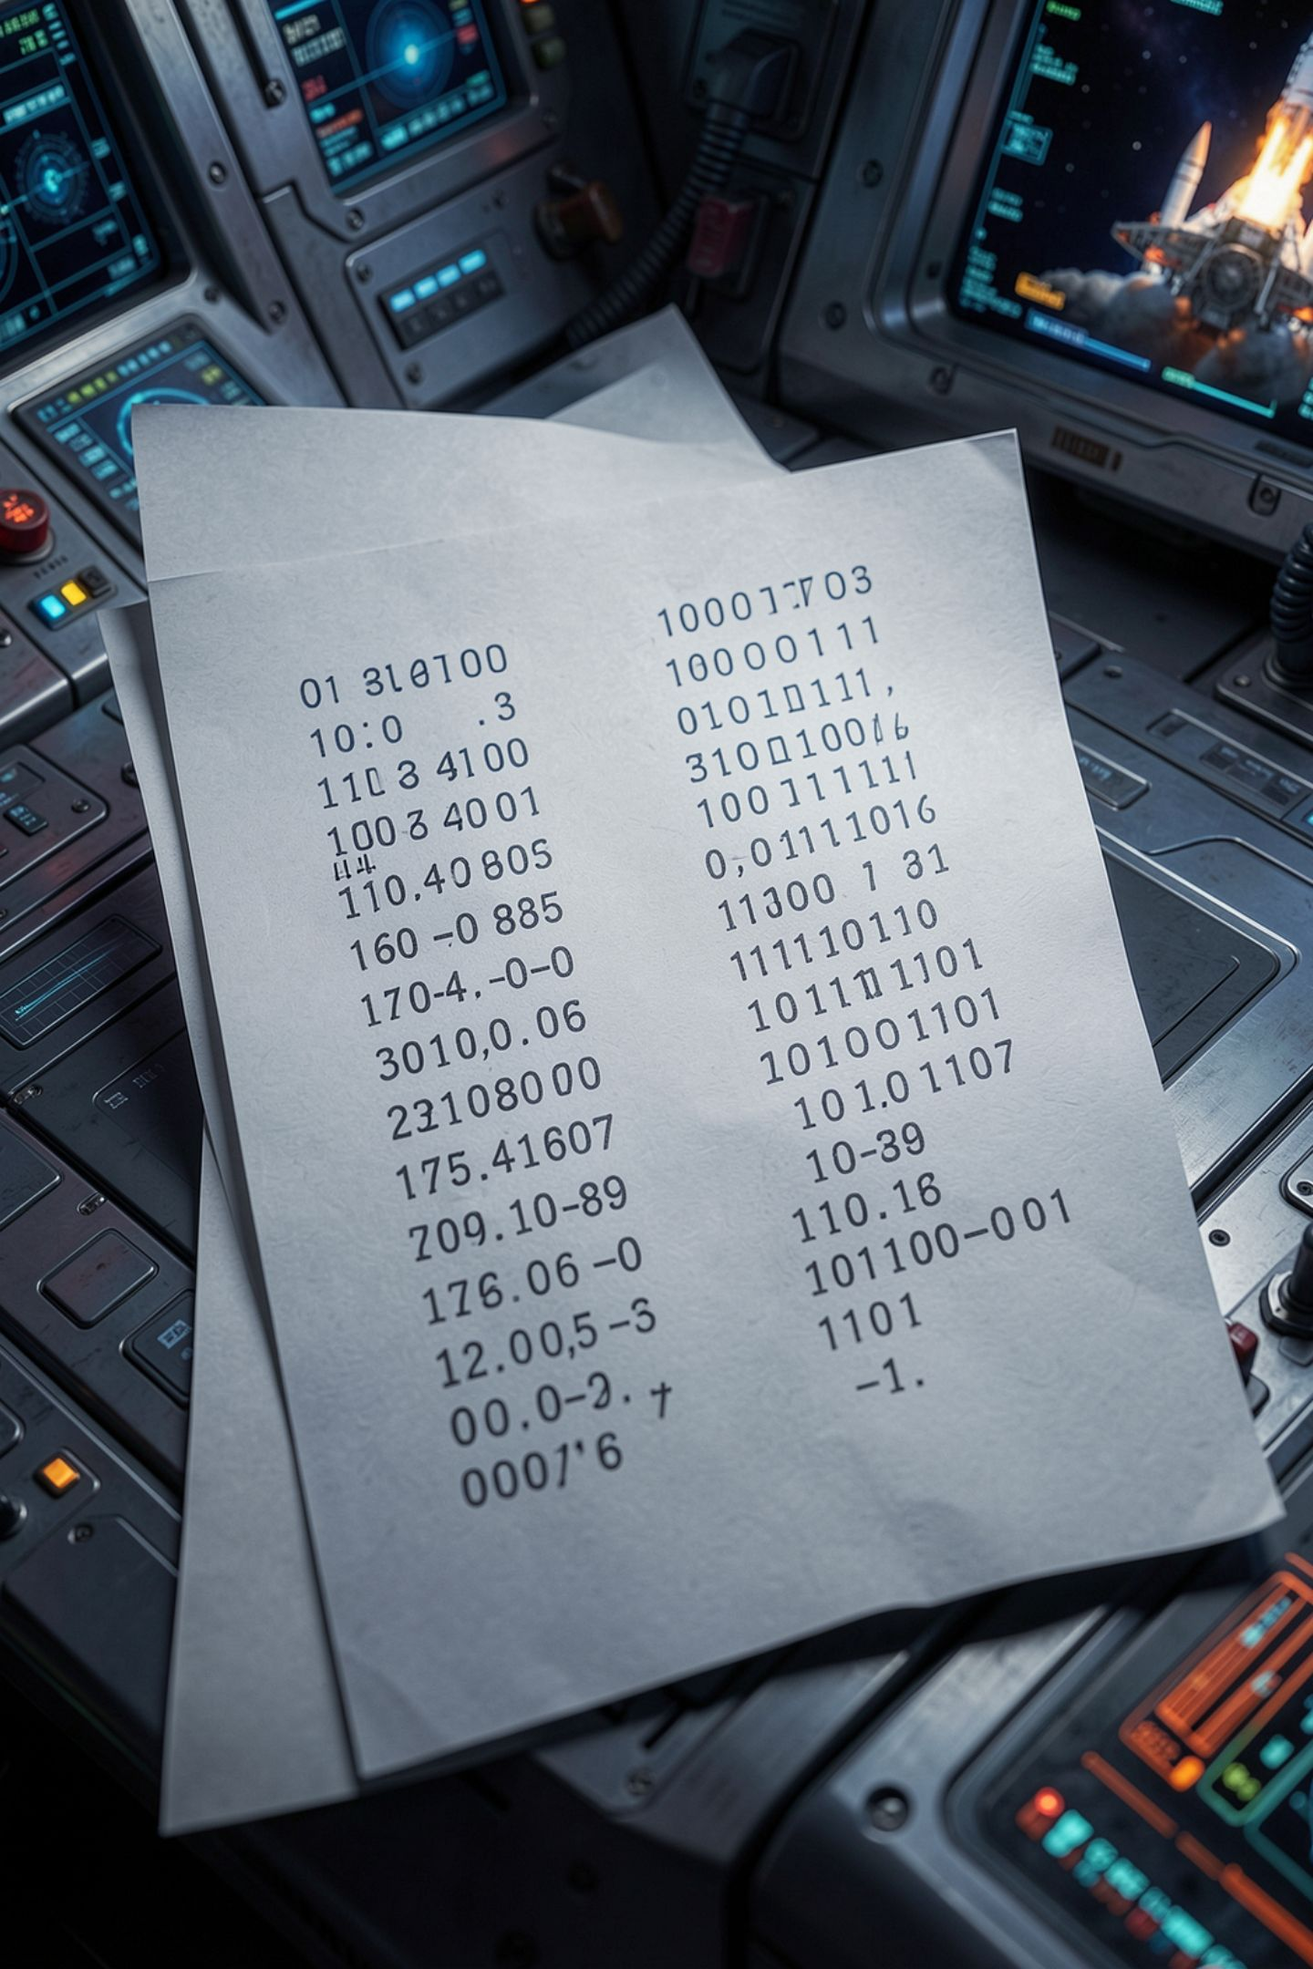
A written number is a value plus a base
The value is the quantity
The base is how many digits you get
Decimal has ten. Binary has two
13 and 1101 are the same value
MCCTC | AI Automation & Software Development
Notes:
This is the one idea for today. A number written on a page is two things at once: how much, and which counting system you used to write it down. Thirteen and one one zero one are not similar numbers. They are the same number. The way thirteen and trece are the same word in two languages. If you keep that straight, conversion stops being magic and becomes bookkeeping.

Slide 4
Place value in decimal, which you already know
1 3
10s 1s
1 x 10 + 3 x 1 = 13
MCCTC | AI Automation & Software Development
Notes:
You have done this since second grade without calling it anything. The one on the left is not worth one. It is in the tens place, so it is worth ten. Each place is worth ten times the place to its right. Binary uses exactly the same idea with one change, and that change is the whole lesson.

Slide 5
Place value in binary
1 1 0 1
8s 4s 2s 1s
8 + 4 + 0 + 1 = 13
MCCTC | AI Automation & Software Development
Notes:
Same idea, but each place is worth two times the place to its right instead of ten. Ones, twos, fours, eights. Wherever there is a one, add that place's value. Wherever there is a zero, skip it. Eight plus four plus one is thirteen. That is the entire technique for binary to decimal and there is nothing else to it.

Slide 6
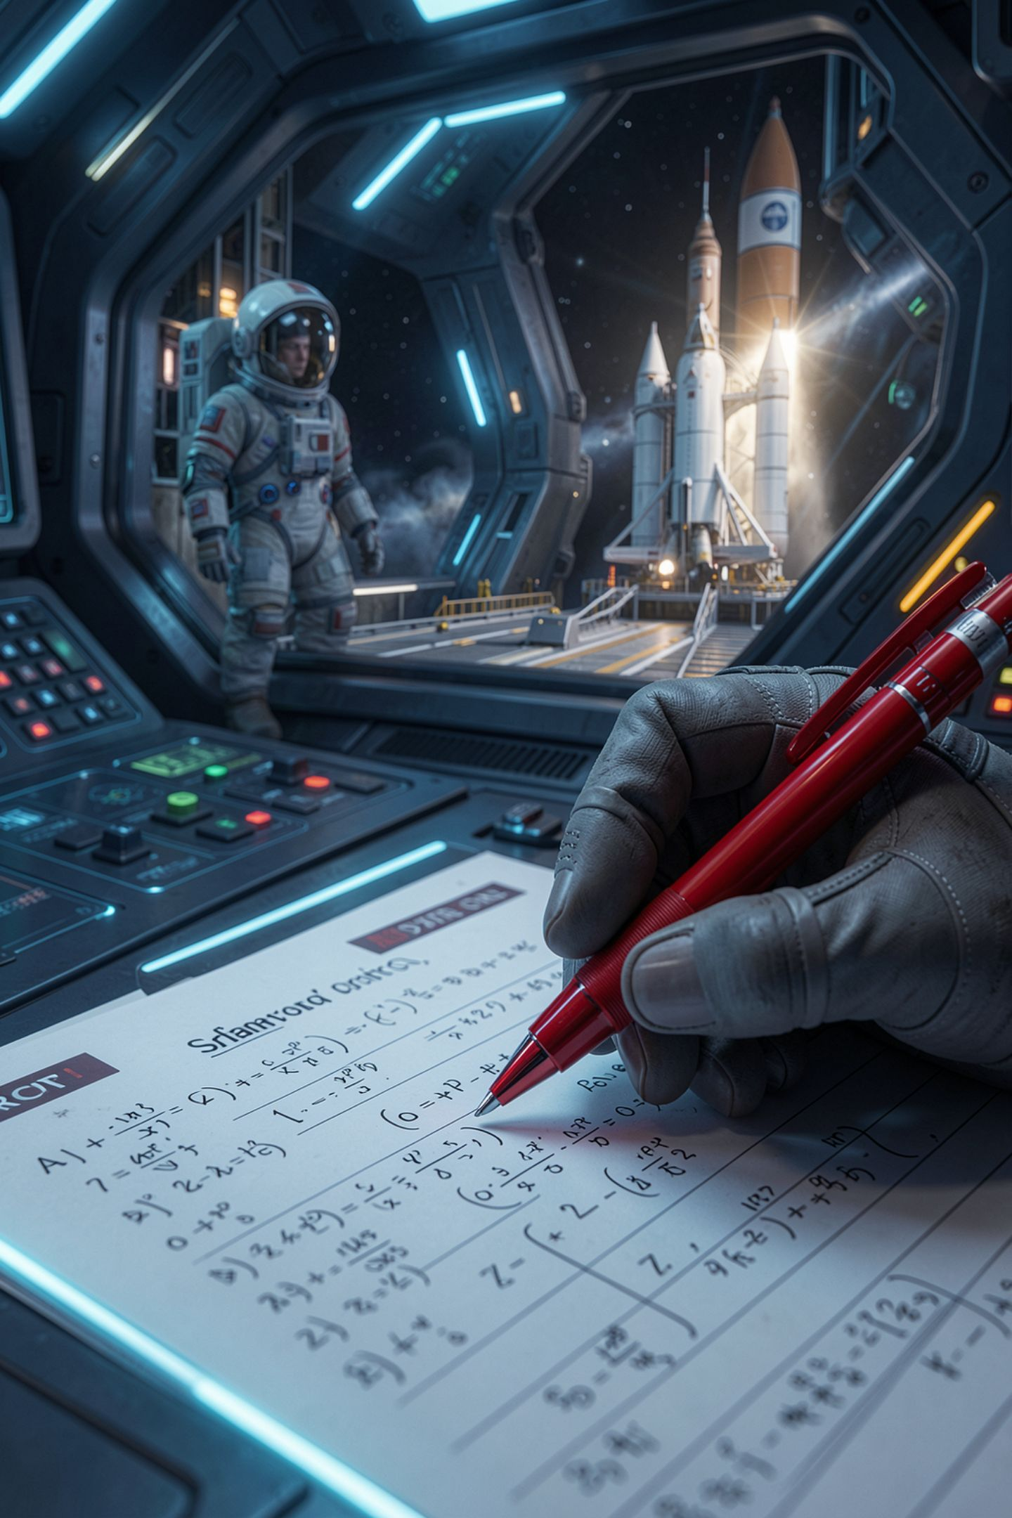
Now I break it on purpose
1101 to decimal
Add the digits: 1 + 1 + 0 + 1
That gives 3
Tell me why that is wrong
MCCTC | AI Automation & Software Development
Notes:
I am going to do what somebody always does. Add up the digits. One plus one plus zero plus one is three. Somebody in here is already objecting. Good. Adding the digits throws away place value, which is the entire idea. The one on the far left is not worth one. It is sitting in the eights place. Three is not a rounding error. It is a completely different number.

Slide 7
Decimal to binary, biggest place first
42 fits in 32? yes remaining 10 digit 1
fits in 16? no digit 0
fits in 8? yes remaining 2 digit 1
fits in 4? no digit 0
fits in 2? yes remaining 0 digit 1
fits in 1? no digit 0
42 in binary is 101010
MCCTC | AI Automation & Software Development
Notes:
Going the other way, start from the biggest power of two that fits. Thirty two fits in forty two, write a one, ten left over. Sixteen does not fit in ten, write a zero. Eight fits, write a one, two left. Four does not fit, zero. Two fits, one, nothing left. One does not fit, zero. Read the digits down the right side. One zero one zero one zero.

Slide 8
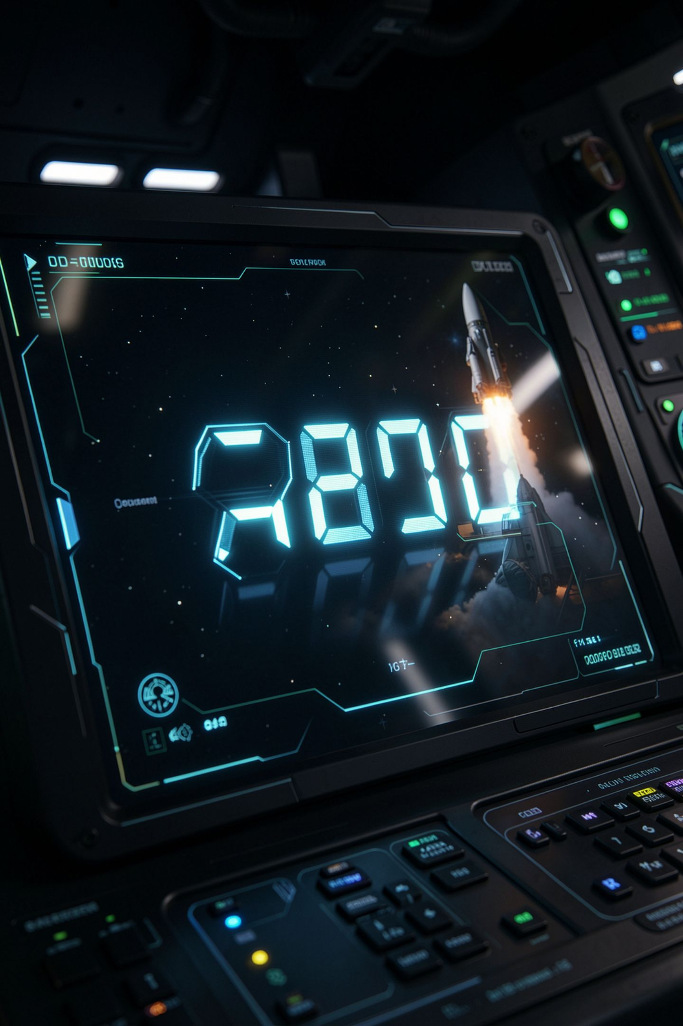
Why hexadecimal exists
Base 16: digits 0 to 9, then a to f
Four binary digits are one hex digit
Always, exactly
1111 1111 is ff, which is 255
MCCTC | AI Automation & Software Development
Notes:
Binary is honest and unreadable. Nobody wants to read thirty two ones and zeros. Hex fixes that, because four binary digits always make exactly one hex digit, so you can translate in chunks. That is why colours on the web look like pound five seven A one E B. Three pairs of hex digits, each pair one byte, each byte a number from zero to two fifty five. That is our course colour, Launch Blue.

Slide 9
Checking your hand work with Python
print(bin(13)) # 0b1101
print(hex(13)) # 0xd
print(int("1101", 2)) # 13
print(int("d", 16)) # 13
print(f"{13:08b}") # 00001101
MCCTC | AI Automation & Software Development
Notes:
Python can do all of this in one call. Use these to check your work, not to replace it. The WebXam asks you to convert by hand, so the skill has to live in your head before it lives in a function. The zero b and zero x at the front are Python labelling which base it is showing you. They are not part of the number.

Slide 10
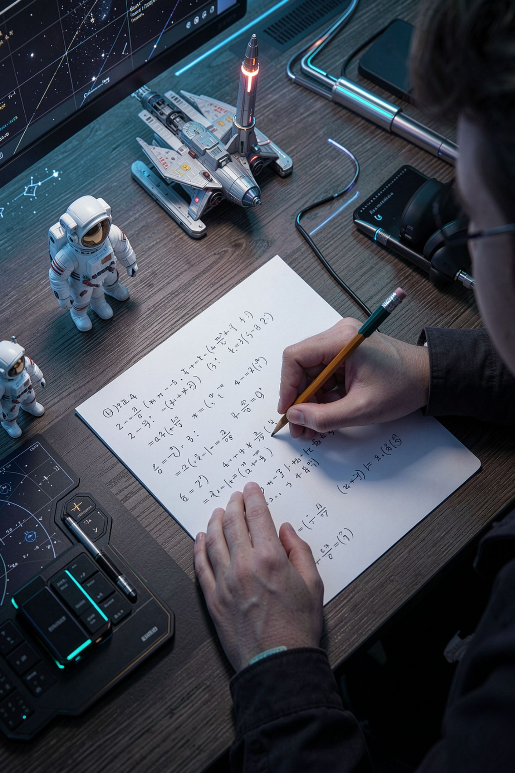
What you are about to build
Twelve conversions on paper, no computer
Show the place values every time
Then check all twelve with Python
Count how many you got right
MCCTC | AI Automation & Software Development
Notes:
Build one is paper and pencil. Four decimal to binary, four binary to decimal, four involving hex. Show the place value arithmetic every time, because the arithmetic is what I am grading, not the answer. Then open a terminal and check all twelve with bin and int. Count your matches. Build two opens the CLI Toolsmith project, and today is planning only, no code.

