Slide 1

Reading Data Out of a File

Slide 2

You cannot type in three hundred members
Every program so far asked a person
That works for four values
It does not work for a roster
And the data vanishes when the program ends
MCCTC | AI Automation & Software Development
Notes:
Look at everything you have built. Every value came from somebody typing. That is fine for a calculator with four questions. It is absurd for a club roster with three hundred members. And when the program ends, everything anyone typed is gone. Real data lives in files. Today your program learns to read one.

Slide 3
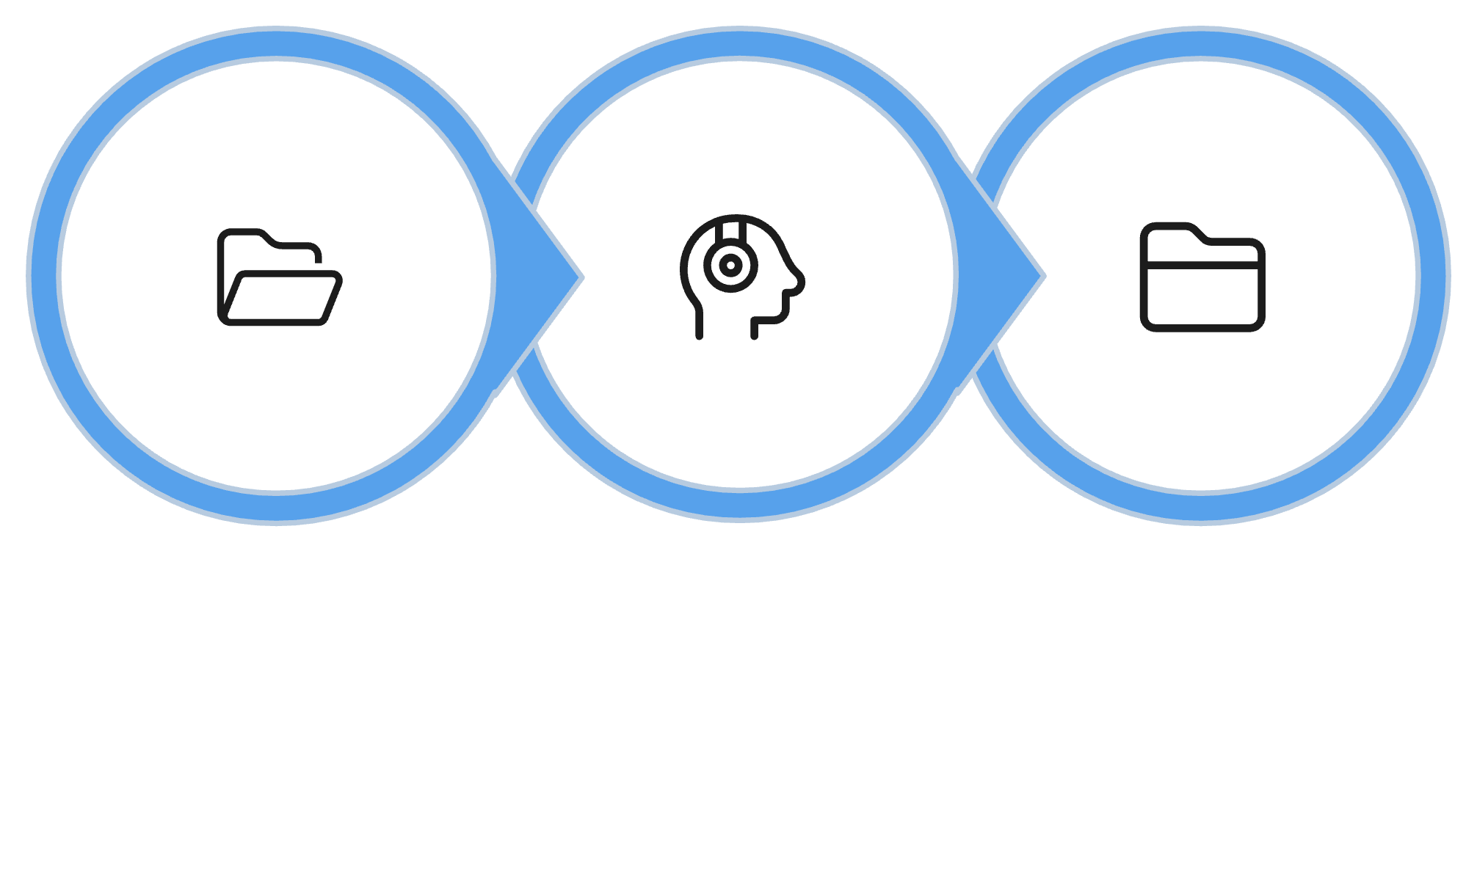
Three steps, always in this order
Open Handle
Read Handle
Close Handle
The handle is not the contents.
MCCTC | AI Automation & Software Development
Notes:
Opening a file does not give you the words in it. It gives you a handle, which is an object that knows how to read the file. Then you ask the handle for the text. Then you close it, which gives the file back to the operating system. On a four line program forgetting to close does nothing you will notice. On a real system it causes problems that are miserable to track down.

Slide 4
read gives you everything as one string
roster_file = open("roster.txt")
contents = roster_file.read()
roster_file.close()
print(len(contents)) # 102
print(repr(contents[0:40]))
'Ava Ruiz ROBO-2026-114\nMarcus'
MCCTC | AI Automation & Software Development
Notes:
read hands you the entire file as one big string. Look at the repr output. Right after the member code there is a backslash n. That is the line break, and it is an ordinary character sitting inside the string, the same as a letter. The file size of one hundred two is three lines of thirty three characters plus one newline each.

Slide 5
readline gives you one line, with its newline
roster_file = open("roster.txt")
first = roster_file.readline()
roster_file.close()
print(repr(first))
print(repr(first.strip()))
'Ava Ruiz ROBO-2026-114\n'
'Ava Ruiz ROBO-2026-114'
MCCTC | AI Automation & Software Development
Notes:
readline gives you one line at a time, and look at the end of it. The newline is included. That is why strip follows readline almost everywhere you will ever see it. If you forget, the newline is invisible until it lands somewhere it should not, like the middle of a sentence or the end of a column.

Slide 6


A fixed-width file is built for slicing
Every line has the same layout
Name in positions 0 to 19
Code in positions 20 to 32
Week 3 slicing reads it directly
MCCTC | AI Automation & Software Development
Notes:
The roster file uses a format called fixed width. Every field starts at the same position on every line, and short names are padded with spaces to fill their field. Plenty of older systems still export data this way. And it means you can read it with nothing but the slicing you learned last week. Slice the name, strip the padding, slice the code.

Slide 7
Now I break it on purpose
roster_file = open("rooster.txt")
FileNotFoundError: [Errno 2] No such file or directory: 'rooster.txt'
MCCTC | AI Automation & Software Development
Notes:
One letter wrong and Python tells you exactly what happened and exactly which name it looked for. That one is friendly. The next one is not, and it is the one that costs students real hours. I am going to run this same program from a different folder, spelled correctly, with the file sitting right there in the sidebar.

Slide 8


The file is right there and Python cannot find it
The name is looked up from where you ran the program
Not from where the program file lives
The error message prints the path it tried
Compare that path to where the file really is
MCCTC | AI Automation & Software Development
Notes:
This is the one. You can see the file in the editor two inches from the error that says it does not exist. Everything in front of you says the file is present. The one thing that matters, which folder your terminal is sitting in, is not visible anywhere on screen. Read the path in the error. It tells you exactly where Python looked. That path is the answer.

Slide 9
Reading past the end does not crash
roster_file = open("roster.txt")
roster_file.readline()
roster_file.readline()
roster_file.readline()
extra = roster_file.readline()
roster_file.close()
print(repr(extra)) # ''
print(repr(extra[0:20])) # ''
MCCTC | AI Automation & Software Development
Notes:
The file has three lines and I asked for a fourth. No error. readline hands back an empty string at the end of a file, and every slice of an empty string is another empty string. Your report would print a blank member and keep going. That is the fourth time this course has shown you the bug that does not crash, and it will not be the last.

Slide 10

What you are about to build
01
Lab U1-03, the Roster Reader
02
Read the file, report its size
03
Slice each member apart, strip the padding
04
Record what a fourth readline gives you
MCCTC | AI Automation & Software Development
Notes:
Build one is the Roster Reader lab. Read the file and report its size, then read each line and pull out the name, the season year, and the member number by position. You will copy the same block three times, and I want you to notice how that feels, because that feeling is why loops exist. Step eight asks you to read a line that is not there and write down what happened. Build two is the CLI Toolsmith.

