Slide 1
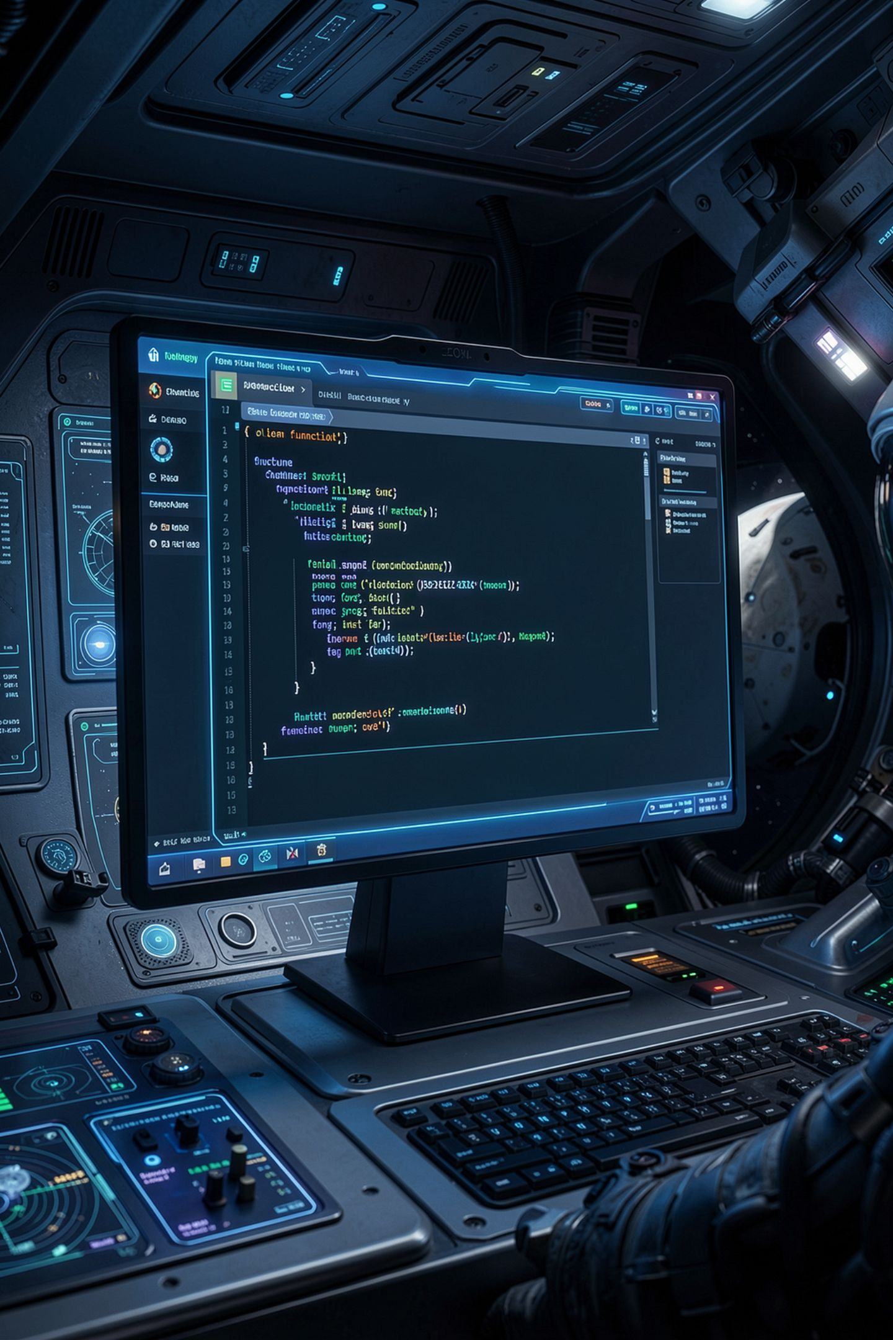
Write It Once, Call It Anywhere

Slide 2
Six copies of the same three lines
Your adventure prints a heading for every room
Six rooms, six copies of the same lines
Your playtester wants the headings in capitals
You change five of them
Nobody notices the sixth for a week
MCCTC | AI Automation & Software Development
Notes:
Open your version one and count how many times you print a room heading, a line of dashes, and an exits line. Copy and paste makes a promise that you will change every copy together, forever. You will not keep that promise. Nobody does. Today you learn how to give a block of code a name so it lives in one place.

Slide 3

The words
def
Body
Parameter
Defines a function. Defining does not run it.
The indented block inside the function.
A placeholder name in the def line.
Call
Argument
Runs the body: name, then parentheses.
The real value in the call.
MCCTC | AI Automation & Software Development
Notes:
You have been calling functions since Week 1. Print is a function, len is a function. Today you write your own. Def teaches Python a new name. The body is what that name means. Parameters are placeholders. When you call it, each argument you pass gets tied to a parameter, first to first, second to second, and then the body runs.

Slide 4
The copy problem, fixed
def show_heading(room_name):
print()
print(f"== {room_name} ==")
print("-" * 20)
show_heading("Kitchen")
show_heading("Porch")
show_heading("Bedroom")
== Kitchen ==
--------------------
== Porch ==
--------------------
MCCTC | AI Automation & Software Development
Notes:
One definition, three calls. On the first call, room name is Kitchen. On the second, Porch. The body is the same three lines every time, and only the value tied to the parameter changes. Now make every heading capitals. One edit. That is the whole reason functions exist.

Slide 5
Two parameters, matched by position
def print_receipt_line(item, price):
print(f"{item:<16}${price:>6.2f}")
print_receipt_line("Nachos", 4.5)
print_receipt_line("Sports drink", 2.25)
print_receipt_line("Pretzel", 3)
Nachos $ 4.50
Sports drink $ 2.25
Pretzel $ 3.00
MCCTC | AI Automation & Software Development
Notes:
The first argument goes to item and the second goes to price. Python matches them by position, not by meaning. And the formatting from Week 3 now lives in one place, so every line of every receipt lines up without you trying.

Slide 6
A body holds anything you know
def repeat_message(message, times):
for count in range(1, times + 1):
print(f"({count} of {times}) {message}")
def warn_storm(moves_left):
if moves_left == 1:
print("Thunder rolls closer. The storm is 1 move away.")
elif moves_left <= 5:
print(f"Thunder rolls closer. The storm is {moves_left} moves away.")
repeat_message("Stay on high ground.", 3)
warn_storm(9)
warn_storm(4)
MCCTC | AI Automation & Software Development
Notes:
Loops and decisions work inside a function body exactly as they do anywhere else. Repeat message prints three numbered lines. Warn storm with nine prints nothing at all, and that is correct, because nine matches neither condition. Warn storm with four prints the four moves warning. The body is ordinary code that happens to have a name.

Slide 7

Defining is not running
def celebrate() then no call: nothing prints
celebrate without parentheses: legal, does nothing
A call jumps into the body, then comes back
The def must run before the first call reaches it
Put every def near the top, below your constants
MCCTC | AI Automation & Software Development
Notes:
A def by itself teaches Python a name and does nothing else. If you forget the call, nothing happens and nothing complains. If you write the name without parentheses, that is also legal and also does nothing. And Python reads top to bottom, so the def has to come before the first call. Constants first, then every def, then the code that calls them.

Slide 8
Watch this: I forget the argument
def show_heading(room_name):
print()
print(f"== {room_name} ==")
print("-" * 20)
show_heading()
MCCTC | AI Automation & Software Development
Notes:
I defined show heading with one parameter, room name. Now I call it with empty parentheses. Before I run it, what do you think Python will say, and will it name the problem?

Slide 9

The wrong way: the missing argument
Traceback (most recent call last):
File "...", line 6, in <module>
show_heading()
~~~~~~~~~~~~^^
TypeError: show_heading() missing 1 required
positional argument: 'room_name'
The error names the missing parameter exactly. Read it before changing anything.
Python tells you which argument is missing and which function expected it. The traceback points to the call, not the def.
MCCTC | AI Automation & Software Development
Notes:
Read it like a sentence. Show heading is missing one required positional argument, and it is called room name. Python names the function, the count, and the exact parameter. Too many arguments gives a message that says takes one positional argument but two were given. Calling before the def gives a NameError. The one that does not crash is passing two text arguments in the wrong order, because Python has no idea north is a direction.

Slide 10


Arguments match by position, not meaning
show_exit(room, direction) called as show_exit("north", "lobby")
No error. The words land in the wrong roles
It prints: From the north you can go lobby
Read the def line before you write the call
The def line tells you the order
MCCTC | AI Automation & Software Development
Notes:
This is the silent one. If both parameters take text, swapping them raises nothing. The function happily prints from the north you can go lobby. The dangerous bugs are the ones that do not crash, and this one is waiting in every function with two parameters of the same type. When you call a function, look at its def line.

Slide 11
What you are about to build
01
02
03
Build 1
Build 2
Find
Unit 3 quiz, 30 minutes.
functions_practice.py
Three repeated shapes in your v1.
04
05
Turn
Call
Each into a function with a parameter.
Each at least twice. Commit.
MCCTC | AI Automation & Software Development
Notes:
Build one is the Unit 3 quiz. Build two is a new practice file, not your version one. Find three places in your adventure where the same shape of code repeats with a different value. Write each one as a function with at least one parameter, and call each one at least twice with different arguments. Every function you write today prints. Tomorrow you learn how to make one hand a value back.

