Slide 1
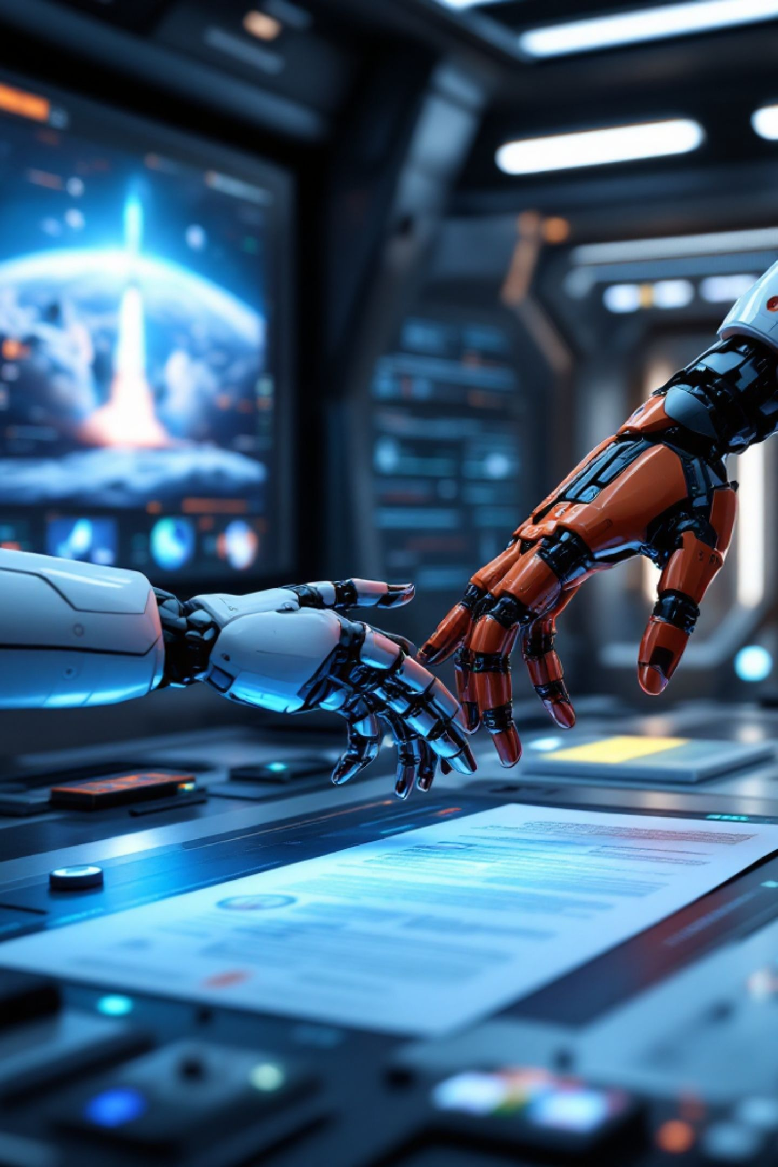
Who Owns What the Machine Made

Slide 2
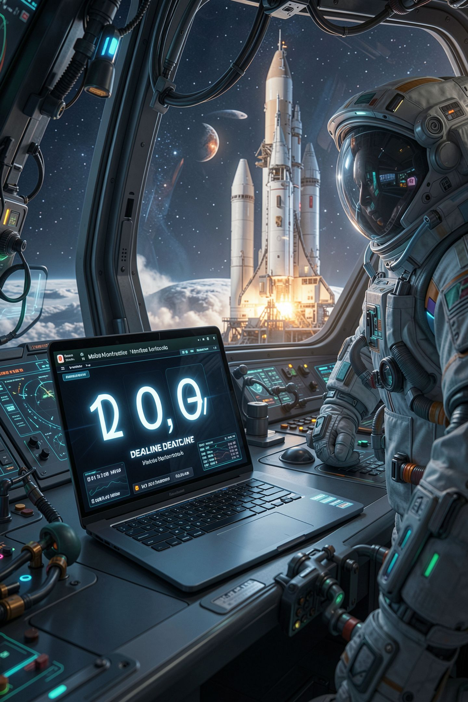
You are going to ship something in six weeks
The Congressional App Challenge closes in about six weeks
A submission is a claim about your work
You will use AI between now and then
Nobody told you what that means yet
MCCTC | AI Automation & Software Development
Notes:
In six weeks some of you submit to a national competition. A submission is not only code. It is a claim that this is your work. Between now and then you will use AI, because this course tells you to. So the question of what you are actually claiming is not theoretical and it is not for later. It is for today.

Slide 3
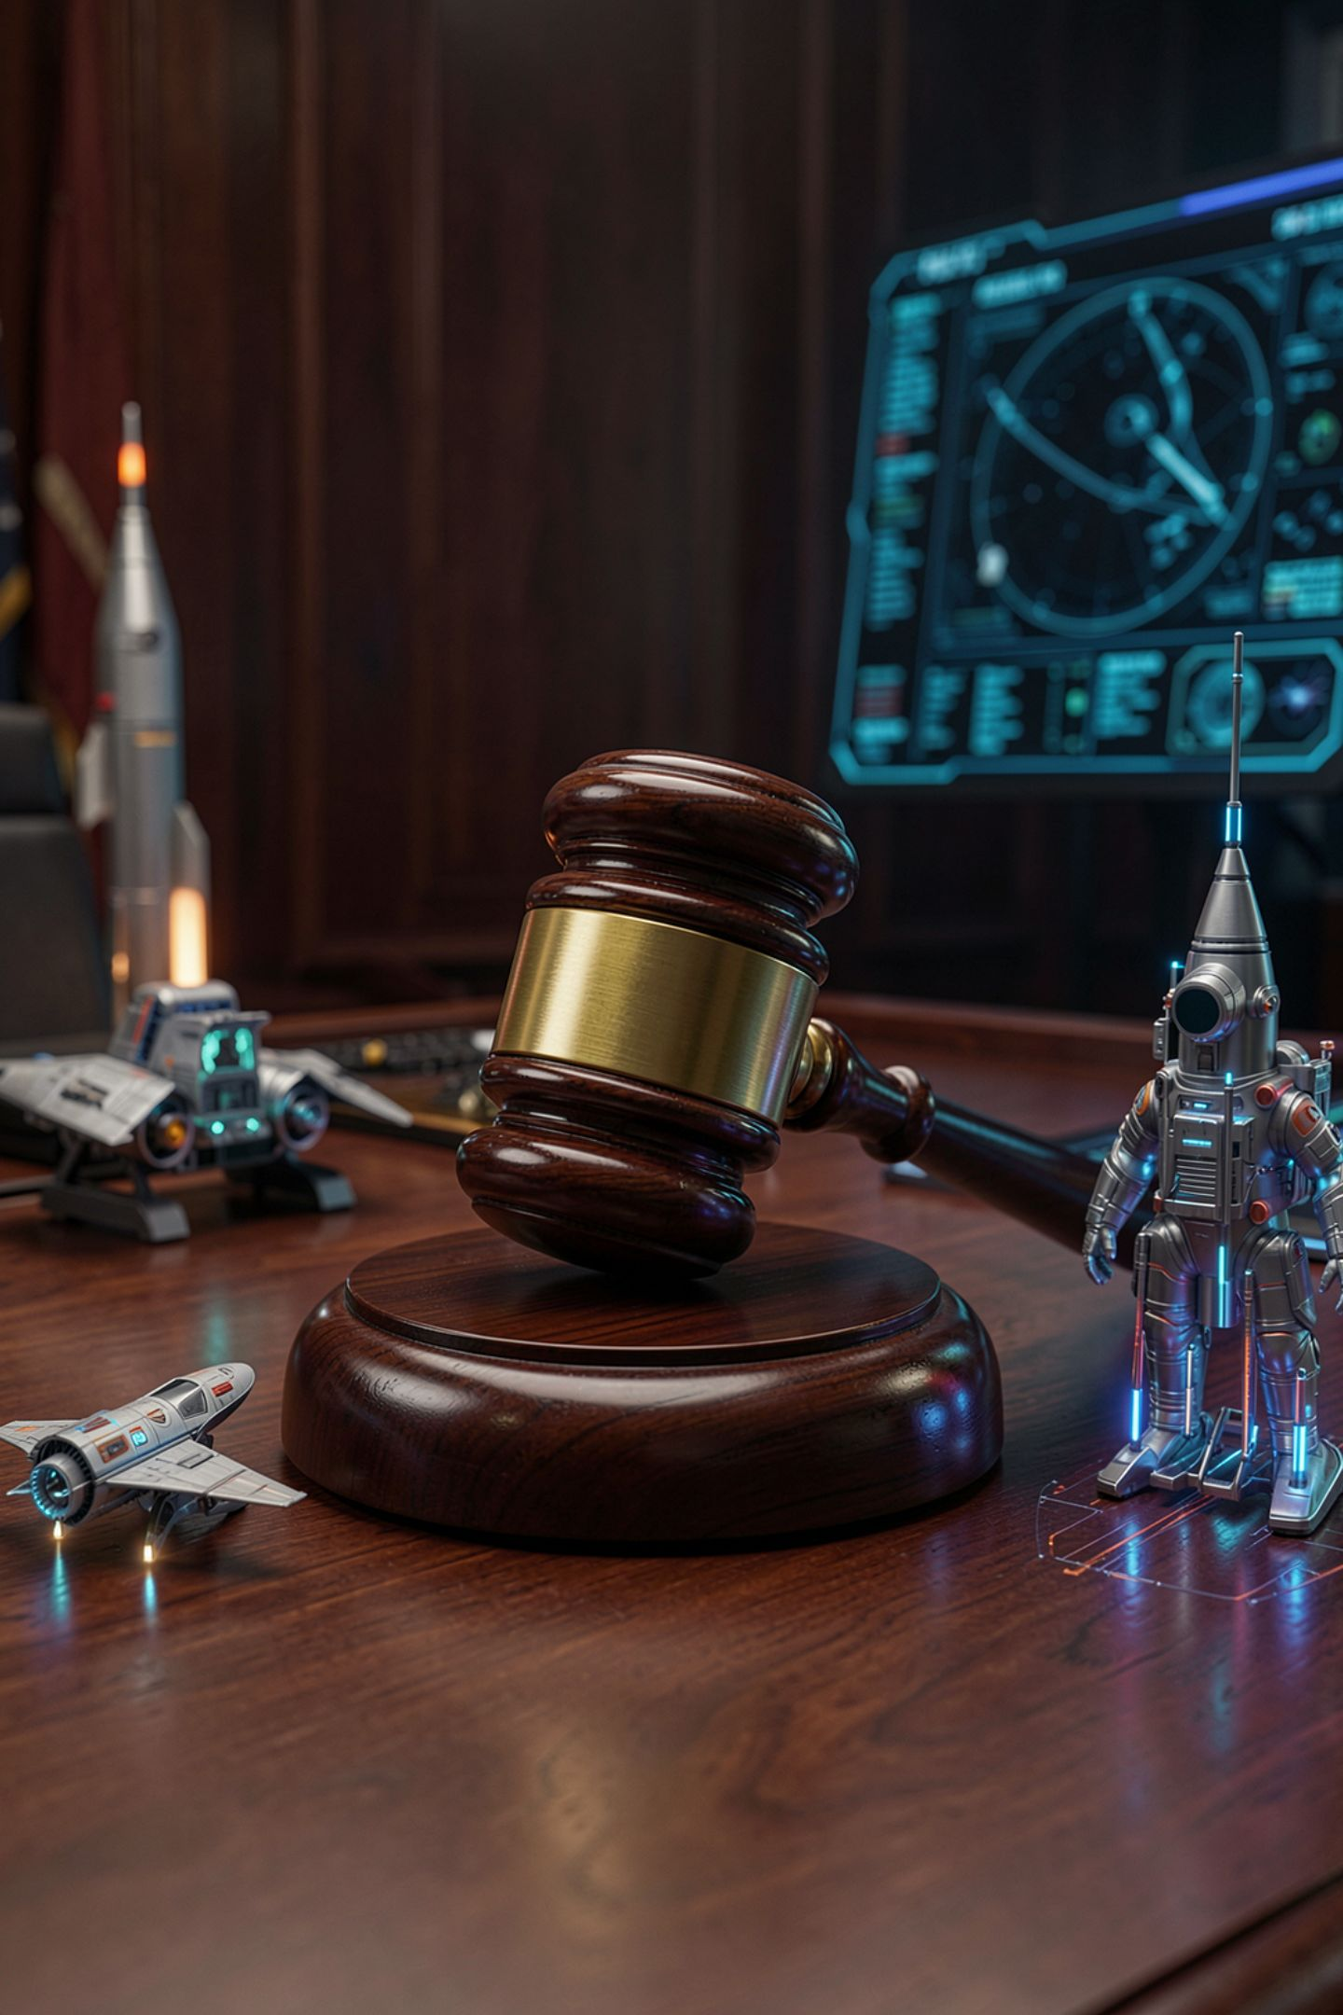
I am not going to pretend to know
This is genuinely unsettled law
It is being argued in court right now
I am not a lawyer and neither is anyone here
Anything stated confidently today may be wrong
MCCTC | AI Automation & Software Development
Notes:
I want to be honest about what I do not know, because that is itself the lesson. Who owns AI output is being fought over right now and the rules are still being written. If I stood here and gave you a clean answer, I would be doing the exact thing we spent yesterday learning to catch. So I am not going to. Instead I am going to show you what you can actually rely on.

Slide 4

Read the documents, not the doctrine
The terms of the tool you used
The license of any code you included
The rules of the competition or the client
All three are written down and findable
MCCTC | AI Automation & Software Development
Notes:
Here is what does not depend on how the law lands. Three documents govern your situation and all three exist today. The terms of service of the tool. The license of any code you pulled in. And the rules of whoever is receiving the work. That last one governs in practice, because they are the ones judging you. Whatever the law turns out to be, you will be judged by somebody who already wrote down what they expect.

Slide 5
Licenses are not contested
MIT
Apache 2.0
Use it, keep the notice
Similar, plus patent terms
GPL
No license at all
Use it, and publish your own source
No license at all is not permission
MCCTC | AI Automation & Software Development
Notes:
This part is settled and checkable, so learn it properly. These three licenses ask genuinely different things of you. The last bullet is the one people get wrong. Code posted publicly with no license attached is not free to take. Public means visible. It does not mean permitted. You are going to read all three of these today and write one sentence each on what they require.

Slide 6
Where to actually find a license
On any GitHub repository, top level folder:
LICENSE most common
LICENSE.md same thing
COPYING older projects, usually GPL
No such file? Then no permission was granted.
MCCTC | AI Automation & Software Development
Notes:
This is where you look, and it takes about eight seconds. The file sits at the top level of the repository next to the README. If you open a project and there is no license file at all, that is not a shortcut. That is the author not having granted anyone permission, and the safe reading is that you may not use it.

Slide 7
What a log entry actually looks like
Model used:
What I asked:
What came back, in summary:
What I kept:
What I changed, and why:
How I verified it:
MCCTC | AI Automation & Software Development
Notes:
This is the template and the last two lines are the graded ones. The first four are record keeping and anybody can fill them in. What I changed and why is where your thinking shows. How I verified it is where I find out whether you checked. It looked right is not verification and it will not earn the points. Today you write your first complete one.

Slide 8
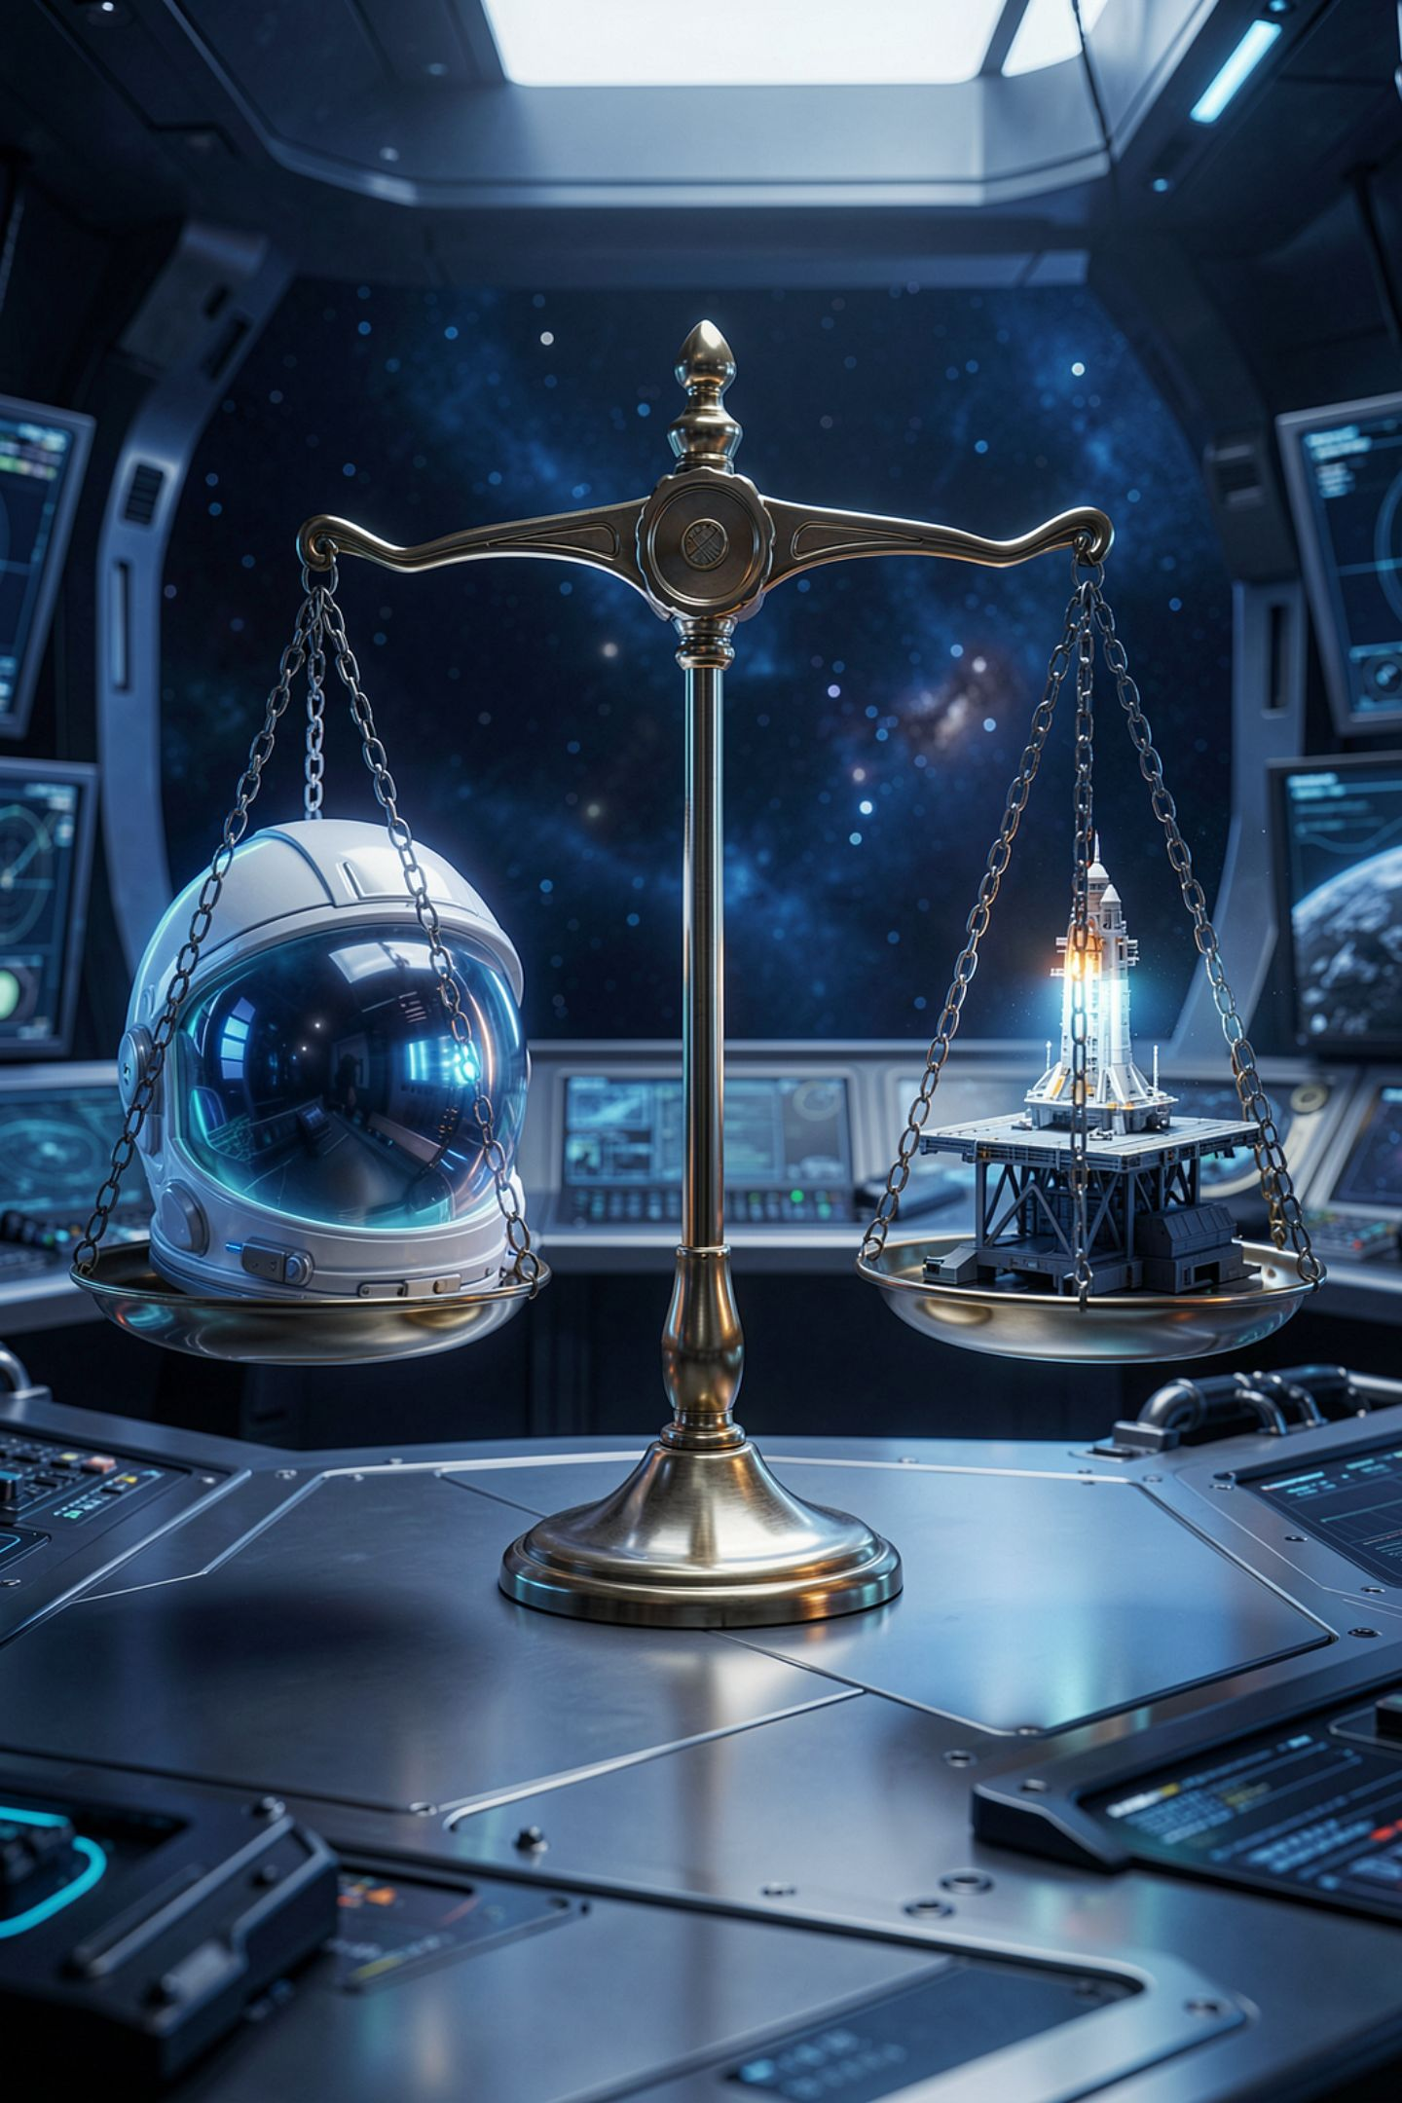
The question, and both sides are serious
Yes: you own it
No: you do not
You chose, judged, revised, integrated
It was assembled from other people's work
Does the prompt writer own the output? Pick a side and argue the other one honestly.
MCCTC | AI Automation & Software Development
Notes:
Here is the question you are writing about today. Take both sides seriously, because both are serious. On one side, you chose the problem, wrote the input, judged the result and fixed it, which is authorship in the ordinary sense. On the other, the output came from patterns in work that other people made and did not agree to, and typing a sentence is not the same act as writing a thousand lines. I am not going to resolve it and neither is your grade.

Slide 9
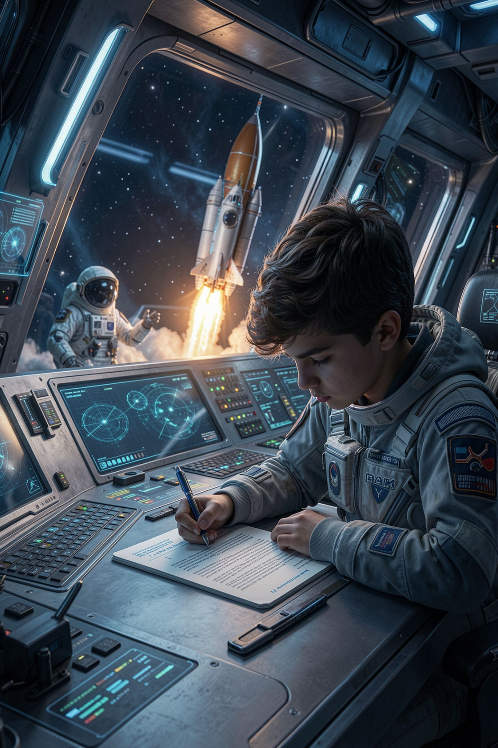
You are graded on the argument
1
State your position clearly
2
Give the strongest case for it
3
Give the strongest case against it
4
Say what would change your mind
MCCTC | AI Automation & Software Development
Notes:
There is no correct side today, so here is what I am actually grading. Four parts. State where you land. Argue it. Then argue against yourself, honestly, which is the part everybody skips and the part worth the most. And name what specifically would change your mind. If nothing would change your mind, you do not have a position, you have a preference.

Slide 10

The claim I am about to read you
It will sound authoritative
It will be about a topic you cannot check from memory
Try to trace it to a primary source
You will not be able to
MCCTC | AI Automation & Software Development
Notes:
I am going to read you a confident sounding statement about AI and copyright. Your job is to try to find where it came from. You will not be able to, because it has no source. That is the point. This is yesterday's lesson moved into a domain where the stakes are legal instead of technical, and where being wrong costs you a competition entry rather than a wrong answer.

Slide 11

What this course requires regardless
Log what you used and what you changed
Be able to explain every line you submit
No personal data in any tool, ever
These hold whatever the law decides
MCCTC | AI Automation & Software Development
Notes:
Four rules that are not contested and are entirely within my authority. Log it. Explain it. Never put anyone's personal information into any of these tools. And the one from the syllabus that governs everything: the only way to fail this course outright is to hand me work you cannot explain. Notice that this rule protects you no matter which way the law goes.

Slide 12
What you are about to build
01
02
Quote the ownership clause
One sentence each
From the actual terms of the tool
On MIT, Apache, GPL
03
04
A 300 to 400 word position paper
Your first complete AI usage log entry
MCCTC | AI Automation & Software Development
Notes:
Four things. Find the ownership sentence in the terms of the tool we use and quote it exactly. Write one sentence per license in your own words. Then the position paper, all four parts including the argument against yourself. And your first full AI usage log entry, with a real answer in the how I verified it box. It looked right is not verification and it does not earn the points.

