Slide 1

How an App Finds Your Top Song

Slide 2

Your music app knows your top song
It counts your plays
It finds your most played song
It searches for an artist
None of that is magic
It is a few algorithms over organized data
MCCTC | AI Automation & Software Development
Notes:
Every app you use is mostly information processing. Counting, adding up, finding the biggest, searching. None of it is one giant clever line. It is a small number of algorithms, run over data that somebody decided how to organize. Today you learn to name both halves, and you learn why the way data is organized changes how much work the program does. That is outcome 5.1.2.

Slide 3



Two words
Algorithm
Precise, finite steps that solve a problem
Your pseudocode is an algorithm in English
Data Structure
How data is organized for a program
One song per line, fields in fixed positions
The structure decides which algorithms are possible
MCCTC | AI Automation & Software Development
Notes:
An algorithm is a precise, finite sequence of steps. You have been writing them in pseudocode for two weeks. A data structure is the way data is organized so a program can use it. Our playlist file, one song per line, title in positions zero to twenty three, is a data structure. And here is the idea that makes this more than vocabulary. Change the structure, and the algorithm changes with it.

Slide 4
The loop every algorithm uses
playlist = open("playlist.txt")
song_count = 0
total_plays = 0
while True:
line = playlist.readline()
if line == "":
break
plays = int(line[44:47])
song_count = song_count + 1
total_plays = total_plays + plays
playlist.close()
print(f"{song_count} songs, {total_plays} plays")
8 songs, 325 plays
MCCTC | AI Automation & Software Development
Notes:
In Week 4, readline returning an empty string at the end of the file was a trap. Today it is the sentinel. A blank line comes back as a newline character, never as empty, so empty means the file is over. This slide writes the loop with Wednesday's break. The lecture notes write the same loop with the check in the while line. Both stop at the same moment. Every algorithm today uses this loop, and only the middle changes. Here it is count and total, two accumulators set to zero above the loop.

Slide 5

Biggest value, and whose it is
# Before the loop
most_plays = 0
top_song = ""
# Inside the loop, once per record
title = line[0:24].strip()
plays = int(line[44:47])
if plays > most_plays:
most_plays = plays
top_song = title
Most played: Group Chat Silence (87 plays)
MCCTC | AI Automation & Software Development
Notes:
The algorithm in one sentence. Keep the best one seen so far, and replace it whenever a better one shows up. And keep two pieces of state together, the value and the label. Eighty seven answers nothing. The song that got eighty seven is the answer. When one changes, both change.

Slide 6

Search, and stop when you find it
Compare each record to what you want
break the moment it matches
static hallway: found after reading 3 lines
An artist who is not there: all 8 lines
Not here always means reading everything
MCCTC | AI Automation & Software Development
Notes:
Wednesday's break turns a loop into a search. The moment the artist matches, stop. Three lines read. But run it for an artist who is not on the playlist and it reads every line, because in an unordered file there is no way to be sure something is missing without checking everything. Also compare the whole artist field with double equals. The word hall is in static hallway, and a search that matches part of a field finds things you never asked for.

Slide 7
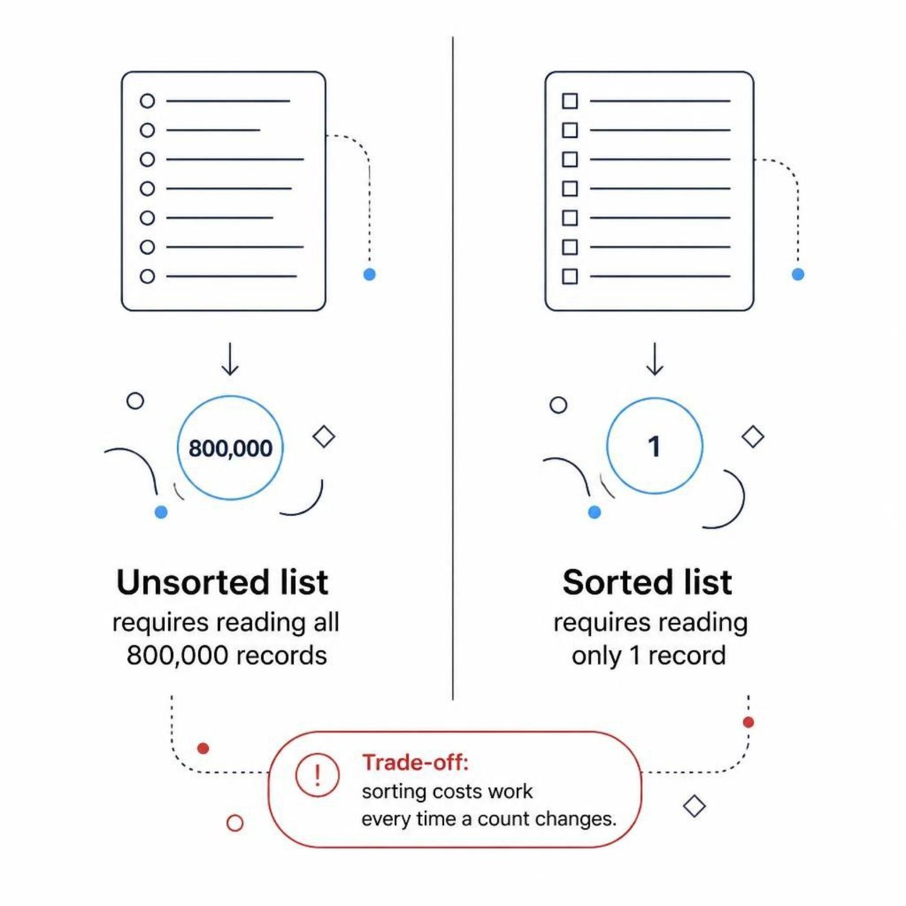
Same question, two structures
Unsorted (order added)
Sorted by plays
Which song has the most plays?
Songs in the order added: read all 8 lines
With 800,000 songs: 800,000 reads
Which song has the most plays?
Songs sorted by plays: read 1 line
With 800,000 songs: 1 read
Sorting costs work every time a count changes
MCCTC | AI Automation & Software Development
Notes:
Same eight songs. Same question. In the order they were added, a bigger number could be on any line, so the algorithm reads everything. Sorted from most plays to fewest, the answer is on line one. Now scale it up. That is the difference between reading one line and reading all of them. So why not always sort? Because every play changes a count, and a sorted file may need that song moved. Neither structure is better. Each makes some questions cheap and others expensive.

Slide 8
Watch this: the least played song
# Before the loop
fewest_plays = 0
quiet_song = ""
# Inside the loop, once per record
title = line[0:24].strip()
plays = int(line[44:47])
if plays < fewest_plays:
fewest_plays = plays
quiet_song = title
# After the loop
print(f"Least played: {quiet_song} ({fewest_plays} plays)")
MCCTC | AI Automation & Software Development
Notes:
The biggest value worked by starting at zero. So to find the smallest, I flip the less than and start at zero again. Same pattern, same file. Predict the song and the number before I run it.

Slide 9

The wrong way: a blank title and zero plays
Least played: (0 plays)
Starting fewest_plays at 0 means no real play count can ever be less than the starting value. The condition plays < fewest_plays is never true, so quiet_song stays blank and fewest_plays stays zero.
MCCTC | AI Automation & Software Development
Notes:
No error. A blank title and zero plays. Every song has more than zero plays, so plays less than fewest plays is False on every single record, and nothing is ever replaced. The loop ran eight times and changed nothing. The starting value was a guess, and the guess was already better than every real record. The fix is to start from the first real record, not from a guess. Read one line, use it as the lowest so far, then loop over the rest. That prints Low Battery with nine plays.

Slide 10
Five algorithms to recognize
Count
1
How many
Total
2
How much altogether
Maximum or minimum
3
Start from the first real record
Search
4
Stop early with break once found
Filter
5
Which records match a rule
MCCTC | AI Automation & Software Development
Notes:
Almost every information processing task you meet this year is one of these five, or a few of them sharing one loop. When you get a data problem, name the algorithm first. Then ask whether it can stop early, and what its starting state has to be. That last question is exactly the one that went wrong a minute ago.

Slide 11

What you are about to build
Build 1: Lab U03-03 Game Night Leaderboard
Count, total, high score, low score, and a search
Step 4 starts the low score at 0 on purpose
Build 2
v1 test scripts, playtest fixes, README
CAC teams: final checks and submission first
MCCTC | AI Automation & Software Development
Notes:
Build one is the leaderboard lab. One pass through a night of game results answers four questions, and a second loop searches for a player's first big round and stops as soon as it finds it. Step four makes you start the low score at zero and record the result. Build two is your text adventure. Write your win and lose test scripts, fix what your playtester found Friday, and draft your README, because v1 is due at the end of the day tomorrow. Congressional App Challenge teams, today is your last class day to submit, and I will check in with you first.

