Slide 1

Two Kinds of Review

Slide 2

Two Kinds of Review
MCCTC | AI Automation & Software Development
Notes:
Welcome back. Your test file checks what your team thought to check, and nobody thinks of everything. That is not a flaw in you. It is what being the author means. Your eyes slide right past your own assumptions because they are yours. This afternoon another team reads your code and you read theirs. Before that, you learn the two kinds of review and exactly what each one misses.

Slide 3

Your tests only check what you thought of
Every check in your file came from your head
The defect you never imagined has no check
You cannot see your own blind spot
Today, somebody else looks
MCCTC | AI Automation & Software Development
Notes:
There are two kinds of code review. In a peer walkthrough, people read the code while the author explains it, requirement by requirement. People are slow and they get tired, but they know what the code is for. Static analysis is a program reading your code without running it, looking for patterns that are usually mistakes. It is fast and tireless and has no idea what the code is for. You need both.

Slide 4

People and programs miss different things
Peer walkthrough: people read it with the author
People understand purpose, and get tired
Static analysis: a program reads it, never runs it
Programs are fast, and have no idea of purpose
MCCTC | AI Automation & Software Development
Notes:
Python ships with a static check you can run right now. py compile asks one question. Can Python read this file at all. door dot py is missing a colon, so it fails. greet dot py prints nothing, which means it passed. It runs and says good morning. But greet has a misspelled variable on a line that only runs in the afternoon. py compile cannot see that. It only checks that the file can be read.

Slide 5
The check that ships with Python
$ python -m py_compile door.py
File "door.py", line 2
if door_open
^
SyntaxError: expected ':'
$ python -m py_compile greet.py
$ python greet.py
Good morning
MCCTC | AI Automation & Software Development
Notes:
This is a real static analysis tool and you can read every line of it. ast parse reads the file the same way Python does before running it and hands back a tree, the whole program as nested pieces. ast walk visits every piece. For each one we ask, is this an except block, and is its whole body the word pass. If so, that block makes failures disappear, and we print the line. The file being checked is never run. It is only read.

Slide 6
Build a checker in eight lines
import ast
import sys
with open(sys.argv[1], encoding="utf-8") as file:
tree = ast.parse(file.read())
for node in ast.walk(tree):
if isinstance(node, ast.ExceptHandler):
if len(node.body) == 1 and isinstance(node.body[0], ast.Pass):
print(f"line {node.lineno}: this except block hides the failure")
MCCTC | AI Automation & Software Development
Notes:
review check dot py is the same idea with six checks, each tied to a review dimension. Here it is on the laptop cart program from your lab. Seven findings in under a second, across four dimensions. Now read the last line out loud with me. Not checked by this tool, requirements fit, and whether the logic is right. It cannot check requirements, because the requirements are not in the file.

Slide 7
The full checker on a peer's code
Static review of cart_checkout.py
------------------------------------------------------------
line 19 Security 'RESET_PIN' looks like a secret written into the code
line 44 Correctness bare except catches every error, including your own typos
line 44 Correctness except block only says pass, so the failure disappears silently
line 48 Readability function 'chk' has no docstring
line 48 Readability one-letter name 'c'
line 48 Readability one-letter name 'n'
line 82 Performance open() inside a loop reads or writes the file on every pass
------------------------------------------------------------
7 finding(s)
Not checked by this tool: Requirements Fit, and whether the logic is right.
MCCTC | AI Automation & Software Development
Notes:
Static tools make mistakes both ways. A false alarm: the checker flags a variable named shopping list as a possible secret, because the word shopping contains p i n. You look at it for two seconds and dismiss it. That kind of mistake is cheap. The other direction is the dangerous one, and I am going to show you.

Slide 8

Tools are wrong in both directions
False alarm: shopping_list flagged as a secret
Because shopping contains the letters p, i, n
A person dismisses it in two seconds
Silent miss: a clean report on broken code
MCCTC | AI Automation & Software Development
Notes:
This is concessions dot py from Lab U06-01 on Thursday. Zero findings. Before I say anything, what did your tests find in this file on Thursday.

Slide 9
Watch this
$ python review_check.py concessions.py
Static review of concessions.py
------------------------------------------------------------
------------------------------------------------------------
0 finding(s)
Not checked by this tool: Requirements Fit, and whether the logic is right.
MCCTC | AI Automation & Software Development
Notes:
Three real defects, the ones your acceptance tests caught. Zero findings from the checker. No error, no warning, a clean report on broken code. The wrong move is the conclusion, zero findings so it is clean. It is the same shape as a test that agrees with the bug. A tool says fine and a person stops looking. So the protocol order is tools first, then the walkthrough anyway.

Slide 10

Zero findings, three real defects
Refuses a legal order of 20 hot dogs
Ignores sports drinks when counting combos
Applies the member discount in the wrong order
Every defect is about purpose. Tools cannot see purpose.
MCCTC | AI Automation & Software Development
Notes:
When you find something this afternoon, write it with four parts. Where, the function and the line. Which dimension. The consequence for a real person, not the word inefficient. And the fix. And one rule above everything. Review the code, never the coder. If your sentence would still make sense with the author's name in it, rewrite it.

Slide 11
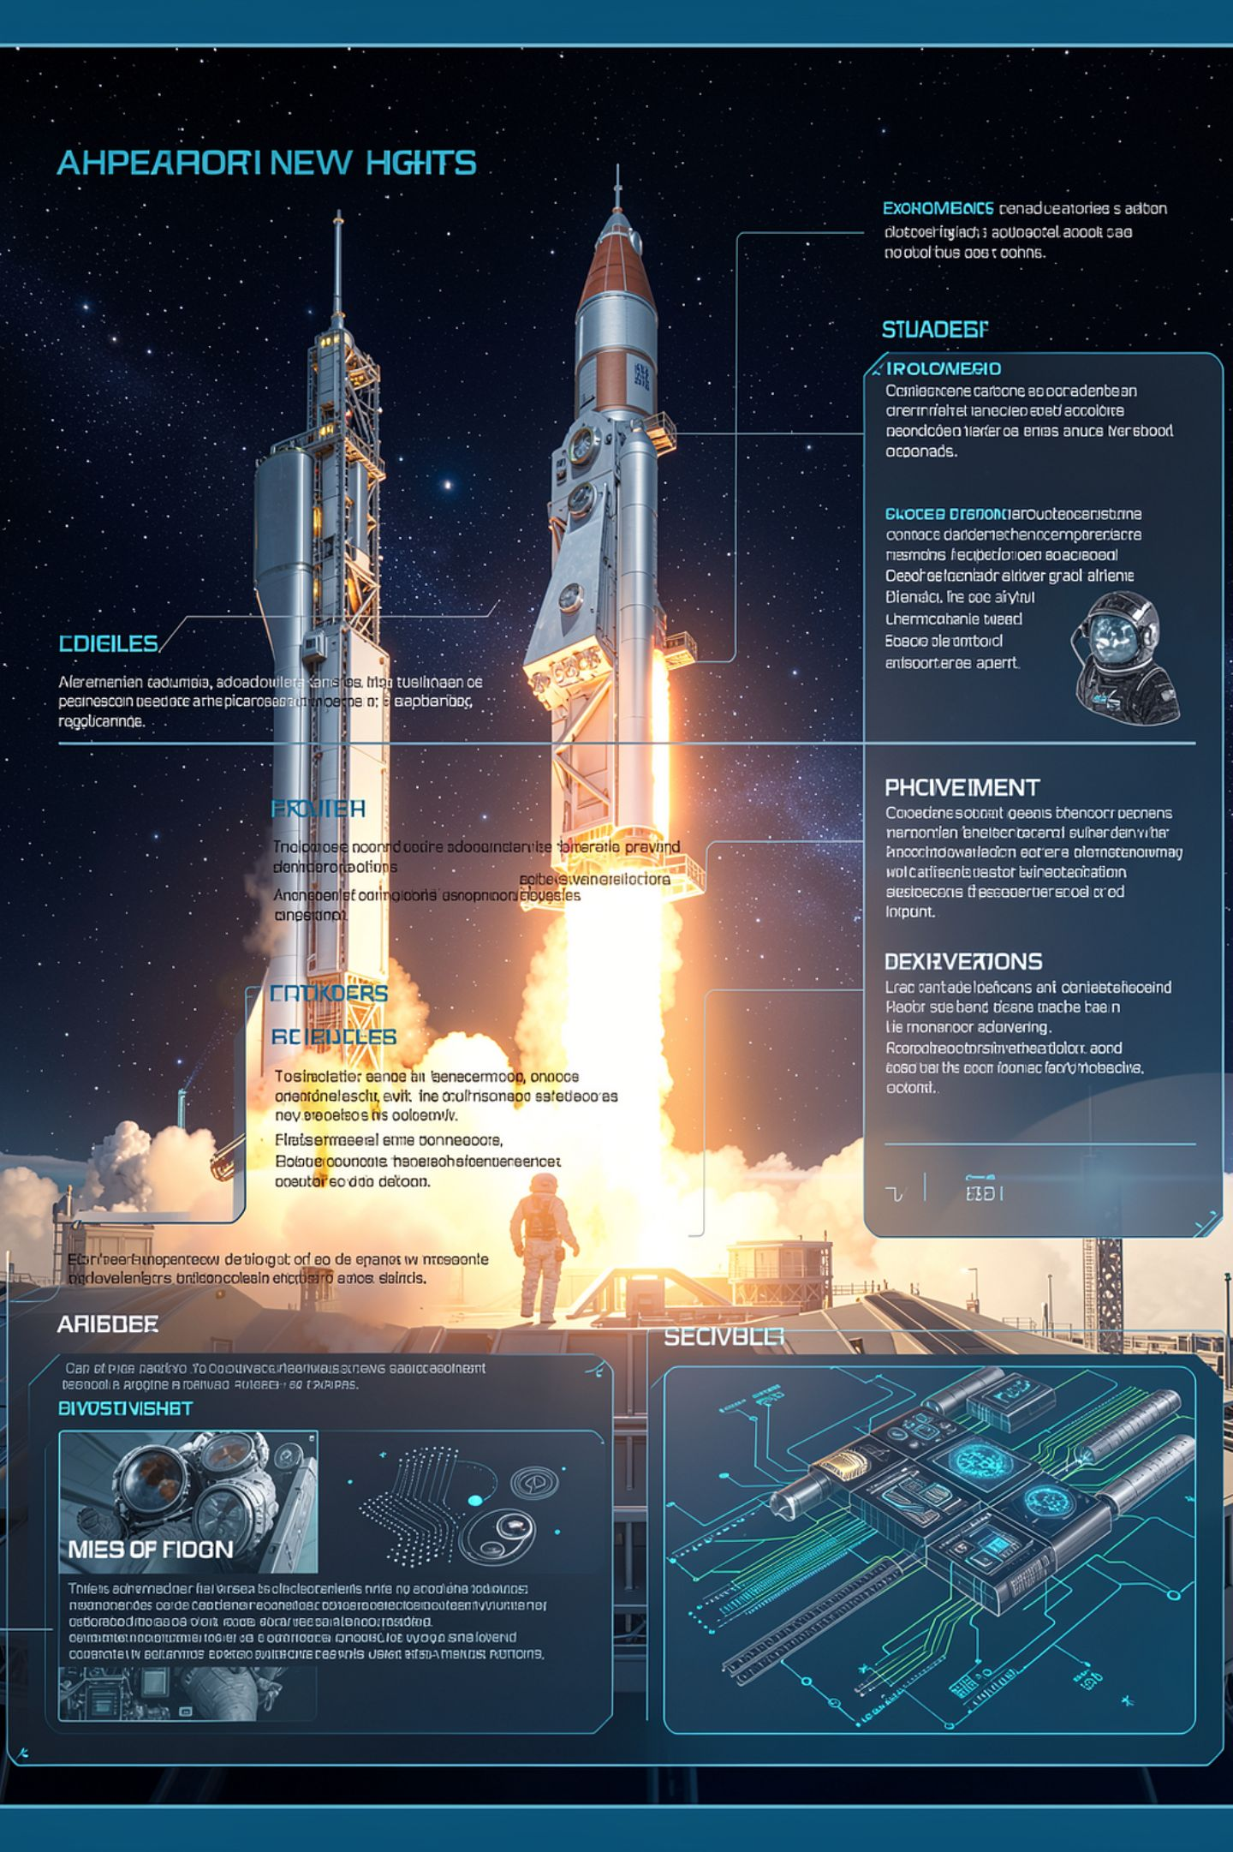
A finding has four parts
Where
Function and line number
Dimension
One of the five
Consequence
What goes wrong for a real person
Fix
What to change
Review the code, never the coder.
MCCTC | AI Automation & Software Development
Notes:
Build one is Lab U06-03. You review the laptop cart program using the full protocol. Run py compile and the checker, then walk through it requirement by requirement and find what the checker could not. There are several. Build two is the real thing. Peer Code Review one, on another team's Sprint 1 code, while another team reviews yours. Authors, your only word during the review is noted. You respond in writing tomorrow.

