Slide 1

Baselines: The Version You Can Always Come Back To

Slide 2

Six small changes and a broken game
Your app went live Monday
Since then: a typo fix, a rename, four more tweaks
Friday morning, nobody can type a command
Which change did it? What did working look like?
MCCTC | AI Automation & Software Development
Notes:
Here is Thursday night for somebody in this room. The app works Monday. Then a typo fix, a variable rename that seemed tidy, and four other little things. Friday morning, the day of your demo, the game will not accept a single command. Which of the six broke it? What exactly was running when it worked? If you cannot answer both questions in under a minute, you have a configuration management problem, and today you fix it before you have it.

Slide 3
Three ideas that are really one
Version management
Interface control
Every release has a name
Know what depends on you
Baseline
Change impact
An agreed version you can return to
Check what breaks before changing
MCCTC | AI Automation & Software Development
Notes:
Ohio calls this configuration management, and it is on your WebXam tomorrow. It sounds like a big company thing. It is a Thursday night thing. Every release gets a name. You know which parts of your app other things depend on. You keep one agreed version you can always go back to. And before you change anything, you list what it touches. Four bullets, one habit.

Slide 4
Every release has a name
MAJOR.MINOR.PATCH
1.4.2 -> 1.4.3 a fix nobody depends on changing
1.4.2 -> 1.5.0 a new feature, everything old still works
1.4.2 -> 2.0.0 something someone depends on breaks
git tag -a v1.0.0 -m "Storm Relay web 1.0.0: first public release"
git push origin v1.0.0
MCCTC | AI Automation & Software Development
Notes:
Three numbers. Patch for a fix. Minor for a feature that breaks nothing. Major when something somebody depends on stops working. In Git, a tag pins that name to one exact commit. And here is the failure mode that catches people. Plain git push does not send tags. Your commits reach GitHub and your tag stays on your laptop. Push the tag by name.

Slide 5
Version numbers are not strings
String comparison sorts character by character. The digit 1 in 1.10.0 is compared to 9 in 1.9.0 before the rest of the number is read.
Use a proper version-aware library or parse the parts as integers before comparing.
print("1.10.0" > "1.9.0")
print(max(["1.2.5", "1.10.0", "1.9.0"]))
False
1.9.0
MCCTC | AI Automation & Software Development
Notes:
Predict before I run it. Is version one point ten newer than version one point nine? Python says no. And the biggest of these three is one point nine. No error, wrong answer, twice. Strings compare one character at a time, and the character one comes before nine. Split the version and convert each part with int before you compare. This is our running thread again. The dangerous bugs are the ones that do not crash.

Slide 6

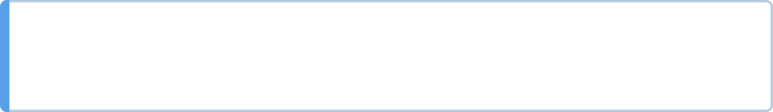
An interface is anything that depends on you
URL paths
Like /health and /command
Form field names
Like command
Environment variable names
Like PORT
Save file keys
Like room
Change these on purpose, never in a cleanup.
MCCTC | AI Automation & Software Development
Notes:
Your code has an inside and an outside. Renaming a variable inside a function is housekeeping. Renaming something on the outside is a change somebody else feels. Paths other people bookmarked. The name of a form field. The PORT variable the host sets. The keys in save files already sitting on someone's disk. Interface control means those only change deliberately, with a version number and a note.

Slide 7
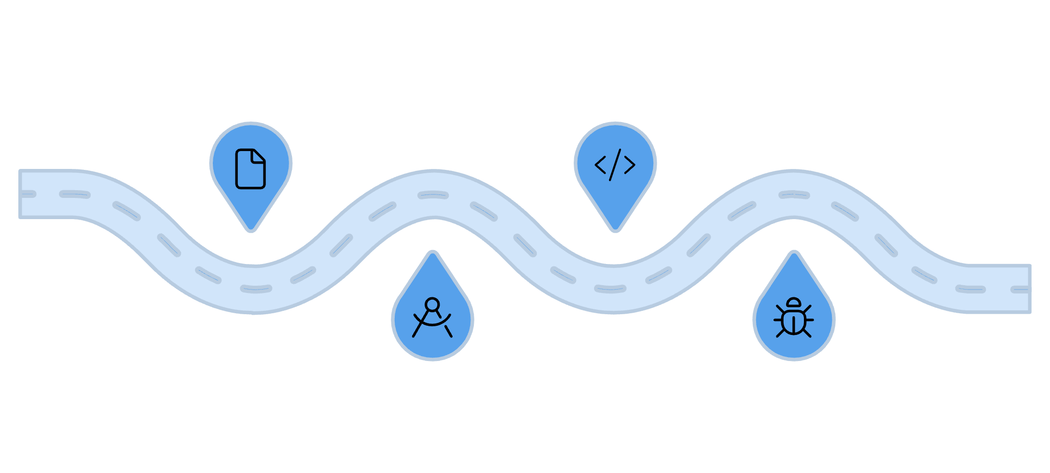
Baselines and lifecycle phases
Requirements
Development
Capture client needs and set baseline
Build features and produce tagged builds
Requirements, design, development, testing, deployment, maintenance
A baseline can be set when a phase ends
Yours: the tagged release your client accepted
Maintenance starts the second your app is live
Design
Testing
Architect solution and review specs
Validate quality before release
MCCTC | AI Automation & Software Development
Notes:
Software moves through phases. Requirements, design, development, testing, deployment, maintenance. When a phase ends and people agree on the result, that result can become a baseline, a line you measure every later change against. For you, the baseline is the tagged version your teacher or client accepted. And notice the last phase. The moment your app goes live Monday, you are in maintenance, which is the longest phase any real software lives in.

Slide 8
The wrong way: a one-word cleanup
<input type="text" id="command" name="cmd" maxlength="40">
>
Type a command. Type help to see the list.
MCCTC | AI Automation & Software Development
Notes:
Somebody decides cmd is tidier than command. They change the form and forget the server, which still reads command. Now a player types north, the browser sends cmd equals north, and the server finds no command at all. Every command, every player, the same reply. The page loads. The server answers normally. Nothing in the log. The game is unplayable, and nobody got an error message.

Slide 9
One test caught it
python -m unittest test_app
FAIL: test_the_form_sends_the_field_the_handler_reads
AssertionError: 'name="command"' not found in '...the whole page...'
Ran 46 tests in 24.191s
FAILED (failures=1, skipped=1)
MCCTC | AI Automation & Software Development
Notes:
I shortened the error line, because it prints the entire page. Forty four tests passed. One failed, and it is the only test that checks the form and the handler use the same name. Every other test sends command straight to the server, so without this one test, that change sails through the whole suite. The form and the handler are two halves of one interface. Tests written for each half separately cannot see the gap between them.

Slide 10
Change impact analysis, before you touch it
1
Code
Which files change together
2
Tests and docs
What must be updated
3
Host settings and stored data
What breaks
4
People
Who notices, and what version number
5
Decide
Patch, minor, major, or reject it
MCCTC | AI Automation & Software Development
Notes:
Here is the right way. Before touching anything, list what the change touches. Code, tests, documentation, settings on the host, data already stored, and the people who use it. Then decide the version number. For our cmd rename, the answer is reject it. Nothing gets better for a player. Rejecting a change is a real, respectable outcome of an impact analysis, and often it is the best one.

Slide 11

What you are about to build
Build 1: Lab U8-02 Part 3, one real change request
Predict what breaks, then make it and check
Build 2: GP2 exam, 50 minutes
Tomorrow: WebXam post-test, then tag your release
MCCTC | AI Automation & Software Development
Notes:
Build one is Lab U8 two, part three. You get one real change request for Playlist Namer. You write the impact analysis first, predicting what breaks. Then you make the change on a branch, run the checker, and compare what broke with what you predicted. Comparing the two is the point of the lab. Build two today is the grading period exam. Tomorrow you take the WebXam post-test first, then you tag your release and write your change impact note.

