Slide 1
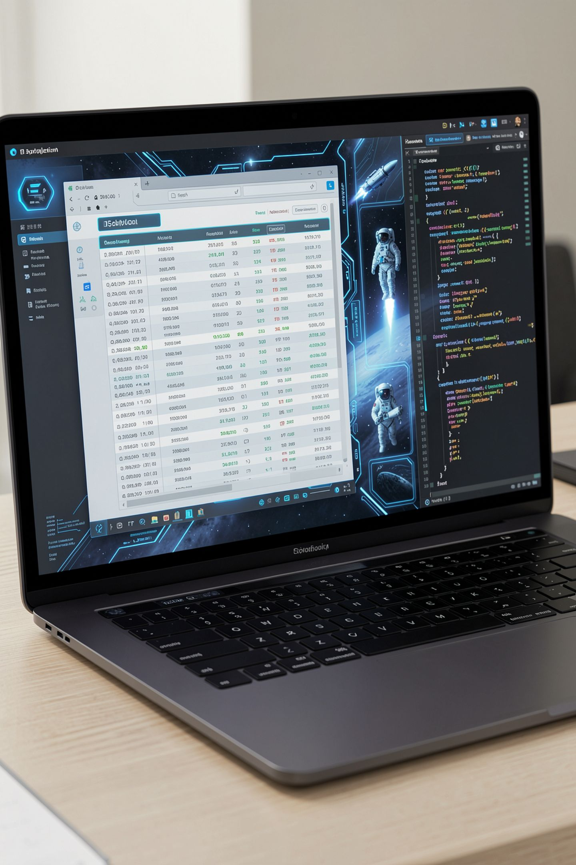
Getting Data Off a Website, Responsibly

Slide 2
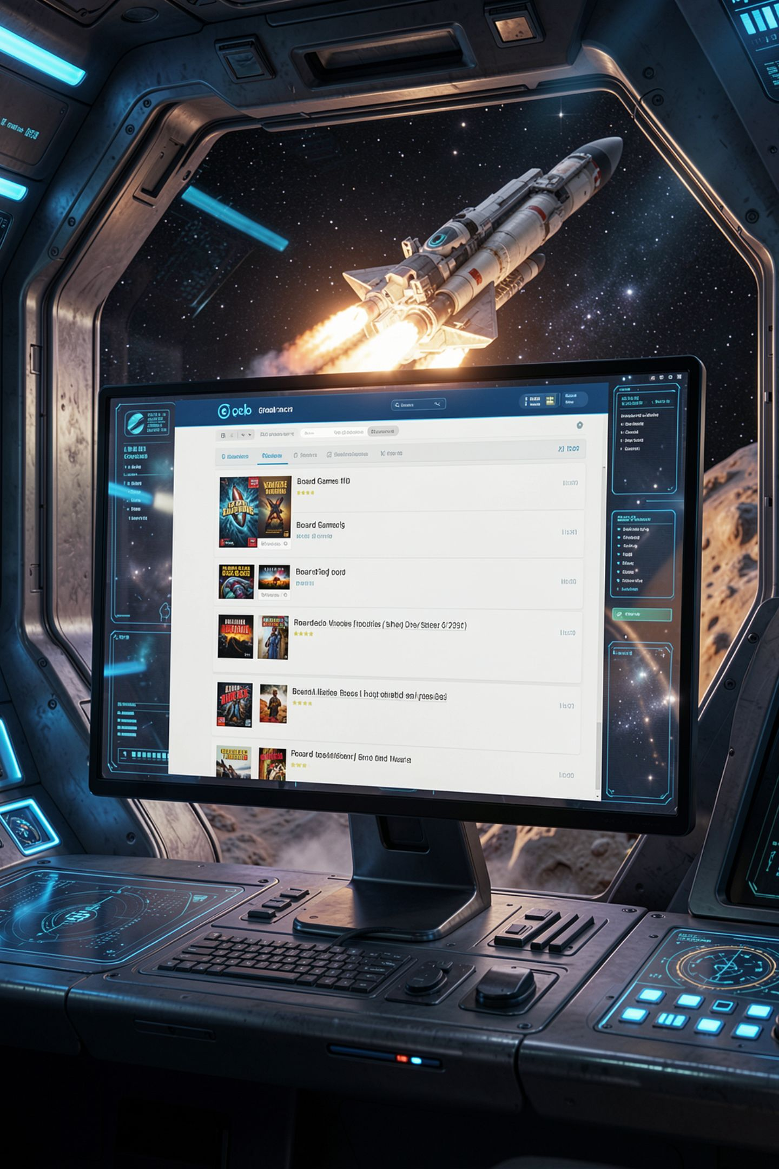
The data is right there on the page
The game club lists 28 games on its site
No download button, no data feed
Copying by hand takes an hour and has typos
A program could do it in ten seconds
MCCTC | AI Automation & Software Development
Notes:
The game club's swap shelf website lists every donated game with its price and condition. You want that data in a spreadsheet. There is no download button. You could copy it by hand for an hour, or write a program that reads the pages for you. That is called scraping. It is powerful, and it is the one skill in this unit where doing it badly affects someone else's website.

Slide 3
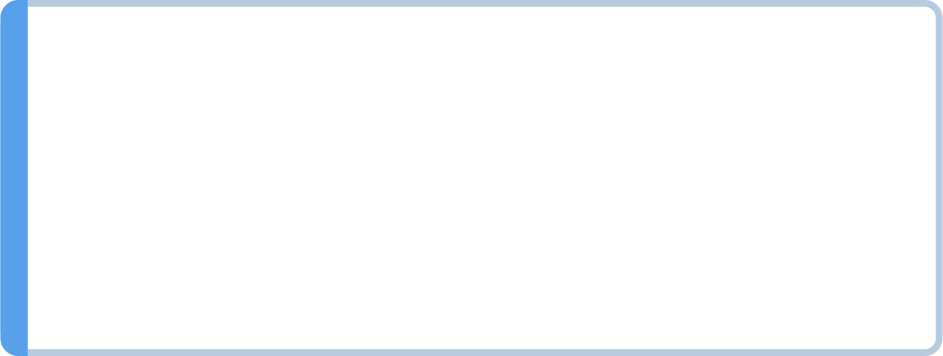
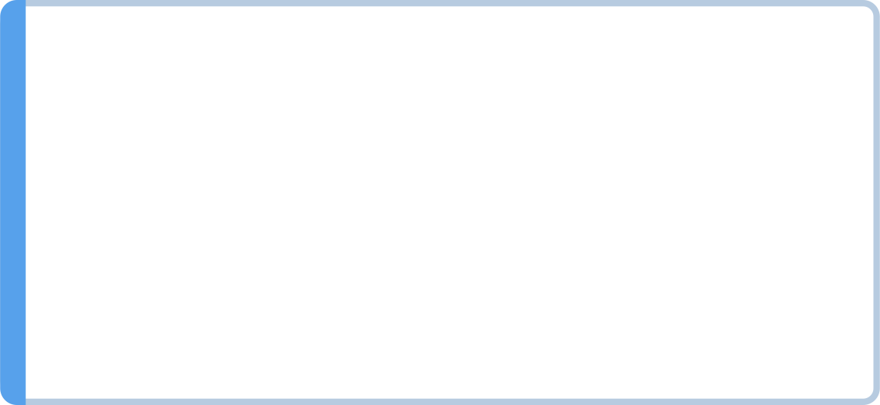
Six rules before a single request
Read robots.txt first, and obey it
Read the terms of use, and quote them
Wait between requests, at least what they ask
Never scrape anything behind a login
Never collect personal information, and use an API if offered
MCCTC | AI Automation & Software Development
Notes:
These are not suggestions. robots dot txt is the site telling programs where they may go. The terms of use are what the owner allows. Waiting between requests keeps your program from hammering a small site that a club pays for. A login page means the data is private. Personal information is off limits no matter how simple it is to reach. And if the site offers an API or a data feed, use it instead, because it is what they built for you.

Slide 4
robots.txt is a public note to programs
The robots.txt file sits at the root of a site and tells automated programs which paths are allowed, which are off-limits, and how fast to go.
User-agent: *
Crawl-delay: 2
Disallow: /members/
Disallow: /drafts/
User-agent: * applies to all programs
Crawl-delay sets the minimum wait in seconds
Disallow marks paths that are off-limits
MCCTC | AI Automation & Software Development
Notes:
This is the real robots dot txt from the swap shelf site you will run on your own computer. User agent star means every program. Crawl delay two means wait two seconds between requests. Disallow means do not go into the members area or the drafts. Nothing stops you. The members page will load if you ask for it. robots dot txt is a request, and respecting it is your decision.

Slide 5
Ask Python to read the rules for you
robots = urllib.robotparser.RobotFileParser(BASE_URL + "/robots.txt")
print("Before read():", robots.can_fetch(USER_AGENT, BASE_URL + "/shelf/page-1.html"))
robots.read()
print("Shelf allowed: ", robots.can_fetch(USER_AGENT, BASE_URL + "/shelf/page-1.html"))
print("Members allowed:", robots.can_fetch(USER_AGENT, BASE_URL + "/members/index.html"))
print("Crawl-delay: ", robots.crawl_delay(USER_AGENT))
Before read(): False
Shelf allowed: True
Members allowed: False
Crawl-delay: 2
MCCTC | AI Automation & Software Development
Notes:
The standard library reads robots dot txt for you. can fetch answers whether a URL is allowed. Look at the first line of output. Before read runs, can fetch says False for everything, because it has not seen the rules yet. Forget to call read and your scraper decides nothing is allowed and collects nothing, with no error.

Slide 6
Ask slowly, and say who you are
time.sleep(2)
request = urllib.request.Request(BASE_URL + "/shelf/page-1.html",
headers={"User-Agent": USER_AGENT})
with urllib.request.urlopen(request, timeout=10) as response:
page_text = response.read().decode("utf-8")
rows = read_tables(page_text)[0]
print(rows[1])
# ['OH-101', 'Moss Knight Chronicles', 'Switch', 'Like New', '$18.00', 'Available']
MCCTC | AI Automation & Software Development
Notes:
sleep two before every request is the rate limit. The User Agent header tells the site what program is asking, which the terms require. timeout ten means a site that never answers cannot freeze your program. Then read tables, a helper that uses Python's own HTML parser, turns the page's table into rows of cells.

Slide 7
Watch this: skip the parser, split on td
Why zero?
prices = []
for chunk in page_text.split("<td>")[1:]:
cell = chunk.split("</td>")[0]
if cell.startswith("$"):
prices.append(cell)
print(f"Prices found: {len(prices)}")
The raw HTML uses lowercase <td> tags, but the actual page may render differently depending on whitespace, attributes, or encoding. Splitting on raw tag strings is fragile and misses real data. A proper HTML parser handles these cases correctly.
Prices found: 0
MCCTC | AI Automation & Software Development
Notes:
It is tempting to treat HTML as plain text and split on the cell tag. Page one has ten prices. This found zero, and it did not crash. The price cells are written as td class equals price, so the text you split on never appears in front of a price. HTML has attributes, line breaks, and codes like amp in places plain splitting does not expect. That is why you use a parser.

Slide 8

Skip the wait and the site says no
urllib.error.HTTPError: HTTP Error 429: Too Many Requests
Three pages requested back to back
The first worked, the second was refused
429 means you are asking too fast
Many real sites also block you after this
MCCTC | AI Automation & Software Development
Notes:
This is what the fixture site does when requests arrive less than a second apart, and plenty of real sites behave the same way. Status four twenty nine, too many requests. Your program crashed, and that is the lucky outcome, because you found out immediately. The fix is not a retry loop that asks faster. The fix is the sleep you left out.

Slide 9
Watch the server count your manners
[14:24:07] GET /robots.txt -> 200 (first request)
[14:24:09] GET /shelf/page-1.html -> 200 (2.1 s after the previous request)
[14:24:11] GET /shelf/page-2.html -> 200 (2.0 s after the previous request)
[14:24:13] GET /shelf/page-3.html -> 200 (2.0 s after the previous request)
[14:24:15] GET /shelf/page-4.html -> 404 (2.0 s after the previous request)
MCCTC | AI Automation & Software Development
Notes:
This is the log from the site's terminal during a polite run, with the User Agent trimmed off the end of each line so it fits. robots dot txt first. Every request two seconds apart. And page four answers 404, not found, which is how the scraper knows it has run out of pages. When you run your lab, keep this terminal where you can see it. It shows you exactly how your program treats someone else's server.

Slide 10

Allowed by robots.txt is not the same as allowed
robots.txt covers where programs may go
Terms of use can forbid more than robots.txt does
A page can be reachable and still private
Deciding not to scrape is a valid result
MCCTC | AI Automation & Software Development
Notes:
Here is the judgment part. robots dot txt and the terms of use are two different documents, and you have to pass both. A site can leave a page open in robots dot txt and forbid copying it in its terms. And a student who reads the rules and decides a site should not be scraped, then writes down why, has done the skill correctly. Side quest thirteen is built around exactly that decision.

Slide 11
What you are about to build
01
02
Lab U5-05: scrape the Swap Shelf, politely
Run the site yourself in its own terminal
03
04
robots.txt, a two-second wait, a User-Agent
Build 2: pipeline ingest, from CSV or the site
MCCTC | AI Automation & Software Development
Notes:
Build one is the Swap Shelf Scraper lab. You start the club's website on your own computer, read its robots dot txt and terms, collect all three pages with a two second wait, and write the listings to a CSV. Step seven has you remove the wait on purpose and record the 429. Nobody in this class scrapes a real website for this lab. Build two is the ingest stage of your data pipeline.

