Slide 1

Why Classes

Slide 2

Your room does not know how to describe itself
In Unit 5 a room was a dictionary
A function far away did the describing
The rules live apart from the data
That gap is where bugs move in
MCCTC | AI Automation & Software Development
Notes:
Pull up your text adventure from Unit 5. A room is a dictionary, and describe_room is a function somewhere else that has to be handed the room every time. The room does not know anything about itself. Today we close that gap.

Slide 3

An object knows things and can do things
Attributes
What it knows
Methods
What it can do
Together
Both live on the same object
Example
Your phone is one already
MCCTC | AI Automation & Software Development
Notes:
Think about your phone. It knows its battery level and whether it is locked. It can ring and take a photo. The knowing is attributes. The doing is methods. A class puts both in one place, so the thing carries its own data and its own behaviour.

Slide 4
The Unit 5 way
pad = {"tag": "CTRL-01", "condition": "good", "borrower": None}
def is_available(gear):
return gear["borrower"] is None and gear["condition"] in ("good", "worn")
print(is_available(pad)) # True
MCCTC | AI Automation & Software Development
Notes:
Here is the old way. A dictionary of values, and a separate function that has to be handed the dictionary. The gear does not know its own rule for being available. Some other code holds it. Watch what changes on the next slide.

Slide 5
The Unit 7 way
class Gear:
def __init__(self, tag, condition="good"):
self.tag = tag
self.condition = condition
self.borrower = None
def is_available(self):
return self.borrower is None and self.condition in ("good", "worn")
print(Gear("CTRL-01").is_available()) # True
MCCTC | AI Automation & Software Development
Notes:
Same answer, True. The difference is not length. Now the gear carries its own rule. Nothing else has to remember it or be handed the data. The gear knows how to answer a question about itself. That is the whole idea of a class.

Slide 6
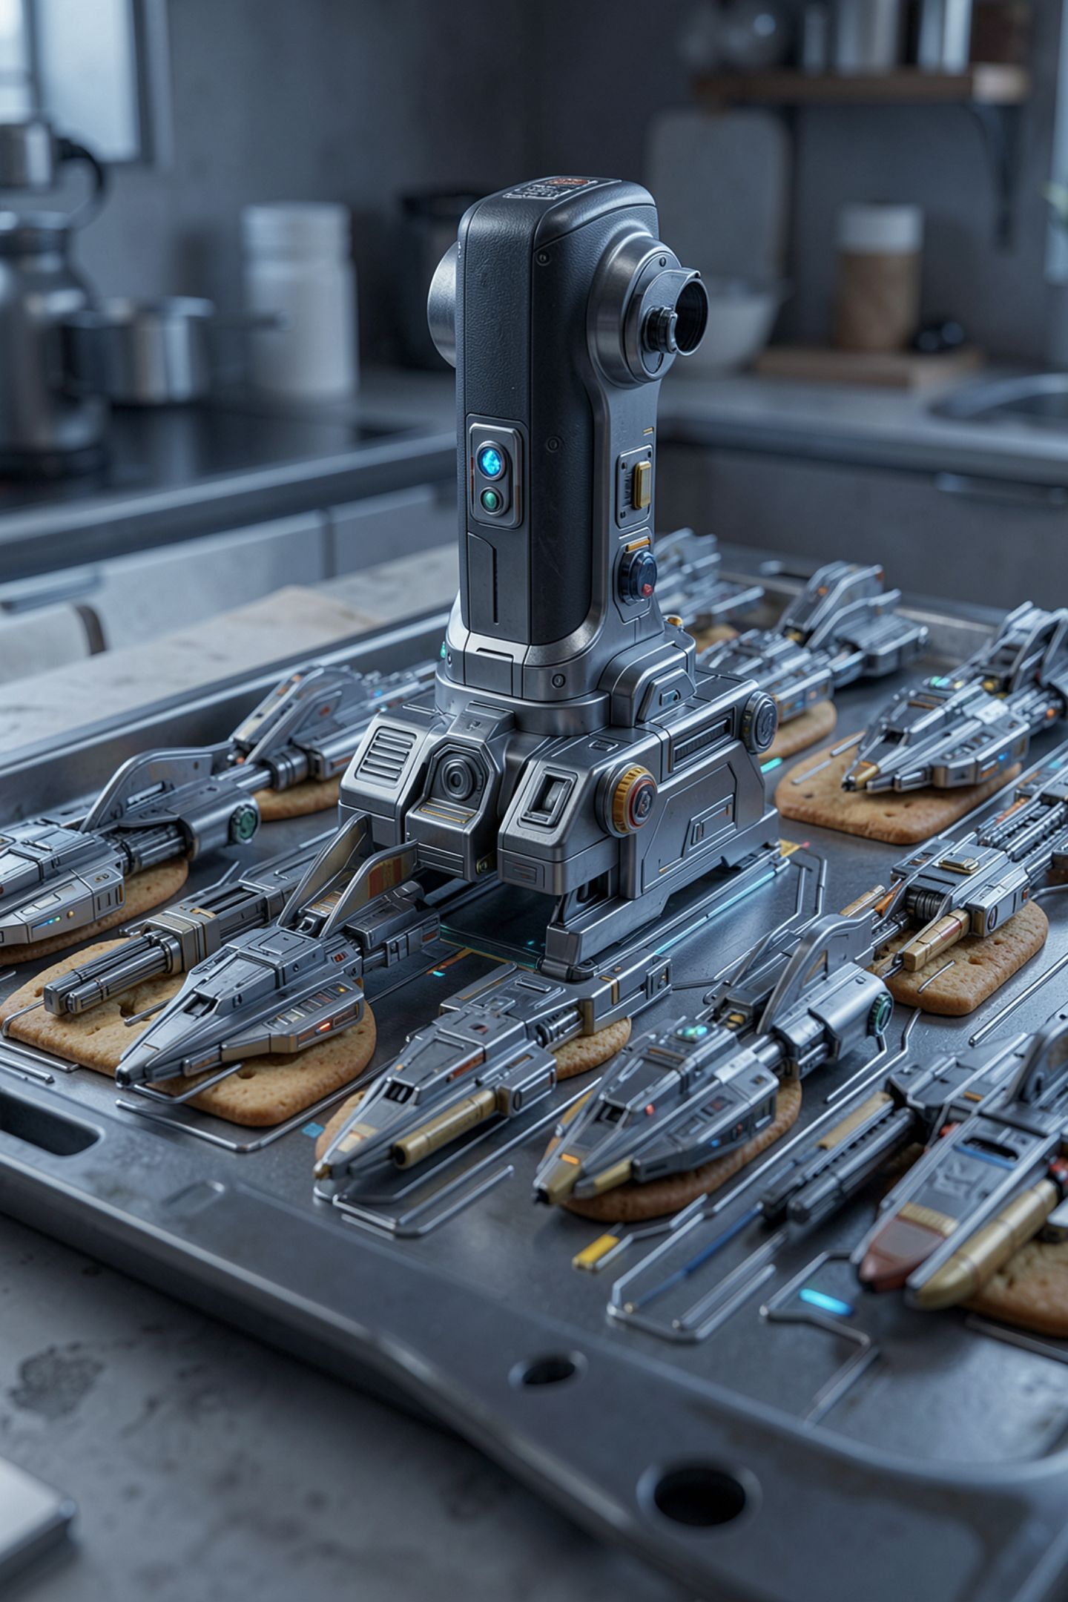
One template, many objects
A class is a template
An object is one filled-in copy
Each object remembers its own values
Write the rule once, reuse it everywhere
MCCTC | AI Automation & Software Development
Notes:
One Gear class can make a hundred gear objects, each with its own tag and condition. You write the template once. Every object fills it in differently and carries its own state. That payoff grows with every object you need.

Slide 7
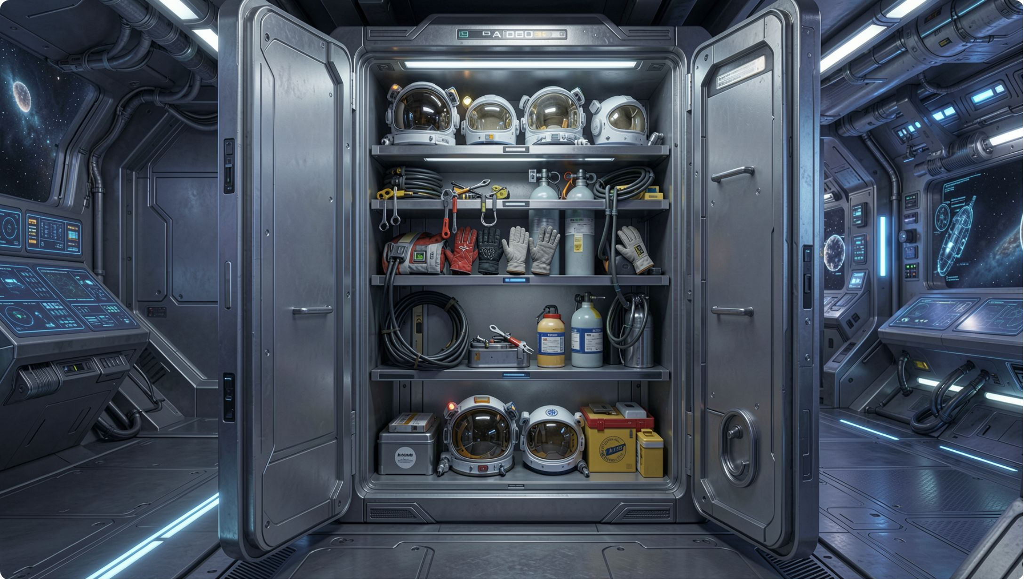
When a class earns its keep
The thing has rules about itself
You have many of the thing
You want the rules next to the data
Otherwise a dictionary is fine
MCCTC | AI Automation & Software Development
Notes:
Do not put everything in a class. A one-line settings blob is fine as a dictionary. Reach for a class when the thing has rules, when you have many of them, or when you want behaviour to live with data. The gear locker has all three.

Slide 8

The trap, watch closely
pad = Gear("CTRL-01")
print(pad.is_available)
Missing parentheses -- this is a common trap.
MCCTC | AI Automation & Software Development
Notes:
I want to know if this gear is available. I call the method. Predict what prints before I press enter. It is not True and it is not False. Watch.

Slide 9
A method without parentheses is a thing
<bound method Gear.is_available of <__main__.Gear object at 0x000001F2A3B7C4D0>>
MCCTC | AI Automation & Software Development
Notes:
No error, and no answer. Without the parentheses I printed the method itself, not its result. Python is telling me is_available is a method sitting on pad, waiting to be called. The fix is pad dot is_available with parentheses. This is our running thread again.

Slide 10


Knowing versus doing
No parentheses
For a value it knows
Parentheses
To make it do something
pad.tag
Is knowing
pad.is_available()
Is doing
MCCTC | AI Automation & Software Development
Notes:
Here is the habit that prevents the trap. When you want a thing the object knows, use no parentheses. When you want the object to do something, add the parentheses. Knowing is pad dot tag. Doing is pad dot is_available with parentheses.

Slide 11

What you are about to build
Read your Unit 5 describe_room and name the seam
Then open the Gear Locker lab
Run the starter and find its shipped bug
Tomorrow you write the Gear class
MCCTC | AI Automation & Software Development
Notes:
Build one is reading your own version 3 and naming the gap a class would close. Build two is opening the Gear Locker lab, running the starter, and finding the bug it already ships with. Tomorrow you write the class that fixes it.

