Slide 1

Asking Another Program for Data

Slide 2

Where does a bus app get the next arrival
You open the app, a number appears
Your phone did not know that number
It asked a server, over the network
Today your program does the asking
MCCTC | AI Automation & Software Development
Notes:
When you open a bus app and see the next arrival, your phone did not know that. It asked a transit server and got the number back. Today your program becomes the one asking. It sends a request to another program and gets data in return.

Slide 3
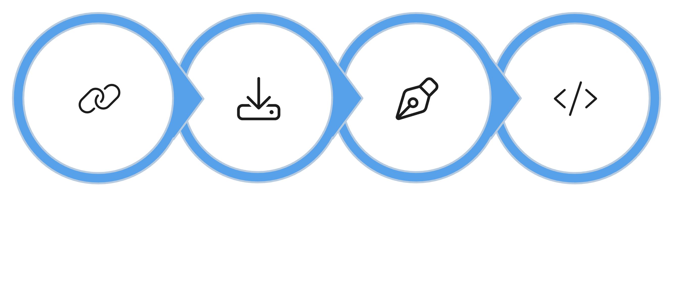
Three steps, three types
Parse JSON
Open URL
Read Body
Decode
MCCTC | AI Automation & Software Development
Notes:
There are three steps between asking and having data you can use. Open the URL and get a response. Read the body and get raw bytes. Decode the bytes to text, then parse the text as JSON, which gives you a dictionary or a list. Watch the type change at each step.

Slide 4
The three steps in code
import json, urllib.request
opener = urllib.request.build_opener(urllib.request.ProxyHandler({}))
with opener.open("http://127.0.0.1:8070/api/v1/stations", timeout=5) as response:
raw = response.read()
print(type(raw)) # <class 'bytes'>
data = json.loads(raw.decode("utf-8"))
print(type(data)) # <class 'dict'>
MCCTC | AI Automation & Software Development
Notes:
Read it top to bottom. We skip proxies, because a school proxy cannot reach 127.0.0.1. We open with a timeout, always. Read gives bytes. Decode gives text. json dot loads gives a dictionary. Miss a step and you get an error.

Slide 5
Now it is ordinary Python
with opener.open(url + "/stations/north-field/observations", timeout=5) as response:
data = json.loads(response.read().decode("utf-8"))
print(data["name"]) # North Practice Field
print(data["observations"][0]["gust_mph"]) # 19
MCCTC | AI Automation & Software Development
Notes:
Once it is a dictionary, it is data you already know how to handle from Unit 5. A JSON object becomes a dictionary. A JSON array becomes a list. You reach in with keys and indexes, exactly like a save file. The network part is over. The rest is Unit 5.

Slide 6


Always set a timeout
A dead server can hang forever
A missing timeout freezes your program
timeout=5 means give up after five seconds
This is an availability problem
MCCTC | AI Automation & Software Development
Notes:
The timeout is not optional. Without it, a slow or dead server can freeze your program with no way out, and a person waiting on it is stuck. That is an availability problem, a term you will name next week. Set a timeout on every request, every time.

Slide 7
The trap, a page that is not JSON
with opener.open("http://127.0.0.1:8070/api/stations", timeout=5) as response:
data = json.loads(response.read().decode("utf-8"))
MCCTC | AI Automation & Software Development
Notes:
This old address returns an HTML page for old bookmarks, not JSON. The request succeeds. Read returns something. It feels like it worked. Predict what json dot loads does with an HTML page before the next slide.

Slide 8


Expecting value, column 1
json.decoder.JSONDecodeError: Expecting value: line 1 column 1 (char 0)
This error appears when json.loads receives content that is not valid JSON.
A wrong URL may return an HTML error page. The decoder sees angle brackets, not JSON, and fails immediately at character zero.
MCCTC | AI Automation & Software Development
Notes:
The reply started with a less-than sign, the start of HTML, and json dot loads cannot read that. Column one, character zero, the very first character. The request succeeded and the data was still wrong. Getting a reply is not the same as getting the data you asked for.

Slide 9

Reply is not the same as data
Getting a reply is not getting your data
A wrong address returns a real reply
A login page returns a real reply
Check what you got, do not assume
MCCTC | AI Automation & Software Development
Notes:
This is the running thread wearing a network costume. The server answered, but a wrong address, a redirect, or an old endpoint all return a real response that is not your data. The crash here is the friendly case. Next week you handle the quiet failures too.

Slide 10




Standard library only
urllib.request
json
Sends the request
Parses the reply
Nothing to install
Works on any lab machine
No extra packages needed
Available everywhere Python is
MCCTC | AI Automation & Software Development
Notes:
Everything today is in Python already. urllib dot request for the request, json for the reply. No packages, no install, nothing that can be missing on a lab machine. The same two modules carry you through the whole week, including talking to the local model.

Slide 11

What you are about to build
01
Start the weather station fixture
02
Write get_json and read the stations
03
Write decide for a calm and a windy reading
04
Pass the Part 1 tests
MCCTC | AI Automation & Software Development
Notes:
Build one starts the fixture server in one terminal and writes get_json to read the station list. Build two writes decide, the rule that says whether practice is on. Run the Part 1 tests until they pass. Tomorrow you handle everything that can go wrong.

