Slide 1

Three Words for What Security Protects

Slide 2

You fixed a pile of bugs, now name them
You found leaks, fakes, and freezes
What do all of those have in common
Security protects three things
They spell CIA
MCCTC | AI Automation & Software Development
Notes:
You have found and fixed a pile of vulnerabilities. Leaks, fakes, and freezes. What do they have in common. Security protects three things about information, and the three spell CIA. Once you can name which one a problem breaks, you can talk about security clearly and answer the exam question.

Slide 3


The three, one line each
Confidentiality
Who can read it
Integrity
Whether it is true
Availability
Whether it is there
Every vulnerability breaks at least one
MCCTC | AI Automation & Software Development
Notes:
Confidentiality is who can read it, broken when someone sees what they should not. Integrity is whether it is true, broken when data is changed or faked. Availability is whether it is there when you need it, broken when a system is down or frozen. Every vulnerability breaks at least one of these.

Slide 4
All three in one codebase
Confidentiality The moderator code and a key sat in the file and the prompt.
Integrity thank() accepted a negative number, so points could be pulled.
Availability The model call had no timeout, so it froze the whole app.
MCCTC | AI Automation & Software Development
Notes:
Take the security lab you finished. The moderator code in the file is confidentiality, anyone reading it could see it. The negative thank is integrity, the saved file said something false. The missing timeout is availability, a hung model froze the app for everyone. One codebase, all three letters.

Slide 5
Your own projects protect all three
Confidentiality No key anywhere. A local model needs none. A test enforces it.
Integrity The keep-phrase check rejects a reply that dropped a needed fact.
Availability Every call has a timeout; the game stops asking after two failures.
MCCTC | AI Automation & Software Development
Notes:
The features you wrote were not only conveniences. No key means nothing to leak, that is confidentiality. The keep-phrase check means the game never shows a false, unwinnable room, that is integrity. The timeouts mean a dead server never freezes the program, that is availability. You were protecting CIA without naming it.

Slide 6

Name the letter, fast
A stolen password reads private messages
A save file edited to add lives
A site taken offline by an attack
Which letter for each
MCCTC | AI Automation & Software Development
Notes:
Practice the move. A stolen password that reads private messages is confidentiality. A save file edited to add lives is integrity. A site taken offline is availability. The test for each, did someone read what they should not, did the data become false, or is the thing not there when needed.

Slide 7

The trap, everything feels like integrity
A leaked password feels serious
So students call it integrity
But nothing was changed
Something was read, that is confidentiality
MCCTC | AI Automation & Software Development
Notes:
Here is the common mistake. A leaked password feels serious, so people call it an integrity problem. But a leaked password did not change any data. It exposed it. Nothing became false, something became readable. That is confidentiality. Feeling bad is not a category.

Slide 8

Why the right letter matters
C Confidentiality
I Integrity
Stop exposing it
Stop it being changed
A Availability
Keep it running
The fix depends on the letter
MCCTC | AI Automation & Software Development
Notes:
Getting the letter right is not pedantry. It tells you what to fix. A confidentiality fix is stop exposing it. An integrity fix is stop it being changed. An availability fix is keep it running. Name the wrong letter and you reach for the wrong fix. Name the right one and the fix is obvious.

Slide 9
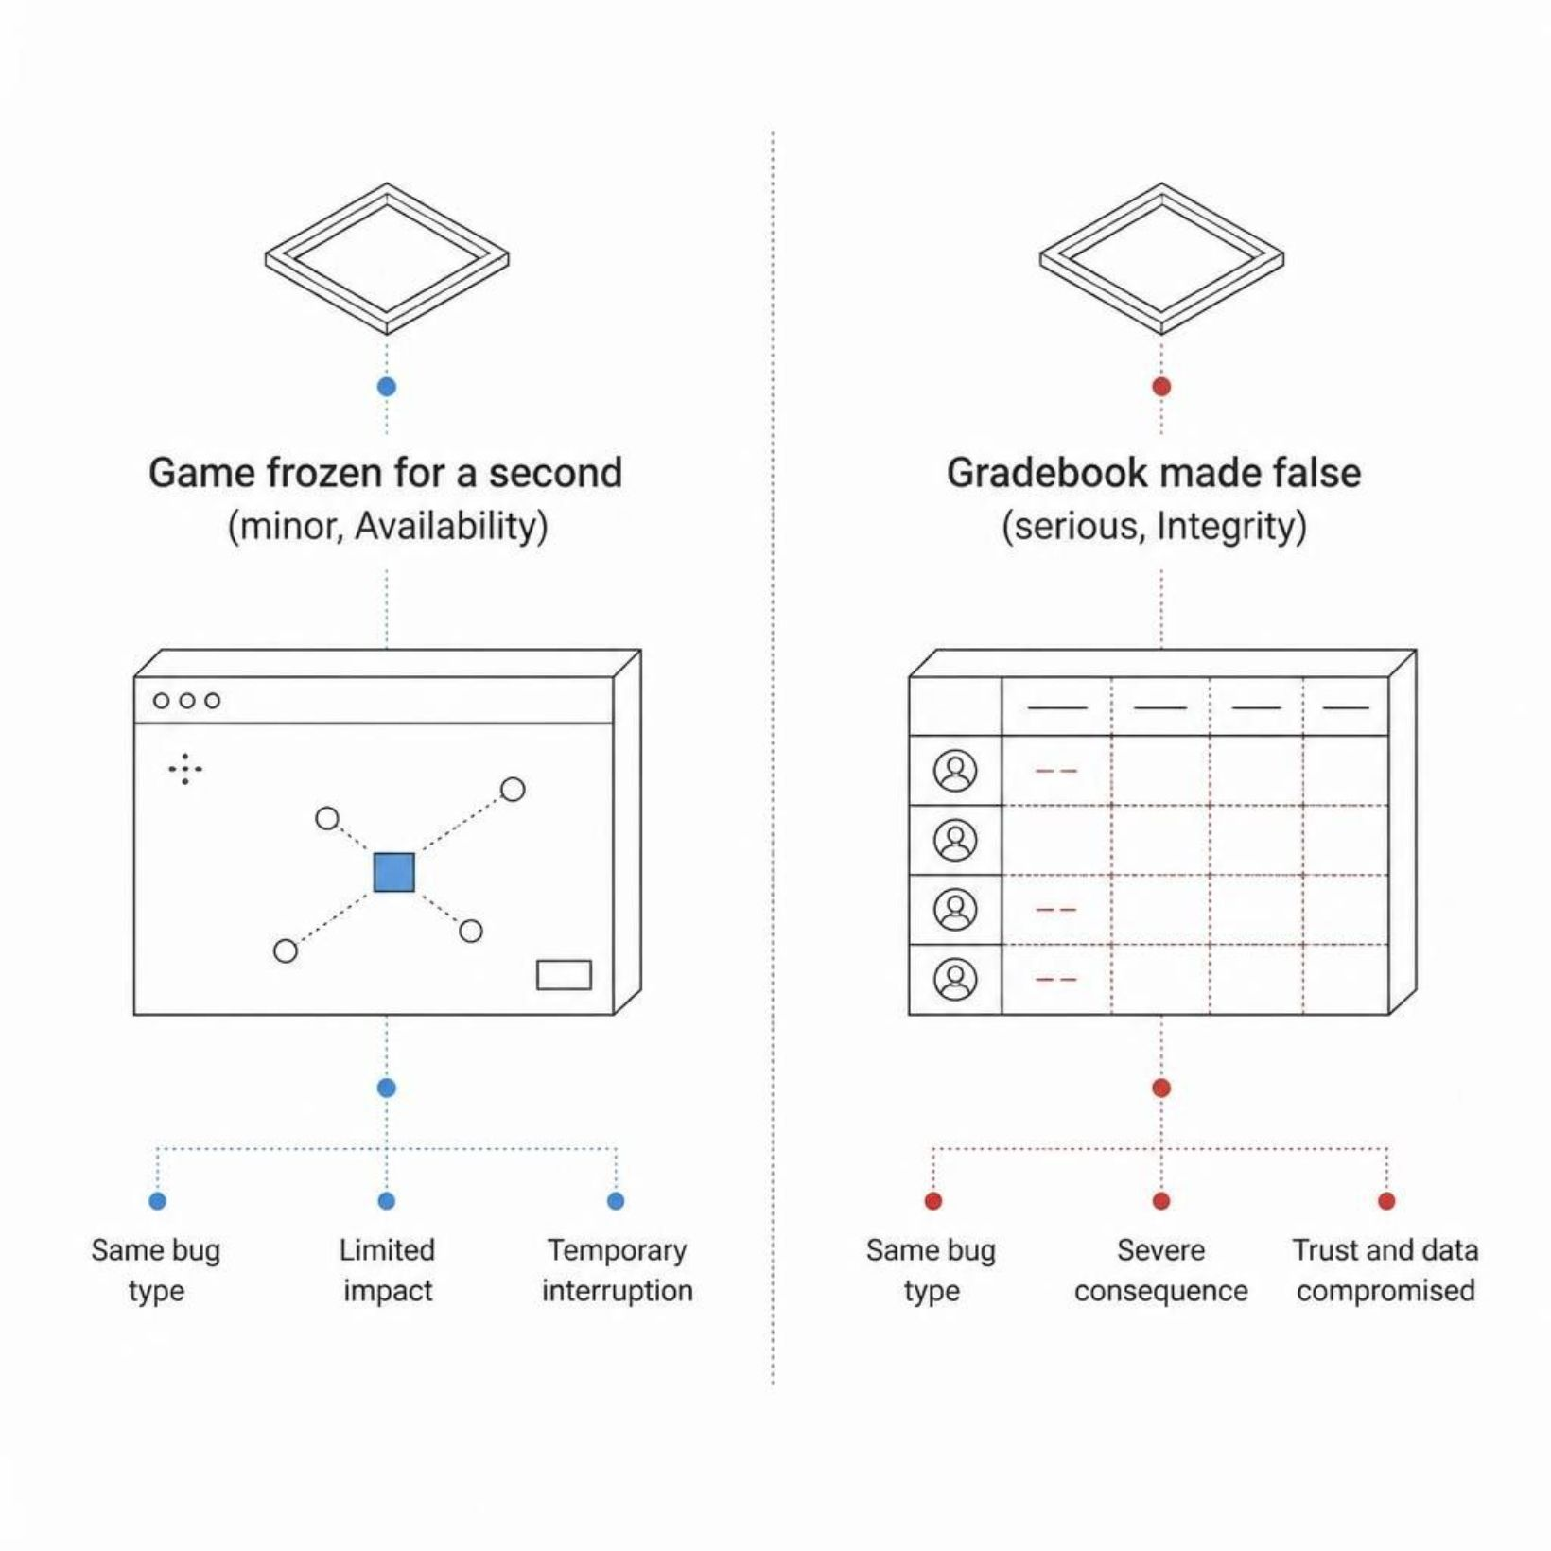
The same bug can matter a lot or a little
A game frozen for a second, minor
A gradebook made false, serious
Depends on the letter and the program
That judgment is the review
MCCTC | AI Automation & Software Development
Notes:
The same vulnerability can matter a lot or a little depending on which letter it breaks and what the program is for. A game losing availability for a second is minor. A gradebook losing integrity is serious. That judgment, not only a list, is what a real security review produces.

Slide 10

CIA connects to the whole unit
Availability
The API app protects availability with timeouts
Integrity
The model code protects integrity with checks
Confidentiality
The no-key rule protects confidentiality
Three weeks, one idea
MCCTC | AI Automation & Software Development
Notes:
CIA ties the whole unit together. The API app's timeouts protect availability. The model code's checks protect integrity. The no-key rule protects confidentiality. Objects, APIs, and security were not three separate topics. They were three angles on building something you can trust.

Slide 11

What you are about to build
Map every lab defect to a CIA letter
Write a one-line reason for each
Then a timed 5.3 review set
The heaviest outcome on the exam
MCCTC | AI Automation & Software Development
Notes:
Build one completes the CIA column of your review template, every defect mapped to a letter with a one-line reason. Build two is a timed review set weighted to outcome 5.3, the heaviest on the WebXam, to start getting ready for the post-test. Name the letters, then sharpen the fundamentals.

