Slide 1

Draw It Before You Build It

Slide 2
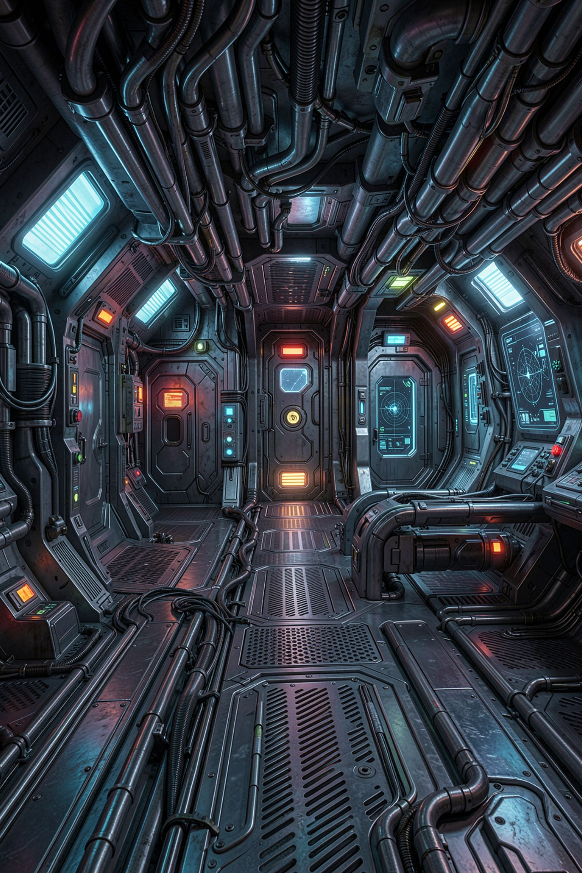
Three days in, there is no way to lose
You start typing a text adventure
It grows for three days
Then you notice: nobody can ever lose
The fix means rewriting half of it
MCCTC | AI Automation & Software Development
Notes:
Unit 3 is a text adventure, and it is the biggest program you have written. Here is how big programs usually go wrong. You start typing, it grows, and on day three you discover one room has no exit, or there is no way to lose, or the game never ends. Every one of those problems is visible on paper in ten minutes. Today you write no Python. That is the lesson, not a gap in it.

Slide 3

Four tools, four questions
1
2
IPO chart
Flowchart
What goes in, happens, comes out
What order, where it splits or repeats
3
4
Pseudocode
Decision tree
Precise steps, one per line
Which question comes next
MCCTC | AI Automation & Software Development
Notes:
Each tool answers a different question. The IPO chart is inputs, process, outputs. The flowchart is order. Pseudocode is the steps written precisely enough to become code. And a decision tree you already know, because your Decision Engine is one. The WebXam outcome is 5.1.3, model the solution with graphic tools and pseudocode, and the syllabus says your model comes before your adventure code.

Slide 4
The IPO chart, plus state
INPUT PROCESS OUTPUT
command typed clean the command room description
decide: move, broadcast, quit, other blocked-move message
move: change room, add 1 to moves thunder warning
check moves against the storm limit win or lose message
STATE (remembered between turns)
room starts as "lobby"
moves starts as 0
playing starts as True
MCCTC | AI Automation & Software Development
Notes:
This is one turn of a three-room slice of Storm Relay, our class adventure. Inputs, process, outputs. And for a game, a fourth list, state, the things the program remembers from one turn to the next. Here is the rule that matters. If a value shows up in the process column and it is not an input and not in state, it does not exist. Remember that for slide nine.

Slide 5
Flowchart shapes
Oval
Parallelogram
Rectangle
Start or end
Input or output
A process step
Diamond
Arrow pointing back up
A decision, one labeled arrow per answer
A loop
MCCTC | AI Automation & Software Development
Notes:
Four shapes carry almost every flowchart you will ever draw. The one that causes trouble is the diamond. A decision needs one arrow out for every possible answer, and each arrow needs a label. And any arrow that points back up to an earlier step is a loop. The game loop is one big arrow that goes back to the top after every command.

Slide 6



Two checks every game-loop flowchart must pass
Check 1
Check 2
A diamond with one arrow is a dead end
Every diamond has an arrow for every answer
At least one path from inside the loop to End
A loop with no exit never finishes
MCCTC | AI Automation & Software Development
Notes:
Before you show me a flowchart, run these two checks. First, every diamond has an arrow for every answer. If a diamond only has a yes arrow, the no answer goes nowhere, and your code will do whatever you happen to type. Second, there is at least one path from inside the loop to the End oval. If there is not, the game can never finish. Tomorrow you will see exactly what that does to a real program.

Slide 7
The same loop as pseudocode
SET room TO "lobby"
SET moves TO 0
SET playing TO True
WHILE playing
DISPLAY the description of room
INPUT command, cleaned to lowercase
IF command is "quit"
SET playing TO False
ELSE IF command is a direction AND room has an exit that way
SET room TO the destination
ADD 1 TO moves
IF moves equals MAX_MOVES
DISPLAY "The storm has reached the ridge."
SET playing TO False
ELSE IF command is "broadcast" AND room is "studio"
DISPLAY the win message
SET playing TO False
ELSE
DISPLAY "You cannot do that here."
DISPLAY "GAME OVER"
MCCTC | AI Automation & Software Development
Notes:
Pseudocode is the flowchart written as precise, indented English. Match every line to a shape. Every if and the while are diamonds. Every set and add is a rectangle. Every input and display is a parallelogram. While playing means repeat this block as long as playing is True. You have never written a loop in Python, and you do not need to, to model one. Tomorrow this exact line becomes code.

Slide 8
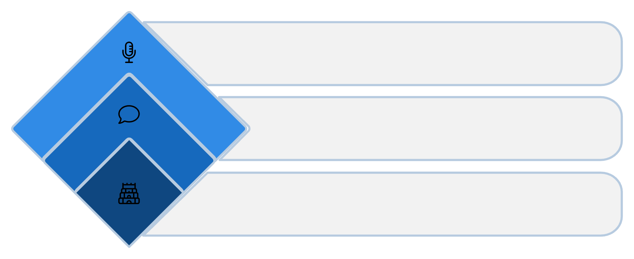
A decision tree for one decision
Which room are you in?
lobby -> north? yes: hallway no: blocked
hallway -> south? yes: lobby
west? yes: studio
other: blocked
studio -> east? yes: hallway no: blocked
Studio
East to hallway or blocked
Hallway
South to lobby, west to studio
Lobby
North to hallway or blocked
MCCTC | AI Automation & Software Development
Notes:
The move step hides a second decision. Where does a move go? That depends on the room first and the direction second, and which directions you check depends on the room. That is a decision tree, and last Thursday's rule says keep the nesting when the next question depends on the answer. You can already write this in Python with an if on the room and an if on the direction inside each branch.

Slide 9



Precise enough to code
Every value must be an input or in state
A classmate should not need to ask you anything
Not precise
IF the player can win
Precise
IF room is studio AND power_on is True
MCCTC | AI Automation & Software Development
Notes:
Pseudocode fails when it hides a decision inside a vague phrase. If the player can win is not a condition. It is a wish. Which room, which values, compared to what. The test for good pseudocode is simple to say and hard to pass. Hand it to a classmate. If they have to ask you a single question before they can type the Python, it is not finished.

Slide 10
The wrong way: code from an incomplete model
room = "hallway"
command = input("> ").strip().lower()
if command == "down":
if has_flashlight:
print("Your flashlight finds the basement stairs.")
else:
print("You step into total darkness.")
NameError: name 'has_flashlight' is not defined
MCCTC | AI Automation & Software Development
Notes:
Somebody skipped the IPO chart and coded the dark basement rule from memory. They never listed the flashlight in state. It crashes, but only when a player walks down the stairs, which might be the forty-first thing somebody tries. On paper this was a missing row in a chart. Ten seconds to fix. And the worse version does not crash at all. It is a path through the game where nobody can win and nothing says so.

Slide 11

What you are about to build
1
Build 1
IPO chart and flowchart for the slice
2
Pass both checks
Before you move on
3
Build 2
Pseudocode and the move decision tree
4
No Python today
Tomorrow the loop becomes code
MCCTC | AI Automation & Software Development
Notes:
Build 1 is the IPO chart with state, and the flowchart for the three-room slice of Storm Relay. Run both checks on your own diagram before you show it to anybody. Build 2 is pseudocode that matches your flowchart line for line, and the decision tree for moves. No Python today. Keep all of it, because tomorrow the while line in your pseudocode becomes the first loop you ever write.

