Slide 1

Keep Asking Until It Makes Sense

Slide 2
Somebody will type loud
Your game asks for a frequency
A player types loud
Another types 2000
Another presses Enter on nothing
Right now your program crashes or shrugs
MCCTC | AI Automation & Software Development
Notes:
Players type anything. Your job is not to hope they type the right thing. Your job is to keep asking until the answer is usable, and to tell them what went wrong each time. Every form, every kiosk, and every game you have ever used does this. Today you get the two keywords that make it clean, break and continue, and the loop that uses them.

Slide 3
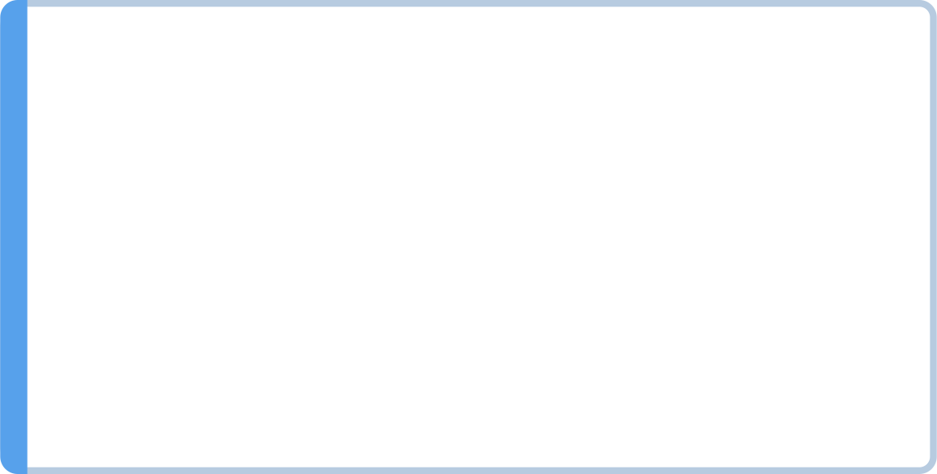

Two words that change a loop from inside
break ends the loop right now
The program continues after the loop
continue ends this pass right now
The program goes back to the top for the next pass
Both apply to the loop they are directly inside.
MCCTC | AI Automation & Software Development
Notes:
Break means we are done with this loop. Jump to the first line after it. Continue means we are done with this pass. Go back to the top and start the next one. Remember the last bullet. It sounds like a detail today and it becomes the whole point tomorrow, when loops go inside loops.

Slide 4
The validation loop pattern
MAX_TICKETS = 8
while True:
tickets_text = input(f"How many tickets, 1 to {MAX_TICKETS}? ").strip()
if not tickets_text.isdecimal():
print("Type a whole number, like 2.")
elif int(tickets_text) < 1 or int(tickets_text) > MAX_TICKETS:
print(f"You can buy between 1 and {MAX_TICKETS} tickets.")
else:
break
tickets = int(tickets_text)
print(f"Ordering {tickets} tickets at $12 each: ${tickets * 12}")
MCCTC | AI Automation & Software Development
Notes:
While True has no condition that ever turns False on its own, so the only way out is the break, and the only way to reach the break is an answer that passed every check. Order matters. isdecimal is checked before int ever touches the text. If int ran first on the word two, the program would crash and never get to ask again. Check that it can convert, then convert.

Slide 5
Guards with continue
while True:
frequency_text = input("Frequency in kHz: ").strip()
if not frequency_text.isdecimal():
print("The dial takes whole numbers only, like 880.")
continue
frequency = int(frequency_text)
if frequency < LOWEST_FREQUENCY or frequency > HIGHEST_FREQUENCY:
print(f"The dial only runs from {LOWEST_FREQUENCY} to {HIGHEST_FREQUENCY} kHz.")
continue
break
Frequency in kHz: loud
The dial takes whole numbers only, like 880.
Frequency in kHz: 2000
The dial only runs from 530 to 1700 kHz.
Frequency in kHz: 1470
MCCTC | AI Automation & Software Development
Notes:
When there are several checks, continue keeps them flat. Read it as a gate with two guards. Each guard either sends the input back to the top, or lets it through. The break at the bottom is only reachable by input that got past both guards. This is the Storm Relay frequency dial.

Slide 6

break as a search, continue as a skip
break on enough
continue as a skip
Save $45 a week for $140 shoes: break on enough. Nobody knows the week in advance, so while True.
Rest on day 4 of a 7-day plan: continue. In a while, update the counter BEFORE continue.
Watch the counter
Otherwise the skipped pass skips the update, forever.
MCCTC | AI Automation & Software Development
Notes:
Break is also how a loop stops the moment it has an answer. Forty five, ninety, one thirty five are short, one eighty is enough, so week four. Continue skips one pass, like a rest day. But there is a trap in a while loop. A for gets its next value from range automatically. A while only moves on if the update line runs. Put the update below a continue, and on the skipped day the counter never changes, and the program hangs with no error.

Slide 7
Watch this: play again
answer = input("Play again? (yes/no) ").strip().lower()
while not answer == "yes" or not answer == "no":
print("Please type yes or no.")
answer = input("Play again? (yes/no) ").strip().lower()
print(f"You chose {answer}.")
MCCTC | AI Automation & Software Development
Notes:
Here is a validation loop written with a condition instead of break. Keep asking while the answer is not yes or not no. That sentence sounds perfect. In the lecture notes this line uses the not equals operator, which does exactly the same thing. I am going to type maybe, and then yes. Predict what happens when I type yes.

Slide 8

The wrong way: nothing gets through
Play again? (yes/no) maybe
Please type yes or no.
Play again? (yes/no) yes
Please type yes or no.
Play again? (yes/no) no
Please type yes or no.
Play again? (yes/no)
MCCTC | AI Automation & Software Development
Notes:
It refuses yes. It refuses no. It refuses everything, forever, and there is no error. Ctrl C to get out. The dangerous bugs are the ones that do not crash, and this one also does not stop. And notice how you would miss it. Most people test validation by typing garbage. The test that catches this is typing a valid answer.

Slide 9

The truth table says why
yes
no
maybe
not yes is False, not no is True. or gives True
not yes is True, not no is False. or gives True
both True. or gives True
The condition is True for every possible word.
Fix: change or to and
MCCTC | AI Automation & Software Development
Notes:
Build the truth table, the way you did in Unit 2. Any single word is always different from at least one of yes and no. So the or is True for every input, and the loop can never end. In English, not yes or no means neither. Neither is and. This is De Morgan's law showing up somewhere that getting it wrong freezes a program.

Slide 10


break or a flag
break
The exit sits exactly where the decision is
A flag
The while line says how the loop ends
One exit reads more clearly than three breaks
Short validation loops in this course: break
Game loops in this course: a playing flag
MCCTC | AI Automation & Software Development
Notes:
Reasonable programmers disagree about this, and both sides have a point. Break puts the exit right at the decision and needs no extra variable. A flag puts the ending in the while line, where a reader looks first, and gives you one exit. Our rule for this course. Short validation loops use break. Game loops use a flag, because a game loop is long, has several endings, and has to report which one happened.

Slide 11
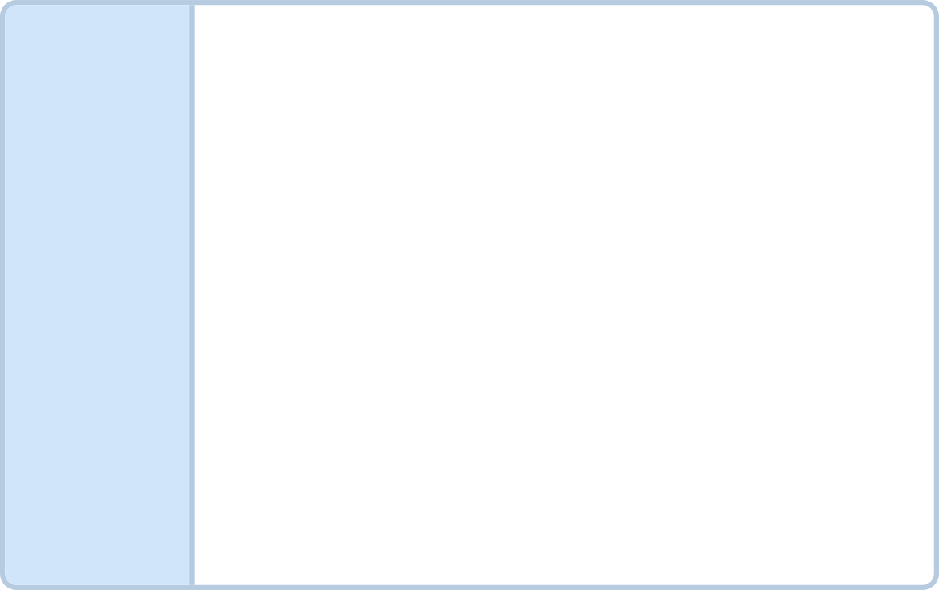


What you are about to build
Build 1: Lab U03-02 Locked Out, Part 2
1
The lockbox keypad: 4 digits, cancel, 3 tries. A badly typed code never counts as a guess.
Build 2: v1 input handling for every command
2
Empty, unknown, and shouting commands all get a message.
MCCTC | AI Automation & Software Development
Notes:
Build one finishes Locked Out. You add a keypad validation loop that accepts exactly four digits or the word cancel, and a wrong but well formed code costs one of three tries. A typo like one two does not cost a try. Build two is your own game. Every possible thing a player types must get a sensible response, including an empty line, a word that is not a command, and a command in capitals. Test with a valid answer, not only garbage.

