Slide 1

The Problem Inside the Problem

Slide 2

How many people are ahead of you?
You are in the lunch line
You cannot see the front
You can only ask the person ahead of you
They cannot see the front either
How do you get a number?
MCCTC | AI Automation & Software Development
Notes:
You are somewhere in the lunch line and you want to know how many people are ahead of you. You cannot see the front. You can tap the person ahead of you. That is all. Take thirty seconds with the person next to you and work out a way to get the exact number using only that. Then we will name what you invented.

Slide 3
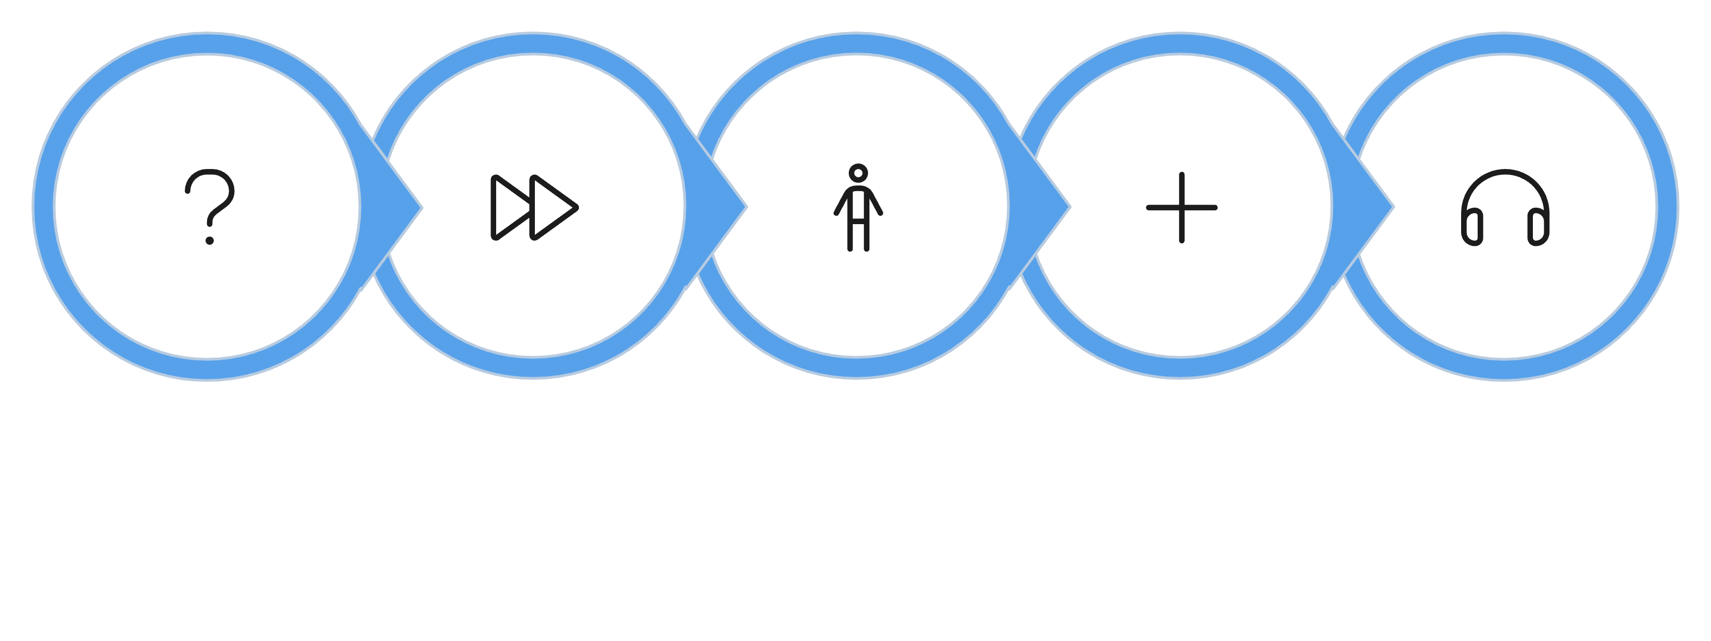
Ask a smaller version of the same question
Front says 0
You hear 3 → 4
You ask
They ask
Answers +1
You ask: how many are ahead of you?
They ask the person ahead of them
The person at the front says zero
Each answer comes back plus one
You hear three, add one: four
MCCTC | AI Automation & Software Development
Notes:
Here is the version most of you came up with. Everyone asks the person ahead the same question. The question travels forward until it reaches the front, where the answer is obvious. Nobody. Zero. Then the answers travel back, and each person adds one. This is recursion. Solving a problem by solving a smaller copy of the same problem.

Slide 4
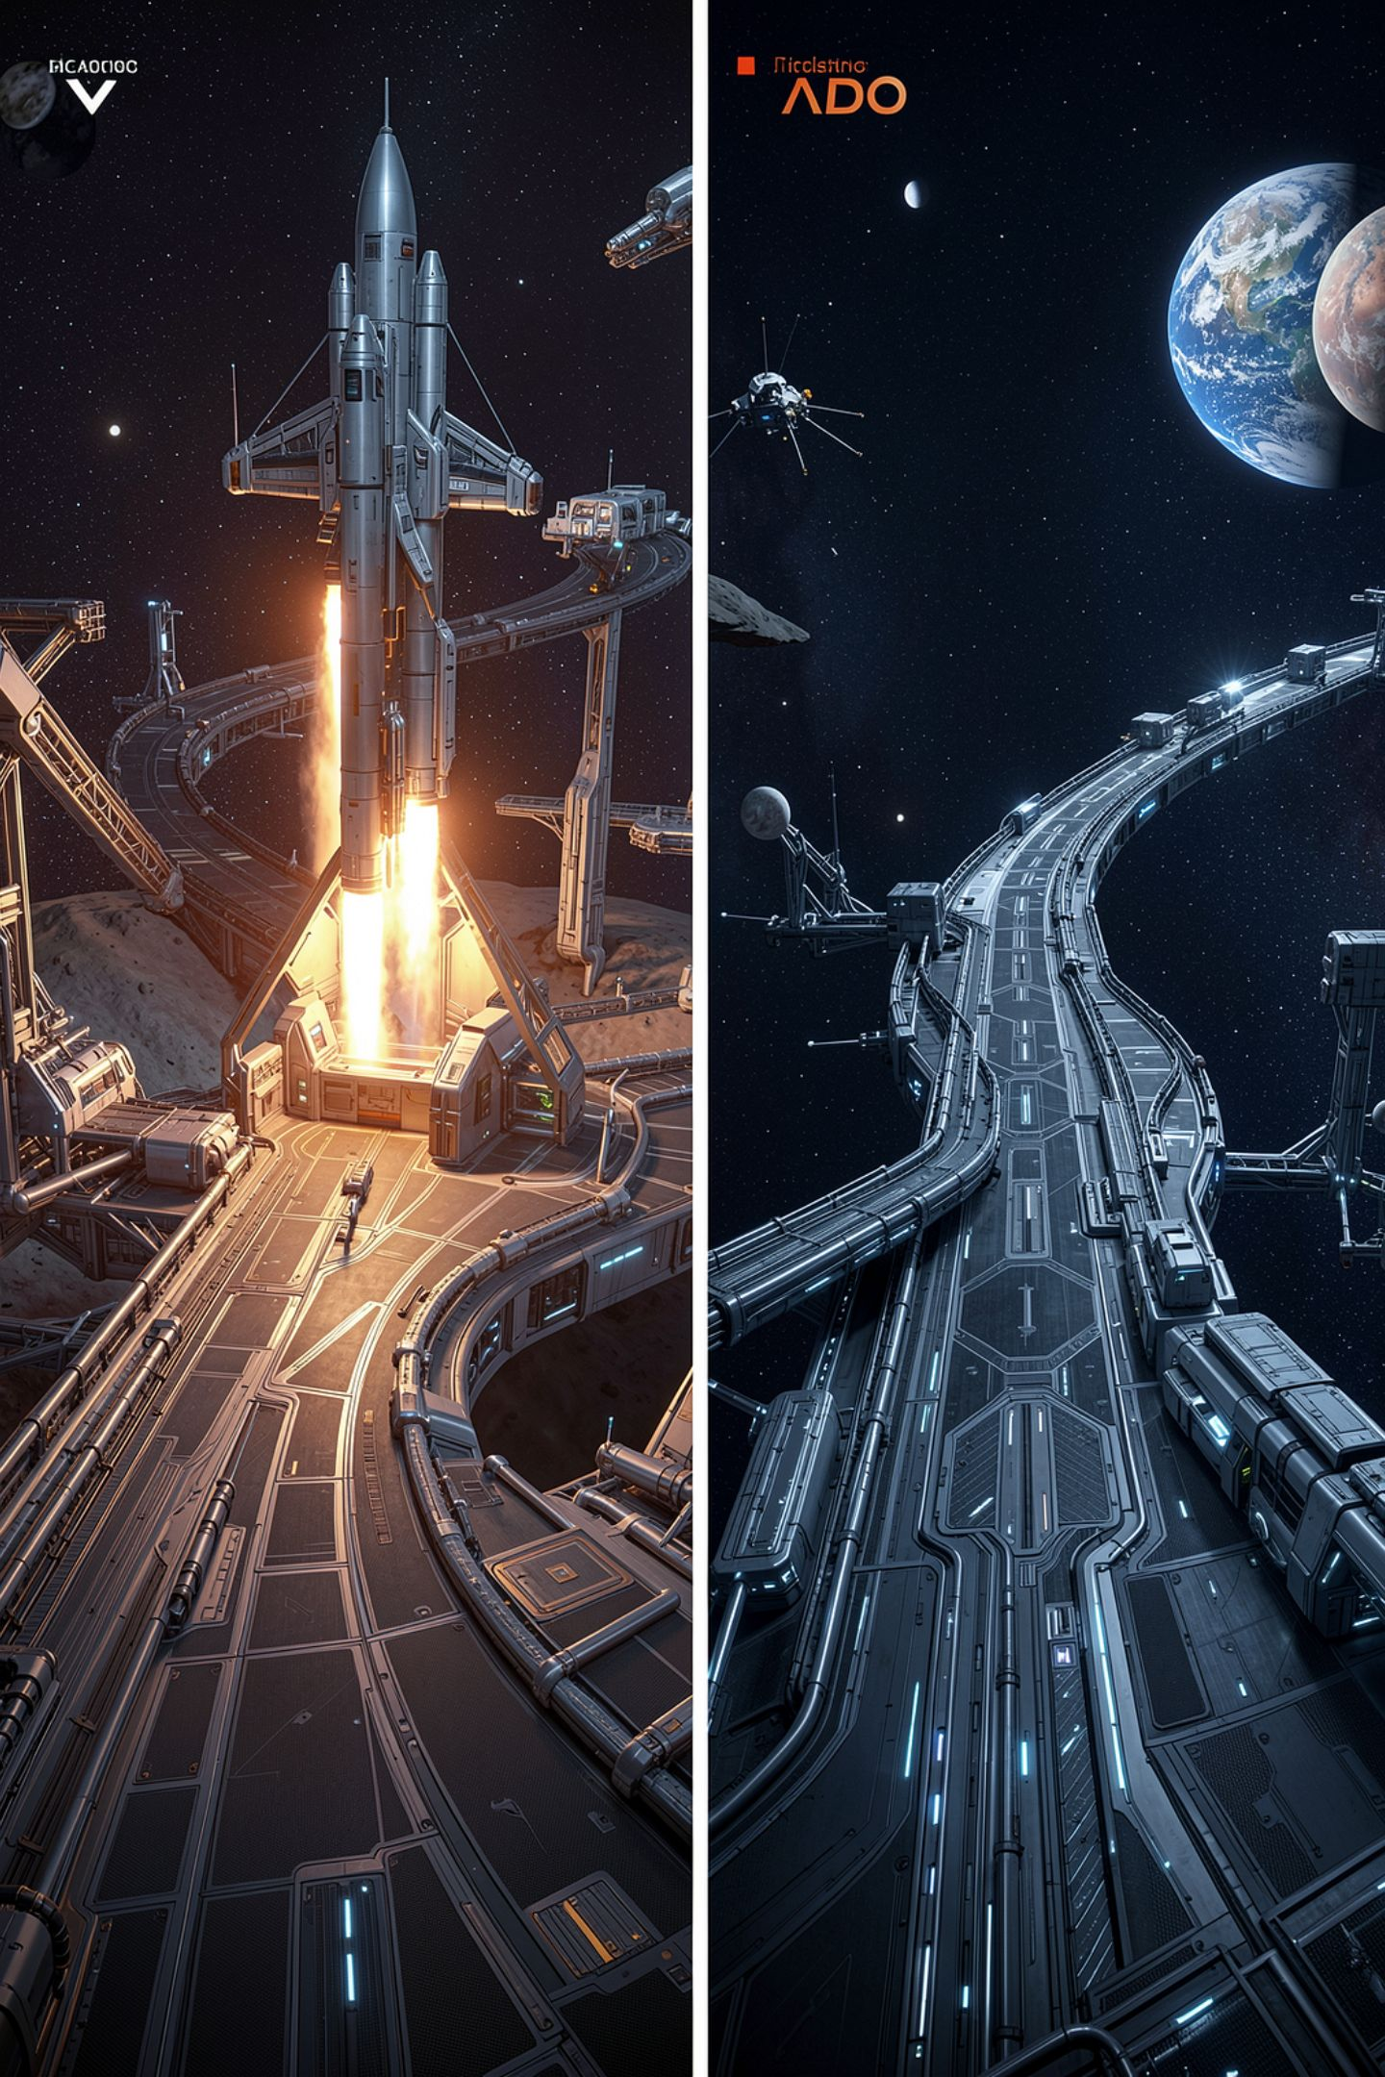


Every recursion has two parts
Base case
Small enough to answer directly. The person at the front says zero.
Recursive case
Ask a smaller question, use the answer. Ask the person ahead, then add one.
Key rule
Every question must move toward the base case.
MCCTC | AI Automation & Software Development
Notes:
Two parts, every time. The base case is the version so small you answer it without asking anyone. The recursive case asks a smaller version and uses that answer. And the questions must move toward the base case. If each question went further back in the line instead of forward, it would never reach the front.

Slide 5
As pseudocode
TO FIND people_ahead(position)
IF position is 1
ANSWER 0
OTHERWISE
ASK people_ahead(position - 1)
ANSWER that answer plus 1
MCCTC | AI Automation & Software Development
Notes:
This is the same kind of pseudocode you wrote for your game. Tomorrow you get def, which is how Python writes TO FIND. Thursday you get return, which is how Python writes ANSWER. That is why today is on paper. The syllabus puts recursion in this unit, and Python needs functions to do it, so today you learn how it works and when to use it, and on Thursday you run it.

Slide 6
The trace table
Step Position Base case? What happens
1 5 No ask people_ahead(4), WAIT
2 4 No ask people_ahead(3), WAIT
3 3 No ask people_ahead(2), WAIT
4 2 No ask people_ahead(1), WAIT
5 1 Yes answer 0
6 2 heard 0, answer 1
7 3 heard 1, answer 2
8 4 heard 2, answer 3
9 5 heard 3, answer 4
MCCTC | AI Automation & Software Development
Notes:
Questions go down, answers come back up. Look at steps one through four. Four people, each paused in the middle of their own question, waiting. The computer does exactly this. It keeps a stack of paused tasks, one for every question still waiting for an answer. That stack is the key to everything else today.

Slide 7

The wrong way: no base case
TO FIND people_ahead(position)
ASK people_ahead(position - 1)
ANSWER that answer plus 1
[Previous line repeated 995 more times]
RecursionError: maximum recursion depth exceeded
Without a base case, the function never stops calling itself.
MCCTC | AI Automation & Software Development
Notes:
I deleted the base case. Trace it. Five asks four, four asks three, one asks zero, zero asks negative one. Nobody ever answers, so nobody finishes, and the stack of paused tasks grows until Python stops it. That error is the real output from a countdown written this way. It printed nine hundred ninety eight lines, from three down to negative nine hundred ninety four, then stopped. You will run it yourself on Thursday. Notice this one crashes. An infinite while loop never does.

Slide 8

When recursion is the right tool
Data nested inside itself, depth unknown
Folders that contain folders
Replies that have replies
Brackets made of smaller brackets
The problem really is a smaller copy of itself
MCCTC | AI Automation & Software Development
Notes:
Reach for recursion when the data is nested inside itself and you do not know how deep it goes. The size of a folder is its files plus the size of each folder inside it, which is the same question again, one level down. A loop handles the next item in a line. Recursion handles the items inside this item.

Slide 9

When it is the wrong tool: your game loop
Take a turn, then ask for the next turn
Every turn waits for the next turn to finish
1,500 turns means 1,500 paused tasks
Python stops at about 1,000
A while loop has no stack. Turn 5,000 costs nothing extra
MCCTC | AI Automation & Software Development
Notes:
This is the example to remember. Somebody learns recursion this week and writes the game as take a turn, then take the next turn by calling the same thing again. It reads beautifully. Look at the trace table. Every turn is paused, waiting for the next turn. Python allows about a thousand paused calls by default and then stops with a RecursionError. A player who explores long enough crashes your game by playing it. A while loop repeats in place. Use loops for repetition. Use recursion for nesting.

Slide 10
Loop or recursion
Use a loop
Use recursion
Until the player quits: loop
Seven times: loop
Every character or line: loop
Every file in nested folders: recursion
Anything a loop does cleanly, recursion does worse
MCCTC | AI Automation & Software Development
Notes:
Here is the honest summary. Anything recursion can do, a loop can also do, sometimes with a lot more bookkeeping. Anything a loop does cleanly, recursion does worse. Professional programmers use recursion for nested data and loops for everything else, and they argue about the cases in between. Know the two ends cold, and on the quiz you will be asked to explain why your game loop is a while.

Slide 11
What you are about to build
01
02
03
Build 1
Run scripts
Build 2
Three trace tables on paper, 15 minutes
Then run your v1 win and lose scripts
Finish text adventure v1
04
05
Final commit
Due
README, known limitations, final commit and push
At the end of today's block
MCCTC | AI Automation & Software Development
Notes:
Build one starts on paper. Three trace tables from the lecture notes self check, fifteen minutes, then put them away and run your test scripts one more time. Build two is the finish. Your README needs every required section, including known limitations that you actually observed. Your last commit must be pushed before the end of the block, because that is the deadline. Anything you have not pushed does not exist.

