Slide 1

Tests the Stakeholder Signs

Slide 2
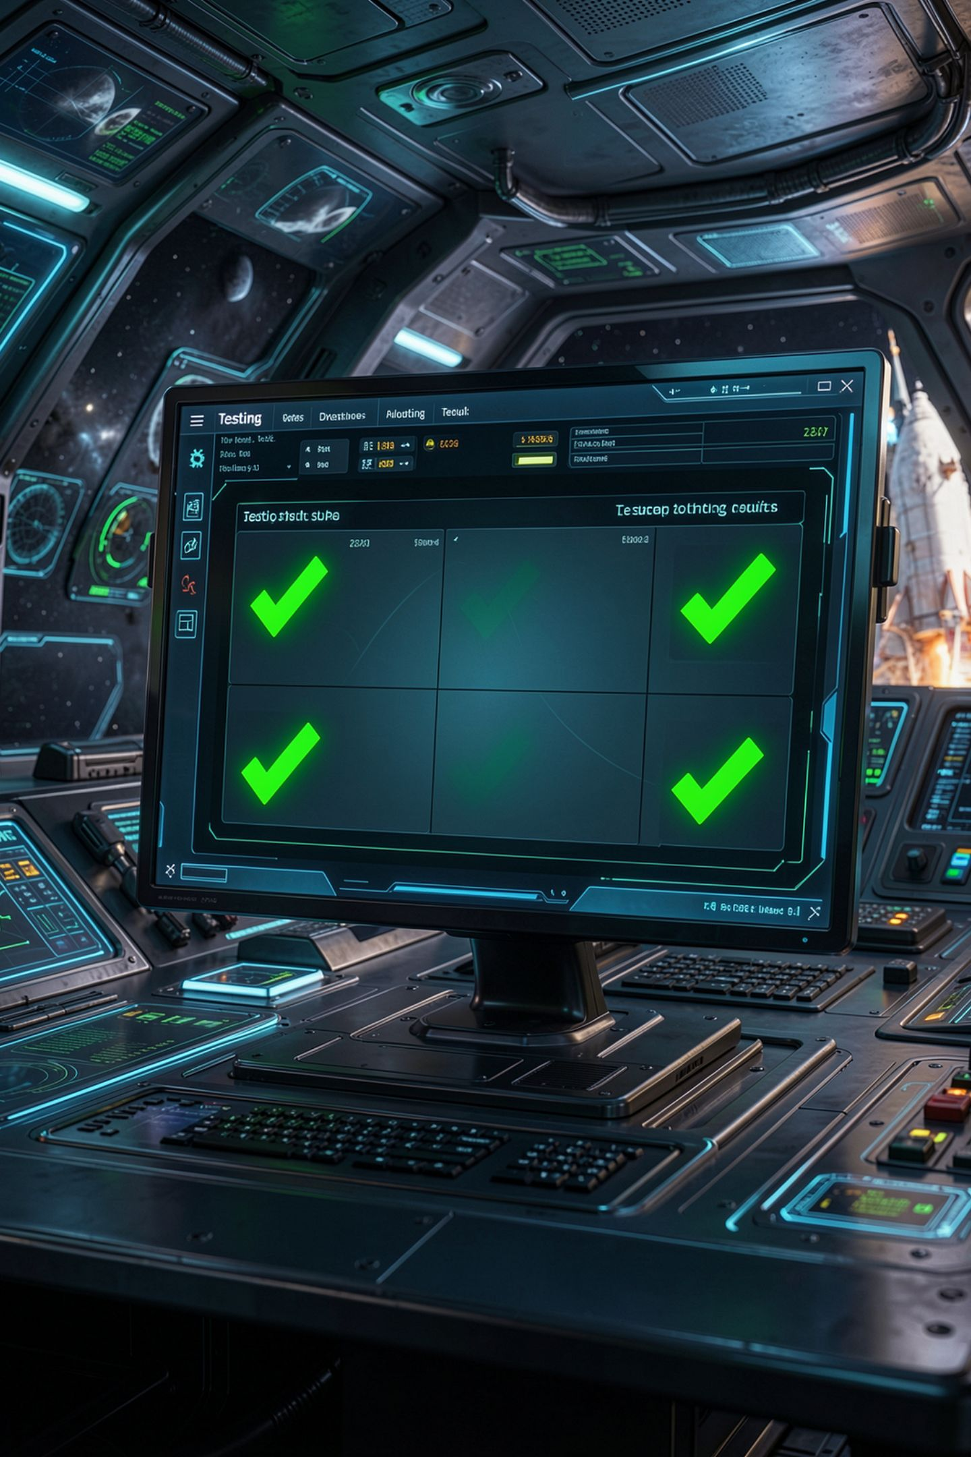
Every test passed. The program was wrong.
Twelve checks, twelve green PASS lines
The stakeholder runs it on real data
The totals are off by a little, everywhere
The tests agreed with the bug
MCCTC | AI Automation & Software Development
Notes:
Here is the worst demo there is. Your test file prints twelve passes. You feel great. The stakeholder runs the program on their own data and every total is off by a little. How did twelve tests miss it? Because somebody ran the program, saw the numbers, and typed those numbers into the tests as the right answers. The tests agreed with the bug. Today is about tests that cannot be fooled that way.

Slide 3
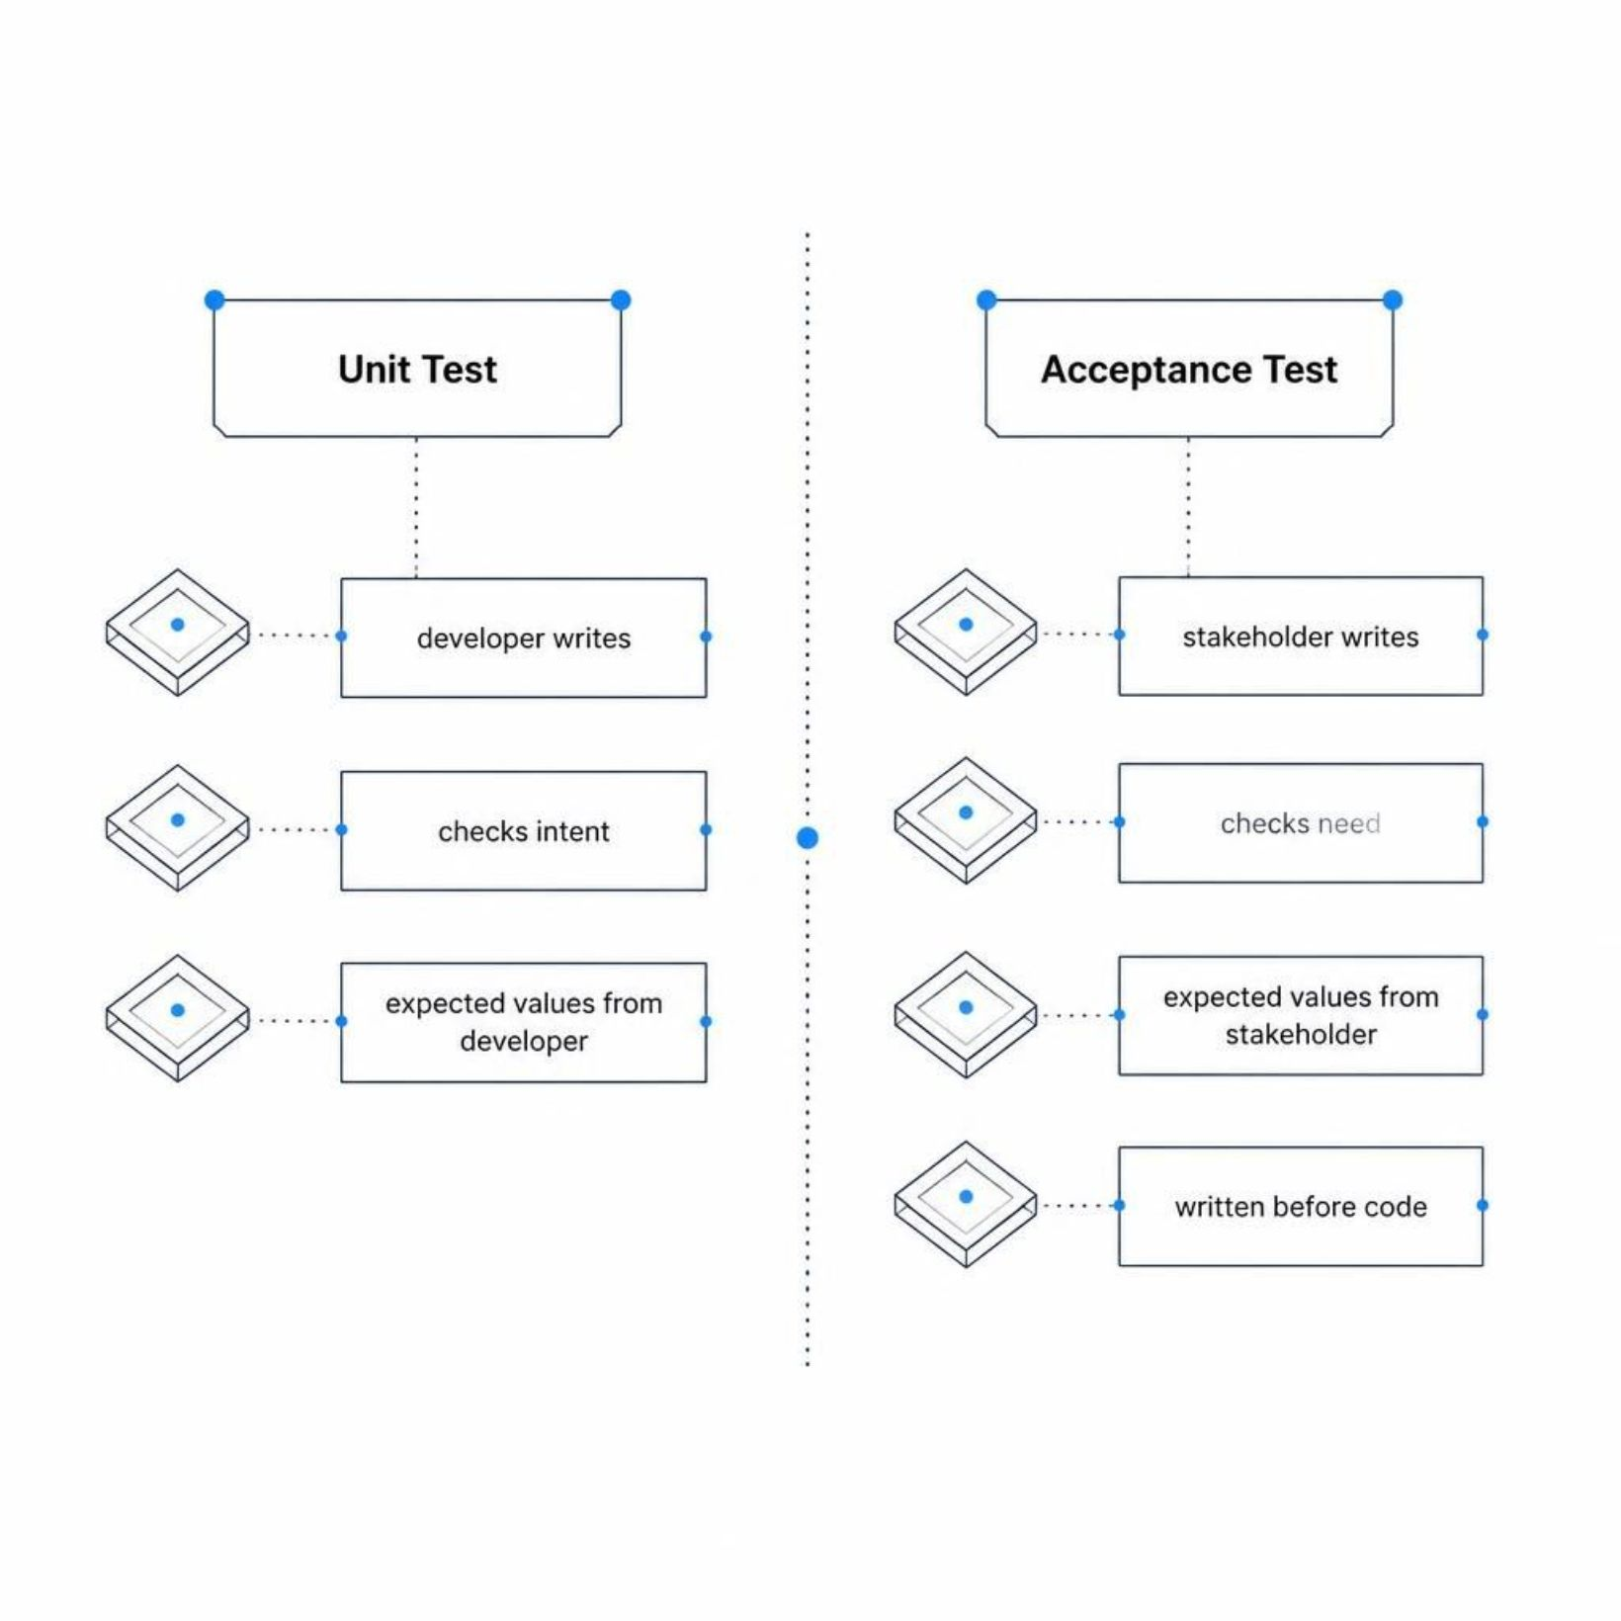
Unit test versus acceptance test
Unit test: does my code do what I intended
Acceptance test: does it do what they need
Expected values come from the stakeholder
Written before the code, failing at first
MCCTC | AI Automation & Software Development
Notes:
In Unit 4 your tests asked whether your code does what you meant. An acceptance test asks the stakeholder's question instead. Does it do what I need. So the expected value in every check comes from the criterion they signed, or from arithmetic you did by hand. Never from your own program. And you write them before the code, which means today they fail. A failing test today is a promise waiting to be kept.

Slide 4
The check helper
results = []
def check(label, actual, expected):
if actual == expected:
results.append(True)
print("PASS", label)
else:
results.append(False)
print("FAIL", label, "expected", expected, "got", actual)
check("AC-2 uneven split rounds up", split_bill(1000, 3), 334)
print(results.count(True), "passed,", results.count(False), "failed")
MCCTC | AI Automation & Software Development
Notes:
Here is the helper every test file uses this unit. Classes are Unit 7, so we are not using the unittest module, which needs them. A check takes a label, the actual value, and the expected value. The label starts with the criterion number, so when something fails you know which promise broke. Where did three thirty four come from? Ten dollars split three ways is three thirty three and a third, and rounding up makes three thirty four. A person did that by hand.

Slide 5

Both sides of every boundary
Rule: 1 to 12 people
Check 0: refused
Check 1 and 12: allowed
Check 13: refused
Four checks, both edges, one step past each
MCCTC | AI Automation & Software Development
Notes:
A boundary has two edges and each edge has two sides. For one to twelve people, you check zero, which must be refused, one and twelve, which must be allowed, and thirteen, which must be refused. Four checks. If a boundary in your requirements has fewer than four checks around it, the gap is where the bug will live, because edges are the last thing anyone tries by hand.

Slide 6
Testing a refusal
def outcome(total_cents, people):
try:
return split_bill(total_cents, people)
except ValueError:
return "refused"
check("AC-4 zero people refused", outcome(2400, 0), "refused")
check("AC-4 thirteen people refused", outcome(2400, 13), "refused")
check("AC-4 twelve people allowed", outcome(2400, 12), 200)
MCCTC | AI Automation & Software Development
Notes:
A refusal raises ValueError, and a raised error would crash your test file instead of being checked by it. So outcome catches it and turns it into a plain value, the word refused. Now check can compare it like anything else. Twelve people on a twenty four dollar bill is two dollars each, two hundred cents, and zero and thirteen both come back refused.

Slide 7
Watch this
def split_bill(total_cents, people):
return round(total_cents / people)
share = split_bill(1000, 3)
expected = split_bill(1000, 3)
if share == expected:
print("PASS uneven split:", share)
else:
print("FAIL uneven split:", share)
print("Collected:", share * 3, "cents for a 1000 cent bill")
MCCTC | AI Automation & Software Development
Notes:
This split bill has a real defect. It rounds to the nearest cent instead of rounding up. And somebody wrote a test for it. Look at where the expected value comes from. It comes from calling split bill. Predict what prints.

Slide 8

A pass that proves nothing
PASS uneven split: 333
Collected: 999 cents for a 1000 cent bill
MCCTC | AI Automation & Software Development
Notes:
It passed. On broken code. It compared the function's answer to the function's answer, so it would pass if split bill returned seven, or negative forty. It cannot fail, so it proves nothing. The group is one cent short. The sneaky version of this is not calling the function twice. It is running the program, seeing three thirty three, and typing three thirty three into the check. Same result. A test that agrees with the bug.

Slide 9
Find the criteria with no test
criteria = {"AC-1", "AC-2", "AC-3", "AC-4", "AC-5"}
checks = {
"even split": "AC-1",
"uneven split rounds up": "AC-2",
"bill is covered": "AC-3",
"zero people refused": "AC-4",
}
tested = set()
for label in checks:
tested.add(checks[label])
print("No test:", sorted(criteria - tested))
MCCTC | AI Automation & Software Development
Notes:
Your test plan maps every criterion to at least one check. Sets from Unit 5 find the gaps. Every criterion, minus the ones that have a check, leaves the ones nobody is verifying. This prints AC five. A criterion with no check is a promise nobody will keep an eye on, and that list has to be empty before your stakeholder signs tomorrow.

Slide 10

Agreed means they saw it
Friday: stakeholder reads your criteria and check labels
Changing a check Friday costs one line
Changing it December 17 costs the demo
Later they run it on real data: user acceptance
MCCTC | AI Automation & Software Development
Notes:
Agreed with stakeholders means they actually read your criteria and your check labels, and signed. That is tomorrow. It is also the cheapest moment in the whole project to find a misunderstanding. One line to fix on Friday. The whole demo on December seventeenth. And when the stakeholder finally runs your program on their own real data to see if it works for them, that is user acceptance testing, the classroom version of what industry calls beta testing.

Slide 11
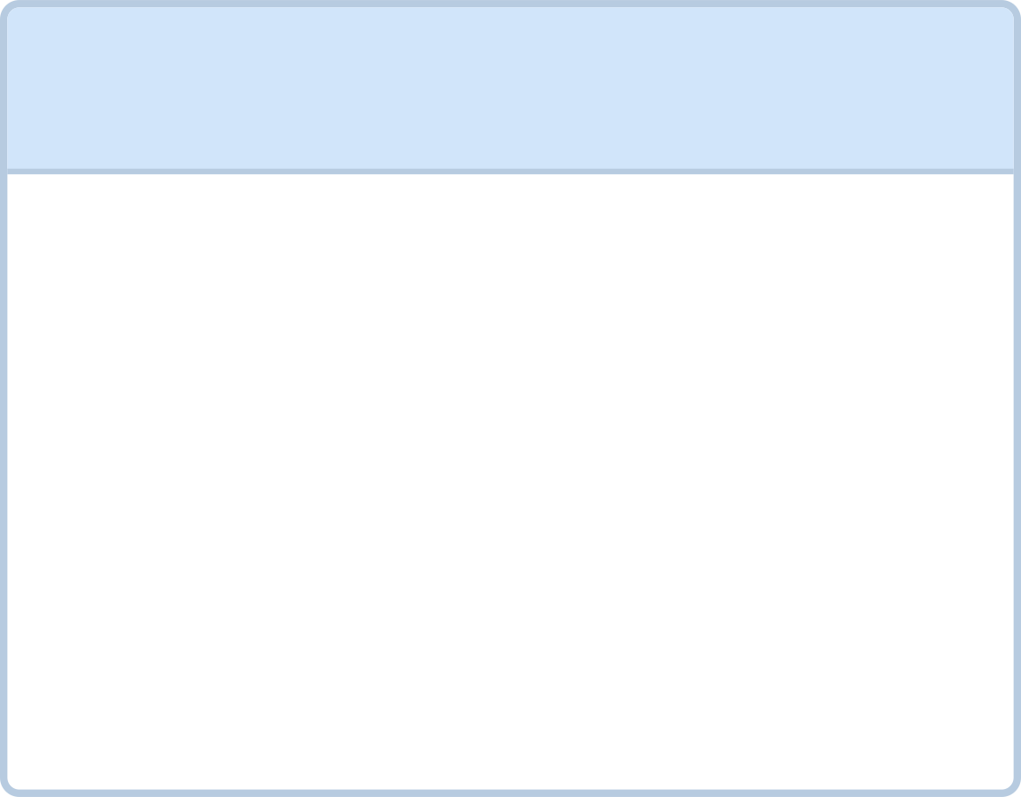
What you are about to build
1
2
3
Build 1
Build 2
Test Plan
Lab U06-01, tests for code you did not write
Write from the spec, not from reading the code
Your team's acceptance tests, all failing
Every criterion, every check, every source
MCCTC | AI Automation & Software Development
Notes:
Build one is Lab U06-01. Somebody else wrote a concession stand program, and you test it from the stakeholder's criteria without reading the code first. If you read the code first, your tests will agree with whatever it does. Expect some checks to fail, because there are real defects in it. Build two, your team writes its own acceptance tests, every one of them failing today, plus a test plan that says where every expected value came from.

