Slide 1
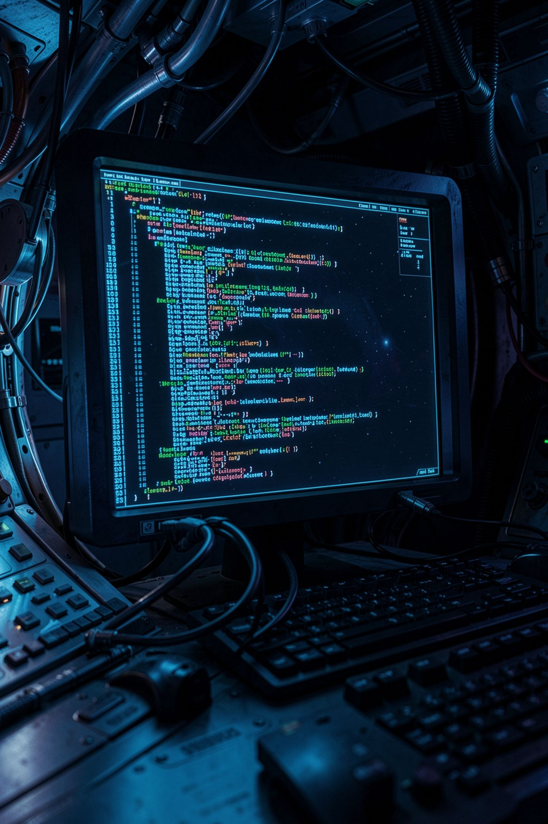
How Code Actually Runs

Slide 2

You have never seen where software lives
You have used apps for twelve years
You have never seen one as a file
Today that gap closes
Three things are involved, not one
MCCTC | AI Automation & Software Development
Notes:
Put your hand up if you have opened an app today. Keep it up if you could tell me, right now, where that app is on the disk. Nobody can, and that is not a knowledge gap you should feel bad about. It is a gap nobody ever showed you. By the end of this block you will have written a file, found it on the disk, and run it on purpose. Three separate things are involved every time software runs, and once you can name all three, error messages stop being noise.

Slide 3
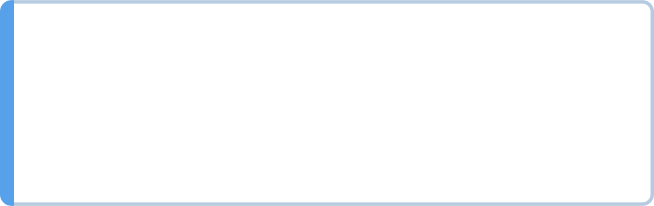


The three things
The file
Text on a disk, does nothing
The interpreter
The program named python
The terminal
Where you hand one over
A recipe is not a cook
MCCTC | AI Automation & Software Development
Notes:
Here they are. The file is a document. It has no more power to act than a note on your fridge. The interpreter is a program already installed on this machine, and its entire job is to read a document like that and carry it out, line by line, top to bottom. The terminal is where you hand the recipe to the cook. Say that back to me. A recipe is not a cook. You are going to write recipes. Python does the cooking.

Slide 4
Our first file
# status_card.py
# Prints a short status card to the terminal.
print("MCCTC Programming 145060")
print("Name: Ava Ruiz")
print("Day 1 goal: run one file I wrote myself")
print()
print("Battery on my phone right now: 41 percent")
MCCTC | AI Automation & Software Development
Notes:
This is the entire program. Eight lines, two of which do nothing at all. I am going to type it in front of you and I want you to watch what I do before I run it, because that step is where half of you will get stuck this week. I write it. Then I save it. Then I run it. If I skip the save, the machine reads the old version and I will swear the computer is broken.

Slide 5
Running it
Command
Output
python status_card.py
MCCTC Programming 145060
Name: Ava Ruiz
Day 1 goal: run one file I wrote myself
Battery on my phone right now: 41 percent
MCCTC | AI Automation & Software Development
Notes:
One command. The word python is the cook. The word after it is the recipe I am handing over. Look at the output and find three things nobody typed. There is a blank line in the middle. There are no quote marks anywhere, even though the file is full of them. And the lines came out in the order I wrote them, which nothing in the file asked for. Top to bottom is the only order there is.

Slide 6
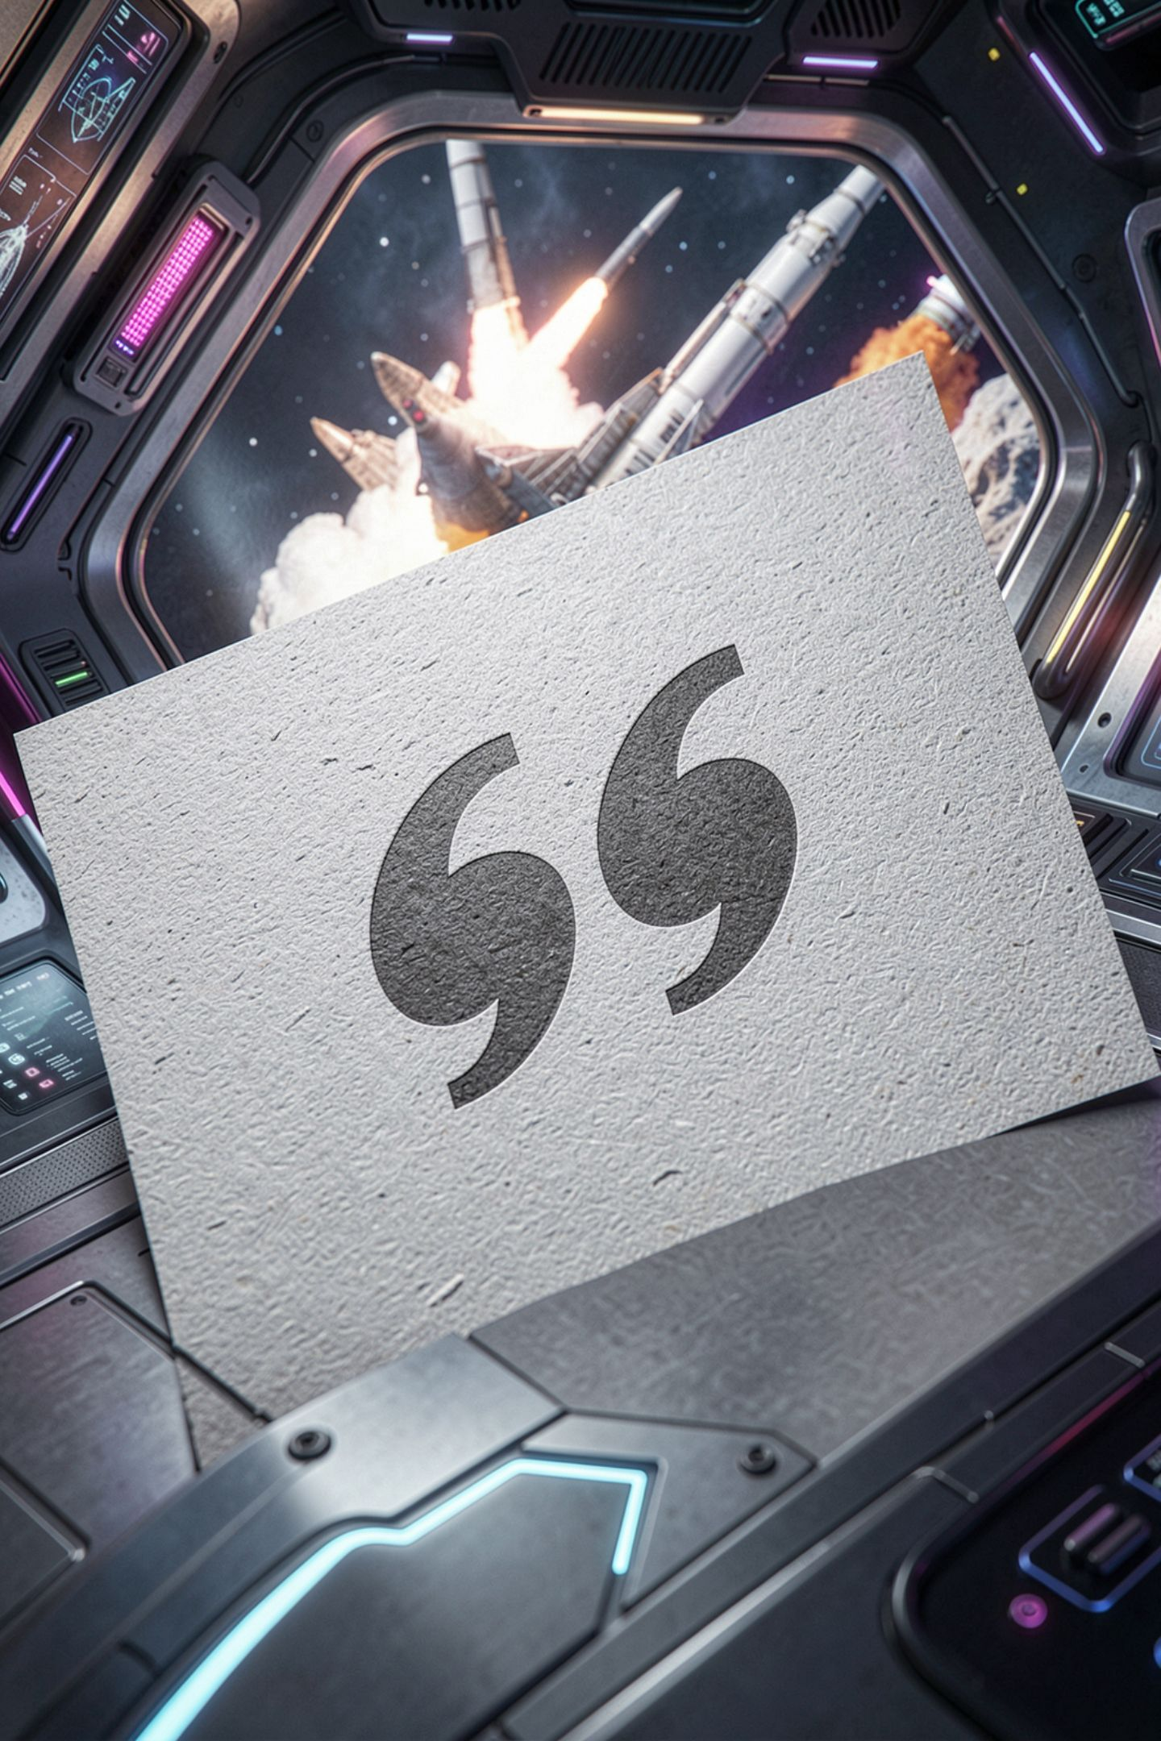

Three things nobody typed
Blank line came from print with empty parentheses
Quotes told Python where text starts and stops
Order came from the file, nothing else
Lines starting with hash produced nothing at all
MCCTC | AI Automation & Software Development
Notes:
Take these one at a time. The empty print printed nothing and then ended the line, and an ended line with nothing on it is a blank line. The quotes are punctuation for Python, not for you, so they never come out. The two lines starting with a hash are comments. Python reads them and moves straight past. You write those for the next person who opens this file, which is usually you, three weeks from now, with no memory of what you were doing.

Slide 7
Now I break it on purpose
print("MCCTC Programming 145060")
print("Name: Ava Ruiz)
print("done")
MCCTC | AI Automation & Software Development
Notes:
I am going to take the closing quote off line two and run it. Do not tell me what happens. I want you to look at the error with me, because reading error messages is the actual skill this week, more than anything about Python. Watch the screen.

Slide 8
The error, read in four steps
File "C:\...\status_card.py", line 2
print("Name: Ava Ruiz)
^
SyntaxError: unterminated string literal (detected at line 2)
MCCTC | AI Automation & Software Development
Notes:
Four questions, in this order, every time. What file. What line. What is the caret sitting under. What kind of error. This message answers all four and most of you skipped past it looking for the word wrong. Notice something else. Nothing printed. Not even line one, which was perfectly fine. That tells you something specific and we are about to say what.

Slide 9

Two kinds of broken
SyntaxError
NameError
Got output before the crash?
The caret points
Found while reading, nothing printed
Found while running, output came first
Trust it over your reading
Problem is below it
MCCTC | AI Automation & Software Development
Notes:
This table is a debugging shortcut you will use all year. If your program printed nothing before it died, Python could not understand the file and never started it. If your program printed six lines and then died, the file was fine as Python and the trouble is at line seven or later. That single distinction cuts your search in half before you read any code. And when the caret points at a character, believe the caret. You cannot proofread your own work, because your eye supplies what you meant to type.

Slide 10
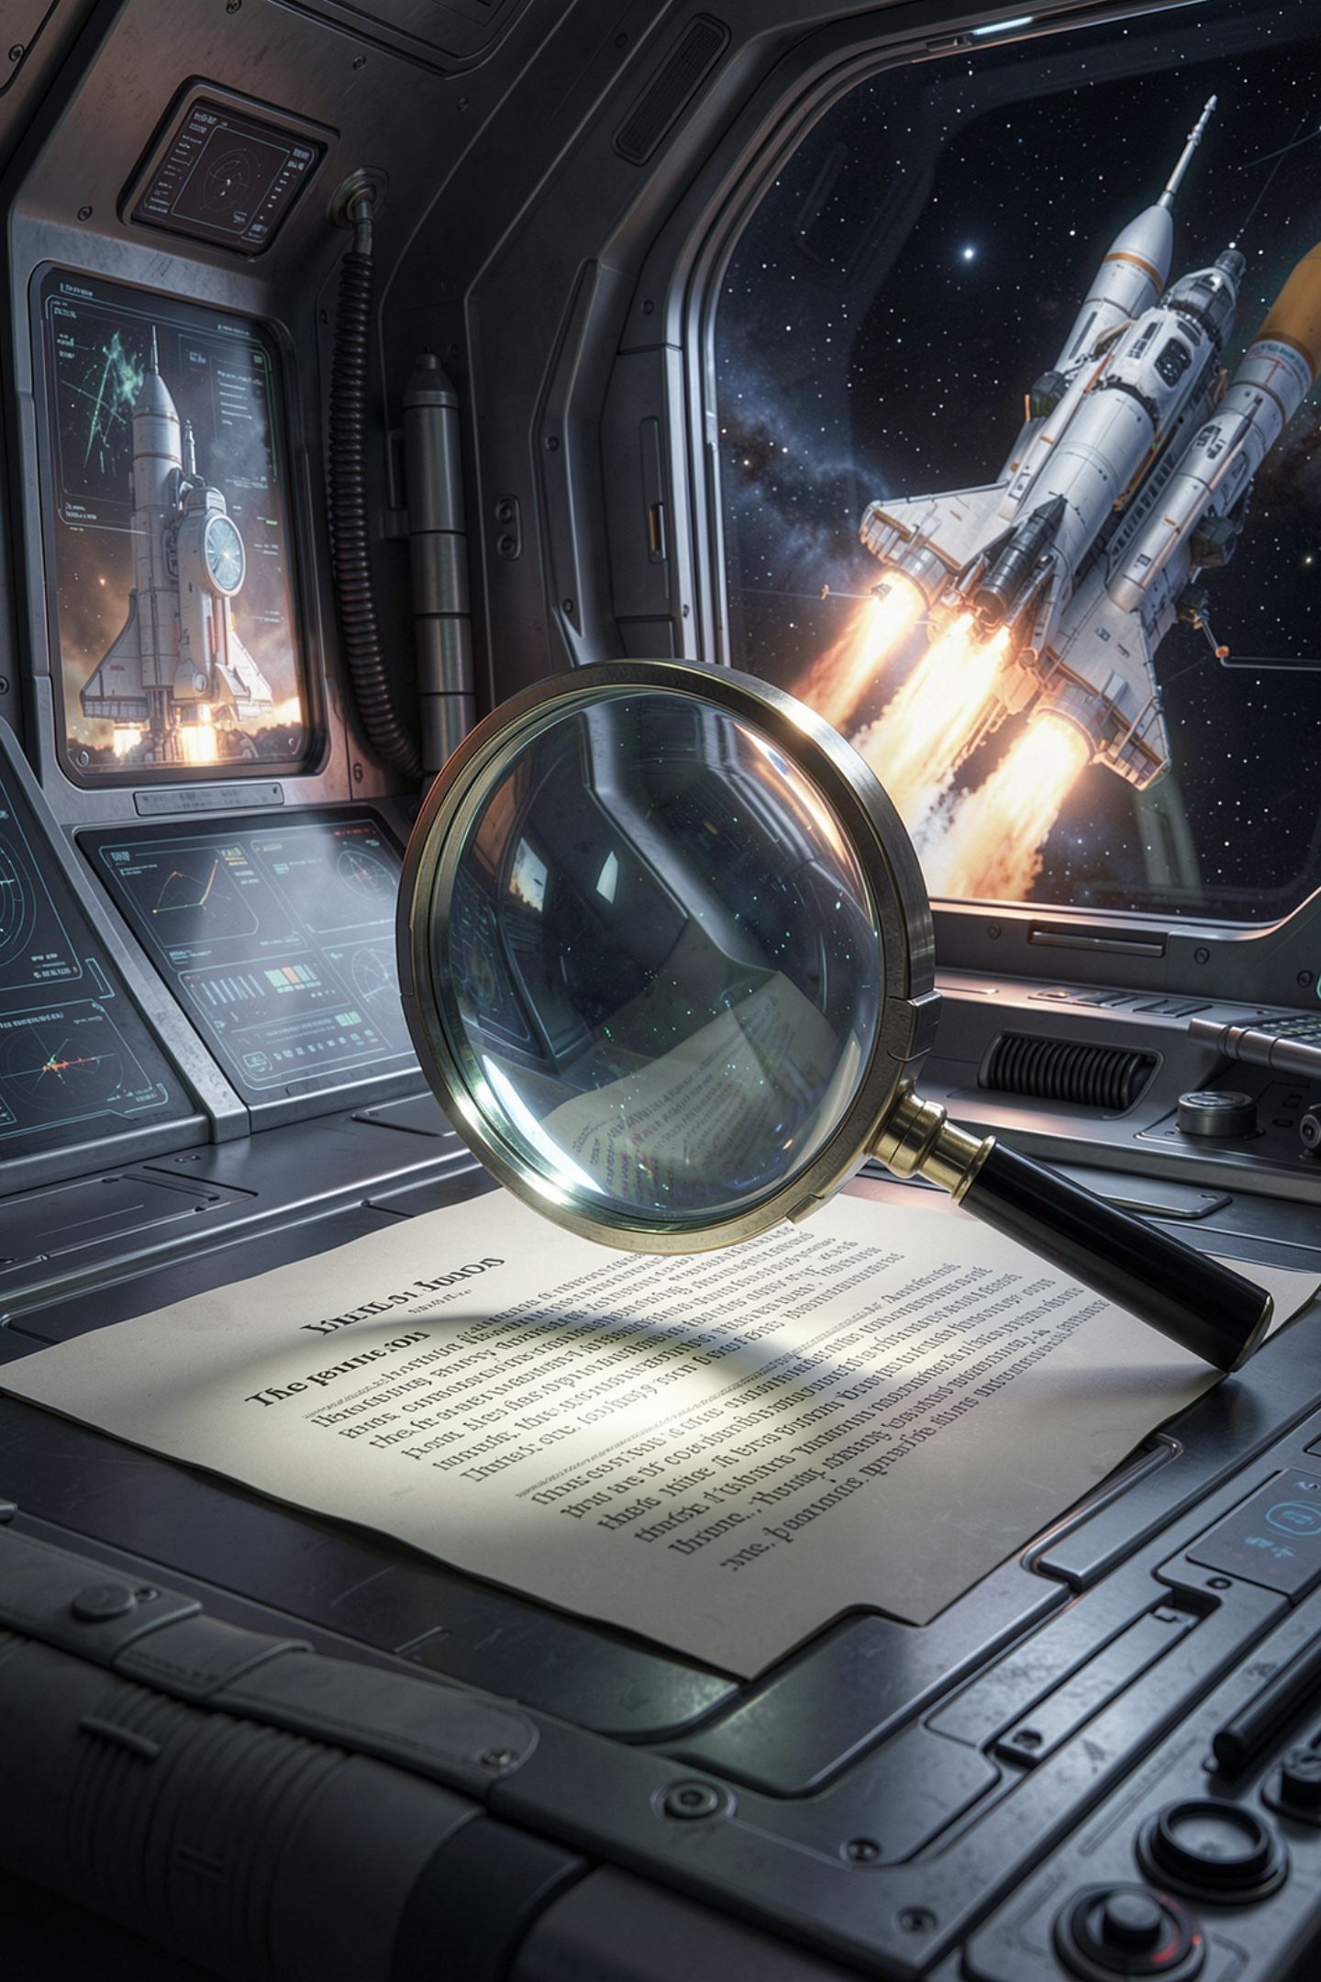
Where the line number lies to you
01
02
Error said line 2, line 3 also stopped working
Python reports where it noticed, not where you erred
03
Read the named line, then read upward
MCCTC | AI Automation & Software Development
Notes:
Here is the trap inside the trap. The missing quote is on line two, so line two is where Python noticed. But because that text never ended, Python kept reading forward and swallowed line three into it. Line three stopped being code without ever being mentioned. About half the time in this course, the fix is one or two lines above the line the error names. Read the named line first, then walk upward.

Slide 11
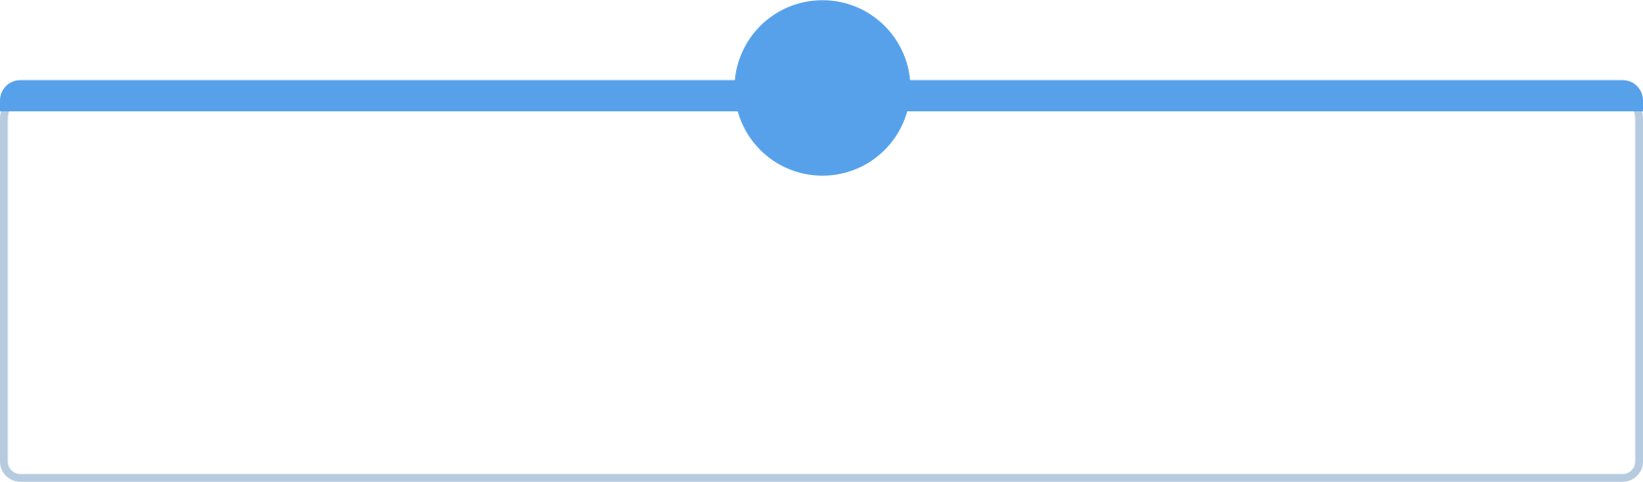
What you are about to build
1
2
Install Python, Git, and VS Code, verified
Write status_card.py yourself, not copied
3
4
Five lines of output, one of them blank
Point at the line that made any output line
MCCTC | AI Automation & Software Development
Notes:
Two blocks. First we get the tools installed and proven working, and that will be the loudest thirty-five minutes of the week, which is fine. Then you write your own status card from scratch. Not copied off this board, typed. Five lines of output, one of them blank, and one line that says something true about your day that the person next to you could check. The bar for done is this: I point at any line of your output and you point at the line in your file that made it.

